Slide 1
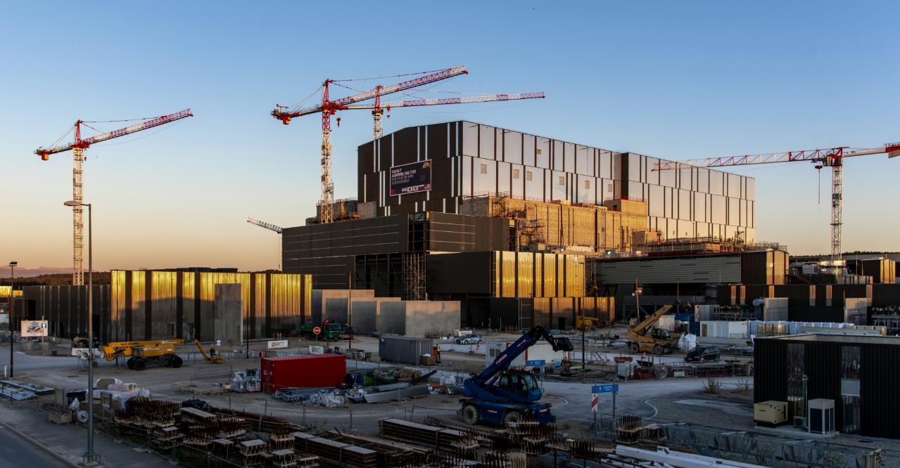

THE ITER PROJECT
PERFORMING TO A NEW BASELINE
Pietro Barabaschi, Director-General
Fusion Power Associates Annual Meeting
2 December 2024

Slide 2
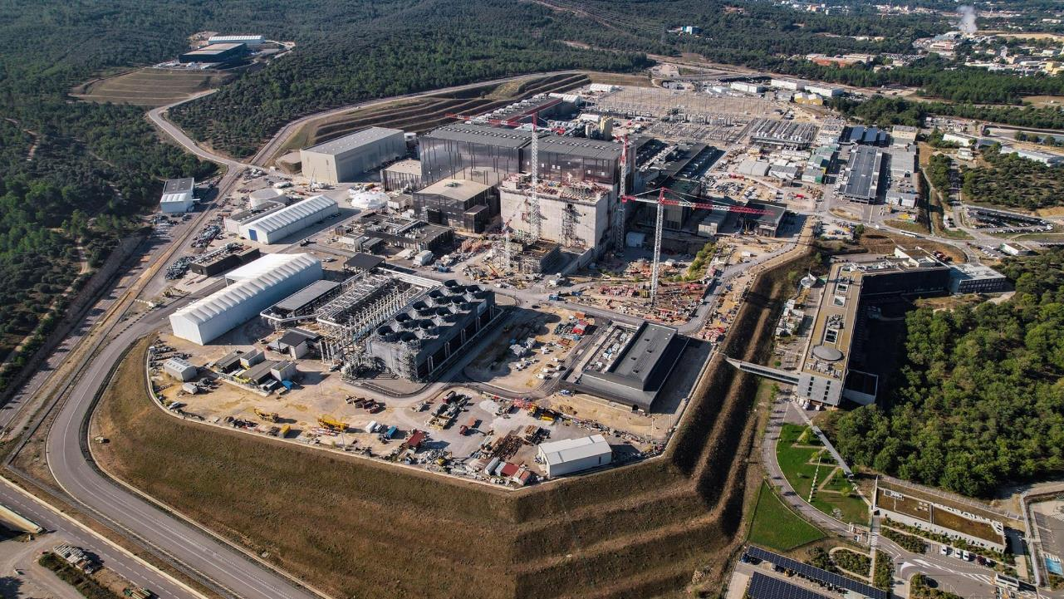

text
text
text
ITER WORKSITE OVERVIEW
Most plant support systems are operational or in commissioning.
text

Slide 3
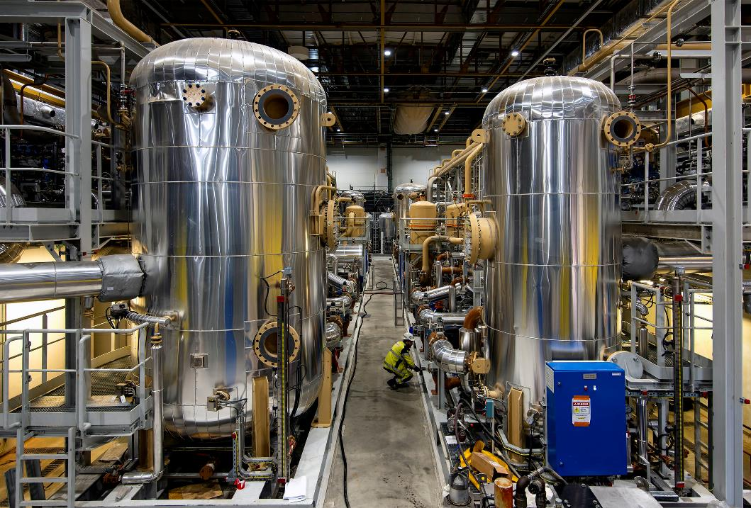
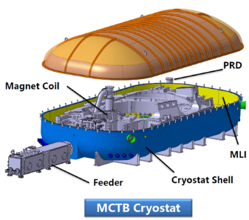

text
CRYOGENICS PLANT COMMISSIONING
Helium gas compressor and gas distribution network has completed functional testing in July 2024.
Helium liquefaction achieved in October 2024.
Will support operation of a Magnet Cold Test Bench (MCTB) under construction.
a
text
text
3
text

Slide 4
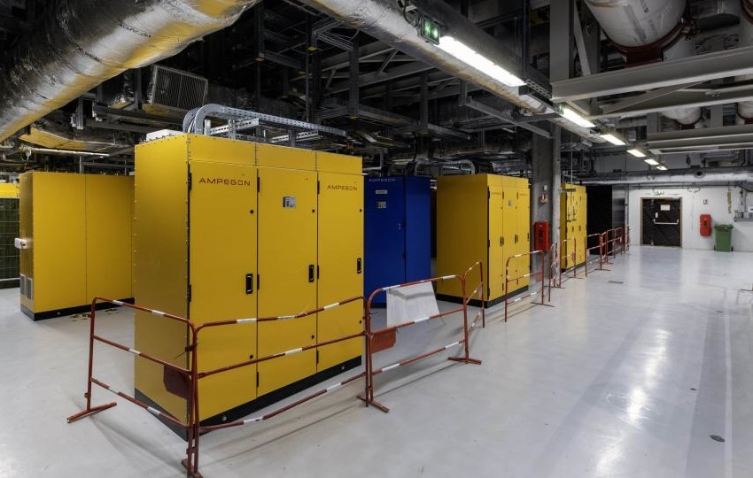
text
HEATING AND CURRENT DRIVE PROGRESS
Radio Frequency Building turned over from F4E to ITER Organization .
Ready for gyrotron installation: beginning to install first Japanese and first Russian gyrotrons.
a
text
text
4
text

Slide 5
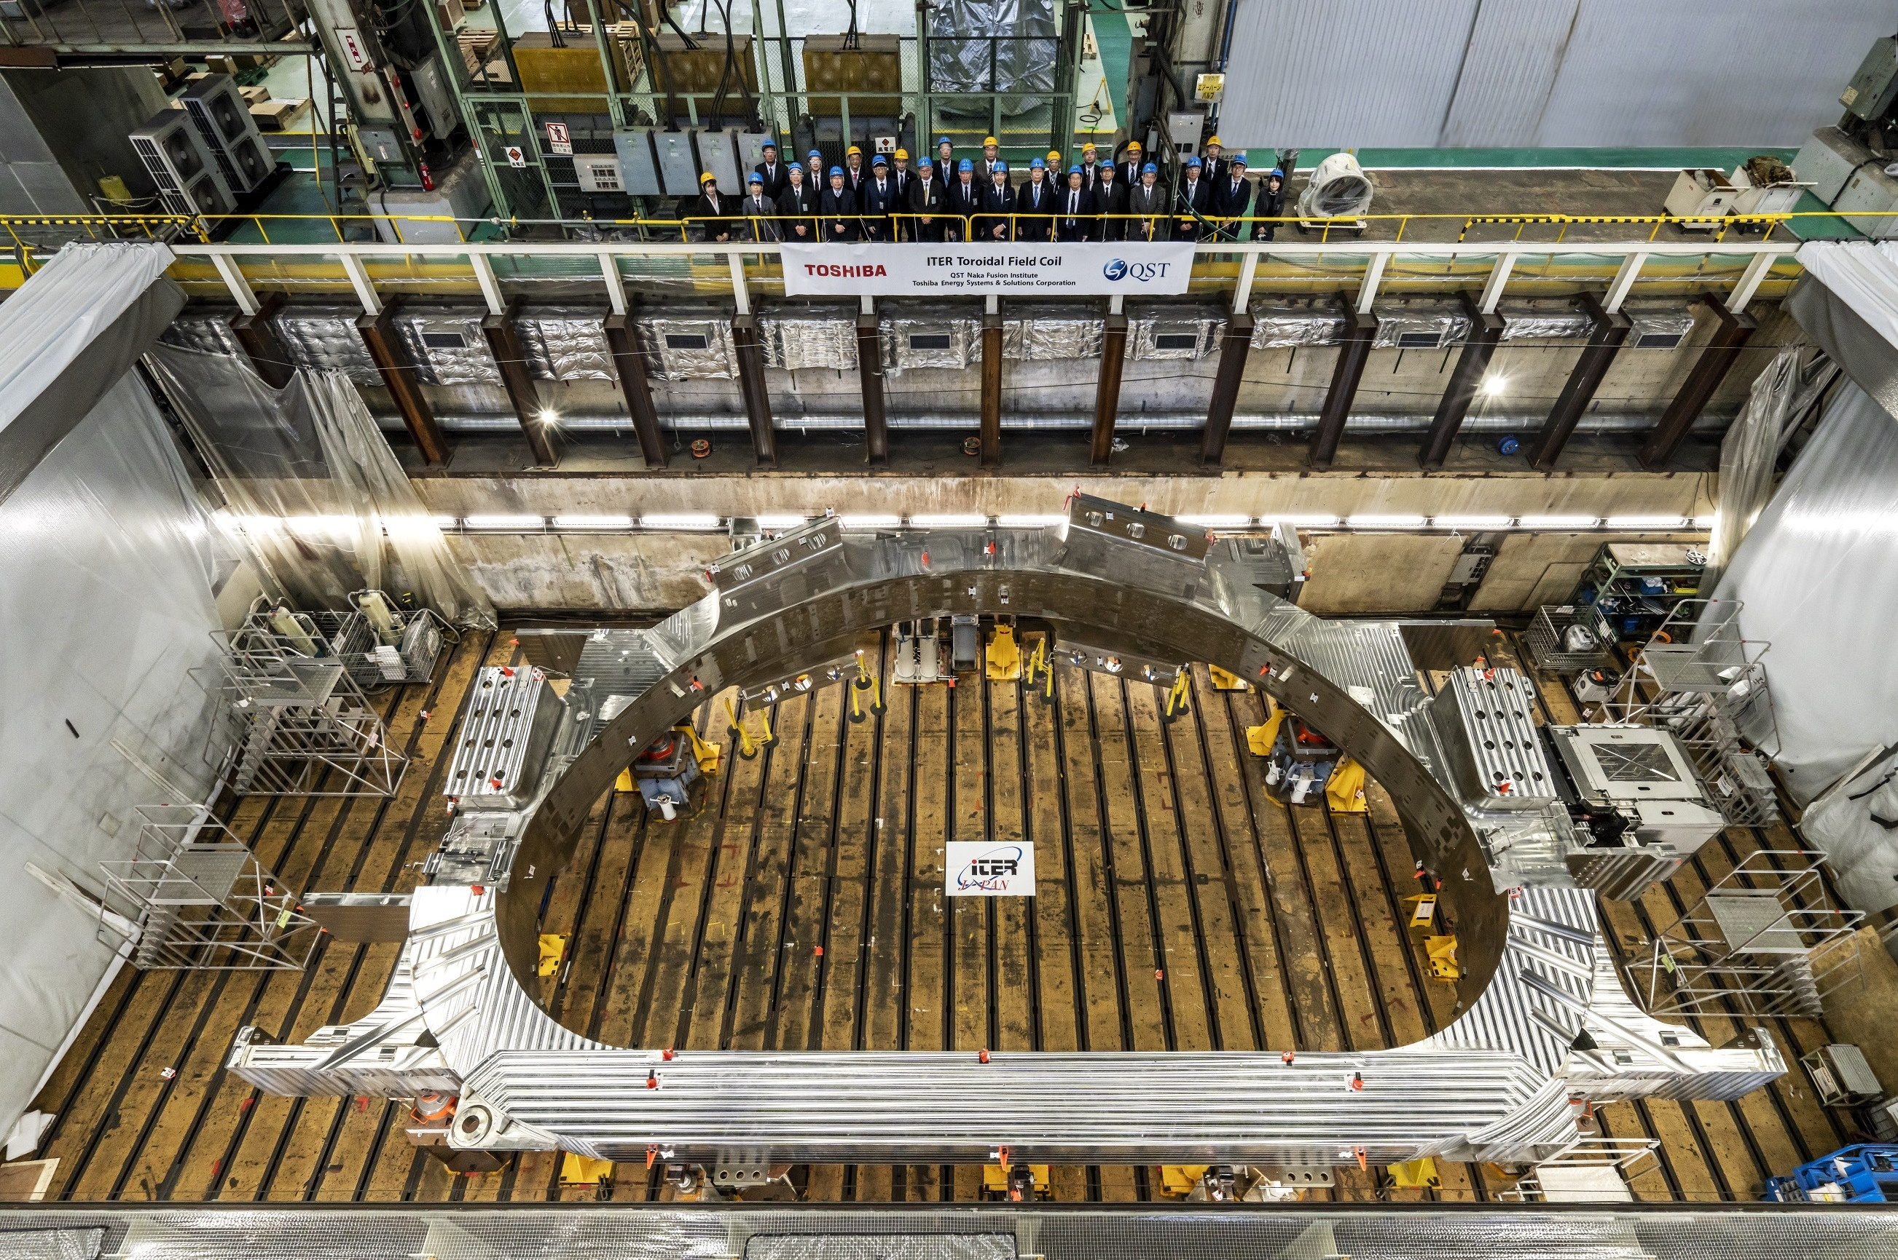
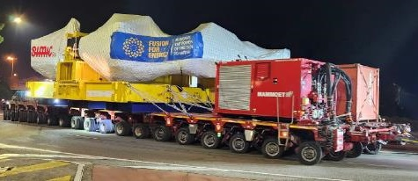

text
TOROIDAL FIELD MAGNET MANUFACTURING AND DELIVERY
All 19 Toroidal Field coils (18 + 1 spare) have been completed and delivered (Japan’s 8th coil pictured at right).
text
text
Last TF coil en route, December 2023
5
text

Slide 6
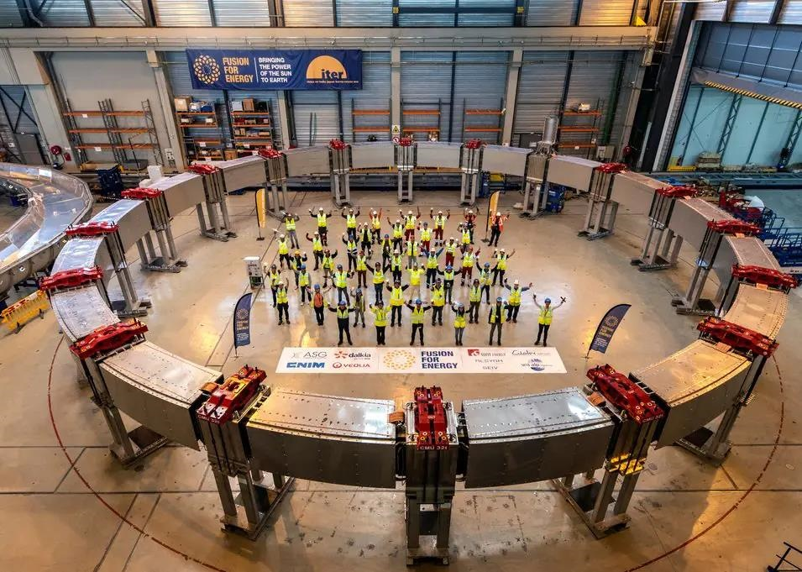
text
POLOIDAL FIELD MAGNET MANUFACTURING AND DELIVERY
All Poloidal Field coils have been completed and delivered (PF2 pictured at right)
text
text
6
text

Slide 7
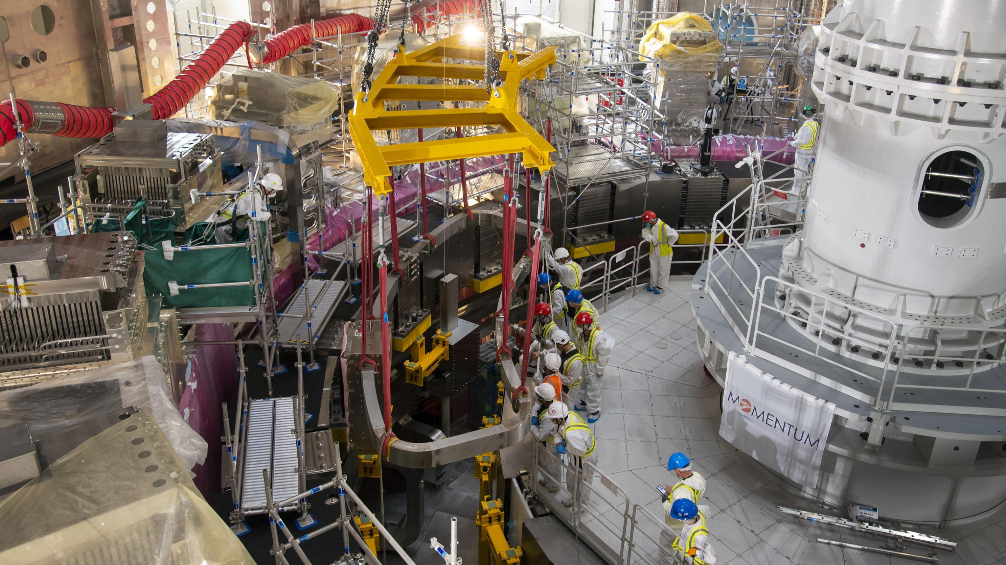
text
CORRECTION COIL MANUFACTURING AND DELIVERY
12 of 18 correction coils have been completed and delivered.
(First installation of a bottom correction coil pictured at right.)
text
text
7
text

Slide 8
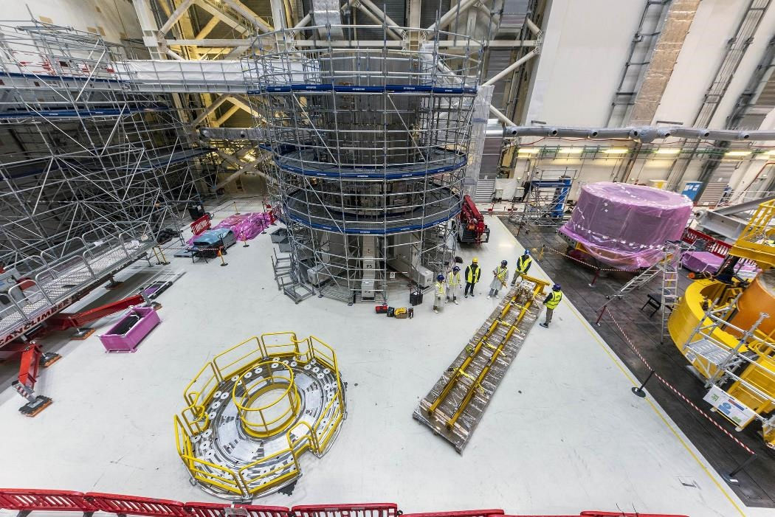
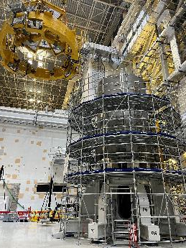

text
CENTRAL SOLENOID DELIVERY AND SUB-ASSEMBLY
Four CS modules have been delivered.
Two modules are stacked and aligned, and a third is in progress.
All six modules plus a spare are scheduled to be delivered by mid-2025.
text
text
Stacking third module, August 2024
8
text

Slide 9
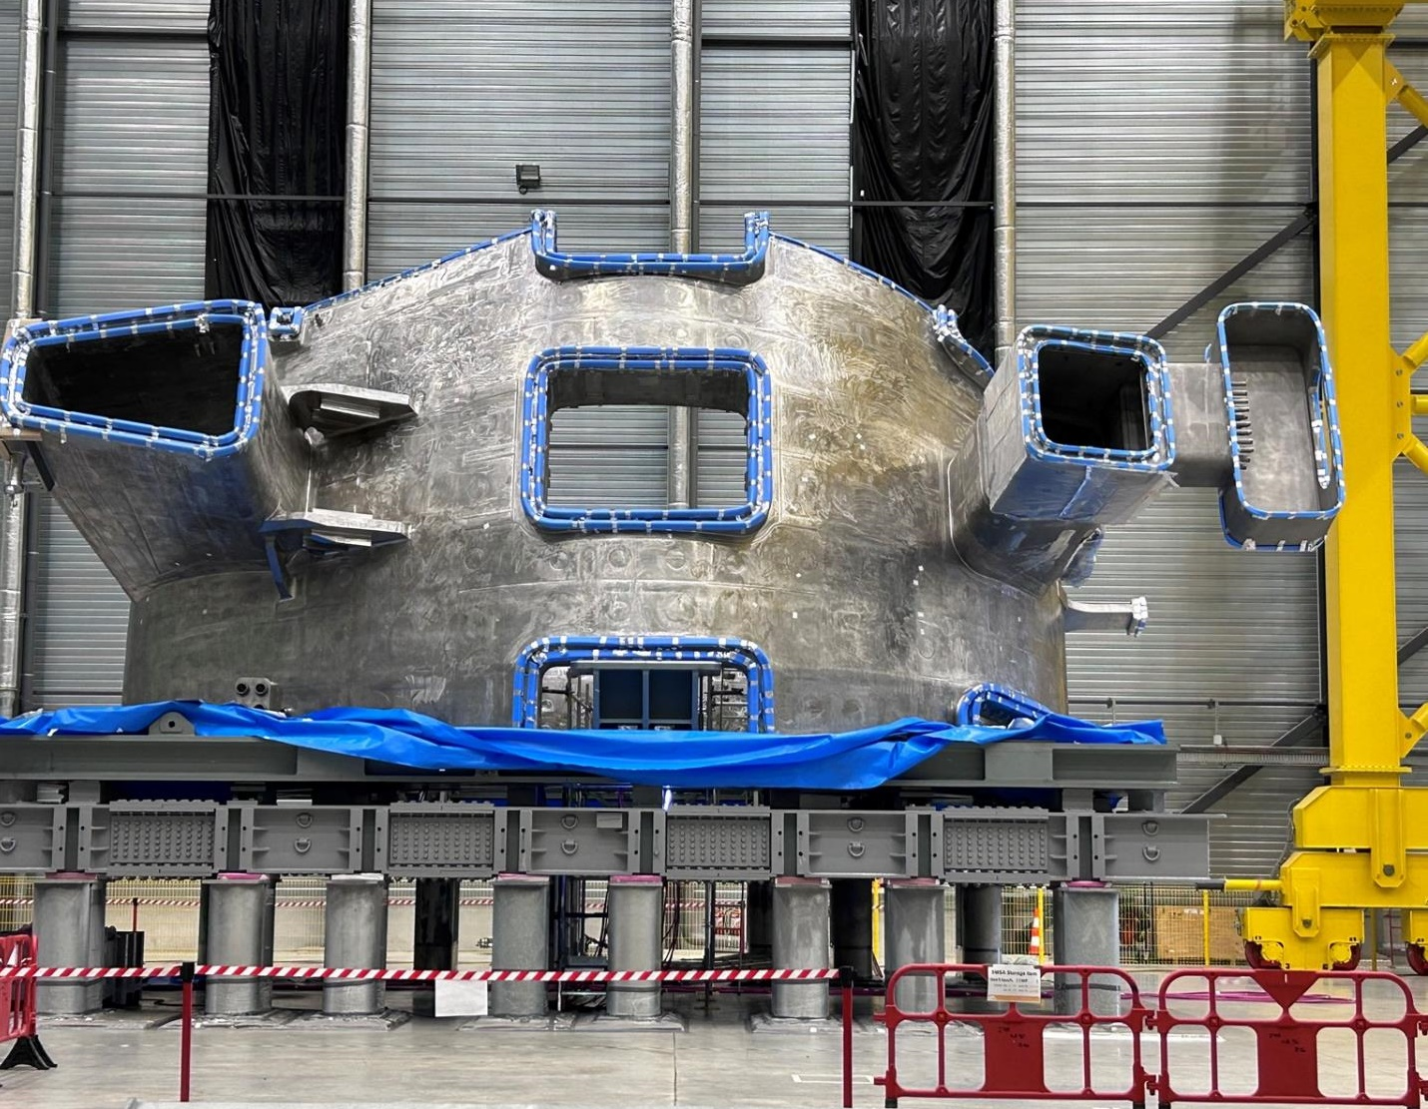
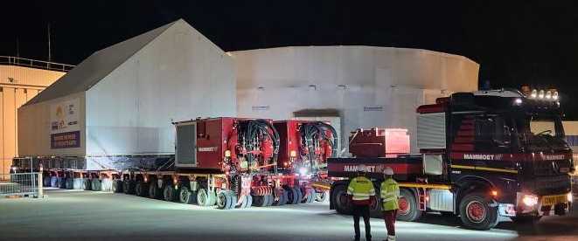
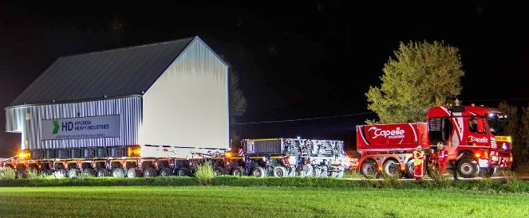
text
VACUUM VESSEL SECTORS
Europe recently delivered its first vacuum vessel sector.
Korea’s fourth (and final) sector arrived two weeks later.
a
text
text
EU sector arrival at ITER, 25 Oct 2024
Korean sector arrival at ITER, 8 Nov 2024
9
text

Slide 10
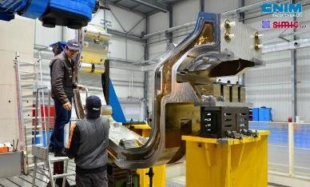
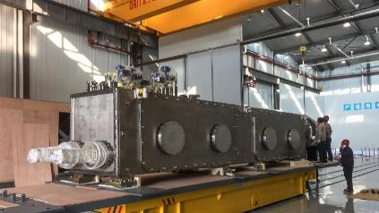
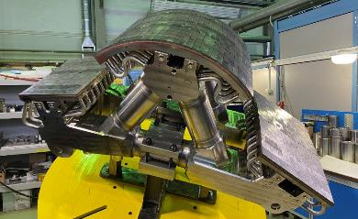
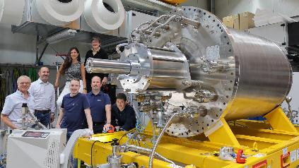
ADDITIONAL MANUFACTURING AND DELIVERIES
Divertor cassette body: 100% of manufacturing has been launched
Magnet feeder components 81% complete
Divertor cassette dome: series manufacturing ongoing for 58 domes
First of 8 Torus and Cryostat Cryopumps passed FAT in May 2024

Slide 11
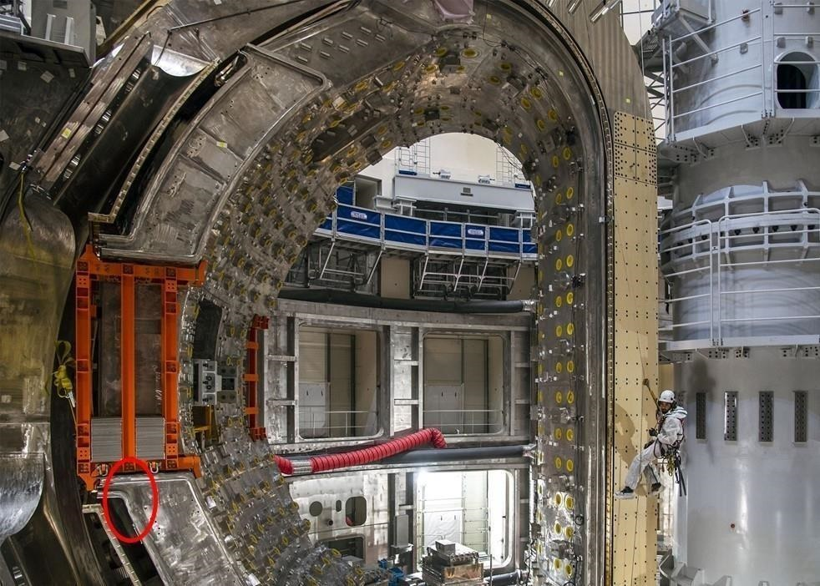
text
CHALLENGES OF
FIRST-OF-A-KIND COMPONENTS
Vacuum Vessel sectors have geometric non-conformities in the field bevel joints.
text
text
11
text

Slide 12
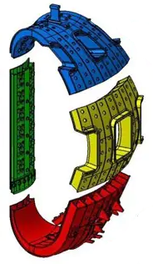
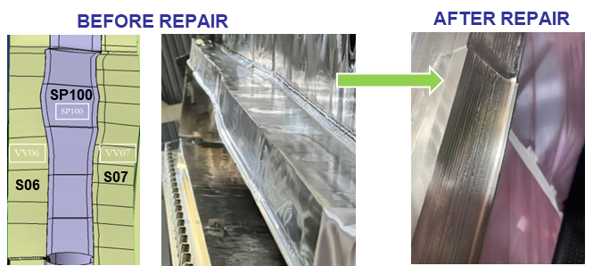
REPAIRS TO VACUUM VESSEL SECTOR BEVEL JOINTS
Issue:
Main reason: Segments machined before assembly into sector
→Weld distortions incompatible with planned sector welding
→ Assembly halted in 2021 due to ASN raising major issue in hold point
Solution:
Bevel Build-up (manual tig / mechanized tig) + NDE (M-UT and RT).
S4, S5, S9, S6 and S7: manual tig
S8 & S1: mechanized and manual tig
Bevel machining, with portable milling machine(s) bolted to the Sector T-rib
STATUS
Sector 5 (at EU Supplier): successfully repaired
Sector 7 (at ITER): successfully repaired
Sectors 6 & 8 (at ITER): repairs in progress
Sector 1 (at ITER): repair to start soon
Sectors 2, 3, 4, 9: manufacturing still in progress

Slide 13
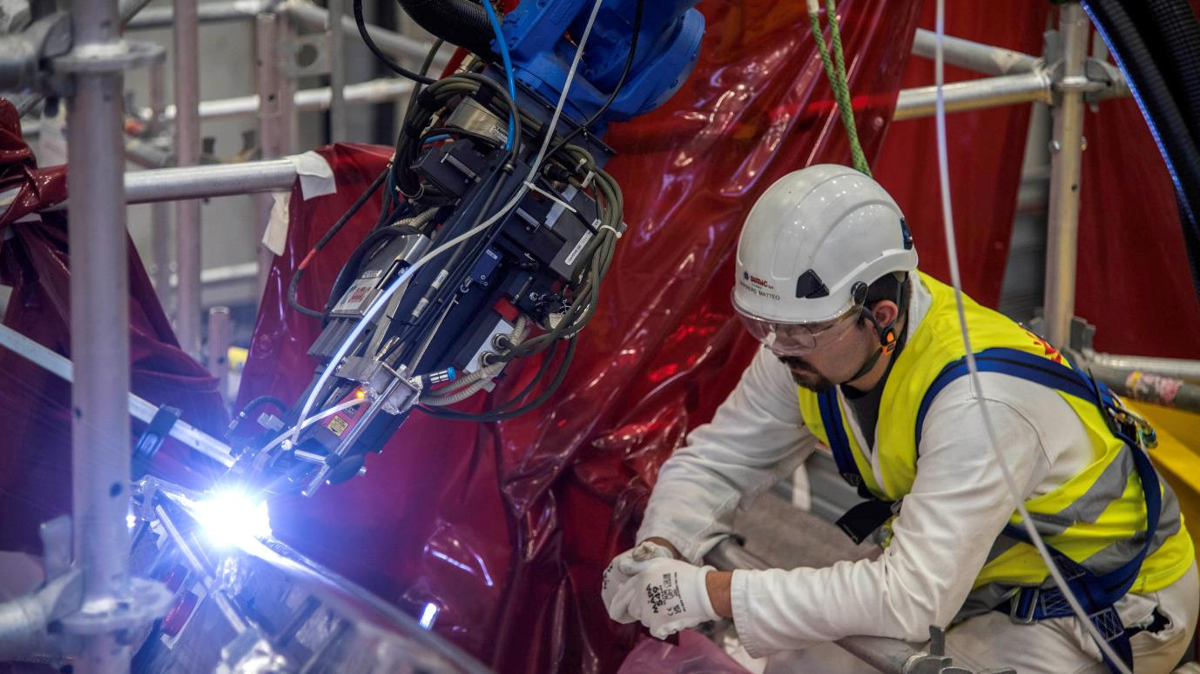

Slide 14
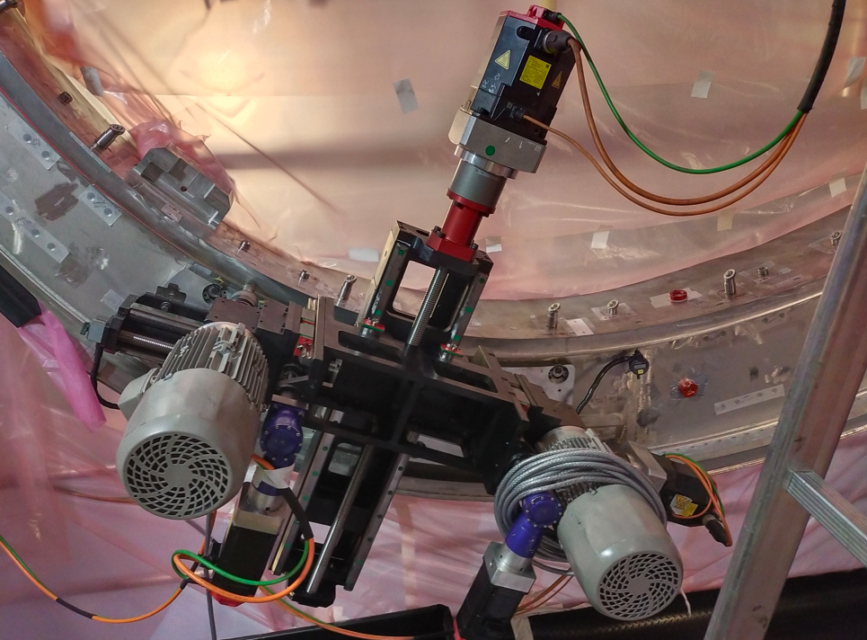
Bevel machining
STATUS
Sector 5 (at EU Supplier): successfully repaired
Sector 7 (at ITER): successfully repaired
Sectors 6 & 8 (at ITER): repairs in progress
Sector 1 (at ITER): repair to start soon
Sectors 2, 3, 4, 9: manufacturing still in progress

Slide 15
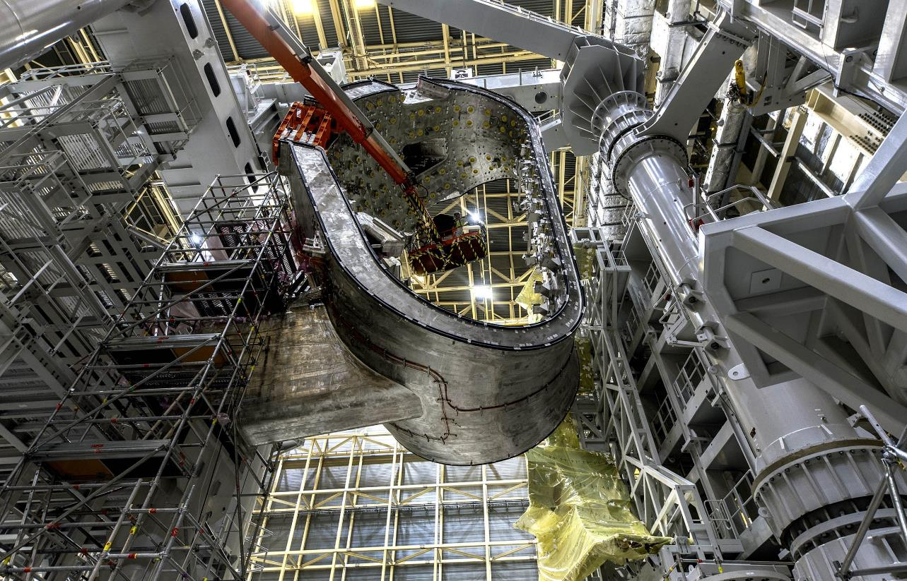

Slide 16
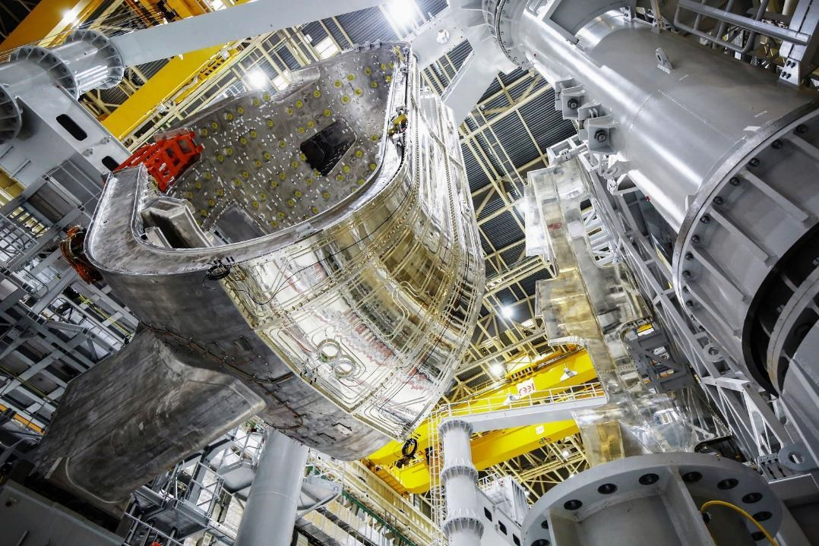
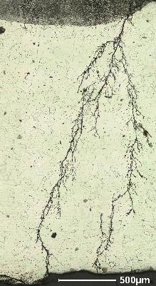

text
CHALLENGES OF FIRST-OF-A-KIND COMPONENTS
Leakage identified in thermal shield cooling piping due to chloride stress corrosion.
a
text
text
16
text

Slide 17
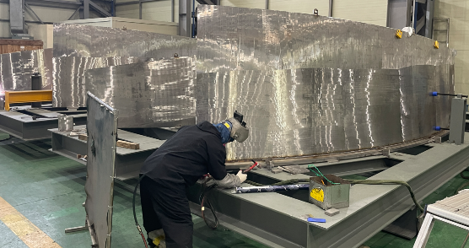
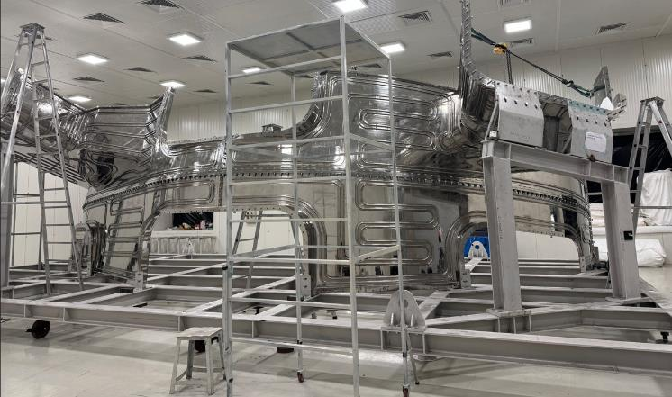
text
VVTS REPAIR PROCESS
Replacement of corroded pipes with new 316L pipes
2 mm panel machining to eliminate potential panel corrosion risk
Surface polishing replacing Ag coating for good emissivity: surface roughness less than 0.1 µm – lower emissivity at 80K
VVTS MANUFACTURING
A risk mitigation measure: a contract to manufacture 3 (or more) new VVTS sectors progressing as planned.
text
text
17
text

Slide 18
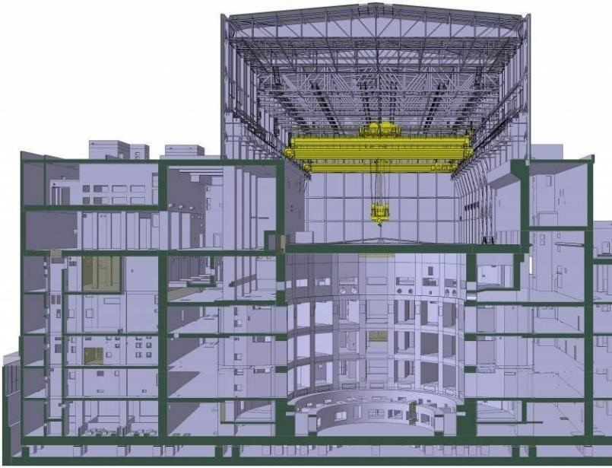
text
OVERVIEW OF NEW PROJECT BASELINE PROPOSAL
WHY? Delays in deliveries (e.g. VV), issues of quality, issues with regulator, Covid impacts, unrealistic plans
GOAL: Deliver substantive research as rapidly as possible
KEY CHANGES:
More components are now available to build a more complete machine
Start of Research Operations targeted in 2034
To include 27 months of research
Full Magnetic Energy: delayed from 2033 to 2036
Start of DT Operations Phase: delayed from 2035 to 2039
text
text
18
text

Slide 19
The PREVIOUS (2016) BASELINE:
Designed to reach First Plasma – any symbolic plasma experiment – as rapidly as possible
Constrained by the fact that some key components would not be available
First Plasma scheduled for end-2025: a brief, low-energy machine test (100 kA)
To be followed immediately by further in-vessel components assembly
Reaching full plasma current in 2033, and starting DT operations in 2035

Slide 20
The NEW (2024) BASELINE
Designed to reach First Plasma – and immediately after to move to full magnetic energy to commission machine as much as possible before final FW installation
Less risky commissioning, research, safety demonstration plan
Start of Research Operation (SRO) 15 MA/5.3T, to include successful demonstration of magnet reliability, control system, disruption mitigation, using H and DD plasmas
DT-1: DT operation focused on achievement of specific project goals -> Q ≥ 10, 300-500s with limited fluence (1/100 of end-of-life)
DT-2: Full achievement of Project goal (safety demonstration based on DT-1)
Stepwise licensing and safety demonstration
TF Test facility under fabrication, a few TF coils will be tested at 4k
Replacement of Beryllium with Tungsten for First Wall
VV welding re-sequenced, from triplets to 9 sectors simultaneously
Increase of heating power
Assembly contracts reformulated, refocus on key assembly tooling

Slide 21
LICENSING: TOWARDS A STEPWISE NUCLEAR SAFETY DEMONSTRATION
The previous nuclear safety demonstration approach pursued by the ITER project has tried to meet all French regulatory requirements at once, despite the uncertainties weighing on this approach due to the major extrapolation of the knowledge available today (e.g. deriving from experience in magnetic confinement fusion facilities such as JET) compared to what is planned as part of the ITER experimental program.
Examples of these uncertainties include:
Dust formation
Tritium retention
Activated Corrosion Products (ACPs) generation
Neutron transport calculations
Effect of neutrons on electronics
Hydrogen formation due to Loss of Coolant Accidents
Effects of plasma transients
Superconducting magnets insulation reliability
Reliability of equipment
Maintenance of equipment
In particular, maintainability of in-vessel components and impact on the hot cell facility

Slide 22
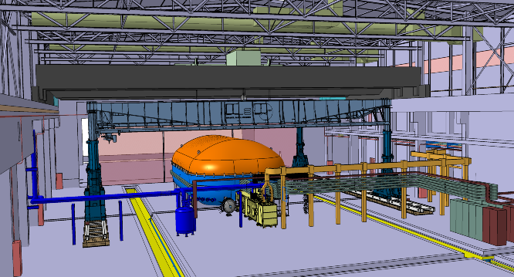
RISK MITIGATION: COLD TESTING OF SUPERCONDUCTING MAGNETS
Cold testing of ITER SC magnets at operating temperature (4K) has so far been limited to Central Solenoid Modules.
The Magnet Cold Test Bench is a facility on ITER site that will allow a few (>3) TF coils and PF1 to be tested at nominal current before their integration.
What will be checked
Coil and Joint Performance
High voltage ground insulation at different T
Quench protection systems
Fast Discharge – cryoplant integration
Coil thermohydraulic performance
Cryostat and Power Supply System are under
manufacturing - delivery of the MCTB facility
targeted by end 2025.

Slide 23
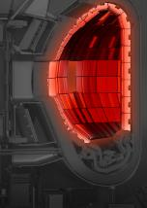
REPLACEMENT OF BERYLLIUM (BE) WITH TUNGSTEN (W) FIRST WALL
The choice of Be as Blanket First Wall (FW) plasma-facing material for ITER has been reconsidered in view of the updated understanding of its implications:
The higher chance of armour bridging during plasma-off normal conditions.
The irrelevance of Be for DEMO, the large cost and time needed to later replace the FW to W
The improved understanding of the implications to meet the stringent Be Health and Safety requirements
…
Tungsten (W) appears the best solution for ITER as it also allows ITER to perform DEMO-like high-Q operation, with a relevant high-Z wall.

Slide 24
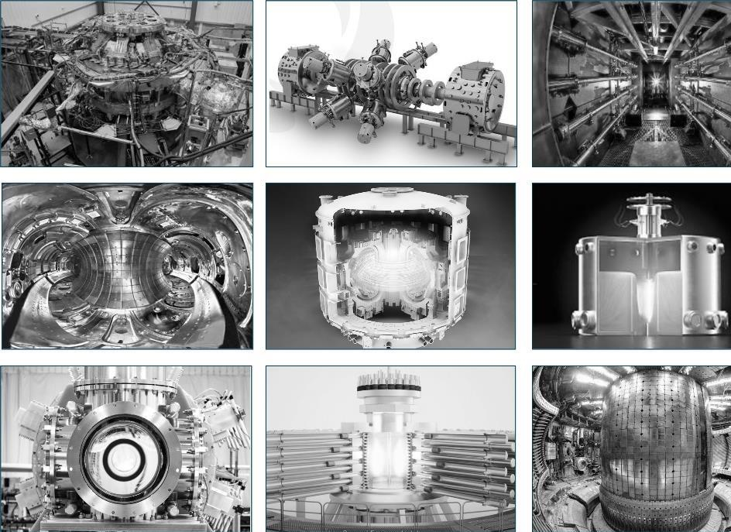
text
ENGAGEMENT WITH PRIVATE SECTOR FUSION INITIATIVES
Initial workshop held at ITER, May 2024
350 participants, strong reception
1 November: launched Private Sector Fusion Engagement (PSFE) Project
ITER Design Handbook
Open-sourcing IMAS software
Access to ITER documents and ITER experts and technical visits
ITPA participation by private entities
Catalogues of fusion resources (supply companies, testing capacities) in preparation
Under consideration: private sector secondees at ITER
Next workshop: 22-23 April 2025
In conjunction with IBF (ITER Business Forum), to be held in Marseille, 24-25 April
Focus on fusion supply chain
First time with fusion start-ups
text
text
text

Slide 25
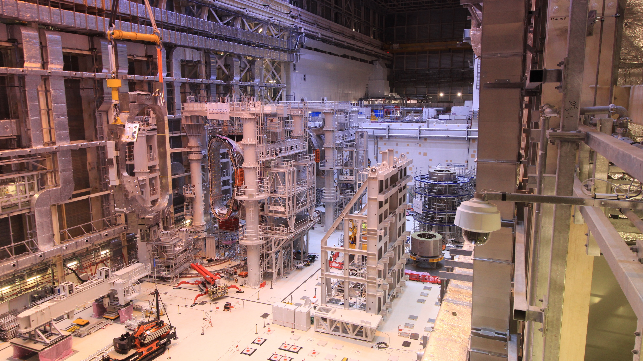
Thank you!
Recent lift of TF Coil to Sector Sub-Assembly Tool

Slide 26
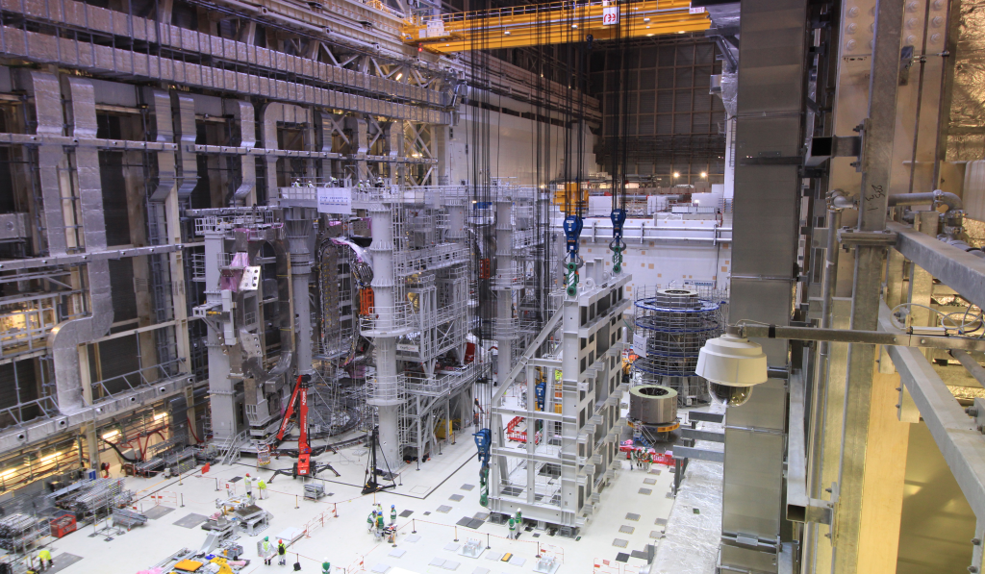
ITER Assembliy Hall, 8:30 am, 29 November

Slide 27
