Slide 1
The Laboratory for Laser Energetics
Inertial Fusion Energy: attracting and training a cadre of stockpile stewards
Dustin Froula and the LLE Team
Professor of Physics
Division Director, Plasma & Ultrafast Laser Science & Engineering
Director, IFE-STAR & IFE-Consortium On LPI Research (IFE-COLoR)
Laboratory for Laser Energetics, University of Rochester
Fusion Power Associates
Washington D.C.
2 December 2024

Slide 2
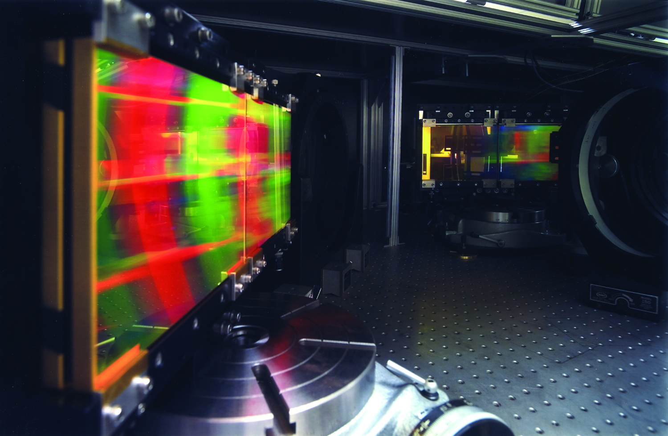
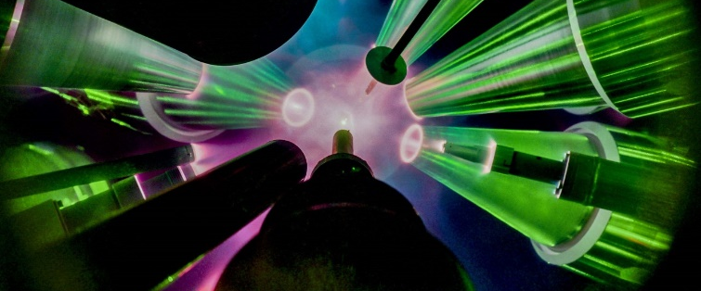
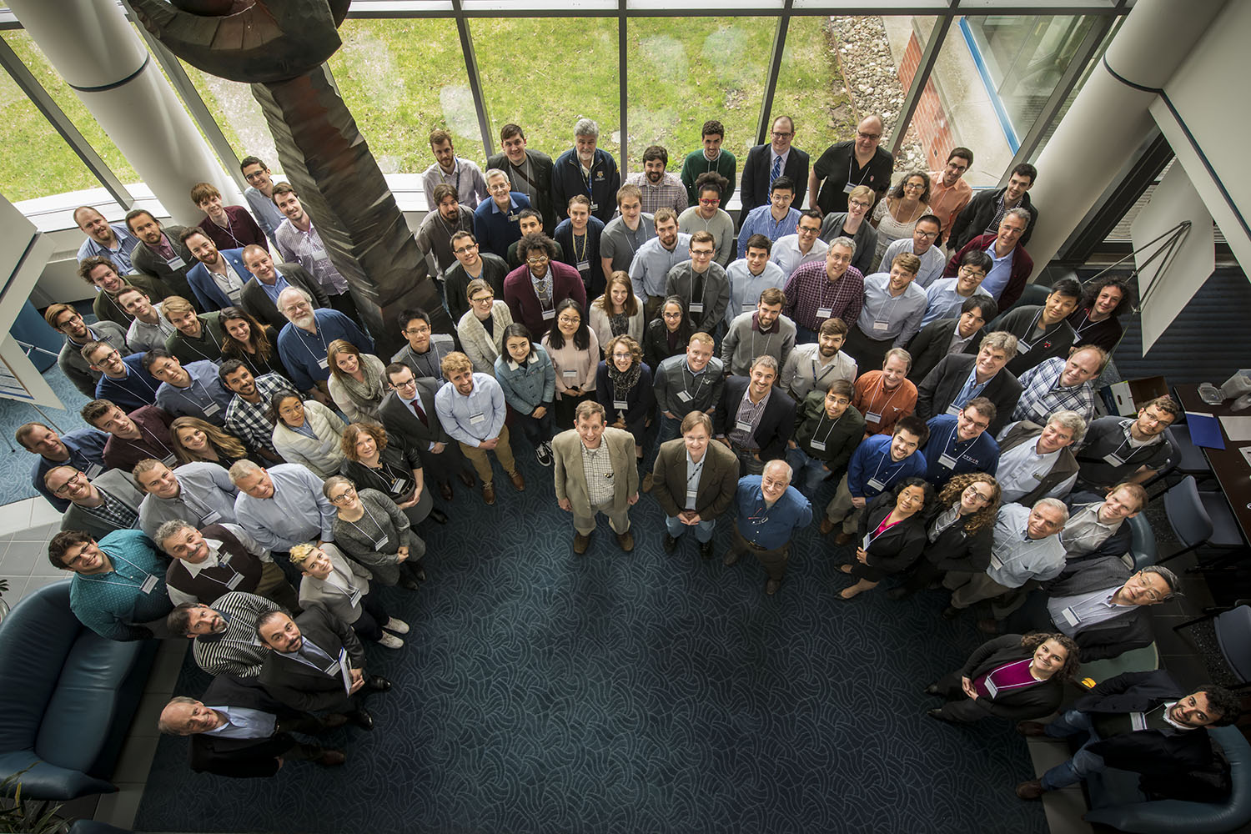
The vision for the University of Rochester’s Laboratory for Laser Energetics
The leading academic institution advancing laser technologies, fusion, and high-energy density sciences at scale
Building S&T and future scientists for national and energy security
Innovate
Leadership
Educate
Stockpile Stewardship | Energy Security | National Security | Economic Security

Slide 3
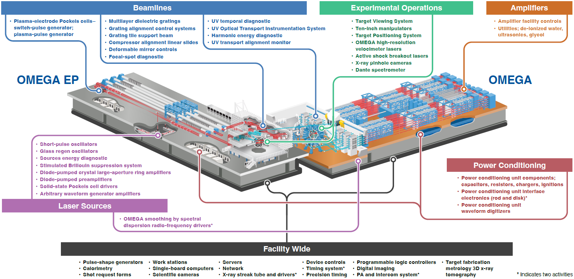
World’s Largest Lasers in an Academic Institution Omega Facilities provide 80% of the Nation’s HEDP experiments to the community
LLEs facilities support a robust direct-drive fusion program
Notes:
Maximizing the opportunities and minimizing the risks on other ICF facilities

Slide 4


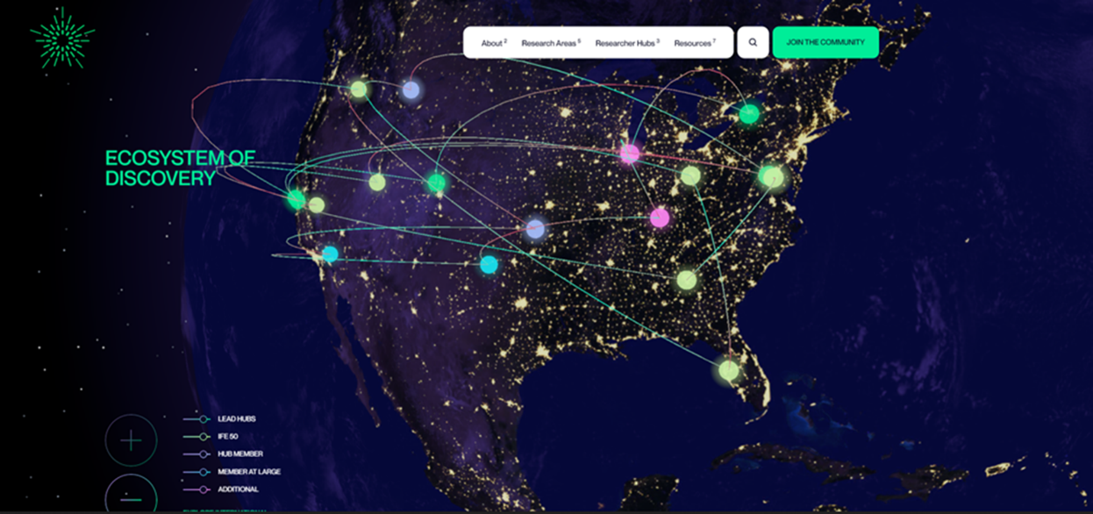



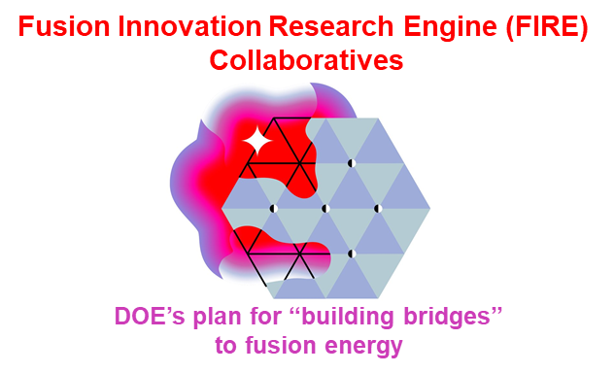
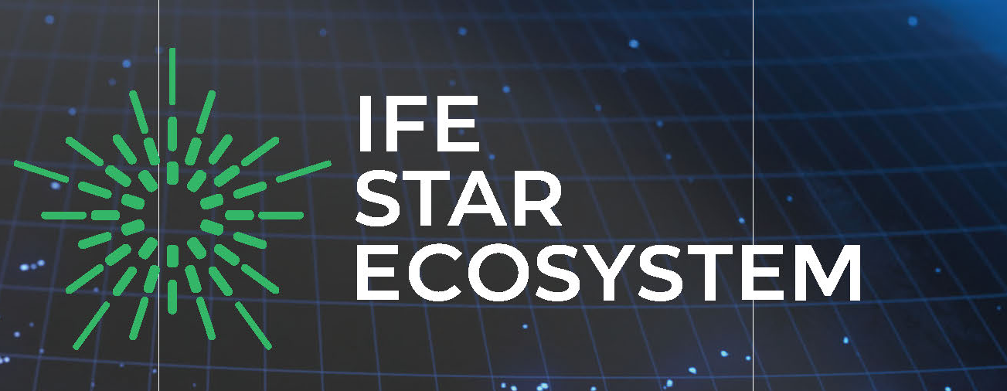



The Office of Science has formed an ecosystem focused on bringing together the Nation’s inertial fusion energy efforts
IFE-Science & Technology Accelerated Research (IFE-STAR) Ecosystem
Tammy Ma
(STARFIRE Director)
Dustin Froula
(IFE-COLoR Director)
Carmen Menoni
(RISE Director)
An ecosystem to accelerate our Nation’s path to a fusion power plant

Slide 5
The Office of Science has formed an ecosystem focused on bringing together the Nation’s inertial fusion energy efforts
IFE-Science & Technology Accelerated Research (IFE-STAR) Ecosystem
IFE-STAR has launched two initiatives for FY24:
National IFE-Undergraduate Summer Research Opportunity
21 Universities and IFE Companies
Application Open
https://www.lle.rochester.edu/ife-star/
IFE-STAR Conference
April 7, 2025 Breckenridge, CO
Website for IFE:
Tammy Ma
(STARFIRE Director)
Dustin Froula
(IFE-COLoR Director)
Carmen Menoni
(RISE Director)
https://www.ifestar.org (coming soon)
An ecosystem to accelerate our Nation’s path to a fusion power plant

Slide 6
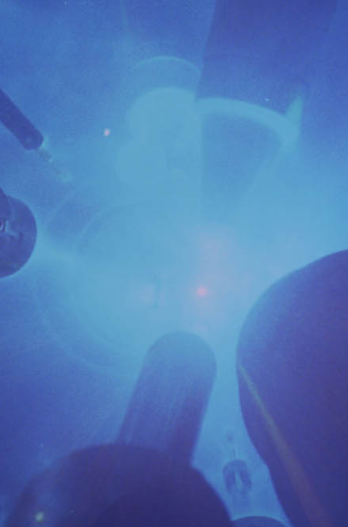


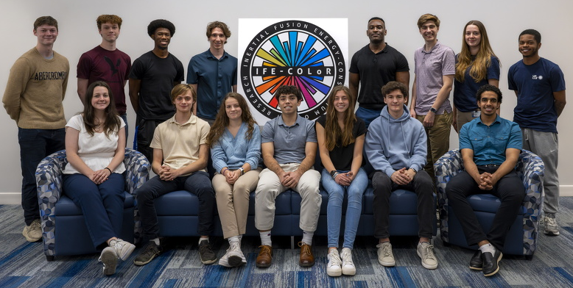



IFE-COLoR (Consortium On LPI Research) is an Office of Fusion Energy Science research hub focused on direct-drive inertial fusion energy (IFE)
Dustin Froula (PI)
Summer 2024 IFE-COLoR Undergraduate Research Program
Arnaud Colaitis
Christophe Dorrer
Russ Follett
John Marozas
David Turnbull
Christophe Dorrer
Dana Edgell
Valeri Goncharov
Avi Milder
Rahul Shah
Connor Galloway
Warren Mori
Paulo Alves
Yongfeng Lu
Archis Joglekar
Principle direct-drive questions:
Do high-bandwidth lasers mitigate LPI?
Can advanced laser-smoothing schemes with bandwidth eliminate imprint?
15 Summer Undergraduate IFE-COLor Researchers
This work is supported by the U.S. Department of Energy (DOE), Office of Science, Fusion Energy Sciences, under Award No. DE-SC0024863: IFE-STAR.

Slide 7
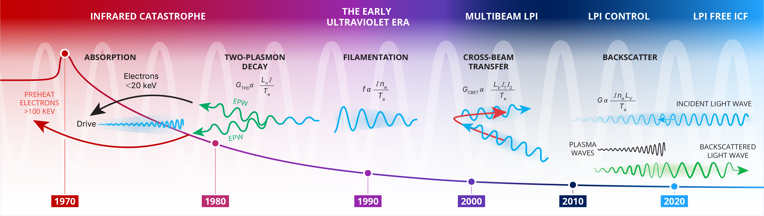
In each decade, the inertial confinement fusion community overcome a significant laser-plasma instability challenge
IFE-COLoR is working to quantitatively demonstrate mitigation of imprint and laser-plasma instabilities with laser bandwidth

Slide 8
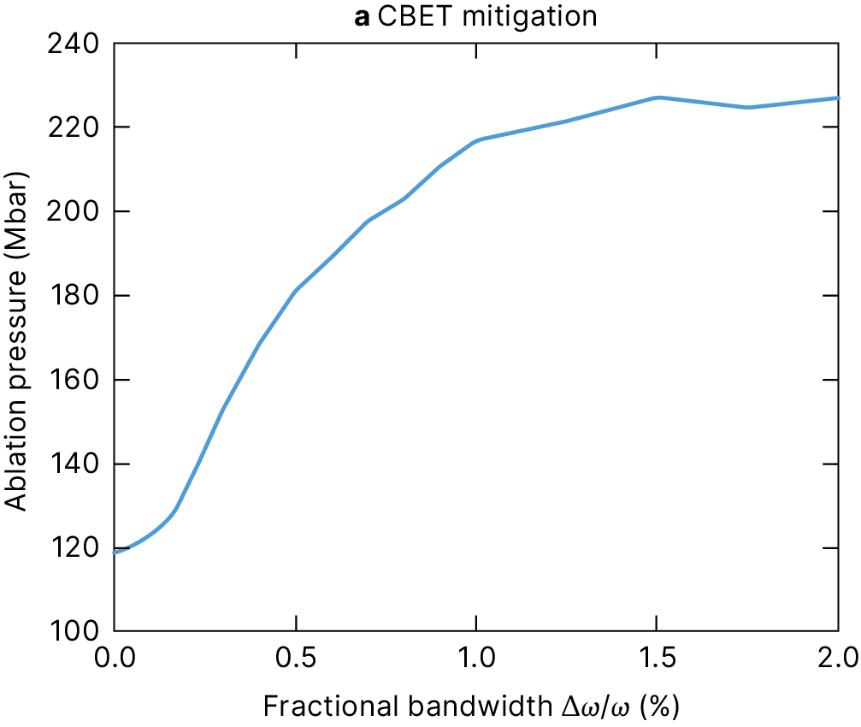
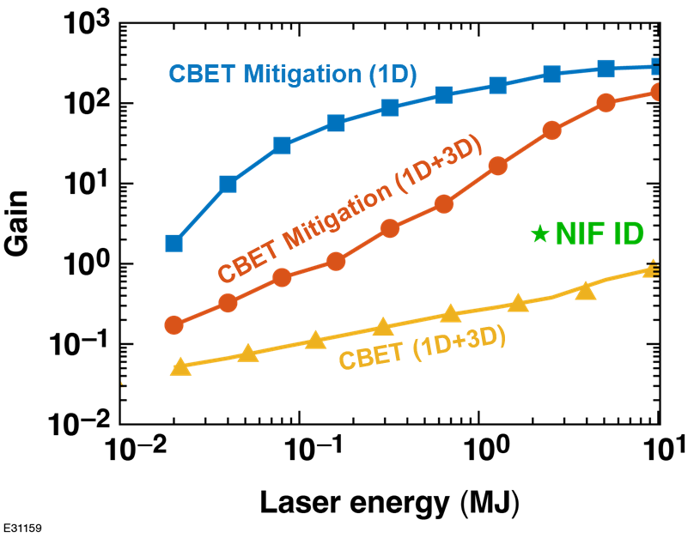
Cross-beam energy transfer reduces the laser absorption and prevents direct-drive ignition
Modeling suggests that 1% bandwidth will mitigate cross-beam energy transfer recovering the efficiency of direct-drive fusion providing a path to small high-gain fusion facilities
R Follett et al. in preparation

Slide 9
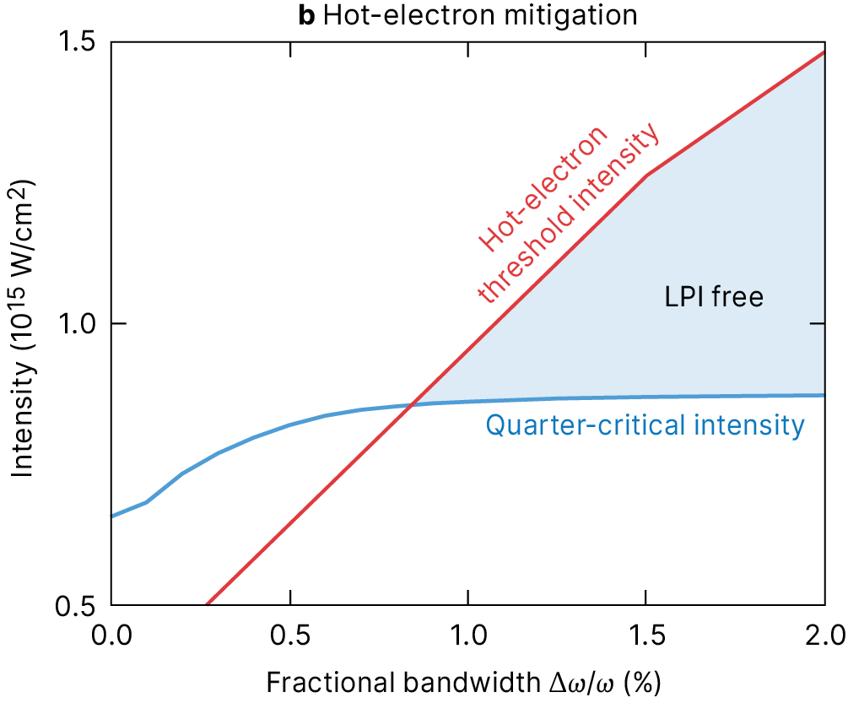
Modeling suggests that >1% laser bandwidth will mitigate both cross-beam energy transfer and hot electron production in direct-drive implosions
Bandwidth greater than 10× current inertial fusion drivers (e.g., NIF, OMEGA, LMJ) is required to mitigate laser-plasma instabilities in direct-drive ignition experiments
R Follett et al. in preparation

Slide 10
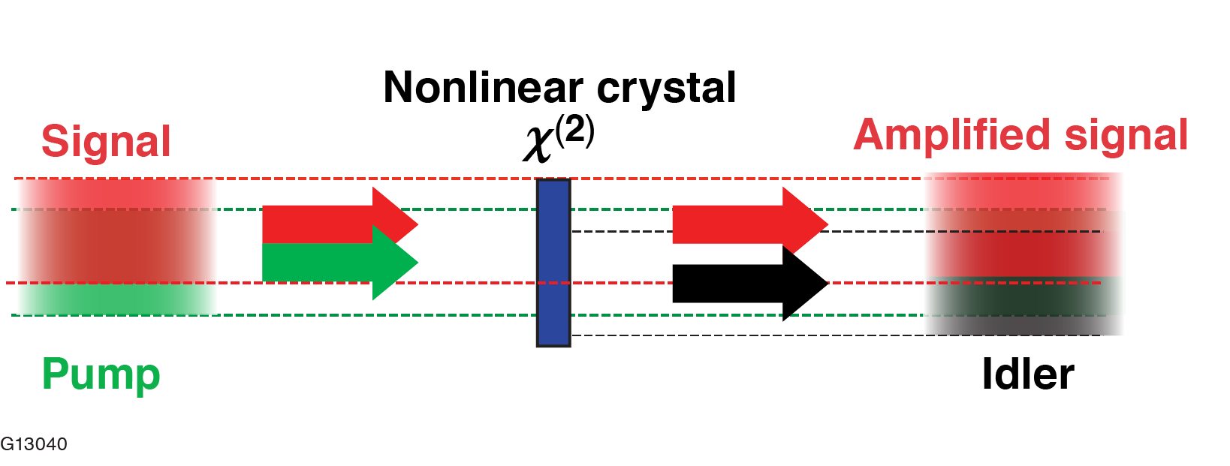
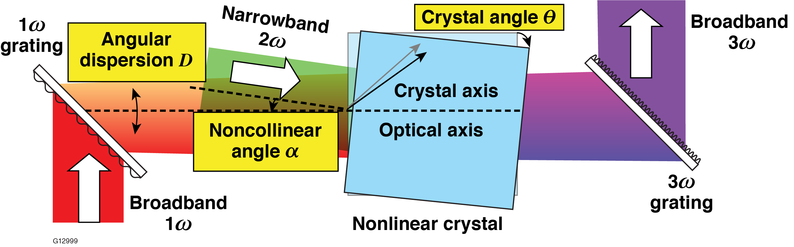
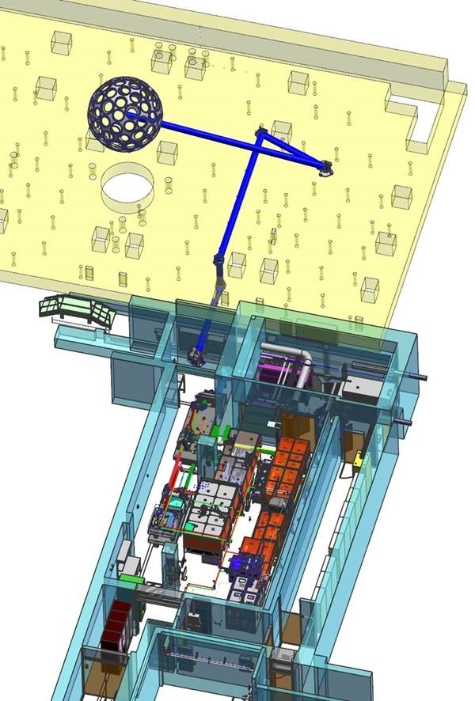
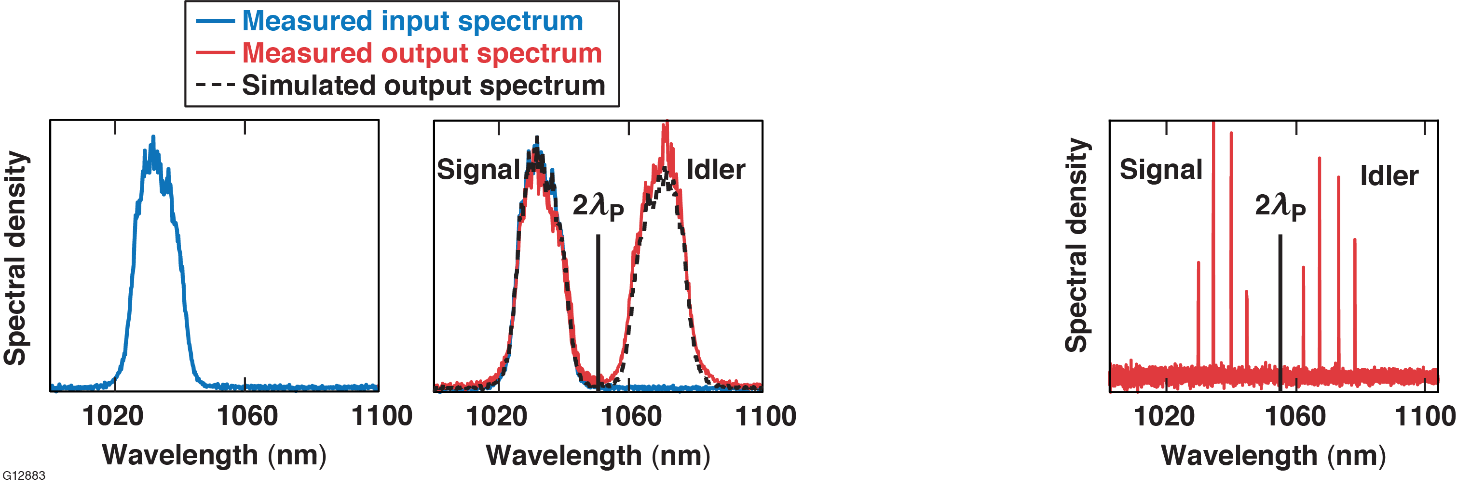
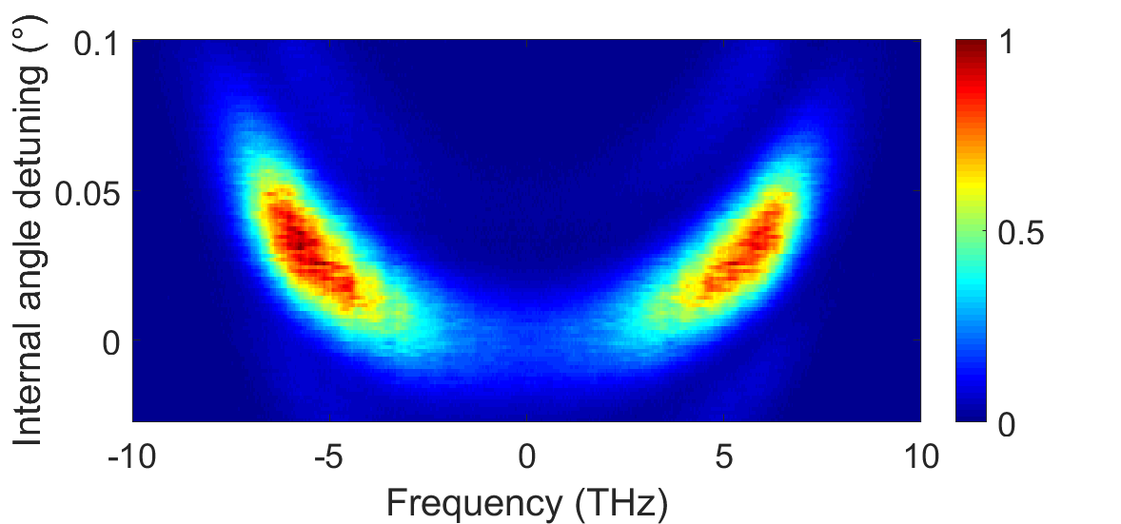
The Fourth generation Laser for Ultrabroadband eXperiments (FLUX) was build to demonstrate the laser technologies and LPI mitigation for a next-gen ICF driver
Collinear Optical Parametric Amplifier
Novel UV Broadband Frequency Conversion
FLUX
OMEGA-60 target chamber
FLUX
C. Dorrer et al., Opt. Express 28, 451–471 (2020)
C. Dorrer et al., Opt. Express 29, 16,135–16,152 (2021)
70% conversion efficiency from pump to broadband signal and idler in power amplifier
Spectrally incoherent 1ω source yields a broadband 3ω pulse with ~15-THz bandwidth (Δω_{UV}/ω_{UV}>1.5%)
FLUX will deliver high bandwidth (Δλ/λ>1%) pulses to the OMEGA chamber along Port 9

Slide 11
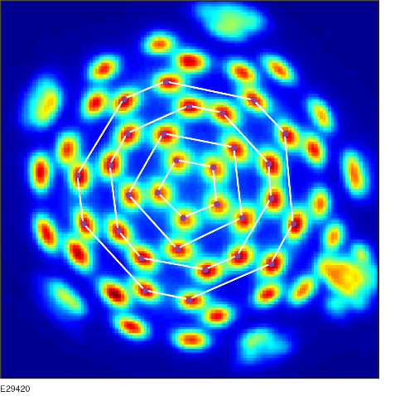
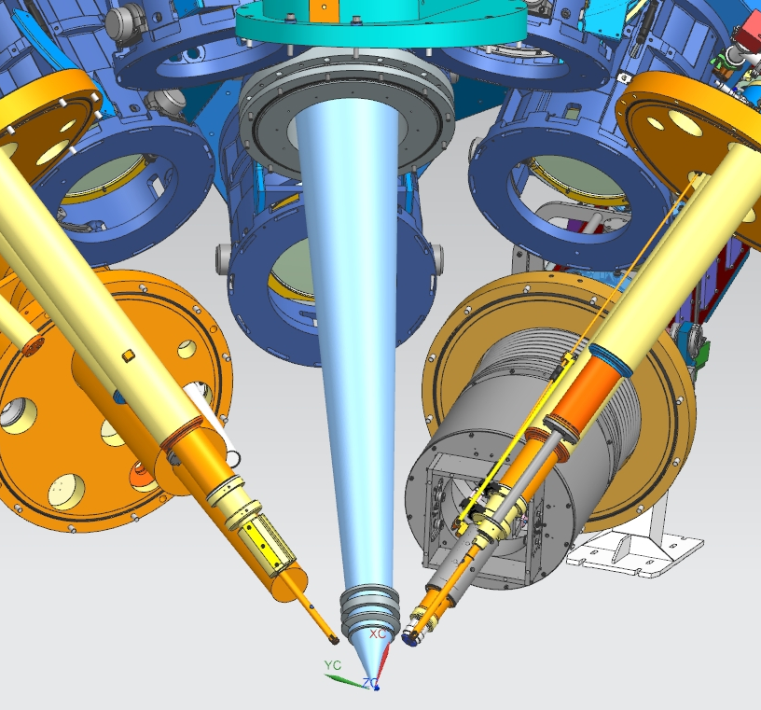
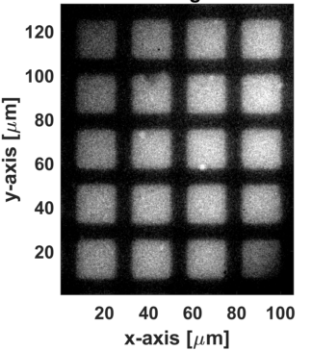
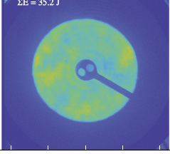
Platforms have been developed to isolate and quantify our understanding of bandwidth on each laser-plasma interaction
Single-Beam LPI
laser absorption, filamentation, SBS, SRS)
Cross-beam Energy Transfer
Multiple Beam Driven Hot Electron LPI
Laser Imprint
1.7 keV
(2 μm resolution)
Transmitted Beam Diagnostic
CBET Beamlets Diagnostic
f/1.5 focusing to mimic multibeam laser
High-Resolution soft x-ray imaging
Katz et al., RSI (2021)
Edgell et al., RSI (2018)
Turnbull et al.
Haberberger et al.

Slide 12
Thank You and Meliora
Questions?

