Slide 1
Path to a Spherical Tokamak Pilot Plant.
Steve Cowley. December 2024
Notes:
I have to put this in the context of PPPL’s view on where fusion stands at the end of 2024.

Slide 2
US Decadal Strategy to Accelerate Fusion to Commercialization
Will the spherical tokamak (ST) be ready to deliver on this timescale?
Notes:
PPPL takes this timeline as the challenge.

Slide 3
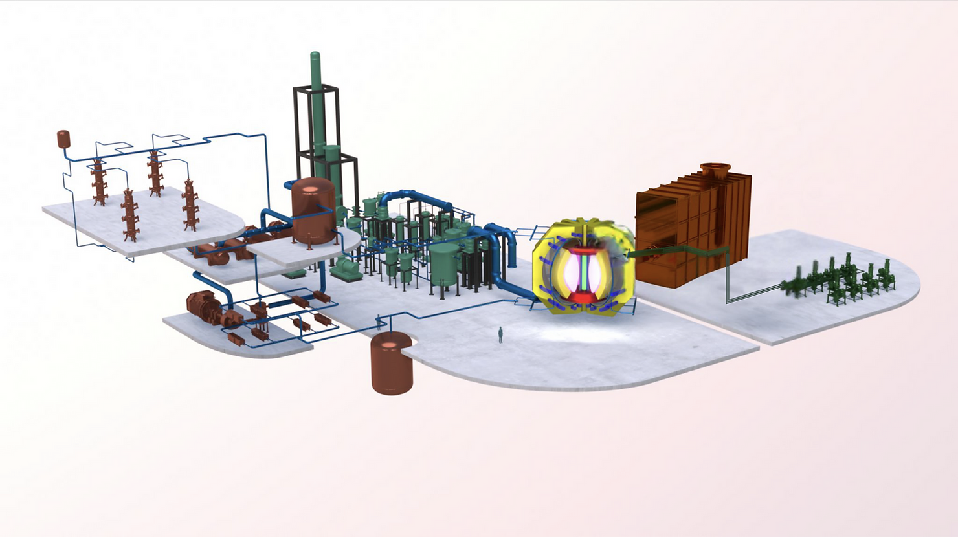
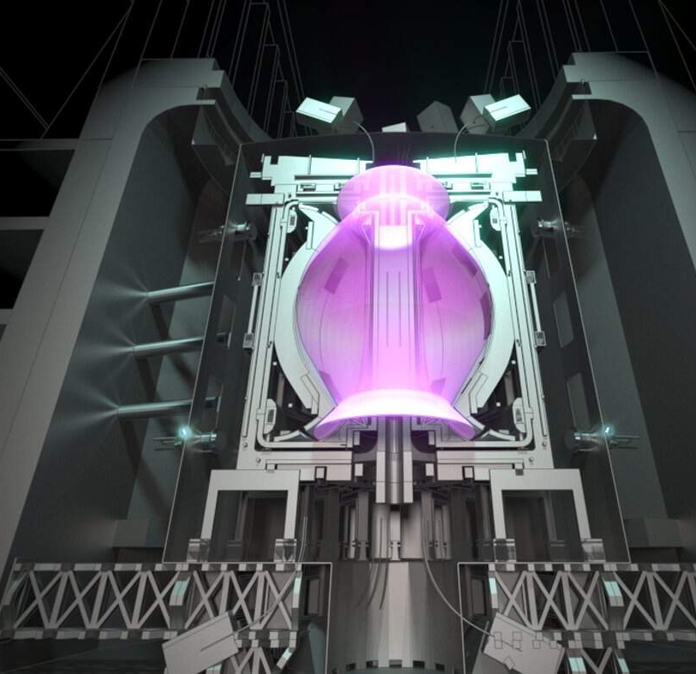
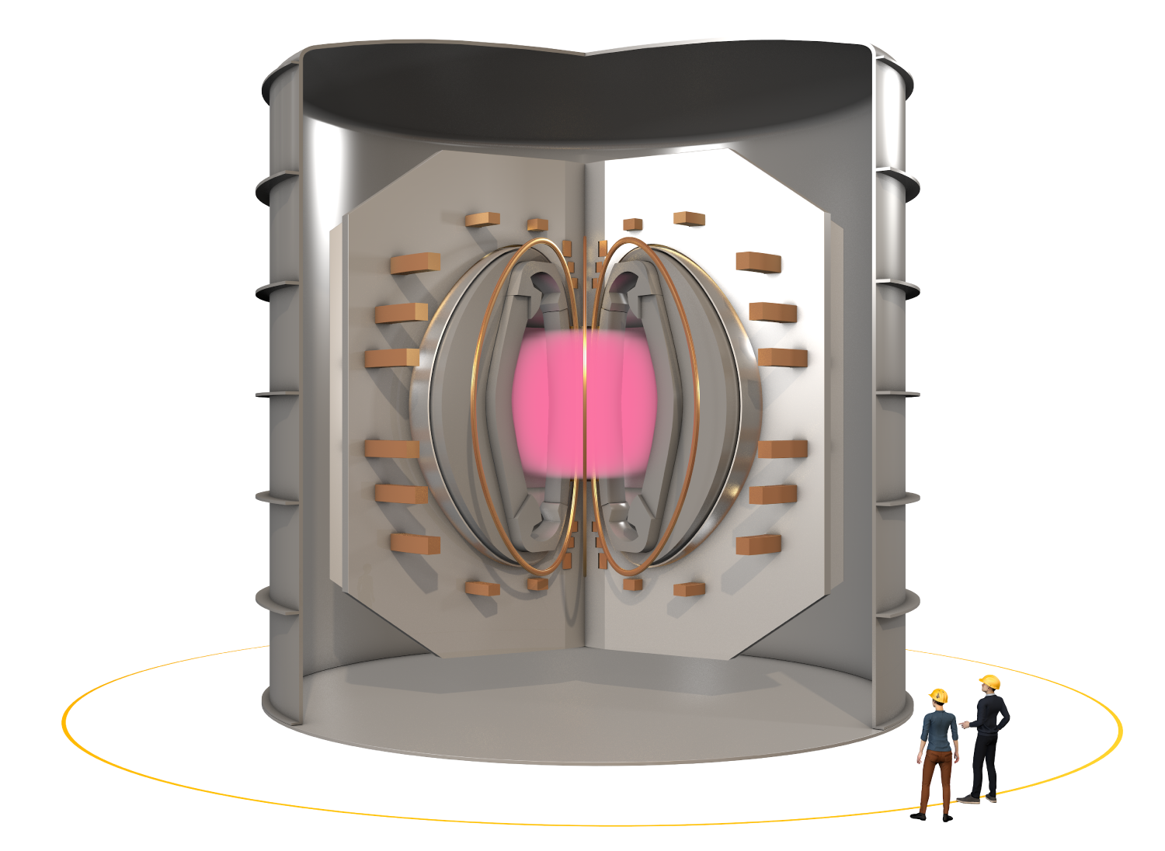
Proposed Spherical-Tokamak Pilot Plants
STAR: Spherical Tokamak Advanced Reactor (STAR) targeting 100-500MWe. PPPL + Tokamak Energy + Kyushu Univ. reactor design.
Tokamak Energy: “ST-E1, which is slated to demonstrate the capability to deliver electricity - producing up to 200 MW of net electrical power - in the early 2030s.”
STEP: “STEP (Spherical Tokamak for Energy Production) is a major technology and infrastructure programme to deliver the UK's prototype fusion energy plant, targeting 2040, and a path to the commercial viability of fusion.” UKAEA
“FAST Project office proudly announces the launch of the FAST (Fusion by Advanced Superconducting Tokamak) project, a groundbreaking initiative aimed at achieving fusion based power generation by the end of the 2030s”

Slide 4
Why the Spherical Tokamak?

Slide 5
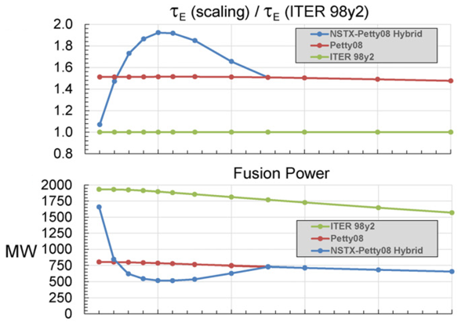
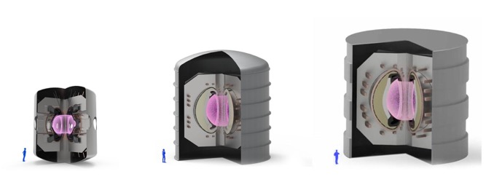
Improved Confinement
| Spherical Tokamak: NSTX-U
Is this true?
NSTX-U will determine how the spherical tokamak scales to reactor conditions.
Empirical reactor scaling from NSTX results suggest H~1.5 – 2. Spherical tokamaks have less turbulent convection → confine better than the main line.
Tokamak Energy: ST-E1 Pilot Plant
J.E. Menard, et al 2022 Nucl. Fusion 62 036026
ST80-HTS
ST-E1
Commercial Deployment
EU DEMO
PPPL’s STAR design
Notes:
This is Jon's analysis.
UK betting on this route with STEP
NSTX-U is essential. UK and Tokamak Energy are awaiting the
confinement results from NSTX-U

Slide 6
NSTX-U one step to the ST pilot plant.

Slide 7
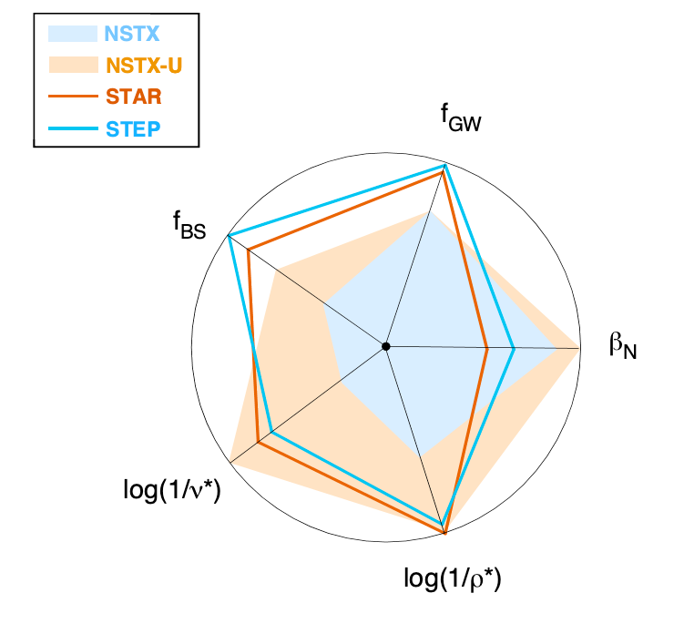
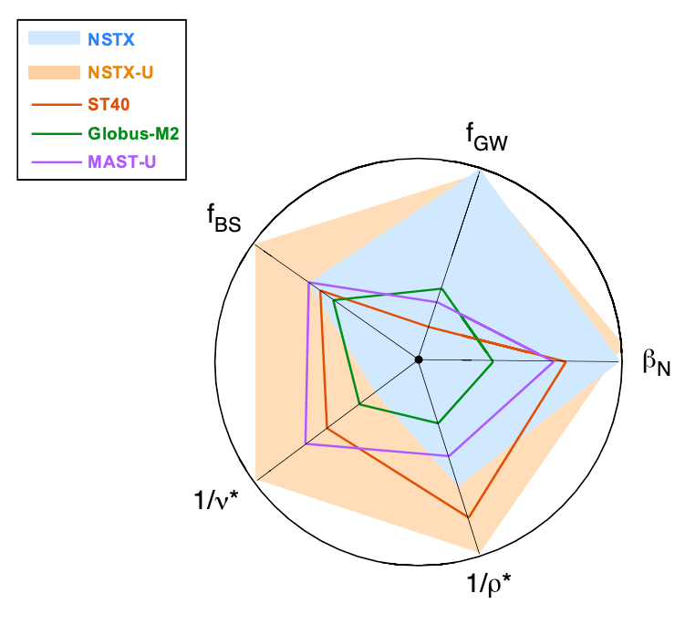
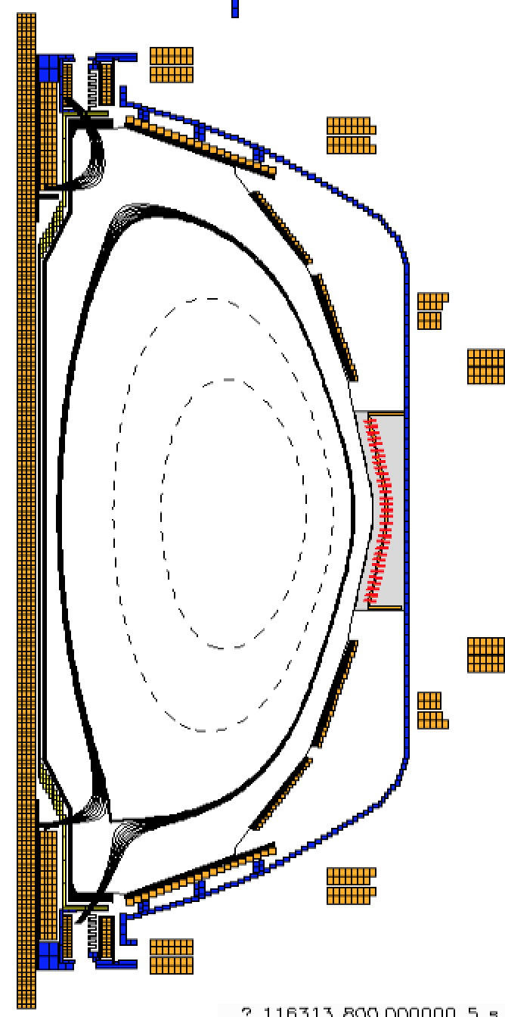
NSTX-U is the most powerful ST in the world and parameter range extends to those projected for ST FPP designs -- it is the “One Step.”
NSTX-U is uniquely positioned to address heat flux mitigation through use of Liquid Metal divertor components
NSTX-U can purposefully achieve q⊥ ≤ 100 MW/m² for PFC tests
R&D ongoing to develop a Lithium Vapor Box
  Heat flux of ~ 90 MW/m² can be reduced to <10 MW/m² with low core contamination
90 MW/m²

Slide 8
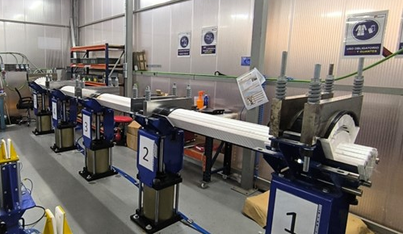
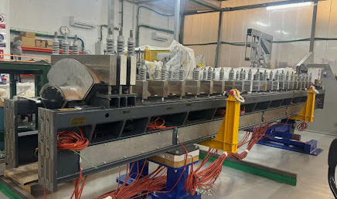
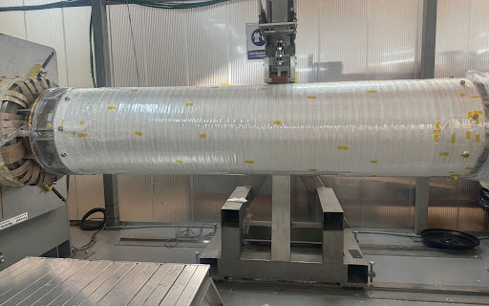
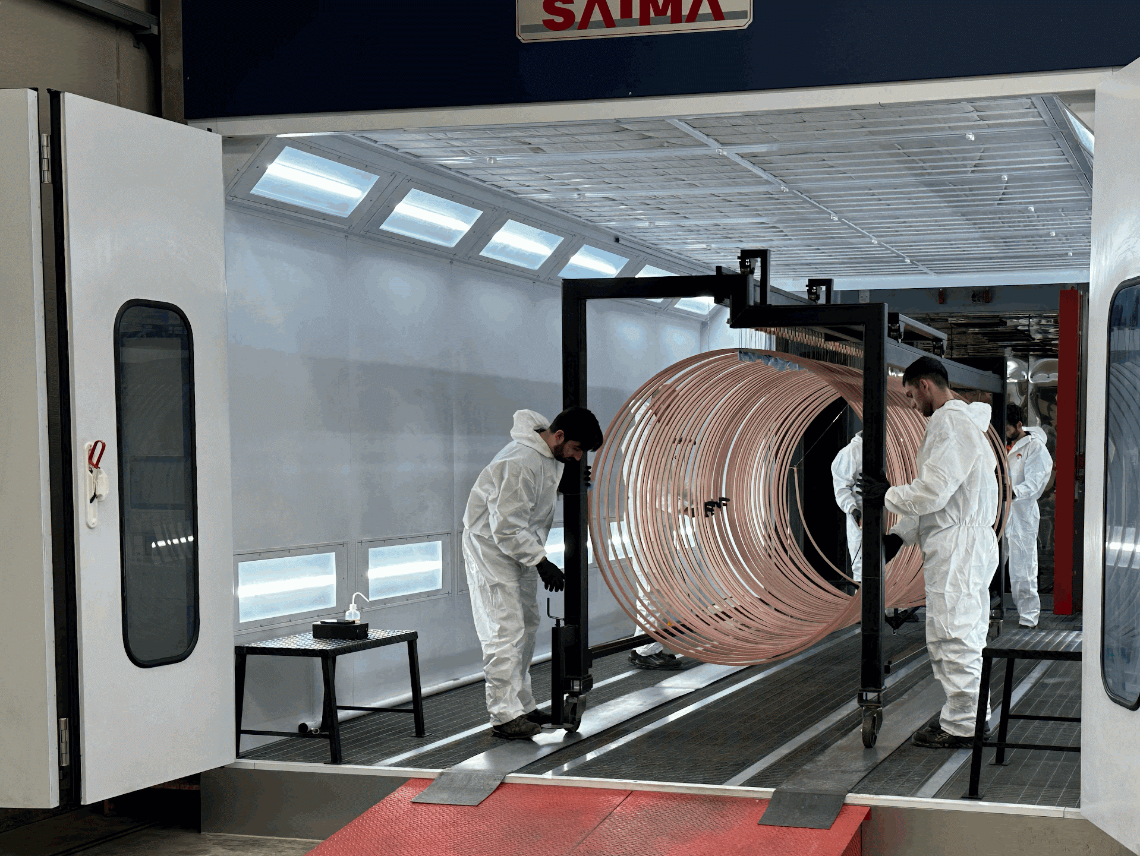
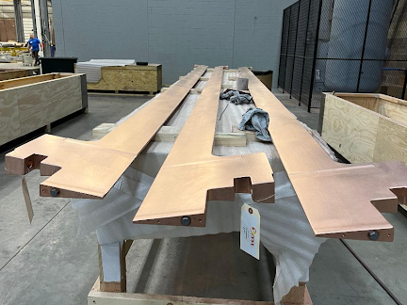
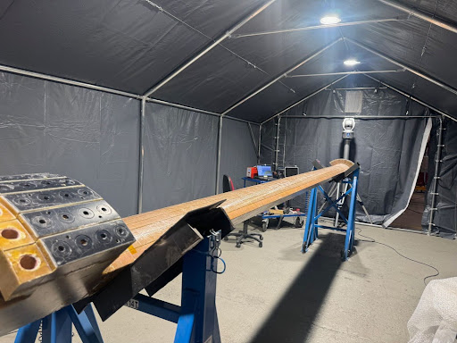
NSTX-U Recovery Project is progressing well
Project is 89% complete
Delivered all components for TF/OH magnet bundle
Successfully assembled first three TF quadrants
Prototype program has been successful in reducing fabrication risk
TF/OH magnet bundle delivery expected in Spring 2025
First plasma in early 2026

Slide 9
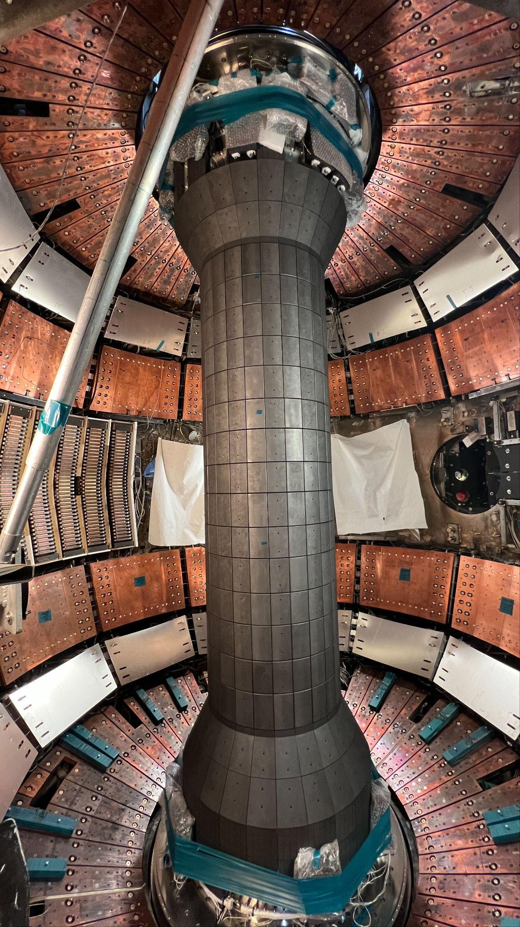
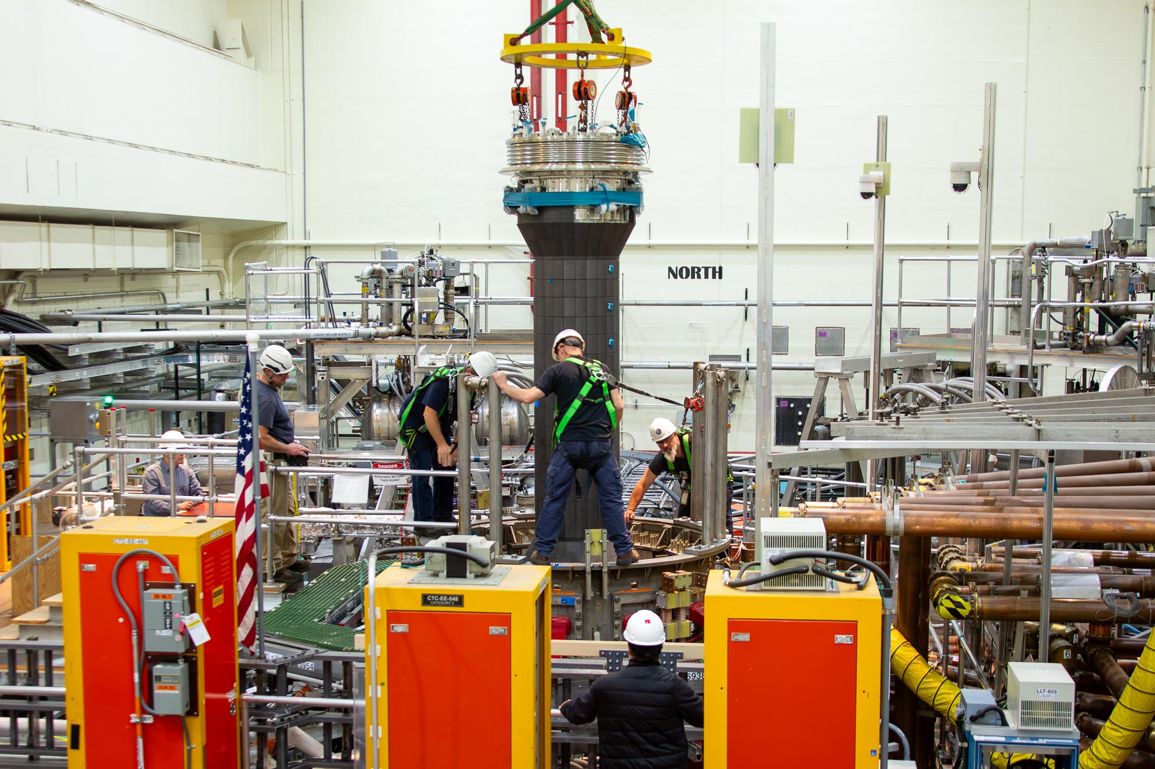
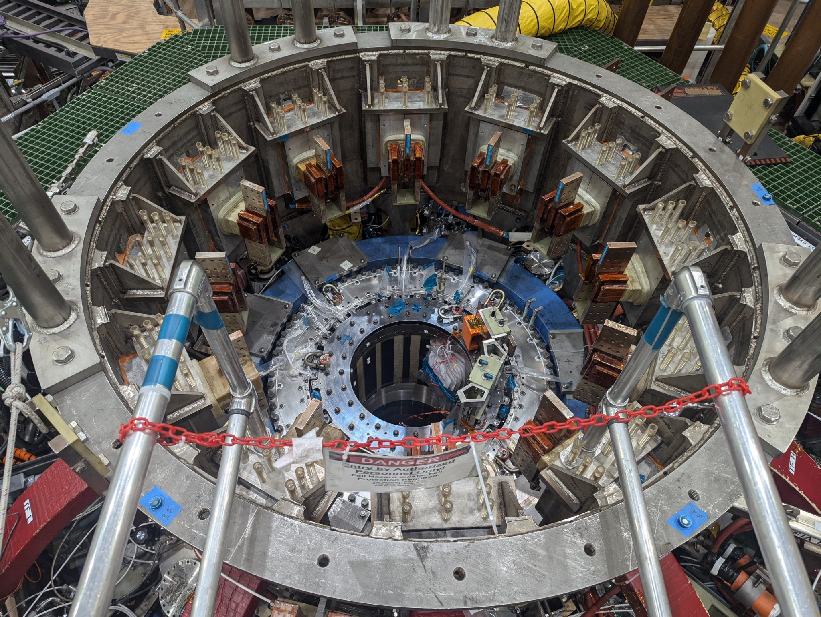
Fit-up of major equipment reduces risk
Successfully installed center stack casing into vessel; major interfaces confirmed
Vessel now has all magnets temporarily installed except for TF/OH being fabricated now
Demonstrated ability to achieve KPP#1
Moved additional Reassembly scope off critical path

Slide 10
NSTX-U/LMCE Timeline
2030 onwards designing and building the Spherical tokamak pilot plant.
2035-40 begin operation of ST pilot plant

Slide 11
The importance of predictive science
We will not have a fusion-burning Spherical Tokamak before the pilot plant. This is a risk, but it may be common to all MFE concepts.
The timeline is only valid if NSTX-U can do three things:
  Confirm scaling of favorable confinement to reactor conditions (we need full agreement with gyrokinetic simulation).
  Show that liquid metal exhaust system can handle >100MW/m² heat fluxes.
  Give reasonable confidence (i.e. scientific prediction) that alpha particles will be confined in a burning ST.

Slide 12
Thank you

Slide 13
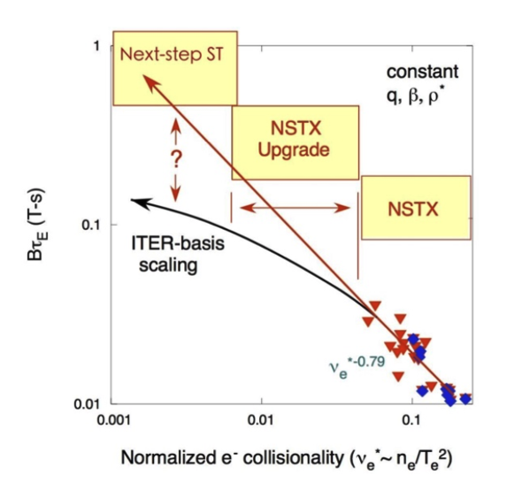
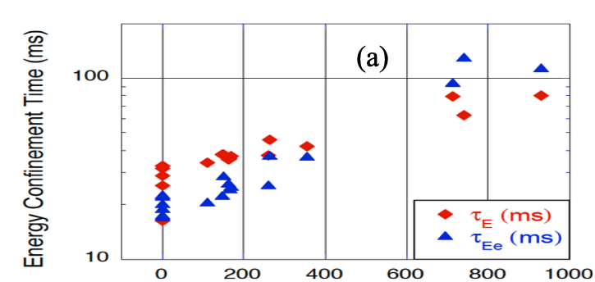
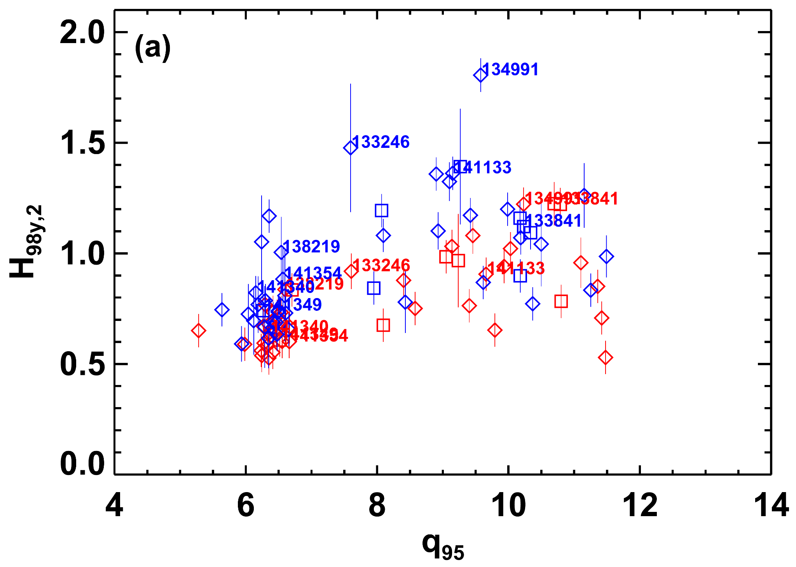
Lithium wall coatings in NSTX led to a marked increase in energy confinement – this is true on EAST and Li or Boron coatings be needed on ITER.
Li with Enhanced Pedestal H-mode
𝝱_{N}~6.5
5x increase in electron 𝞽_{E}
3x increase in total thermal 𝞽_{E}
Up to 1.8 H98y,2
Gerhardt et al., 2014
Maingi et al., 2011

