Slide 1

EPRI Fusion Energy Strategic Program
Fusion Energy: Progress, Challenges, and Promise
Diana Grandas, Lead Fusion Energy Research Analyst, EPRI
Fusion Power Associates Annual Meeting
December 2nd, 2025

Slide 2

EPRI: Born in a Blackout
Mission
Advancing safe, reliable, affordable, and
clean energy for society through global collaboration, science and technology innovation, and applied research
Who We Are
Independent, nonprofit center for collaborative public interest energy and environmental research
Global Presence
Major offices in Palo Alto, CA, Charlotte, NC, and Knoxville, TN. Laboratories in Knoxville, Charlotte and Lenox, MA. In-country presence around the world
International Membership
New York City: The Great Northeast Blackout, 1965
Over 40 countries participate in EPRI research, development, and demonstration activities

Slide 3
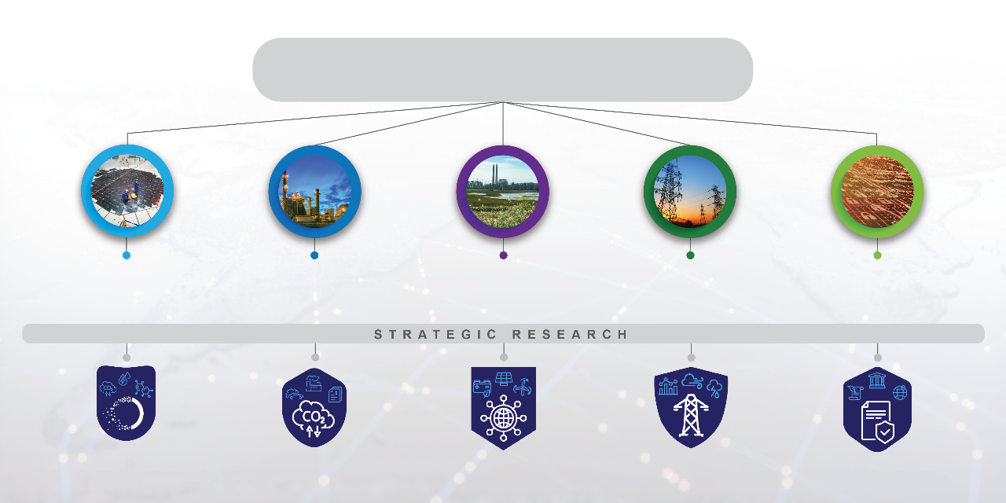
EPRI Research & Development Areas
TECHNOLOGY INNOVATION
Driving thought leadership, advanced R&D, and technology scouting and incubation to sustain a full pipeline of solutions
Nuclear Power
Energy Supply and Low-Carbon Resources
Electrification and Sustainable Energy Strategy
  Transmission and Distribution Infrastructure
Integrated Grid and Energy Services
Low-Carbon Resources
End-Use/
Economy-Wide Carbon Reduction
Electric System
Reliability/Resilience
Electric System
Flexibility
Market Transformation/
Policy/Regulatory Education
Notes:
EPRI has work ongoing across the entire energy landscape, including research programs in nuclear, all other types of energy generation and low carbon resources, and then the transmission, delivery and end use of energy, including research into integrated grids, electrification, and sustainability.
The vast majority of our research solves near term, year on year challenges, helping keep the lights on today. However, cutting across all our sectors is our work in technology innovation, looking 5, 10, 20 years down the line and preparing our members for needs and technologies of the future. We joke that this is the work that our members think we are crazy for looking at now, but in 5 years were very happy we started looking at it. It’s through this technology innovation function that EPRI’s fusion work is performed.

Slide 4


What will it take to commercialize fusion?
      TECHNOLOGIES THAT ARE:
        compelling → new attributes & capabilities
        mature → demonstration
        competitive → cost & value
      CUSTOMERS WHO:
        understand → information & engagement
        believe → evidence of performance
        need → business case
EPRI’s fusion portfolio targets technology development and transfer to end-users
Notes:
This one is decent. May not need anything.

Slide 5
Science, technology, & engineering gaps, deployment needs
Select science, technology, & engineering gaps:
Technology-agnostic R&D for deployment & operation:
Fusion fuel cycles
Fusion blanket development
Advanced materials & manufacturing, testing infrastructure
… in addition to plasma physics challenges
Safety assessments
Owner-operator requirements
Supply chain & workforce development
Grid integration
Community engagement, equity & environmental justice assessments

Slide 6

Value of utility/owner-operator requirements
Requirements reflect the needs and expectations of utilities and other owner-operators of a technology asset.
Answer the Key Question: What do utilities and other owner-operators want and need from fusion energy technologies to consider adoption of a fusion power plant as part of a future energy generation system?
With appropriate specificity, requirements provide unique benefit during early technology development stages to align technology attributes and customer needs
Notes:
What are requirements, why are they needed
Requirements: reflect the needs an expectations of utilities and owner-operators of a technology asset (in this case, fusion)
Fundamental Research Question: What do utilities and other owner-operators want and need from fusion energy technologies in order to consider adoption of a fusion power plant as part of a future energy generation infrastructure?
When defined with the appropriate level of specificity for the relevant stage of development (less specific for earlier maturity technology), they can be useful for accelerating deployment→ developers know what relevant targets their designs need to hit
Objectives of a Requirements Guide:
Set expectations and needs of prospective owner-operators, promoting alignment of technology attributes and customer needs

Slide 7
Fusion Commercialization Timeline & EPRI Roles
R&D
Demo/Pilot
Commercial
Now
2030+
2040+
Enabling
Technology
Evidence of
Performance
Priorities
Operation
Advanced materials and manufacturing
Safety assessments
Fuel cycle operating experience
Owner-operator requirements
Workforce development
Engineering and construction
Commissioning and initial operations
Operating experience
Energy system integration
Operations and maintenance
Inspection/NDE
Waste management
EPRI Roles
Notes:
What role can EPRI play in fusion commercialization? One way to answer this question is to look at the current timeline for commercialization and map R&D activities against those stages.
VALUE TO MEMBERS: understanding and supporting high risk, high reward energy generation technology early in maturity. To do this, much of the engagement is with the developer community. But the ultimate goal is a commercial technology that utilities and other end-users can procure and operate.
The National Academy of Sciences, Engineering, and Medicine defines a successful pilot plant as demonstrating:
Net electricity gain > 1
Peak net electrical power ≥ 50 megawatts
At the lowest possible capital cost

Slide 8
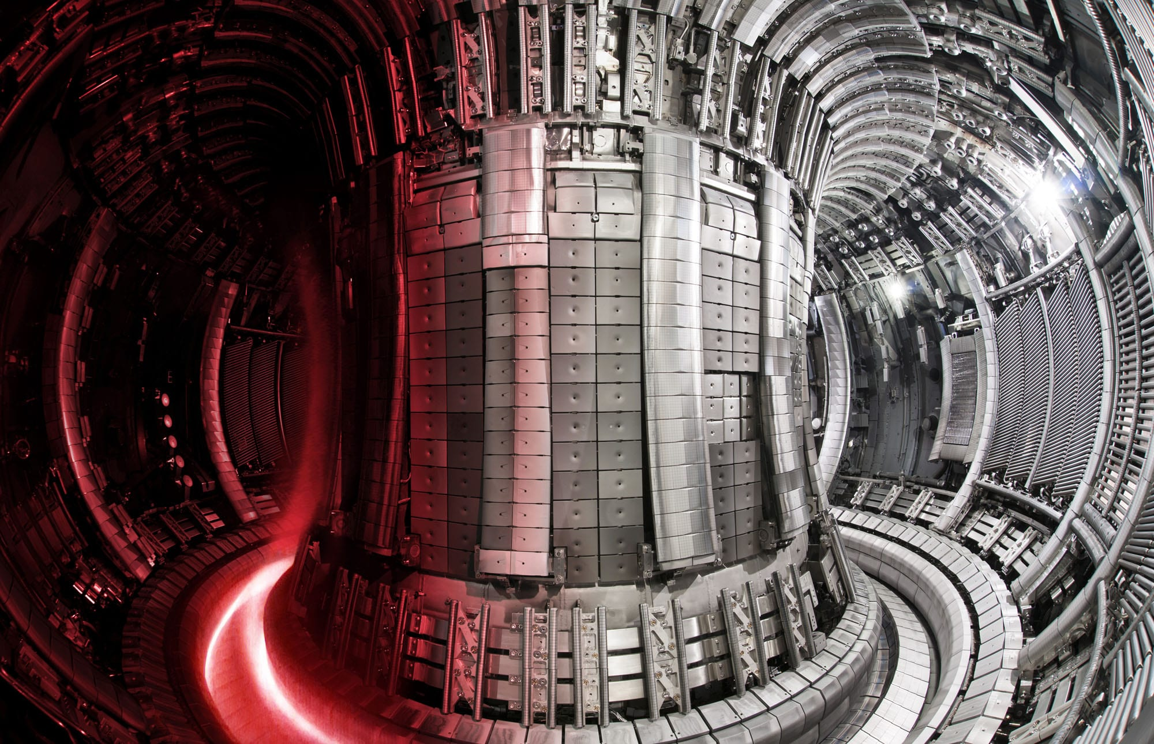
EPRI Fusion Energy Strategic Program: Objectives
Support and enable fusion commercialization
Inform EPRI and its members on technology, challenges, opportunities (prepare for the future)
Generate publicly available R&D products and resources
Target broadest benefit for stakeholders, including the fusion community, EPRI members, regulators, and decision-makers
Tailored projects can/will be pursued outside of this internally sponsored program (e.g., EPRI “supplemental” projects)

Slide 9



EPRI Fusion Energy Strategic Program: Priorities
EPRI Fusion Forum
Scouting reports
Briefings to industry advisors
Informing EPRI community about state of fusion technology
Engaging the fusion community and relevant stakeholders
EPRI Fusion Forum
Workshop and conferences
FIA, FPA, and other fusion community orgs
Control
Identifying research gaps on pathway to commercialization
EPRI fusion R&D portfolio
External funding opportunities
Collaborations

Slide 10
Ongoing Projects
Non-destructive Examination for Fusion Energy Technologies
Fusion Materials Gap Analysis
ASME Sec. III Div 4 Code Development
Safety-in-Design for fusion – methodology body of knowledge
Safety-in-Design demonstration/pilot for fusion application(s)
Revisiting EPRI Utility Requirements for Fusion (from 1982)
Role of Fusion in Future Energy Markets
Fusion Industry Scouting
Tritium Operating Experience (DOE INFUSE Award with SRNL)
Advanced
Materials and Manufacturing
Safety Assessment
Owner-Operator
Requirements
Technology and Performance Assessment
Notes:
What specifically is EPRI doing? Near-term plan reflecting EPRI’s core strengths, fusion industry interest/needs, and opportunities.

