Slide 1
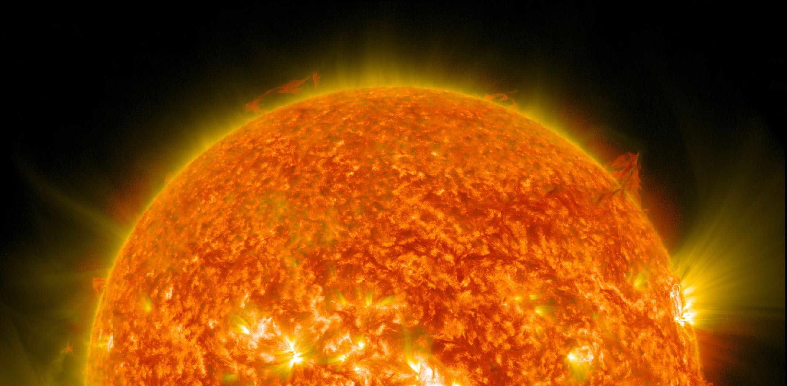

Cary Forest | CSO
cary@realtafusion.com
December 2-3, 2024 | FPA | Washington, D.C.

Slide 2
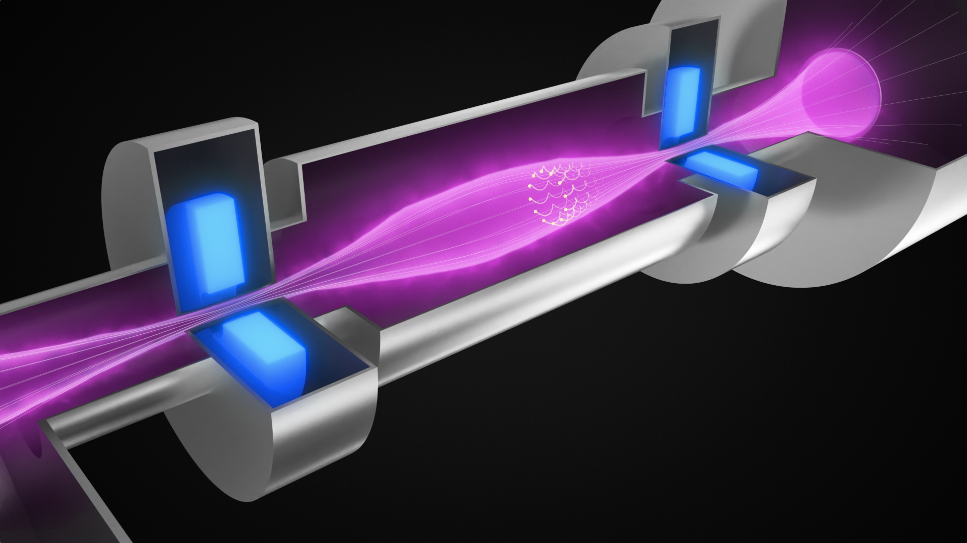
We are advancing the axisymmetric magnetic mirror fusion concept
HTS planar magnets B_{m} ~25 T
B₀
Confinement improves with higher mirror ratio $R_{m}=B_{m}/B_{o}$
Axial difference in magnetic field $B_{m}>B_{0}$ generates mirror force to confine charged particles
C.B. Forest | Realta Fusion | FPA

Slide 3
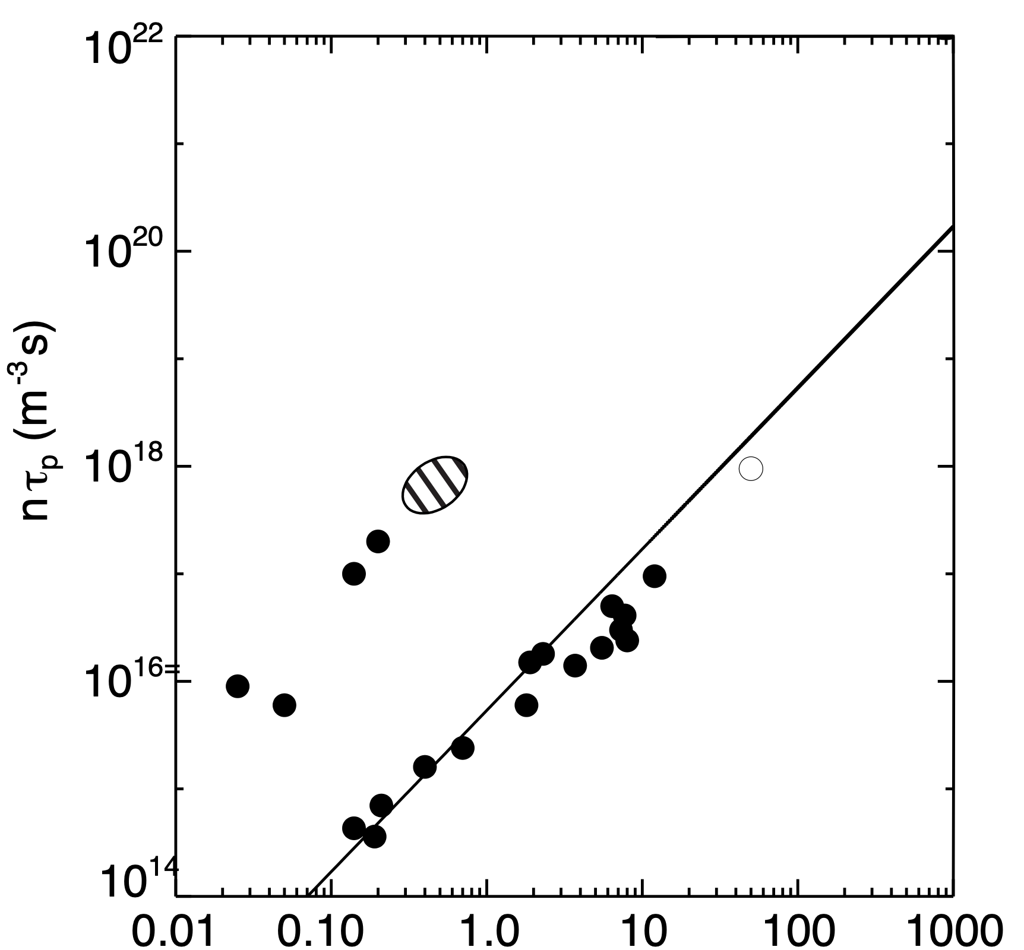
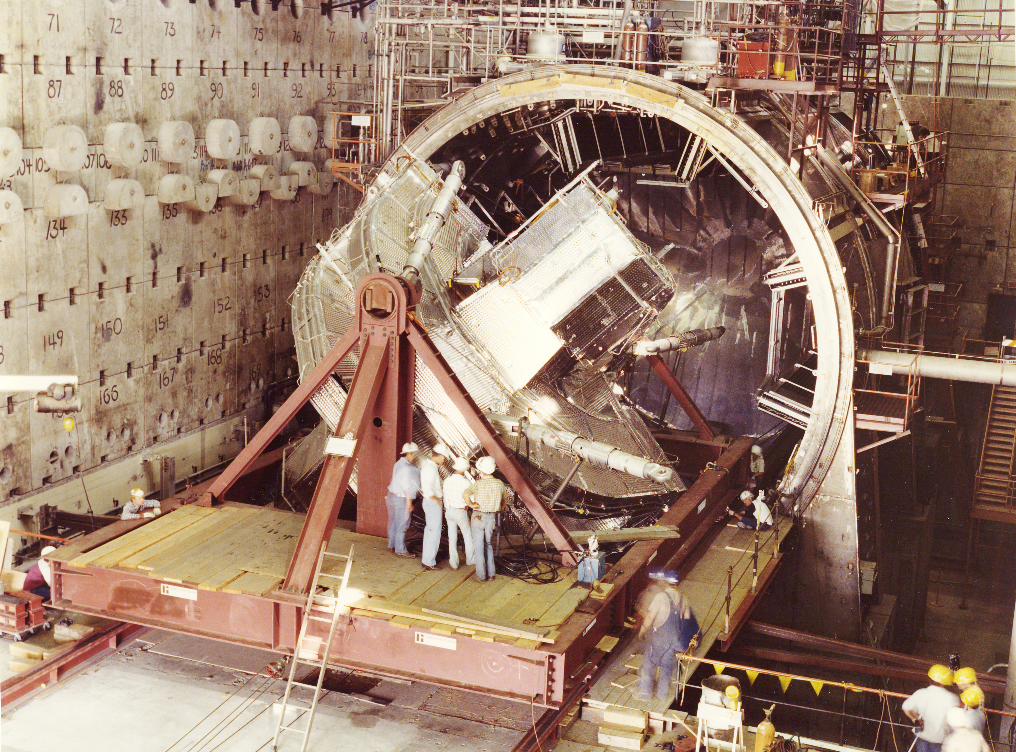
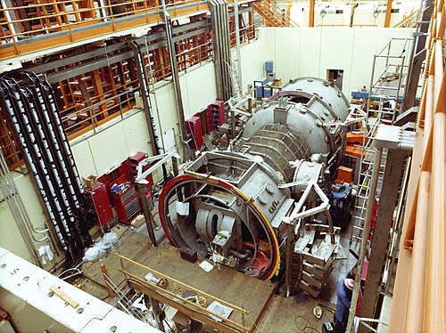
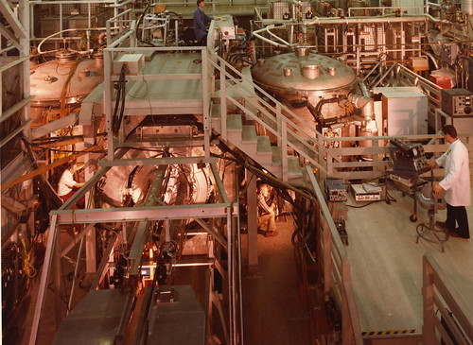
Brief History of US Mirror Confinement up to 1986
MFTF-B Tandem
Breakeven
Lawson Diagram
Tandem Confinement
TMX-U
1982
Rm=2
MFTF
MFTF
1986
2XIIB 1976
beta =1 , 10 keV
$$n_{20}τ_{p}=\text{0.25}E_{b,100\text{keV}}^{3/2}\log_{10}R_{M}\text{sec}$$
2XIIB
1976
BB1
1969
$$E_{i}(keV)$$

Slide 4
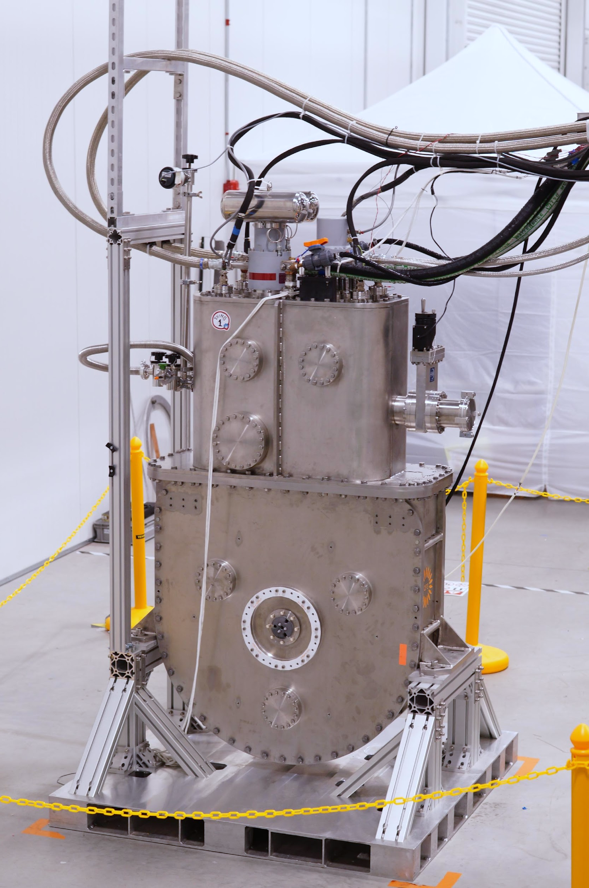
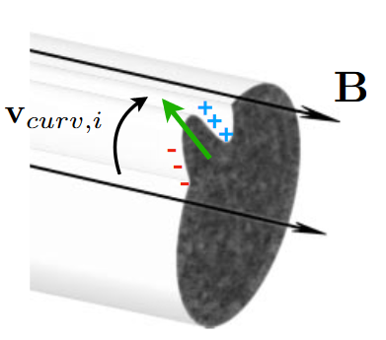

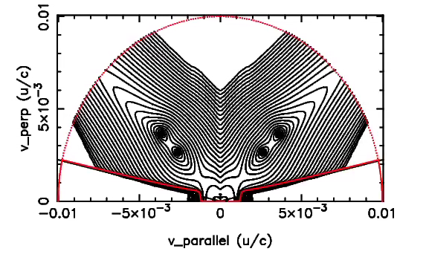
New advances in technology, computational capability and physics understanding are reinvigorating the magnetic mirror fusion concept
17 T WHAM Coil
$$i+$$
RF Energization
$${u_{⊥}}/c$$
NBI Source
$${u_{∥}}/c$$
Advanced Stabilization
Axisymmetric mirrors $R_{m}\sim 10$ possible
HTS
~ 2x field possible from previous technology
Advanced heating systems
Modern NBI, ECH, and ICRH systems.
C.B. Forest | Realta Fusion | FPA
Notes:
Find more attractive advanced stabilization photo eventually

Slide 5
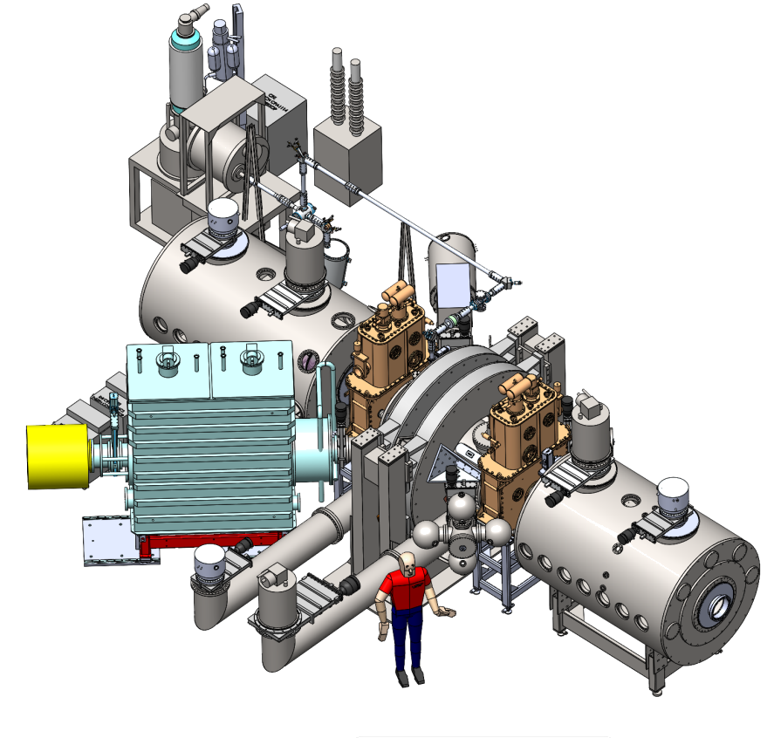
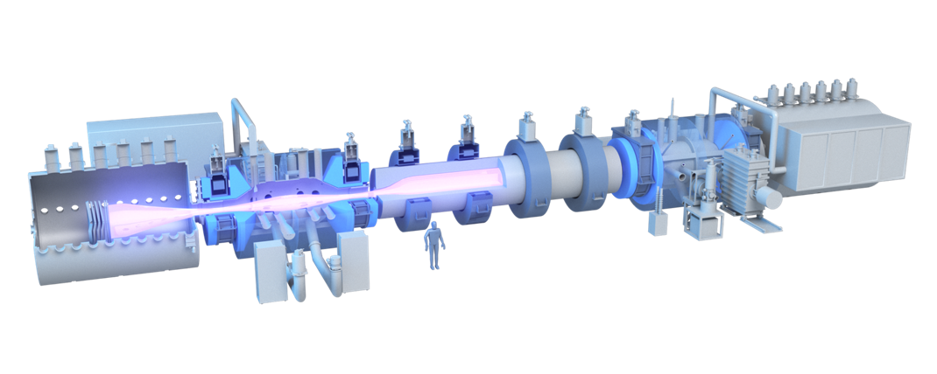
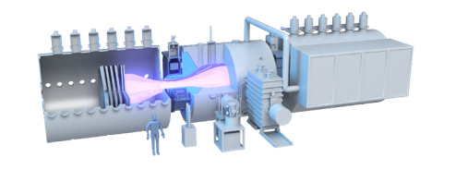



Realta Fusion’s FPP* roadmap
Experiment: WHAM
De-risk technology & validate physics
CFS-built HTS magnets
NBI, ECH, ICRH
Prototype: Anvil
Demonstrate long pulse plasma at HAMMiR End-Plug conditions and fusion power plant nuclear technology at scale
Can be optimized for DT neutron yield for a VNS-like device
Commercialization:
Hammir (FPP)
Axisymmetric tandem magnetic mirror
Fully integrated net-energy generator demonstration
* FPP = Fusion Pilot Plant
D. Endrizzi et al., “Physics basis for the Wisconsin HTS Axisymmetric Mirror (WHAM),” Journal of Plasma Physics, vol. 89, no. 5, p. 975890501, 2023. https://doi.org/10.1017/S0022377823000806
C. B. Forest et al., “Prospects for a high-field, compact break-even axisymmetric mirror (BEAM) and applications,” Journal of Plasma Physics, vol. 90, no. 1, p. 975900101, 2024. https://doi.org/10.1017/S0022377823001290
C.B. Forest | Realta Fusion | FPA
Notes:
Cary
First version of Beam 100 keV NBI ; HAMMiR endplug would use RF and approach MeV energies

Slide 6
Hammir makes use of Anvil end plugs to construct an axisymmetric tandem mirror configuration for FPP
End Plugs
Strongly Driven By RF, NBI, Non-Maxwellian Plasma
4x planar ~ 25 T HTS magnets
Full-scale demonstrate with ANVIL simple axisymmetric mirror
Central Cell
Maxwellian plasma with high-gain fusion plasma conditions, low-field magnets, scalable in length to change power output
D.A. Sutherland | Realta Fusion | EPRI Fusion Forum
Notes:
Cary
First version of Beam 100 keV NBI ; HAMMiR endplug would use RF and approach MeV energies
HAMMiR – High-Field Axisymmetric Magnetic Mirror Reactor

Slide 7

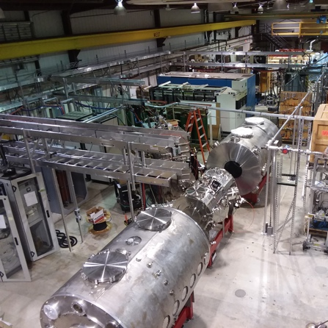


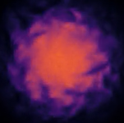

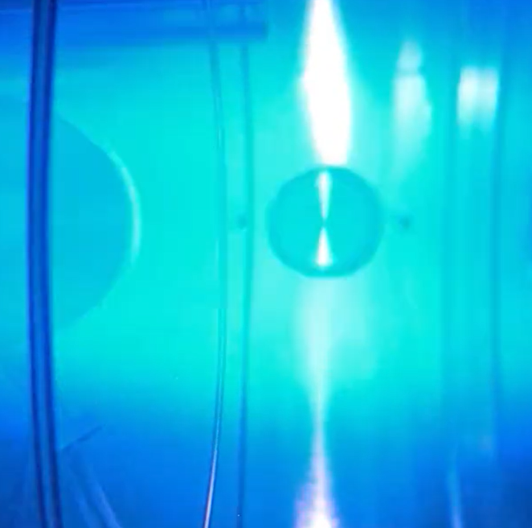

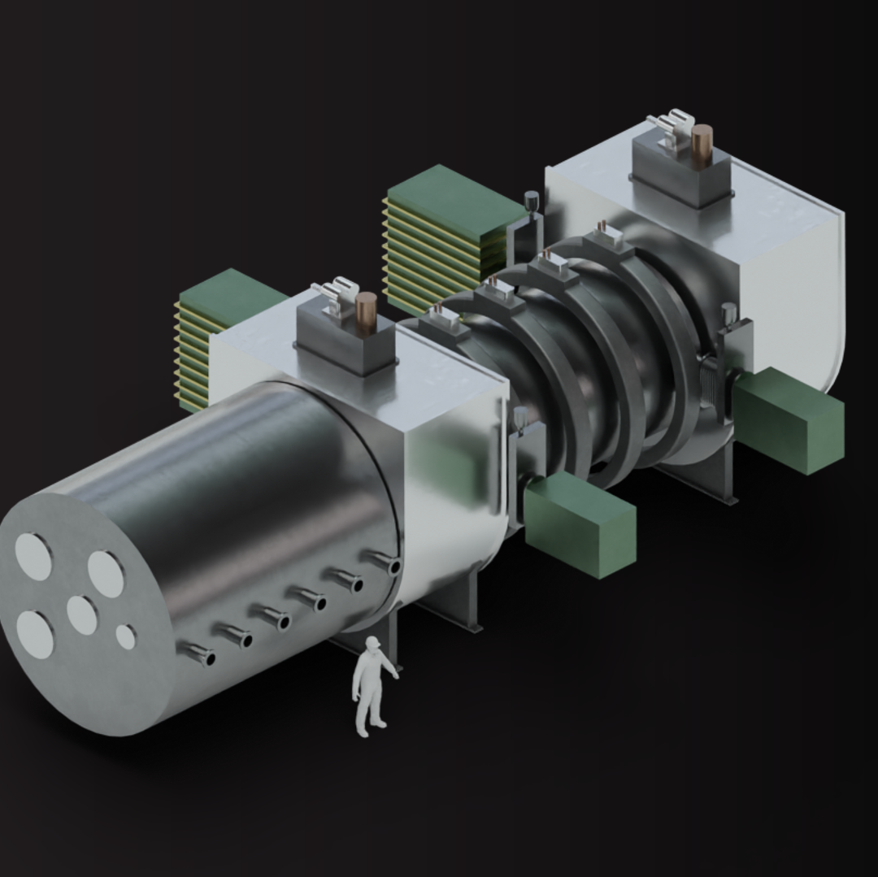
October 2020
September 2022
$10M ARPA-E funded project, WHAM
(Wisconsin HTS Axisymmetric Mirror)
Spin-out company established
timeline
May 2024
May 2023
Develops RealTwinTM
plasma simulator
(hosted on AWS)
Seed round led by Khosla Ventures
June 2024
July 2024
U.S. Dept. of Energy Milestone contract
World-record breaking first WHAM plasma: 17 Tesla
mid 2030s
2029
Commercial energy production
Decarbonizing heavy industry
Anvil: proof at scale
(volumetric neutron source)

Slide 8
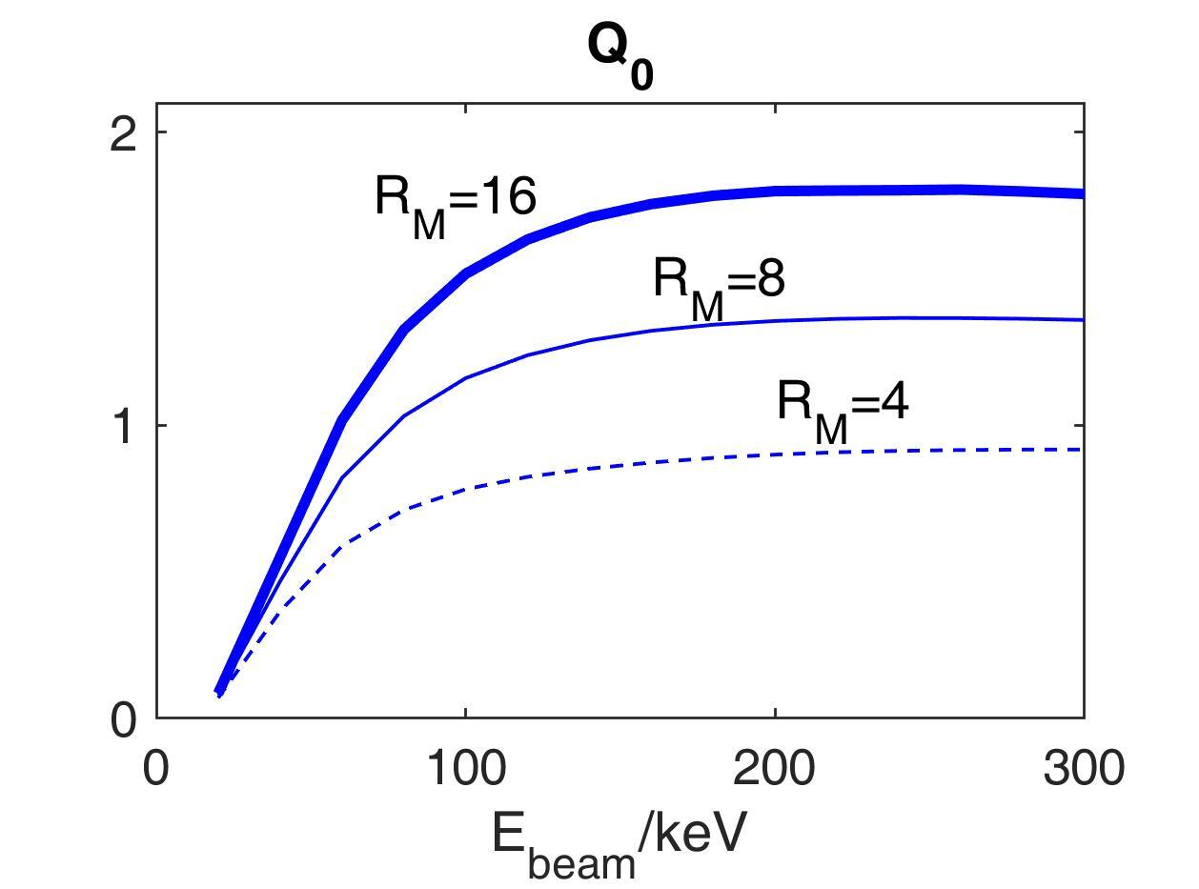
Revisit the classical simple mirror with higher mirror ratio and high field magnets using modern modeling
Classical Mirror confinement
For NBI fueled plasma
For DT Fusion
Fusion gain is independent of size or B
$$τ_{p}=0.25\frac{E_{b,100keV}^{3/2}}{n_{20}}\log_{10}R_{M}\text{sec}$$
$$P_{nbi}=I_{b}E_{b}=\frac{enV}{τ_{P}}E_{b}∼\frac{{10}^{20}}{3}\frac{n_{20}^{2}}{E_{b,100keV}^{1/2}\log_{10}R_{M}}V\frac{MeV}{sec}$$
$$P_{fus}=\frac{1}{4}⟨σv⟩n^{2}E_{fusion}V∼5×{10}^{19}n_{20}^{2}V\frac{MeV}{sec}\text{for}E_{fusion}\text{=22.4 MeV and}T_{i}∼\text{100 keV}$$
Egedal, J., Endrizzi, D., Forest, C. B. & Fowler, T. K. Fusion by beam ions in a low collisionality, high mirror ratio magnetic mirror. Nucl Fusion 62, 126053 (2022).
$$Q≡\frac{P_{fusion}}{P_{nbi}}∝⟨σv⟩E_{b}^{1/2}\log_{10}R_{M}∼1.3E_{b,100keV}^{1/2}\log_{10}R_{M}$$

Slide 9
What sets minimum size for a beam-heated breakeven-class experiment at RM=10?
Interchange/ballooning beta limit sets density:
$n_{20}=β_{c}B_{0}^{2}/3E_{b,100\text{keV}},β_{c}∼0.3$
neutral beam shine through sets plasma radius:
$n_{20}a_{0}≥0.42E_{b,100\text{keV}}^{1/2}$
Kinetic Stability (DCLC) sets normalized plasma size:
$$\frac{a_{0}}{ρ_{i}}≡N_{ρ}≈25\frac{a_{0}B_{0}}{\sqrt{E_{b,100keV}}}>25$$
FLR stabilization sets plasma length:
$L>12.5a_{0}^{2}B_{0}≈10\frac{E_{b,100\text{keV}}^{3}}{β_{c}^{2}B_{0}^{3}}\text{m}$
Unique solution from 1-3:
$$B_{0}≳\frac{E_{i,100keV}}{N_{25}β_{c}}\text{Tesla},a_{0}=1.4\frac{β_{c}N_{25}^{2}}{\sqrt{E_{b,100keV}}}\text{meters}$$
Eb | 100 keV
beta | 0.3
B0 | 3 T
a0 | 0.3 m
n20 | 0.9
L | 4 m
Nrho | 25
Pnbi | 7 MW
J. Plasma Phys. (2024), vol. 90, 975900101, 2024.
Published by Cambridge University Press
doi:10.1017/S0022377823001290
Prospects for a high-field, compact break-even
axisymmetric mirror (BEAM) and applications
C.B. Forest 1, J.K. Anderson1, D. Endrizzi 2, J. Egedal 1, S. Frank 2,
K. Furlong2, M. Ialovega1, J. Kirch1, R.W. Harvey3, B. Lindley1,
Yu.V. Petrov3, J. Pizzo1, T. Qian 4, K. Sanwalka1, O. Schmitz1, J.Wallace1, D. Yakovlev1 and M. Yu1,†

Slide 10
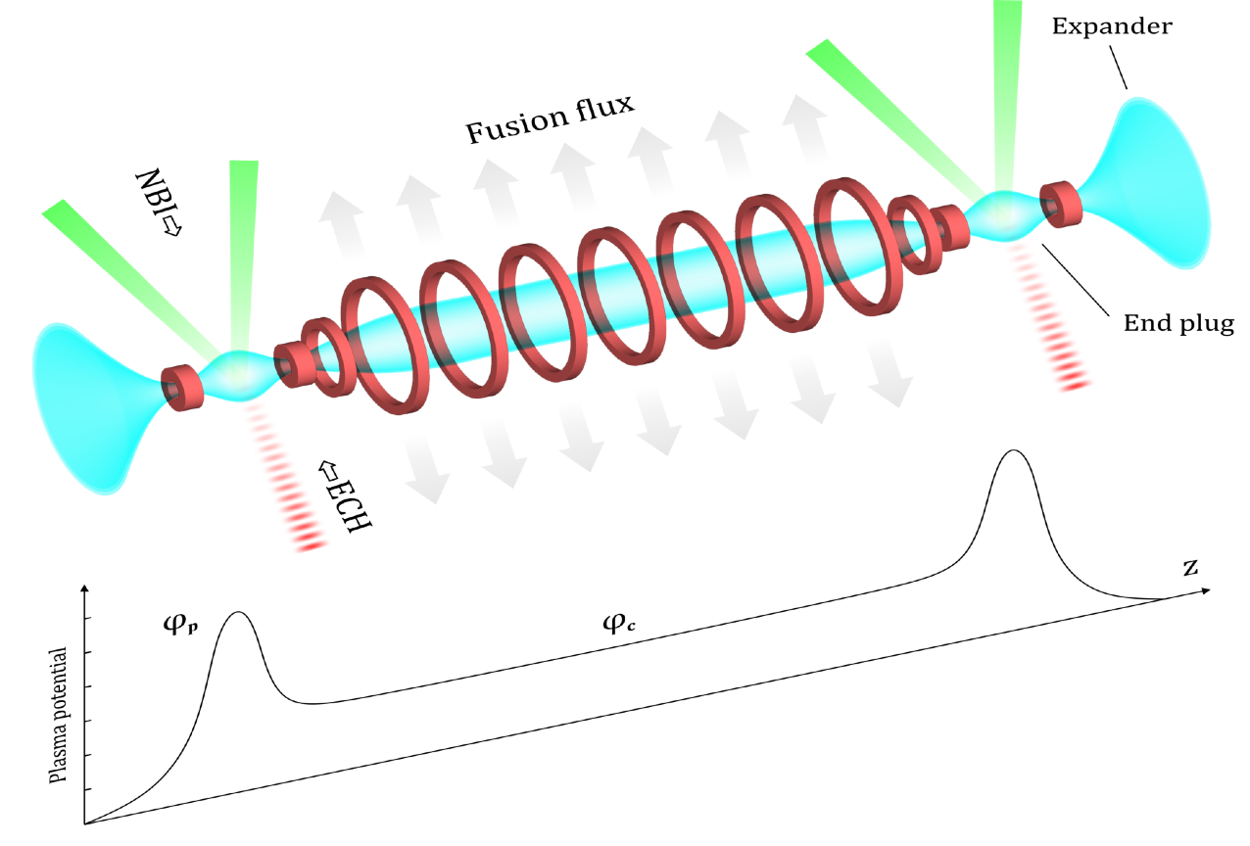
Compact, high field mirror leads to attractive Tandem Mirror Designs
axisymmetric classical tandem mirror
(no thermal barriers)
Tandem Mirror POPCON
Submitted to J. Plasma Phys. (2024)
Published by Cambridge University Press
arXiv preprint ar.Xiv:2411.06644. 2024 Nov 11.
Integrated modelling of equilibrium and transport in axisymmetric magnetic mirror fusion devices
S. J. Frank, J. Viola, Yu. V. Petrov, J. K. Anderson, D. Bindl, B. Biswas, J. Caneses, D. Endrizzi, K. Furlong, R. W. Harvey, C. M. Jacobson, B. Lindley, E. Marriott, O. Schmitz, K. Shih, C. B. Forest
A new simpler way to obtain high fusion power gain in tandem mirrors, Fowler, T. K., Moir, R. W. & Simonen, T. C.. Nucl Fusion 57, 056014 (2017).
C.B. Forest | Realta Fusion | FPA

Slide 11
Scaling the simple and tandem axisymmetric mirror to high performance plasma conditions
MFTF-B Tandem
HAMMiR
ANVIL
Tandem Confinement
MFTF
1986
WHAM
TMX-U
1982
$$R_{m}=10$$
2XIIB
1976
$$E_{i}(keV)$$
C.B. Forest | Realta Fusion | FPA

Slide 12

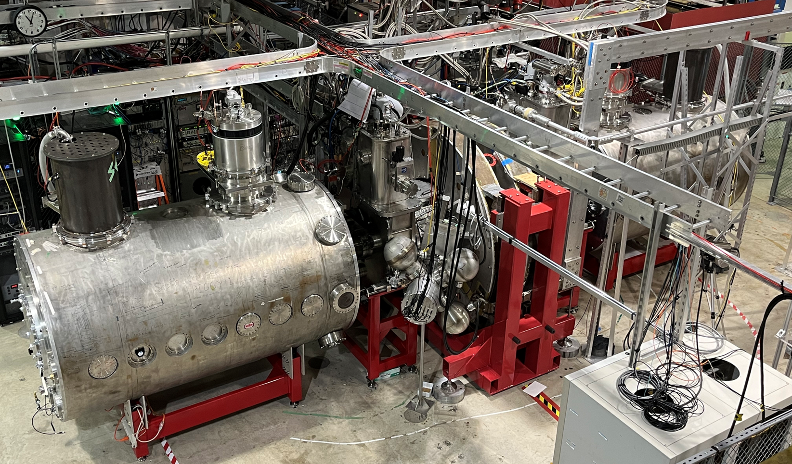
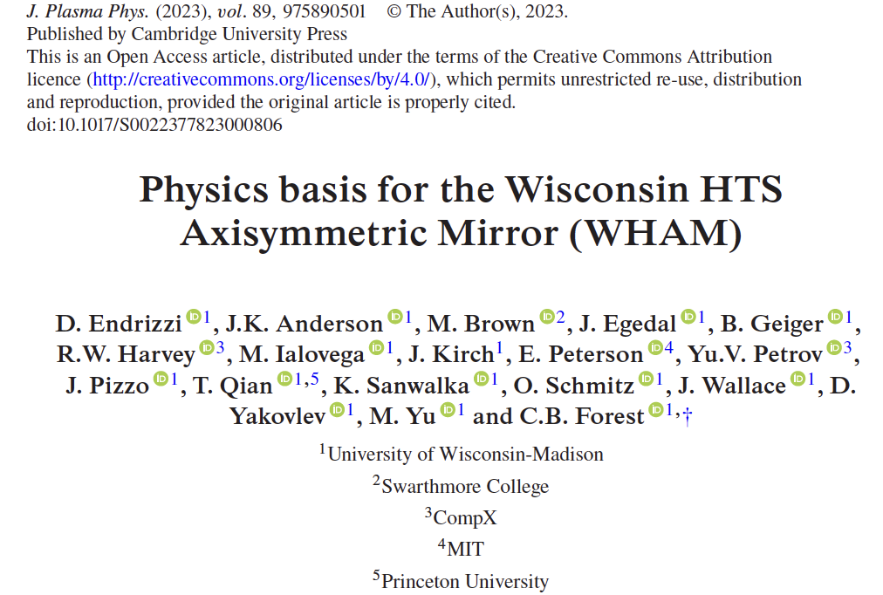
WHAM is newly operational and addressing MHD stability and mirror confinement

Slide 13
Phased WHAM Project Approach
System | Phase 1 (2024) | Phase 2 (2025)
Mirror coils | 17.05 T | 17.05 T
End-ring biasing (stability) | 2 MW bipolar waveforms
NBI | ~24 kV, <800 kW, 20 msec
RF: fast wave |  | 4 – 30 MHz, < 1 MW
ECH | 110 GHz, <600 kW, 20 msec
Vacuum | <2,000 L/s turbos / cryos | >100,000 L/s Ti, Ta gettering
Central field | < 0.3 T, R ~ 50 – 70 | 0.3 – 0.9 T, R = 20-50
WHAM is a $≥$ $20M machine built on $10M budget.
State-of-the-art HTS mirror coils + a lot of surplus equipment
C.B. Forest | Realta Fusion | FPA

Slide 14









Diverse Sourcing of Components on WHAM
System | Phase 1 2024 | Phase 2 2025
Mirror coils | 17.05 T | 17.05 T
End-ring biasing (stability) | 2 MW bipolar waveforms
NBI | ~24 kV, <800 kW, 20 msec
RF: fast wave |  | 4 – 30 MHz, < 1 MW
ECH | 110 GHz, <600 kW, 20 msec
Vacuum | <2,000 L/s turbos / cryos | >100,000 L/s Ti, Ta gettering
Central field | < 0.3 T, R ~ 50 – 70 | 0.3 – 0.9 T, R = 20-50
Archimedes transmitter via
C.B. Forest | Realta Fusion | FPA

Slide 15

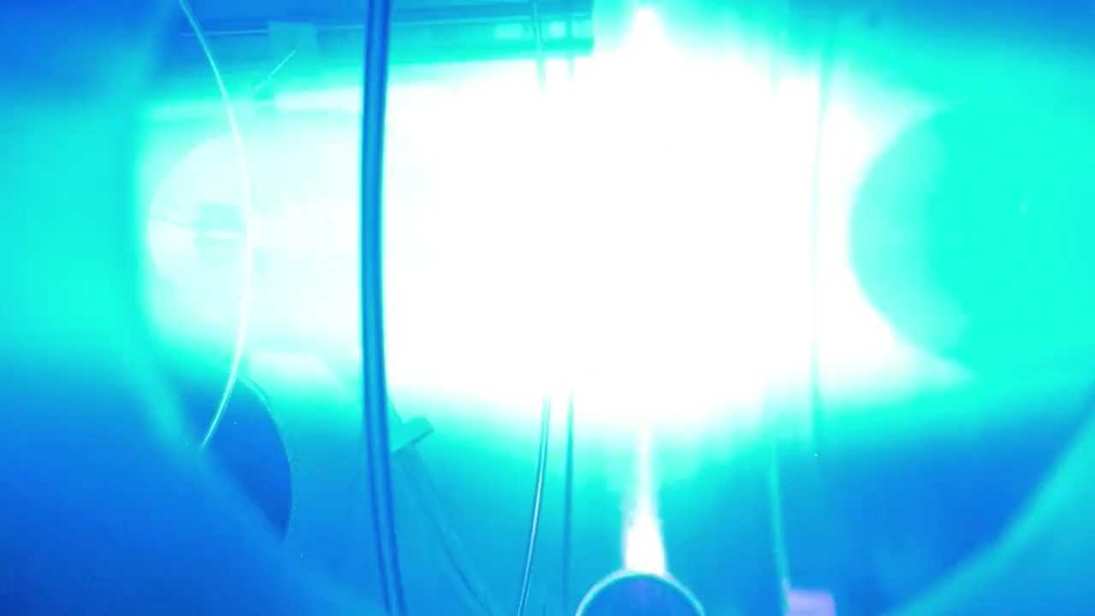



Results from the first experimental campaign on WHAM
Cary Forest, Jay K. Anderson¹, Oscar Anderson¹, Ted Biewer³, Dominick Bindl², Bodhi Biswas², Mike Brown⁴, Mike Clark¹, Elliot Claveau², Jan Egedal¹, Doug Endrizzi², Sam Frank², Kiesuke Fujii³, Kieran Furlong², Mykola Ialovega¹, Jeremiah Kirch¹, Grant Kristofek⁵, Spencer Kwan¹, Xavier Navarro-Gonzalez¹, Ben Lindley², Ed Marriott², Vladimir Mirnov¹, Bob Mumgaard⁵, Solomon Murdock¹, Everett Penne¹, Jon Pizzo¹, Steve Oliva¹, Tony Qian¹, Kunal Sanwalka¹, Oliver Schmitz¹, Kai Shih², Mary Severson¹, Benjamin Terranova¹, Aaron Tran¹, Jesse Viola², John Wallace¹, Dmitry Yakovlev¹, Mason Yu¹
1 University of Wisconsin-Madison
2 Realta Fusion
3 Oak Ridge National Lab
4 Swarthmore College
5 Commonwealth Fusion Systems
WHAM plasma 7/15/24
Photo credit: Mason Yu
66th APS DPP 10/11/24

Slide 16

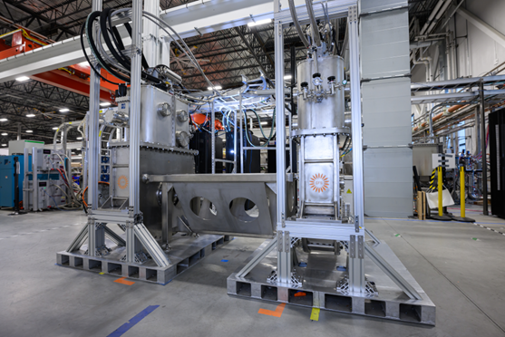
CFS delivers HTS magnets
Specifications – NINT magnet design operates continuously in DC mode with conduction cooling (liquid cryogen-free)
mass: 1500 kg height: 2.1 m width: 1.2 m
bore diameter: 55 mm bore length: 310 mm length
axial load limit: 63 tons
Record field (MCF) – 17 T on axis (on plasma)
Continuous operation – 1st campaign upon commissioning lasted 82 days and maintained full field for 78 days, both magnets landed safely at end of campaign
Turnkey magnets – CFS delivered a complete package of self-contained systems with all necessary functions to operate magnets “out of the box”, each including:
Low infrastructure – operation only requires electrical power, cooling water, data
Fast installation – installed on day 1, pumping down on day 2, cooling on day 3, and first plasma 2 weeks after delivery
Above: Dual magnet qualification testing at CFS-1, Devens, MA
Performance Parameter [unit] | Design target | Measured performance
Field on axis [T] | 17 | 17.05
Peak field on winding pack [T] | 20 | *
Stored Energy (per magnet) [MJ] | 3.2 | *
Engineering current density [A/mm²] | 178 | *
Operating temperature (1st stage) [K] | 60 | 47.7
Operating temperature (2nd stage) [K] | 20 | 11.0
Operating current [A] | 2000 | 1727
Winding pack power (at full current) [W] | * | 1.1
Estimated heat load to 1st stage [W] | 180 | 167
Winding pack
Cryostat
Power supply
Cryogenics
Vacuum system
Instrumentation & Controls
Operational and monitoring software
All customer facilities interfaces
* Parameter not predicted or measurable

Slide 17
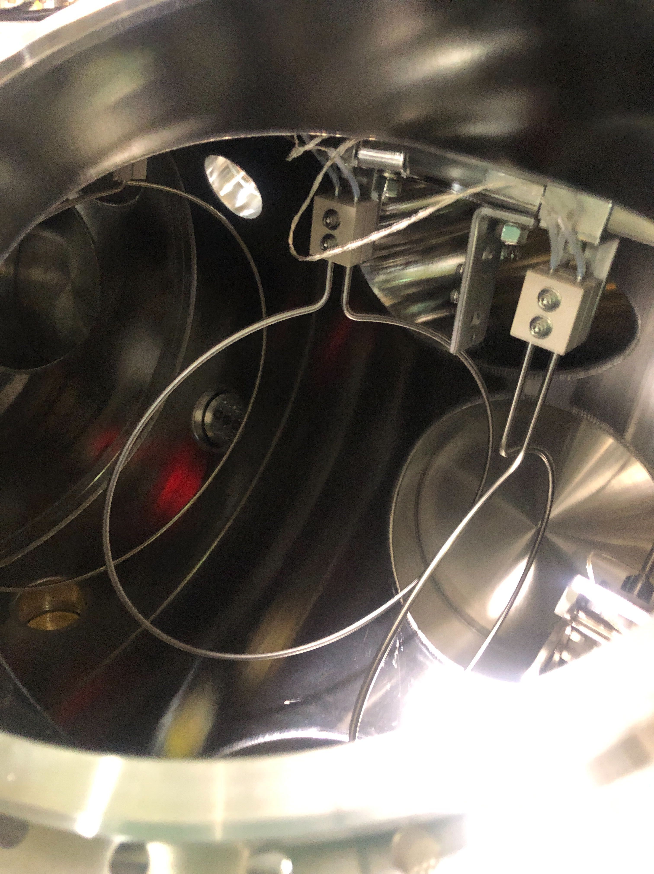
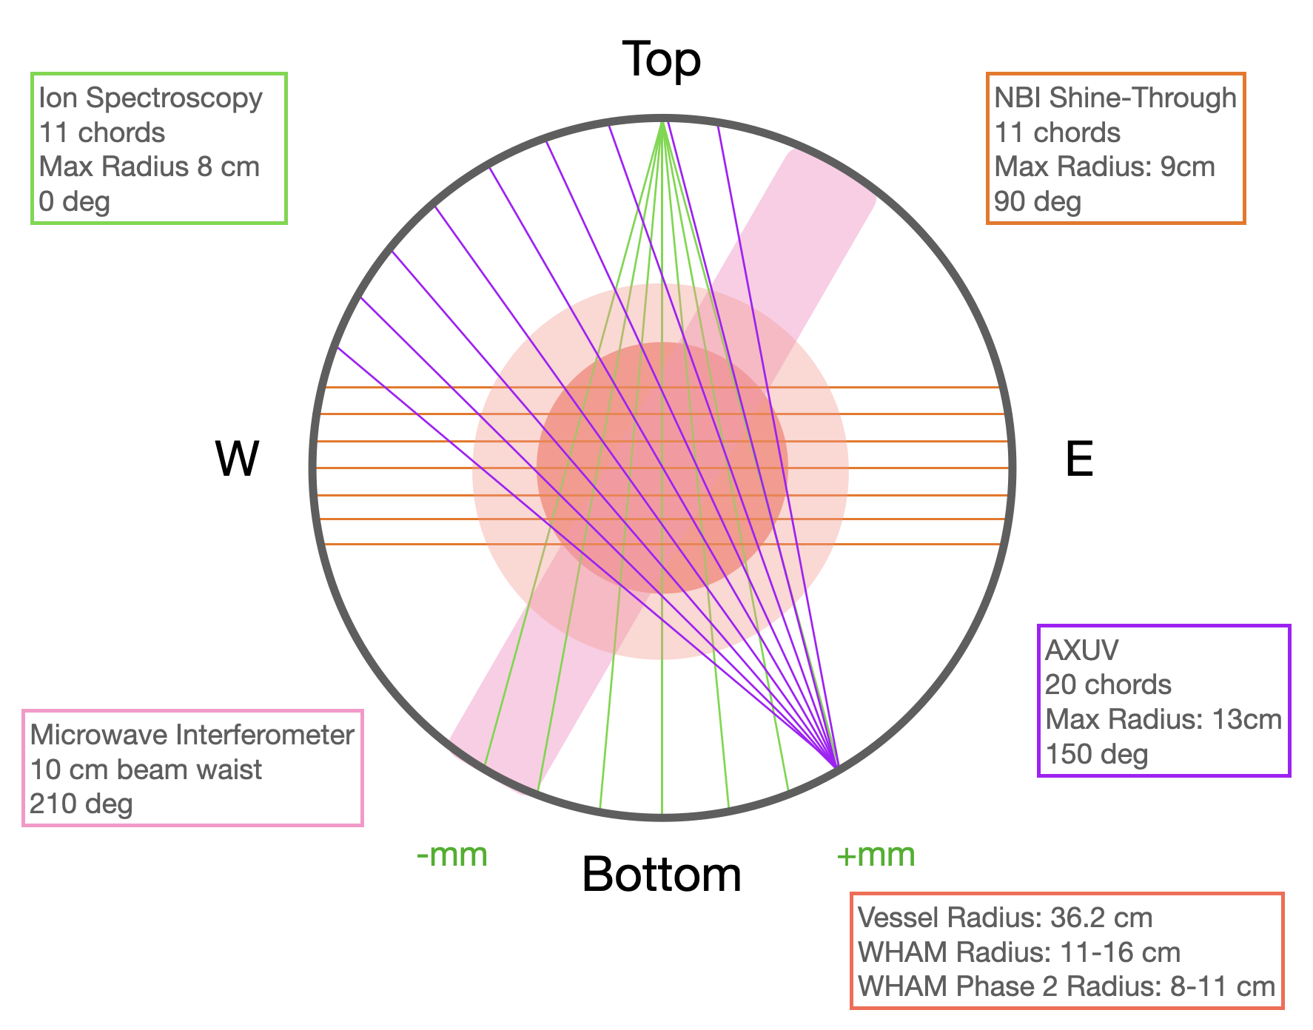
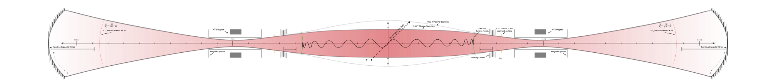


Key diagnostics for equilibrium, fluctuations
Flux loops
Fast visible camera
mm wave
Phantom Fast Camera
40-150k frames per second
319 GHz Interferometer
Z=0, single-chord
NBI Shine-Through array
11+4 chord Secondary Emission Detectors
ECH Split-Waveguide
Edge Fluctuation Ring
Z = 57.1 cm
R = 5.7 cm
Fast ion turning point
R_{m}=2, 1.72 T, 13.6 MHz
ICRF Resonance
4T 110 GHz
ECH Resonance
4T 110 GHz
ECH Resonance
Foil bolometers
Adjustable Mirror
11-chord Ion doppler spectrometer
20-chord AXUV photodiode
Z=0
Flux Loop 1
Z = 7.8 cm
R = 25 cm
Flux Loop 2
Z = 33.0 cm
R = 20 cm
Flux Loop 3
Z = 52.2 cm
R = 15 cm
Travelling Limiter
R = 3.425 cm
Z = (69.8, 78.8) cm

Slide 18
WHAM research mission derisks MHD instabilities, probes microstability
Step 3:
Suppress low m MHD instabilities via biasing or other techniques.
Step 4:
Performance extension
Step 1:
Observe, identify, probe MHD instabilities.
Step 2:
limit neutrals CX to confine fast ions from NBI. Expect FLR stabilization of high m at modest fast ion concentration.
Achieve collisionless regime
Explore μstability limits of loss-cone ion distribution
Study effect of rf
Ponderomotive stabilization
Enhanced plugging
Rapid iteration with,
validation of,
RealTwinTM models
Jan | Feb | Mar | Apr | May | Jun | Jul | Aug | Sep | Oct | Nov | Dec | Jan | Feb | Mar | Apr | May | Jun | Jul | Aug | Sep | Oct | Nov | Dec | Jan | Feb | Mar | Apr | May | Jun | Jul | Aug | Sep | Oct | Nov | Dec
2024 |  |  |  |  |  |  |  |  |  |  |  | 2025 |  |  |  |  |  |  |  |  |  |  |  | 2026
Jan | Feb | Mar | Apr | May | Jun | Jul | Aug | Sep | Oct | Nov | Dec | Jan | Feb | Mar | Apr | May | Jun | Jul | Aug | Sep | Oct | Nov | Dec | Jan | Feb | Mar | Apr | May | Jun | Jul | Aug | Sep | Oct | Nov | Dec
>100
plasma shots/day
construction
commissioning
early MHD
advanced MHD
MHD and performance exploration
9

Slide 19
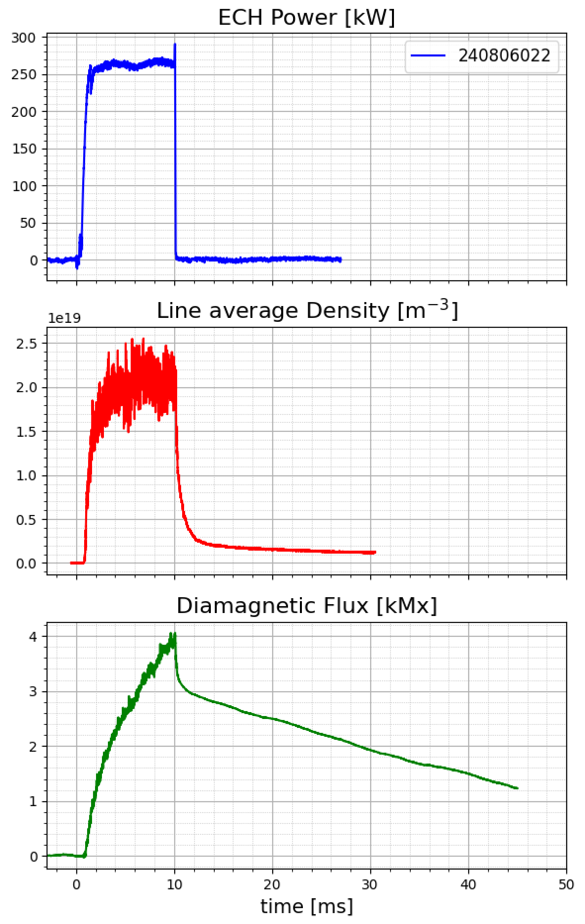
Typical WHAM discharge: bulk + fast pressure
300
200
Reliable breakdown with 30 - 400 kW ECH into ~.05 m³ plasma
Line-averaged densities of 0.03 – 5 x 10¹⁹ m⁻³
Distinct dual population: warm plasma + hot electrons
Warm bulk decay < 1 msec.
Collisional; majority of density
Hot e- slow pressure, minority density decay on much longer timescale
Majority of pressure
100
0
10¹⁹
2.0
1.0
0
n_{fe} <E_{e}>
n_{w}T + n_{fe} <E_{e}>
0
10
20
30
40
50
Time (ms)

Slide 20
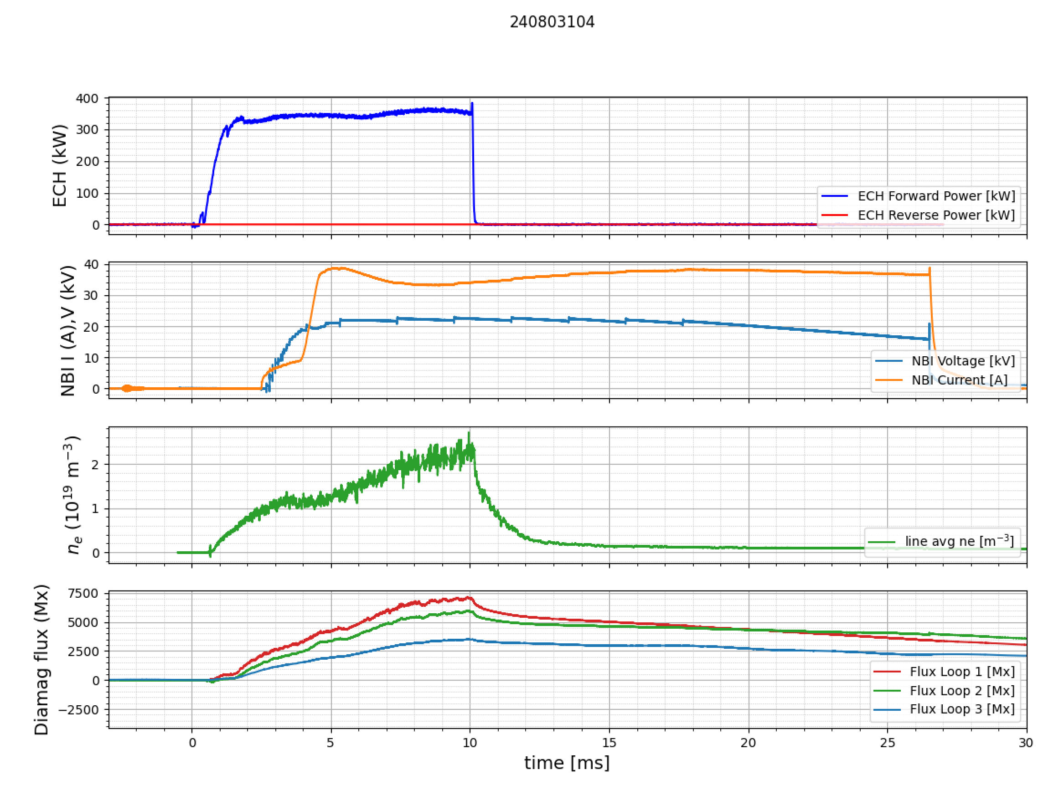
NBI fueling accesses high density regime
NBI into dense target plasma adds fueling
Fast ion confinement in Phase 1 limited by charge exchange losses, per expectations.
Warm plasma timescale increases modestly relative to ECH-only
0
5
10
15
20
25
30
Time (ms)

Slide 21
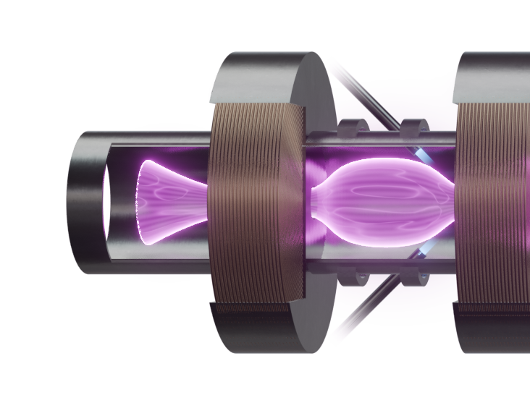
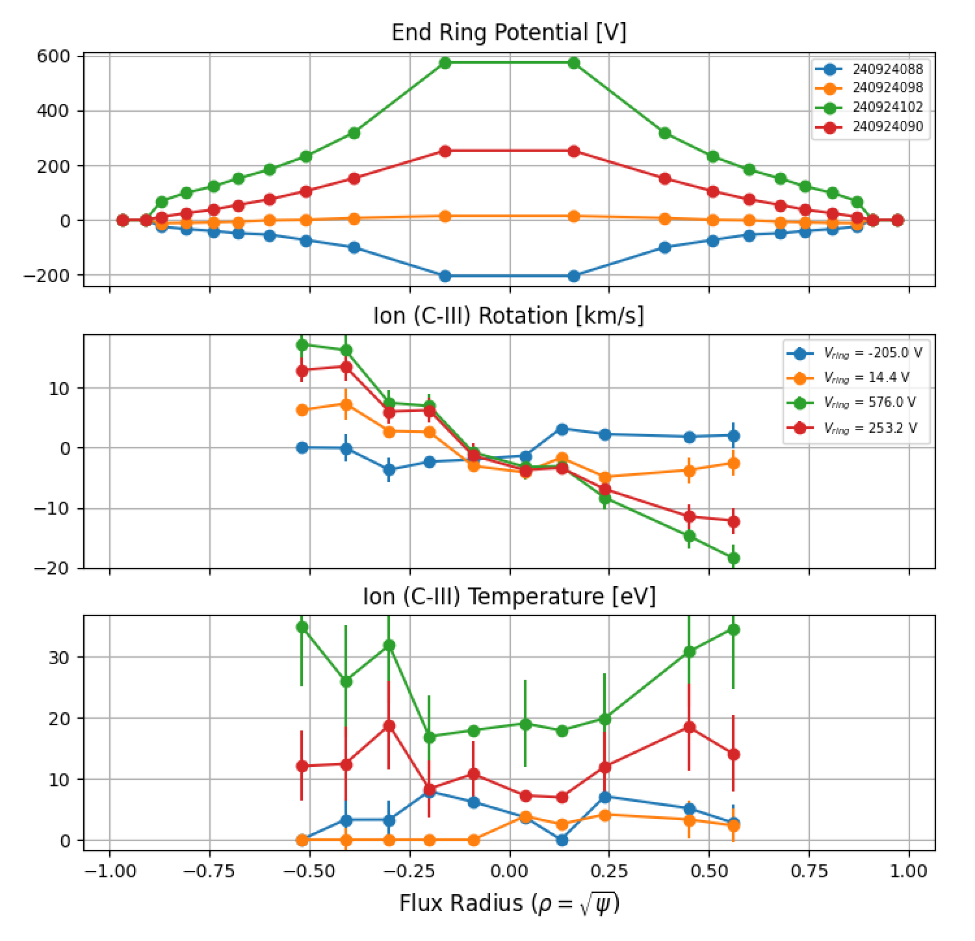
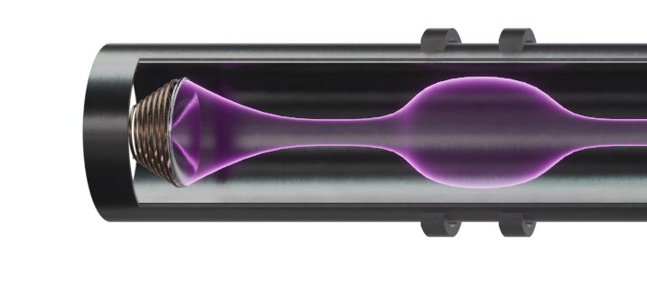
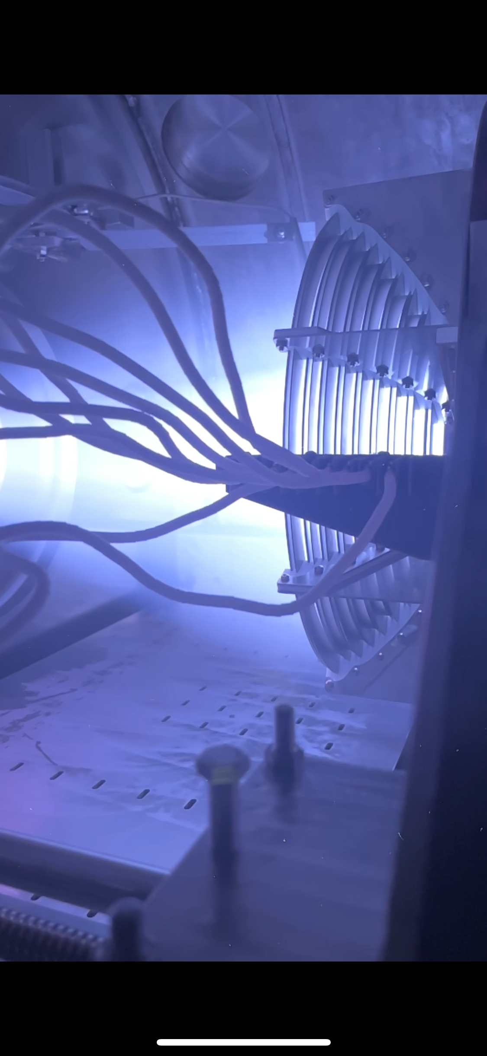
Gaining control of MHD: Imposed rotation
V
Ring Bias
Mirror plasma natural rotates in ion diamagnetic direction.
Positive bias enhances flow;
Negative bias opposes and can reverse flow
NP12.00145 Qian

Slide 22
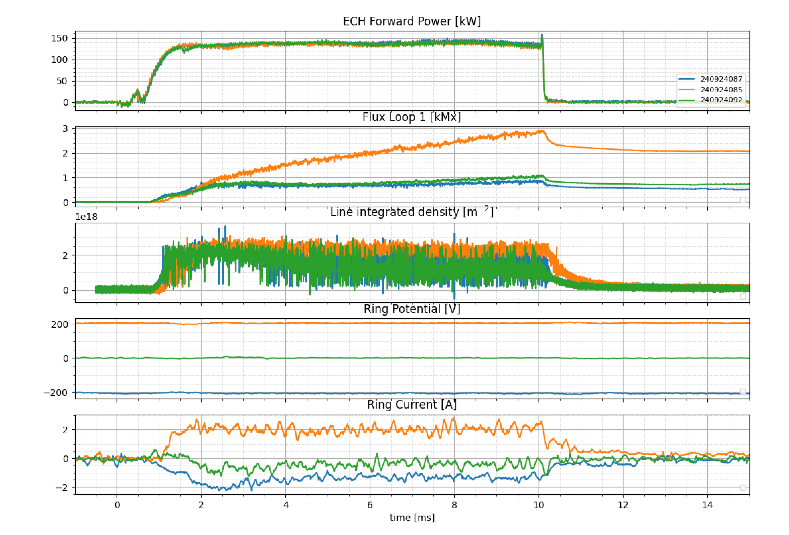
Rotating plasma reduces fluctuations, stores more energy
0
2
4
6
8
10
12
Time (ms)
NP12.00145 Qian

Slide 23
Summary
WHAM is operational.
ECH breakdown creates reliable target plasma with controlled density.
Expected MHD signatures observed (high- and low- m).
Imposed rotation affects and reduces fluctuations.
Hot electrons are well confined, > 1 second beyond ECH pulse.

Slide 24
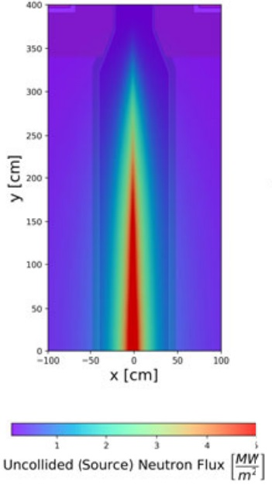
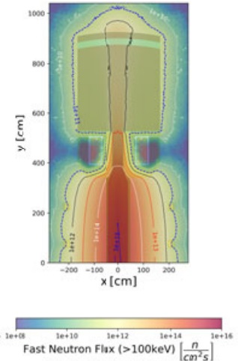
Aiming for a DT fusion fuel cycle for Anvil and first Hammir FPP design point - potential use of Anvil as VNS
Blanket / fuel cycle technology needs for Anvil and Hammir:
Flowing liquid metal blankets (e.g., PbLi) / molten salt (e.g., FLiBe) mostly parallel to magnetic field (axially)
Radiation tolerant first wall materials (i.e., first RAFM, advanced alloys later)
Tritium processing / handling systems needed for any DT-based FPP
Opportunity to optimize Anvil for DT fusion neutron production and use as VNS for testing materials and test blanket modules
Sub-gain long-pulse to steady-state operation (Q ~ 0.1-1) at ~1-10 MW-class fusion power output
Relatively low-cost access to > 1 MW/m² DT neutron wall loadings over large volumes, enabling parallel testing of materials / blanket modules
Reach high-dpa in materials in a reasonable amount of time with DT neutrons.
Evaluating other fuel cycle design points that may eliminate need for breeding blanket for VNS
C. B. Forest et al., “Prospects for a high-field, compact break-even axisymmetric mirror (BEAM) and applications,” Journal of Plasma Physics, vol. 90, no. 1, p. 975900101, 2024. https://doi.org/10.1017/S0022377823001290
C.B. Forest | Realta Fusion | FPA

Slide 25
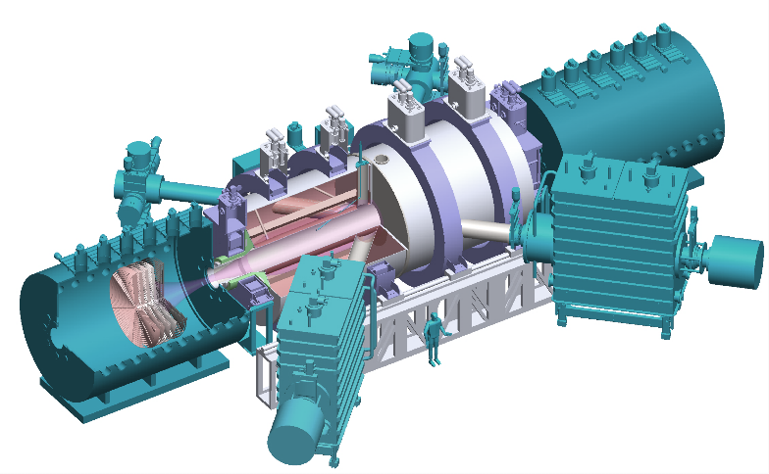
BEAM (now Anvil) could be FIRST—integrated DT blanket testing at ~1-10 MW scale
Axisymmetric simple mirror with HTS magnets
Q ~ 1 device is near-term economical source of DT neutrons and reactor-relevant heat flux which enables evaluation of tritium breeding blankets, tritium fuel cycle elements, materials damage, plasma material interactions, and large bore HTS magnets
Physics advantages
No disruptions (no net current)
Stabilization techniques identified
Compact (HTS enabled)
Intrinsically steady-state (no pulsed power)
Engineering advantages
Manufacturability (simple linear design)
Upgradeability (length, radius, heating)
Modularity and flexibility (expander cells, TBMs, test coupons)
Operational advantages
Inspectability (linear design facilitates access)
Maintainability (modularity enabled)
Reliability
Availability
C.B. Forest | Realta Fusion | FPA

Slide 26
Science and Technology Gaps Addressed by Anvil as FIRST
Tritium Breeding Blankets
Tritium breeding ratio, nuclear heating, flow of conductive fluids in high magnetic fields
Modular design to simultaneously evaluate designs using liquid metals, molten salts, ceramics
Tritium Fuel Cycle
Tritium self-sufficiency, steady-state, closed fuel cycle
Direct internal recycling, impurity removal, isotopic separation systems, detritiation systems
Accountancy, safety, licensing
Materials Degradation
High DT neutron flux
Large volume available for testing
High magnetic field, high temperature
Plasma Material Interactions
First wall material evaluations
High heat flux, DT neutron flux, tritium, alphas
High Field Magnets
Large-bore HTS magnets and cables
Compact fusion concept
High neutron flux
APS-DPP Community Planning Process, "A Community Plan for Fusion Energy and Discovery Plasma Sciences," 2020.
NASEM Final Report of the Committee on a Strategic Plan for U.S. Burning Plasma Research, 2019.
C.B. Forest | Realta Fusion | FPA

Slide 27
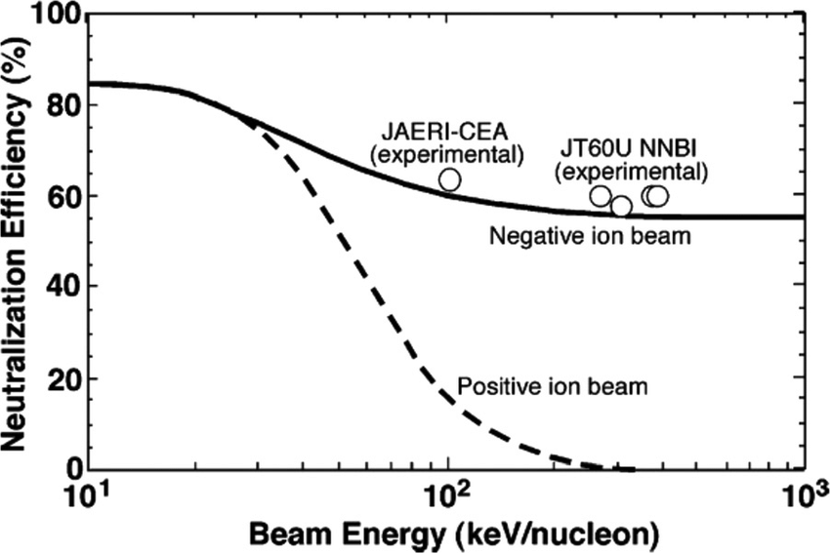
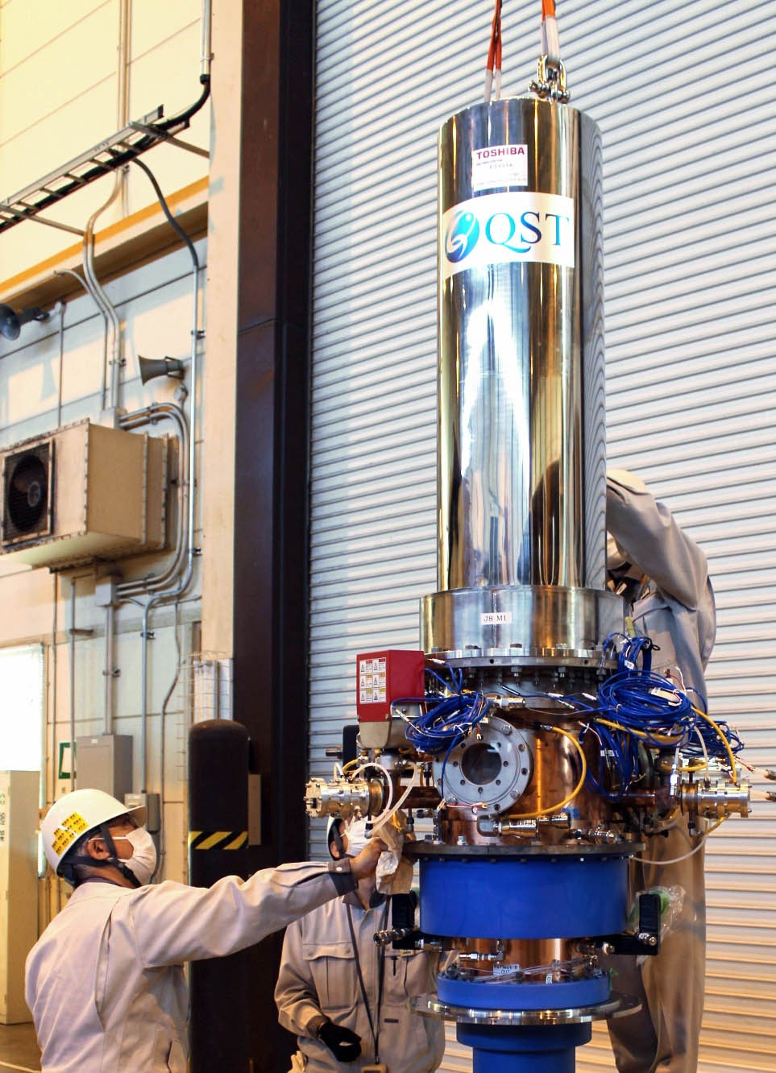
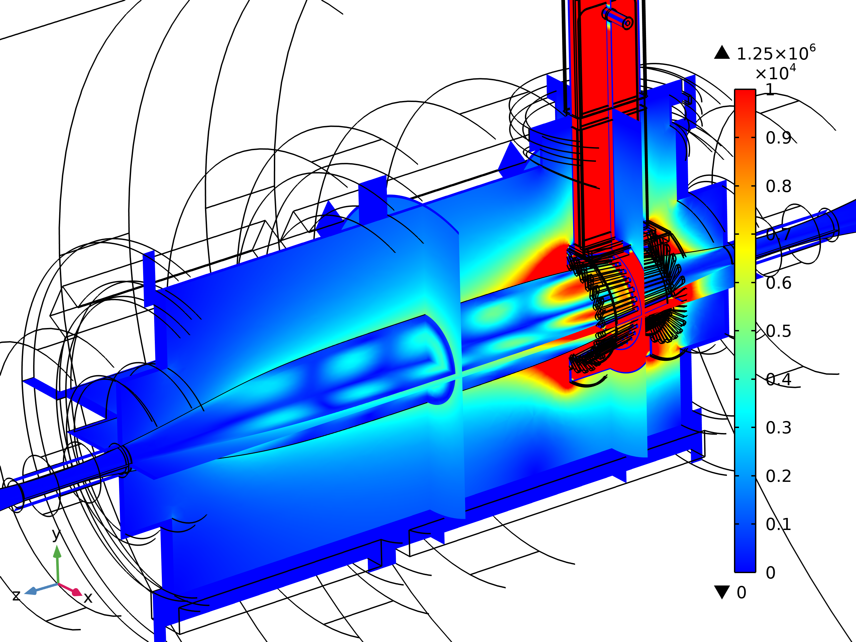
Advanced heating systems are required to advance magnetic mirror towards high performance plasma conditions
Likely heating technology needs for ANVIL & HAMMIR:
Steady-state ECH ~ 3-6 MW @ 170 GHz
Steady-state ICRH ~ 5-10 MW @ 50-200 MHz
Steady-state negative ion beam NBI w/ ~ 10-40 MW @ 100-500 keV beam energy
NBI neutralization efficiency for positive and negative ion beams
R.S. Hemsworth and T. Inoue, IEEE Trans. Plasma Sci. 33(6), 1799 (2005).
Image source: iter.org, https://www.iter.org/node/20687/japan-develops-first-high-output-multi-frequency-gyrotron
Ongoing full wave RF simulations
C.B. Forest | Realta Fusion | FPA

