Slide 1

The EUROfusion approach to DEMO and fusion energy
Ambrogio Fasoli
Programme Manager

Slide 2
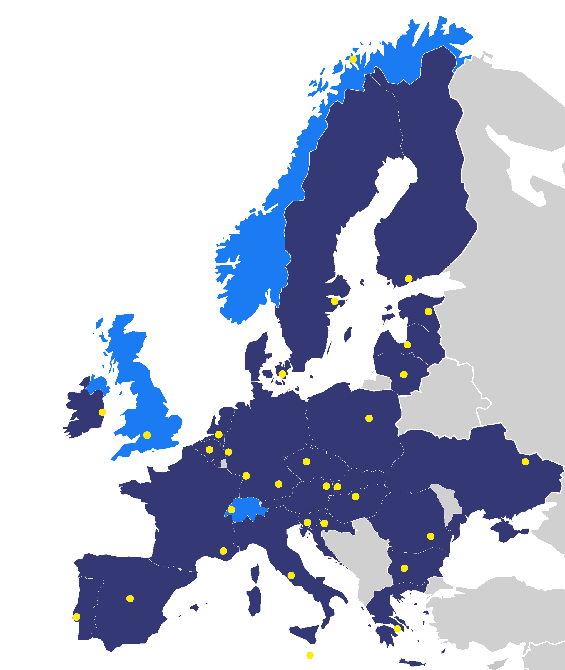
About EUROfusion
EUROfusion integrates R&D in fusion science and technology
29 Countries
31 Research Institutions
164 Universities
~1000 MSc & PhD students
~5000 Fusion Researchers & Support Staff

Slide 3

R&D program follows the European Fusion Roadmap
Short-term
Medium-term
Long-term
Research on present and planned facilities, analysis and modelling
ITER
First plasma
Full performance
Commence
construction
Fusion Power Plants
Consistent
concept
Electricity
production
DEMO
Material research facilities IFMIF/DONES
Current resource allocation
Stellarator as fusion plant?
Lower cost through concept improvements and innovations
Milestone

Slide 4
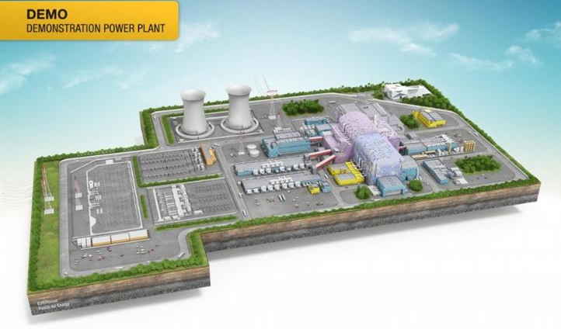
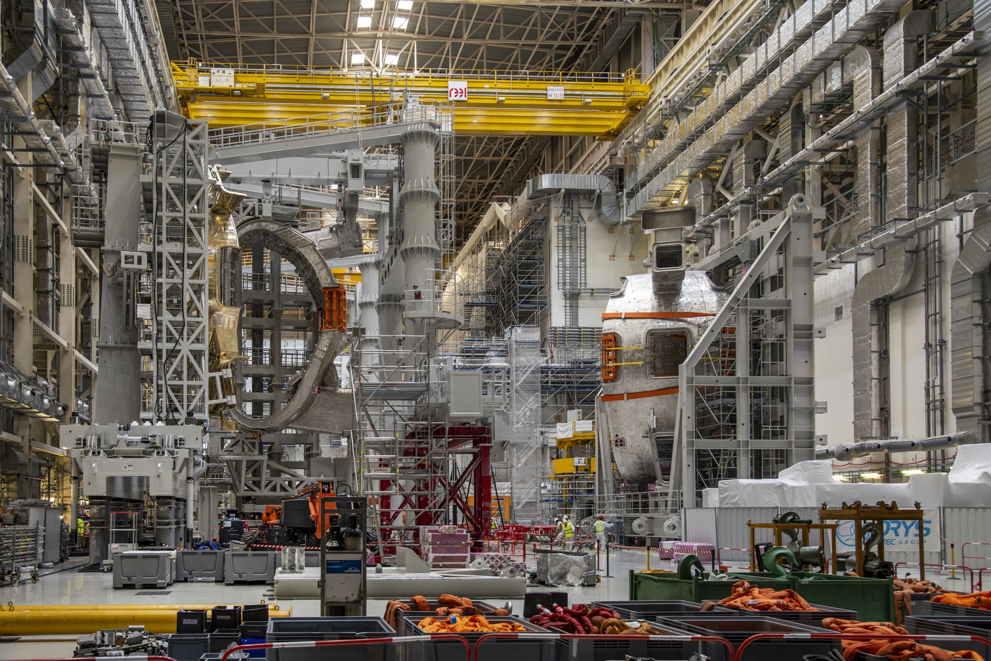

Main elements of the Roadmap revision
Definition of the DEMO step
Gaps to be addressed
Measures to accelerate the DEMO and FPP (fusion power plant) programmes
These points are in addition and in synergy with the activities for ITER, which remain central

Slide 5
Definition of the DEMO step – high level goals
Demonstrate performance and integration of key technologies with tolerable failure rates to achieve adequate levels of availability
Self-sufficient fuel cycle
Robust plasma operation scenario & power-exhaust
Intrinsic safety and tolerable impact of waste
Phase 1: blanket radiation exposure 20dpa (~7y)
Phase 2: net electricity output ~300MW (t_{pulse}~hours)
Tokamak configuration
Notes:
Why 20dpa ? He content still very low (200-300 appm) and database from specimen irradiated in fission material test reactors is relevant

Slide 6
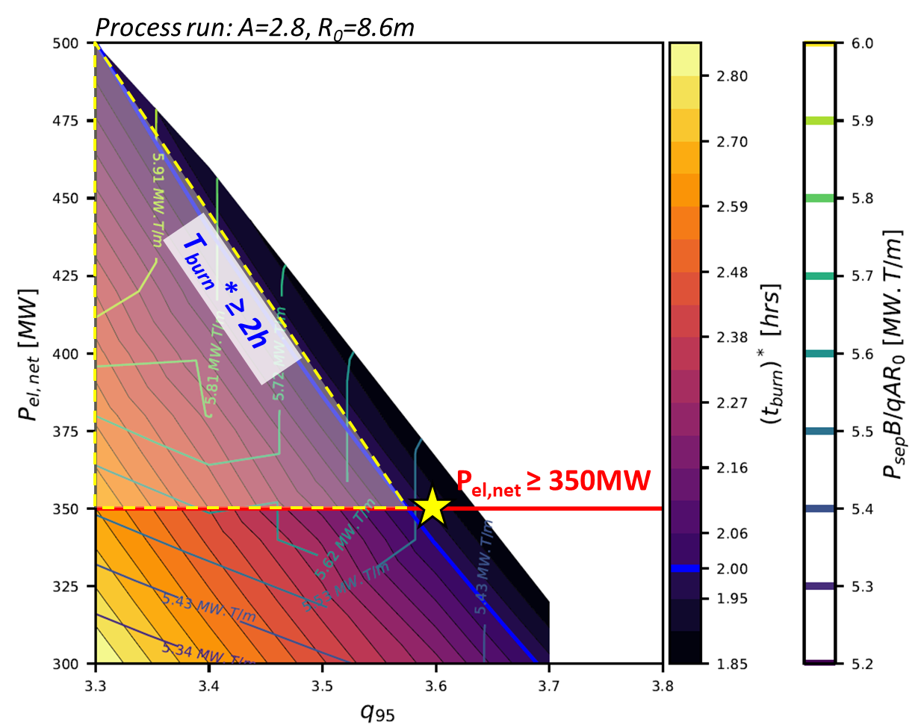
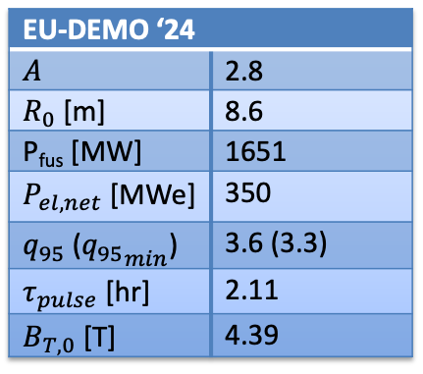

Example of system code exploration of DEMO low aspect ratio solution
Requirements
τ_{burn} ≥ 2h
P_{el,net} ≥ 350 MW
Constraints
$$H\sim 1$$
$$q_{95} \left[3.3;3.6\right]→Ip margin$$
$\frac{P_{sep}B_{T,0}}{q_{95}AR_{0}}$≤ 6 MW.T/m
EU-DEMO ‘24
$A$ | 2.8
$R_{0}$ [m] | 8.6
P_{fus} [MW] | 1651
$P_{el,net}$ [MWe] | 350
$q_{95}$ (${q_{95}}_{min}$) | 3.6 (3.3)
$τ_{pulse}$ [hr] | 2.11
$B_{T,0}$ [T] | 4.39
$Courtesy of M.Coleman, H. Zohm$
Notes:
The proposed design point fulfills the stakeholder requirements with margin in exhaust and lower TF
incorporating plasma uncertainties (+/-50%) into the design allows to lower the targeted fusion power
q₉₅ increase provides operational safety for the plasma scenario (less disruption prone at higher q₉₅).
the heat flux in case of reattachment has almost been halved, now in the window for mitigation

Slide 7
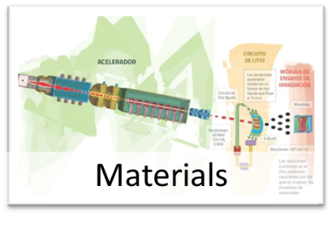
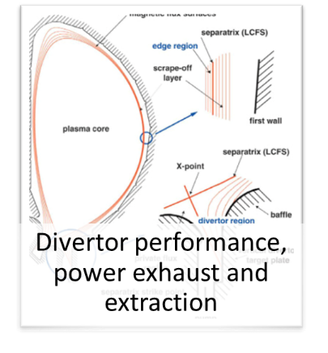
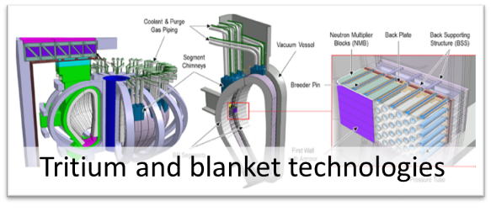
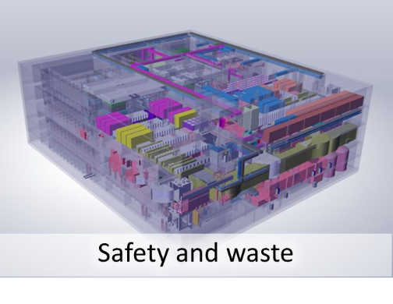
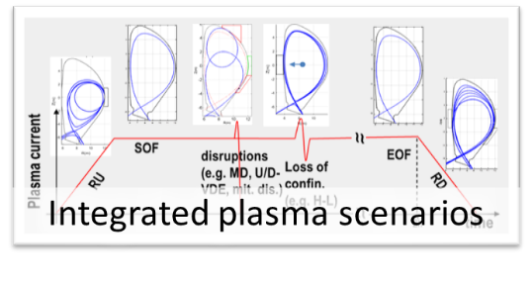
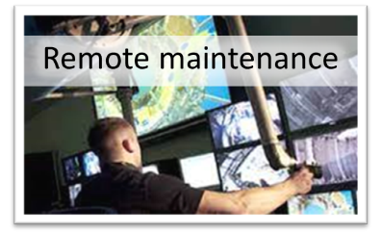
Gaps to be addressed
Notes:
+ theory and numerical simulations

Slide 8
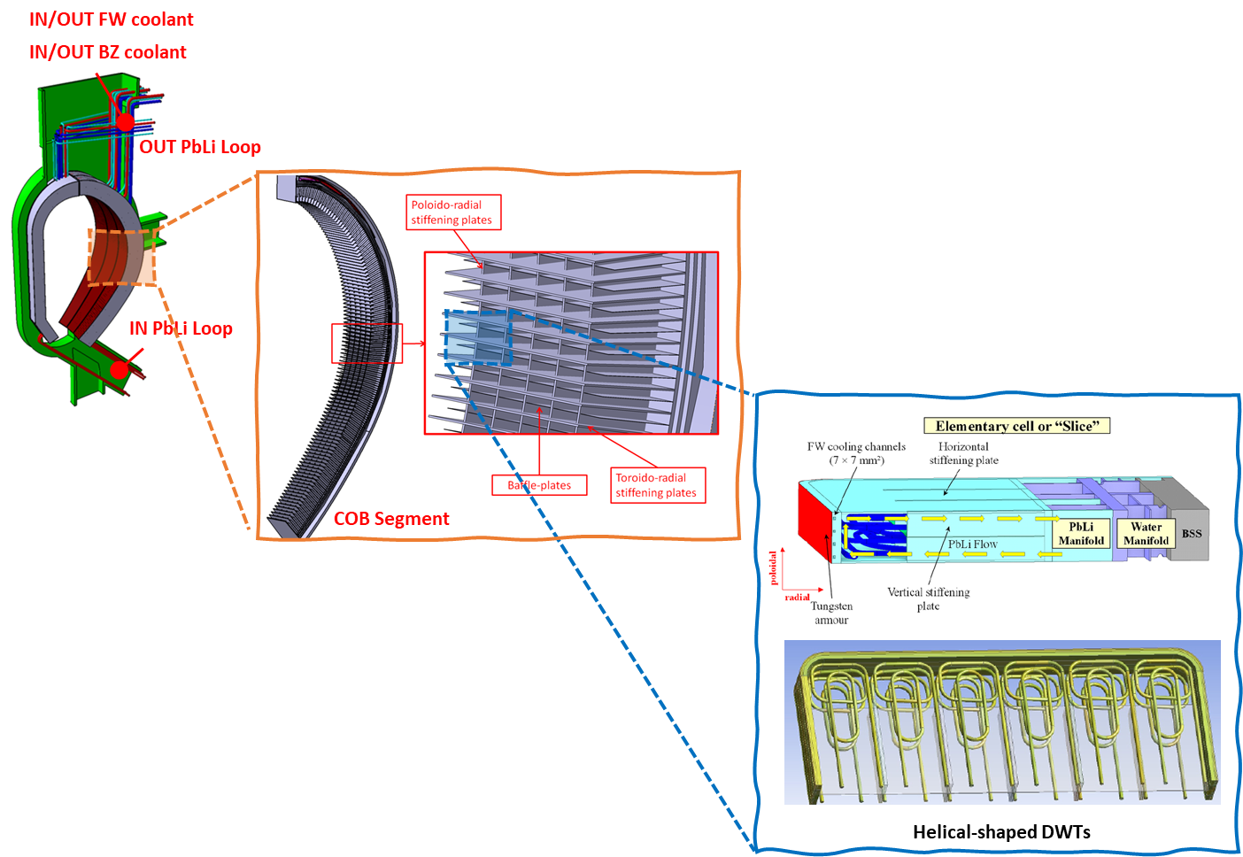
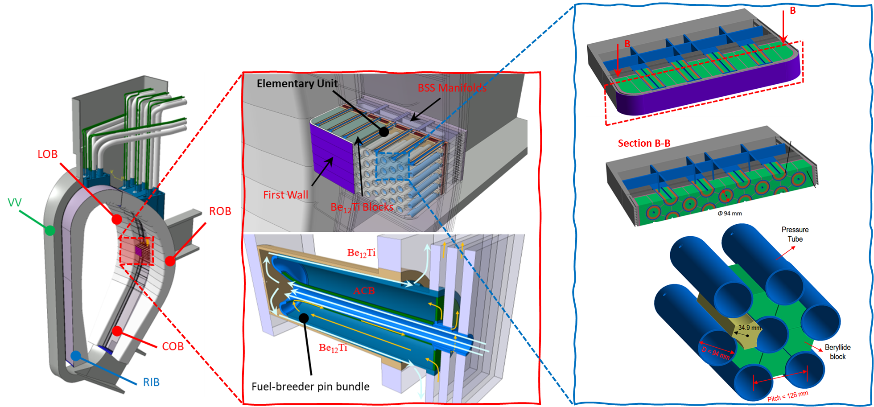
Breeding Blanket in DEMO: main reference concepts
Helium Cooled Pebble Bed (HCPB)
Breeder: Li₄SiO₄ + Li₂TiO₃ in form of a pebble bed, ⁶Li at 60%
Neutron multiplier: Beryllide (TiBe₁₂) rods
Coolant: He 300-520°C @ 8 MPa
T extraction with purge Helium
Water Cooled Lead Lithium (WCLL)
Breeder/neutron multiplier: PbLi (⁶Li at 90%) liquid (~330°C)
Coolant: Water (295-328°C)
T extraction from recirculating PbLi
P. Arena et al, (2023) Design and Integration of the EU-DEMO Water-Cooled Lead Lithium Breeding Blanket, Energies, 16, 2069
G. Zhou et al, (2023) The European DEMO Helium Cooled Pebble Bed Breeding Blanket: Design Status at the Conclusion of the Pre-Concept Design Phase, Energies, 16, 5377
$Courtesy of S.d^{′}Amico, F.Hernandez$

Slide 9
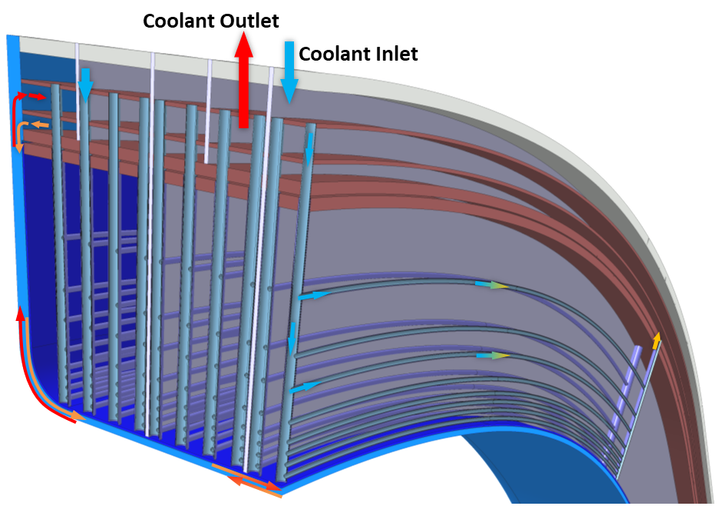
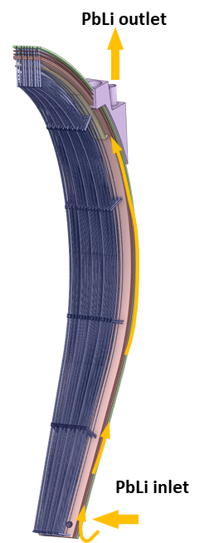
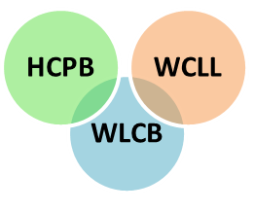
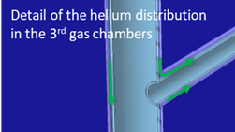
Breeding Blanket in DEMO: improved variants
Water Cooled Lead Lithium Concept (WCLL) – Double Bundle
Breeder zone and first wall in series (T_{in,FW} ≈ 315 °C)
Less tubes, less welds, less surface, less water, more PbLi
→ more reliable, lower T permeation, better TBR
→ avoids PbLi - water interaction
Water-cooled Lead and Ceramic Breeder (WLCB)
Neutron multiplier: molten Pb or solid Pb compound
Coolant: Water (285-325°C @15.5 MPa)
T extraction with purge Helium: 0.1% H₂/H₂O@ ~0.2 MPa
Breeder zone and first wall in series (T_{in,FW} ≈ 315 °C)
Available TER and water PWR technology
Good TBR and neutron shielding, low T permeation
P. Pereslavtsev et al, (2023) Neutronic Activity for Development of the Promising Alternative Water-Cooled DEMO Concepts, Appl. Sci., 13, 7383,
$Courtesy of S.d^{′}Amico, F.Hernandez$

Slide 10
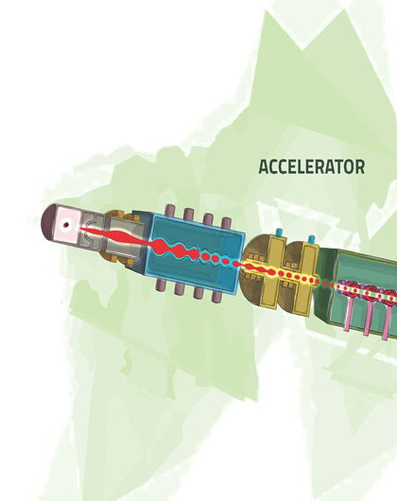
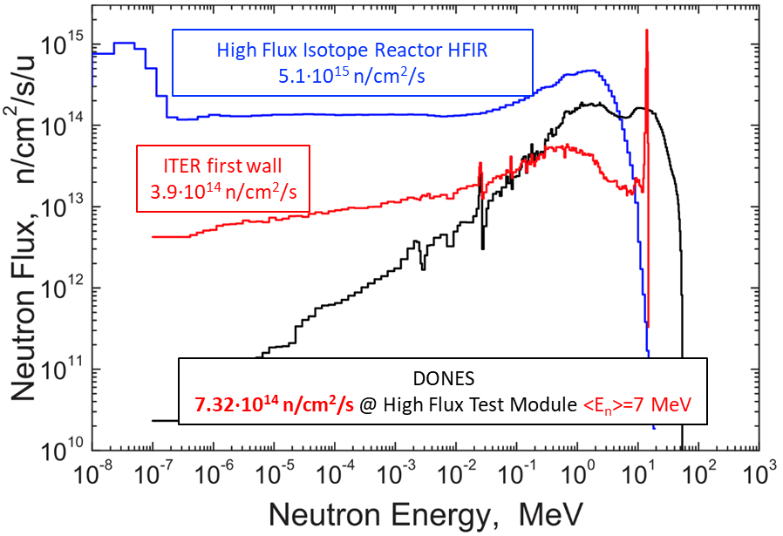
Materials
A development programme is needed to qualify materials to enable roll-out of FPPs
response to plasma exposure and to 14-MeV n-irradiation >20dpa
mechanical and thermal properties
chemical compatibility and safety issues
Robustness of industrial fabrication must be increased
IFMIF-DONES will be the only facility with neutrons of adequate spectrum and fluence to qualify materials

Slide 11
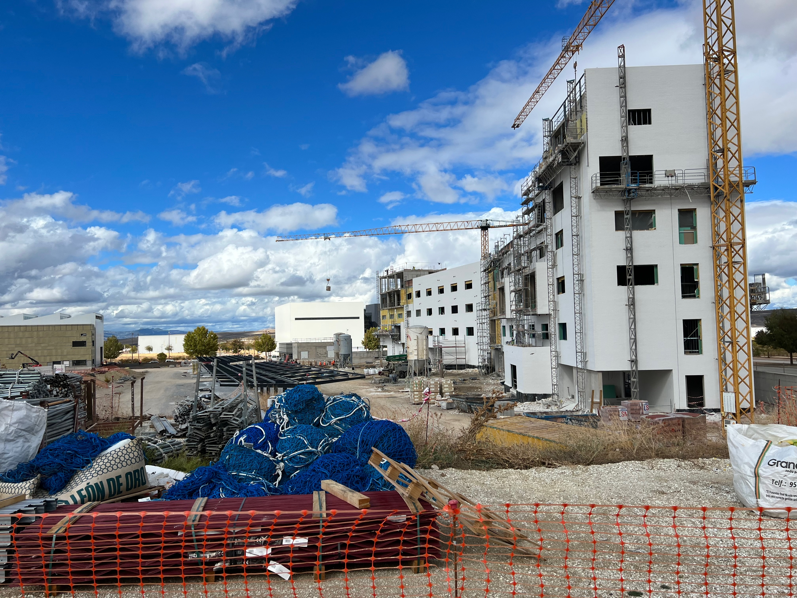
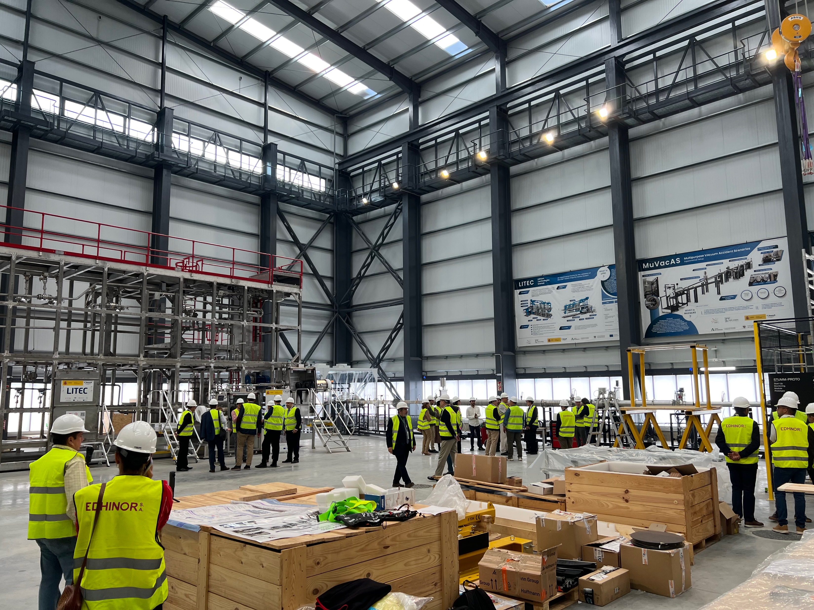




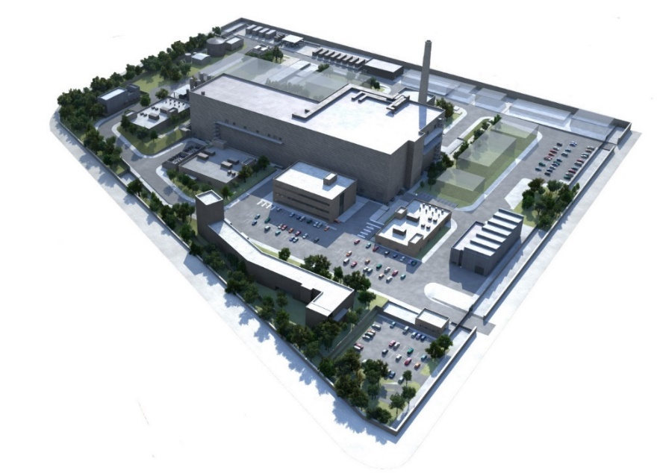
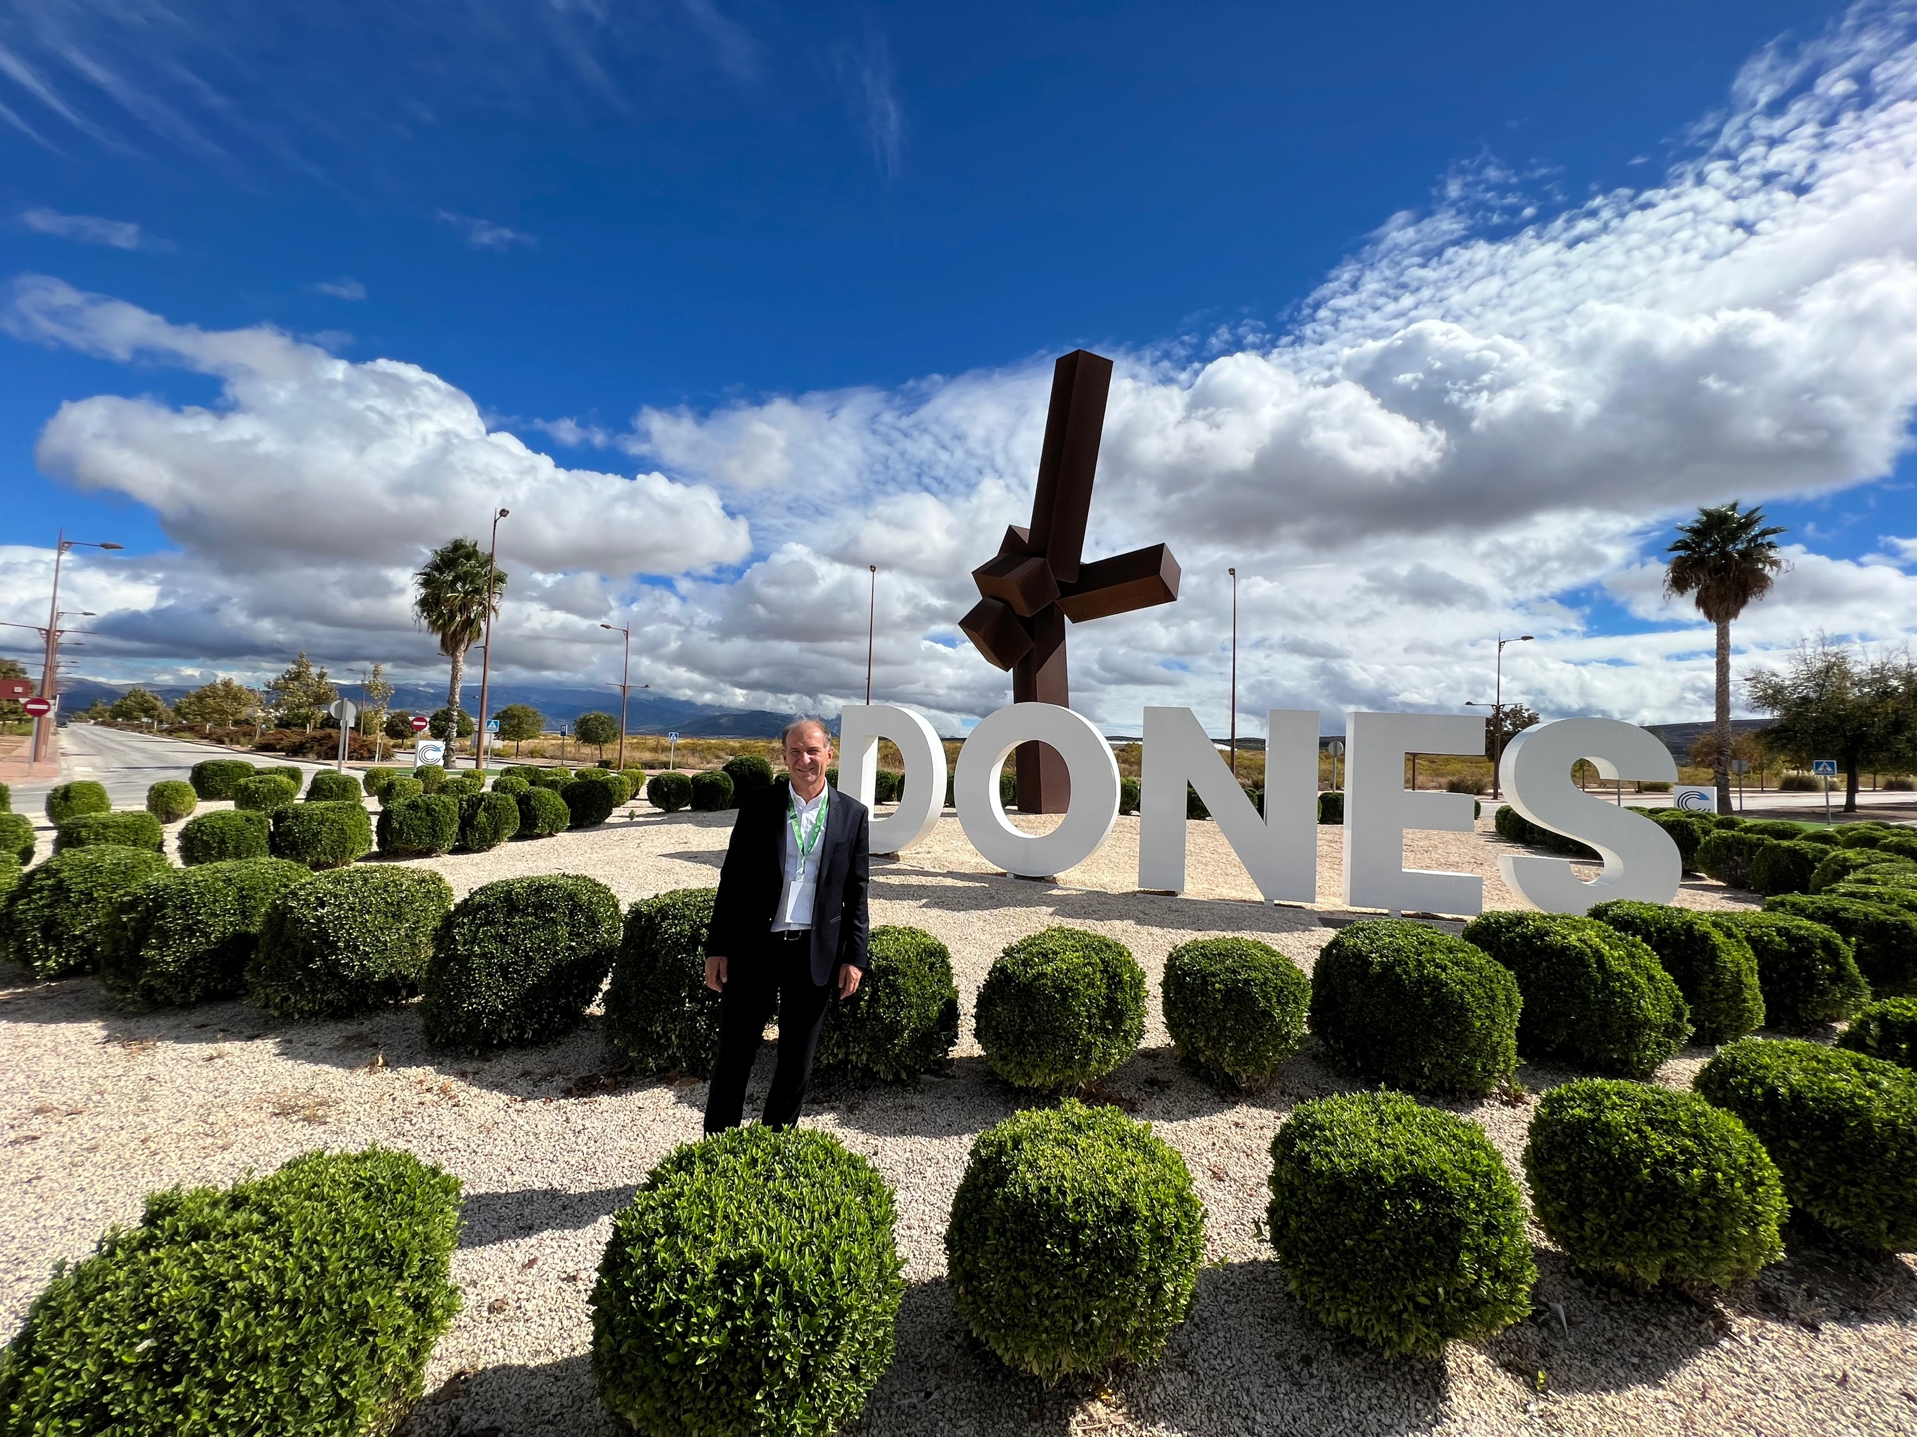
IFMIF-DONES: construction has started
At Escúzar, Granada, Spain
Operation expected in ~2034
Pictures taken on Oct 16, 2024

Slide 12
DEMO Phase 1 or a Volumetric Neutron Source ?
While burning plasma physics require large fusion power (~500 MW in ITER), nuclear technology tests require low fusion power (~50 MW), but need high n-fluence (>10 dpa)
The combination of high power for physics testing and high fluence for nuclear technology testing in a single device leads to high T consumption
The feasibility of a Volumetric Neutron Source (VNS) to qualify components is under consideration (instead of, or as a different version of, DEMO Phase 1)
Physics basis
14 MeV neutron source with peak Neutron Wall Loading ≥ 0.5 MW/m²
Beam-target reactions (like JET) to keep machine size low
NBI also employed to drive I_{p}, as there is no space for large CS
β_{N} < 3.5; max. B-field on TF ~ 13T (LTS, but HTS options are also explored)
q₉₅ > 3; R ≤ 3m and P_{fus} < 50MW

Slide 13
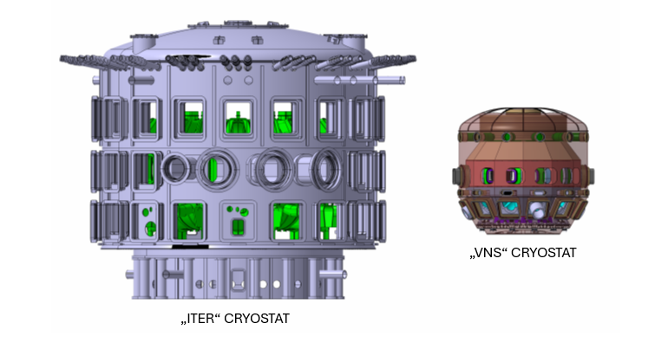
Present view of the VNS design – comparison to ITER
 | VNS | ITER
Linear Size, R_{o}, (m) | 2.5 | 6.2
Fusion power (MW) | <50 | 500
Plasma current (MA) | 1.7 | 15
Magnetic Field (%) | 5.4 | 5.3
Q | <1 | 10
Beams energy (keV) | 120 | 1000
Beams power (MW) | 45 | 33
ECH (MW) | 10 | > 40
Plasma volume (m³) | 23 | 1300
Plasma surface (m²) | 80 | 900
Power consumption (MW) | 170
Neutron wall (MW/m²) | 0.5 | 1
Fluence (dpa) | 50 | 0.3
$Courtesy of G.Federici$

Slide 14
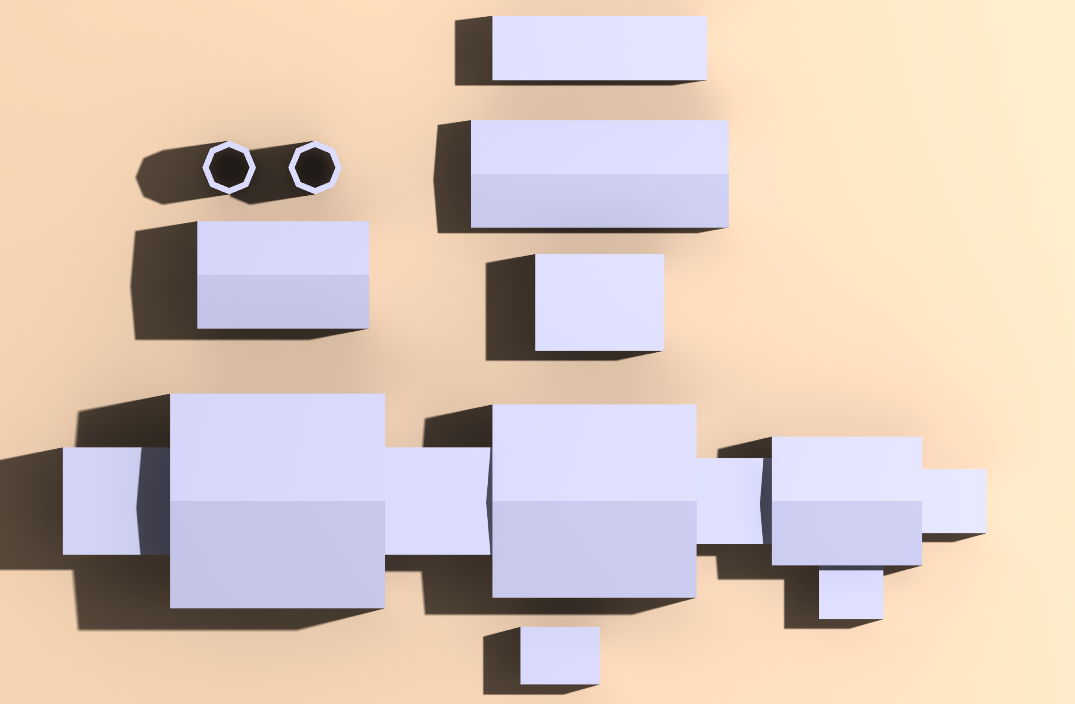

The VNS as an element of the DEMO plant ?
Electrical system
Cooling systems
Balance of Plant
T, Fuelling, Vacuum
DEMO Assembly hall
DEMO_1 / VNS
Active Maintenance Facility
DEMO_2
DEMO_1 / VNS Assembly hall
Cryo
$Courtesy of S.Renard$

Slide 15
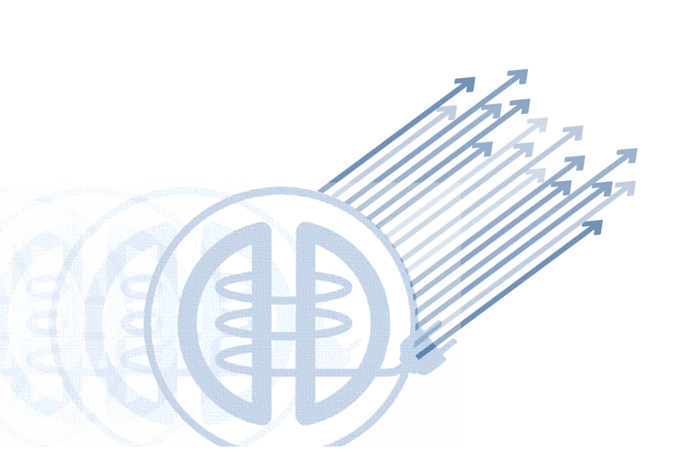
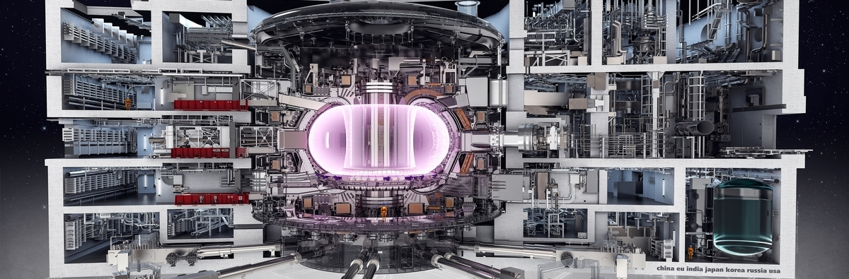
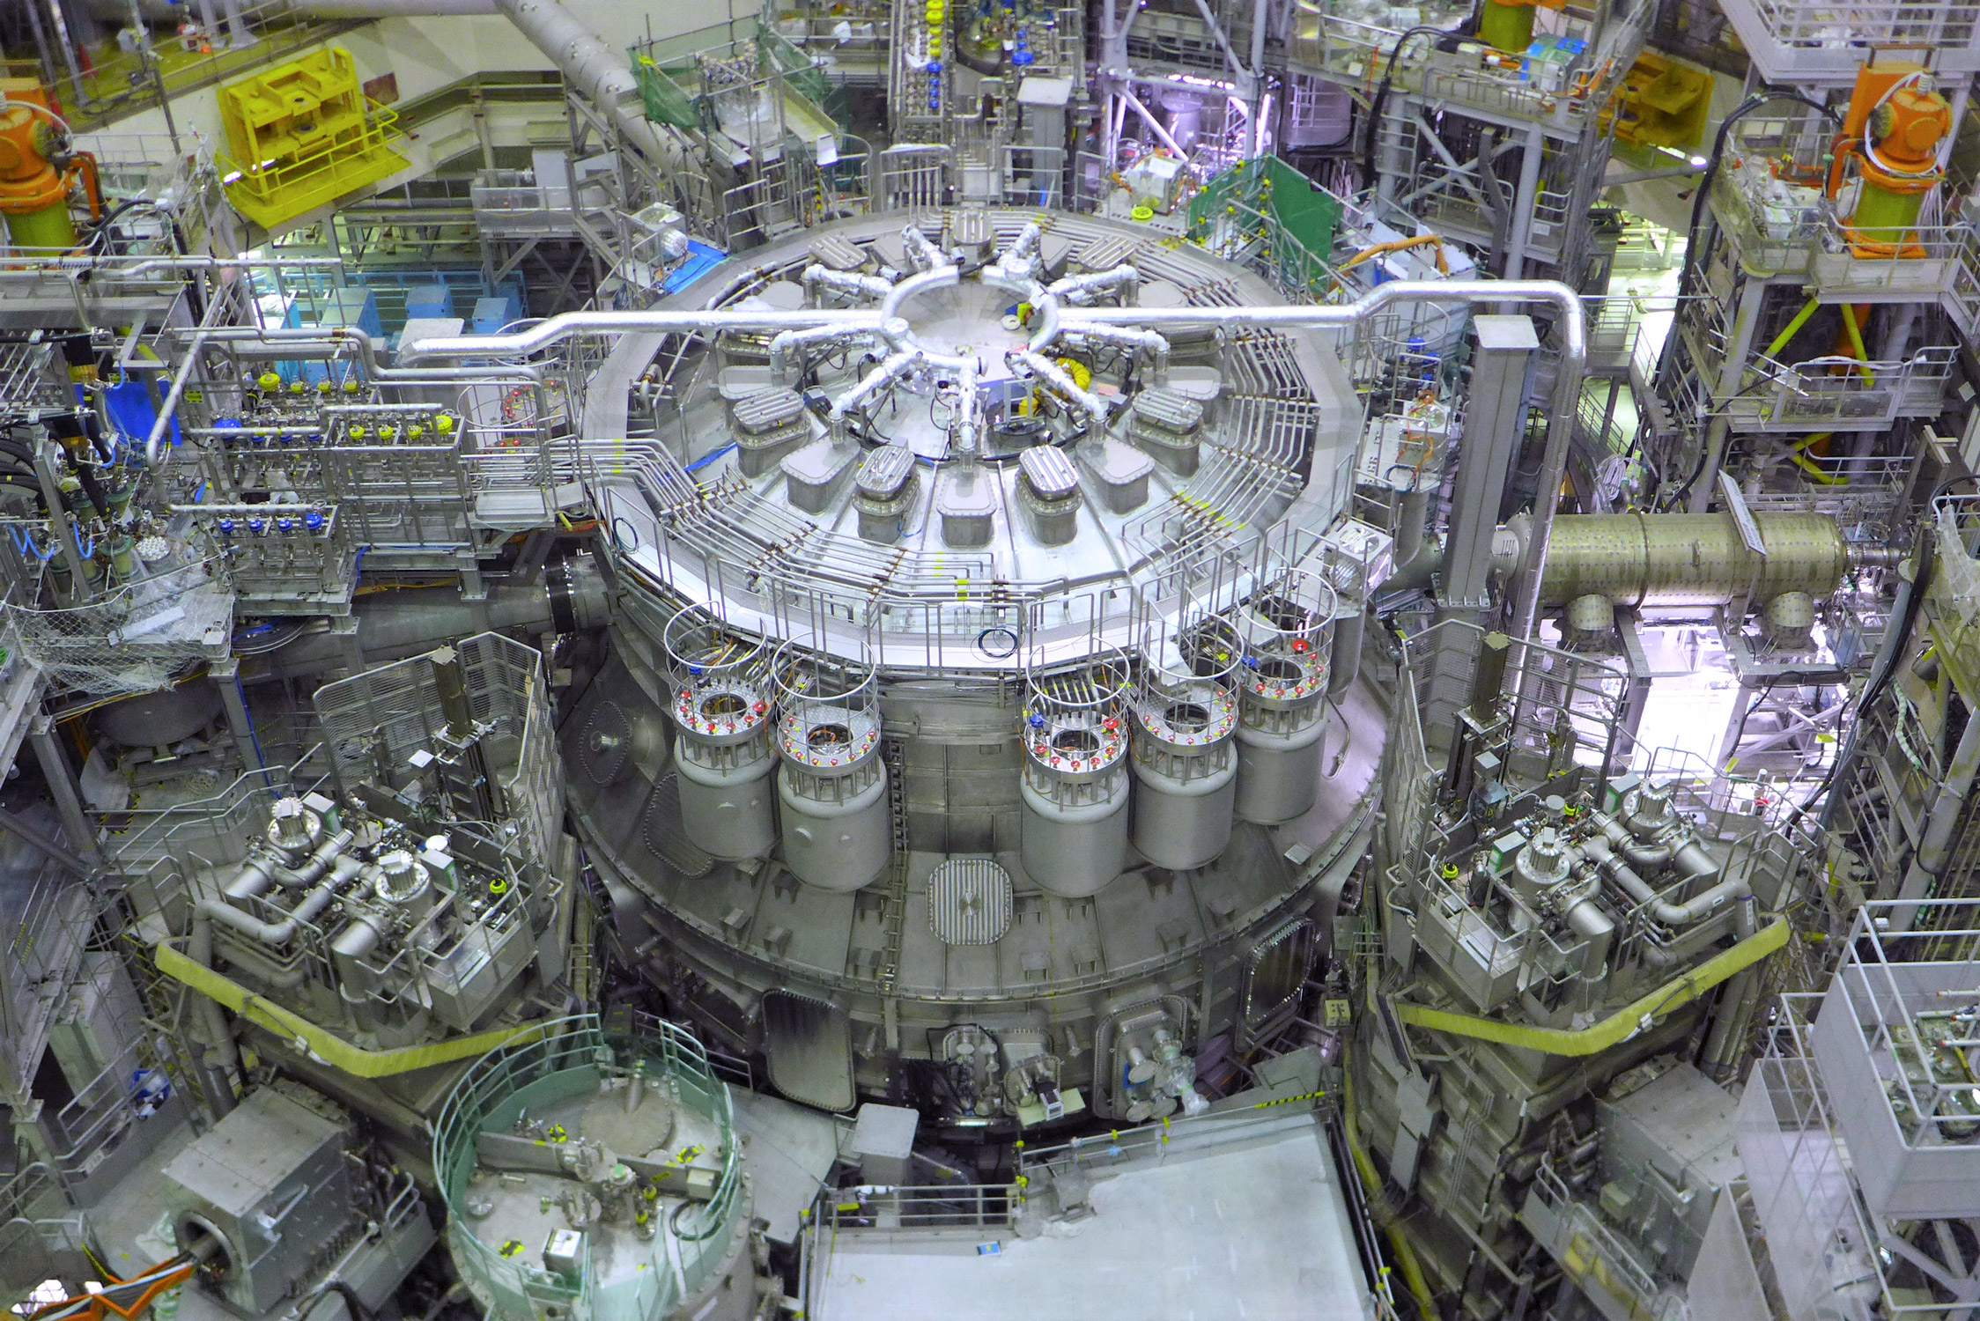
Measures to accelerate the DEMO program
Strengthening R&D in the identified gap areas
Strong synergy with new ITER Baseline (W-related work)
exploitation of JT-60SA
(integrated in our Tokamak Exploitation programme)

Slide 16
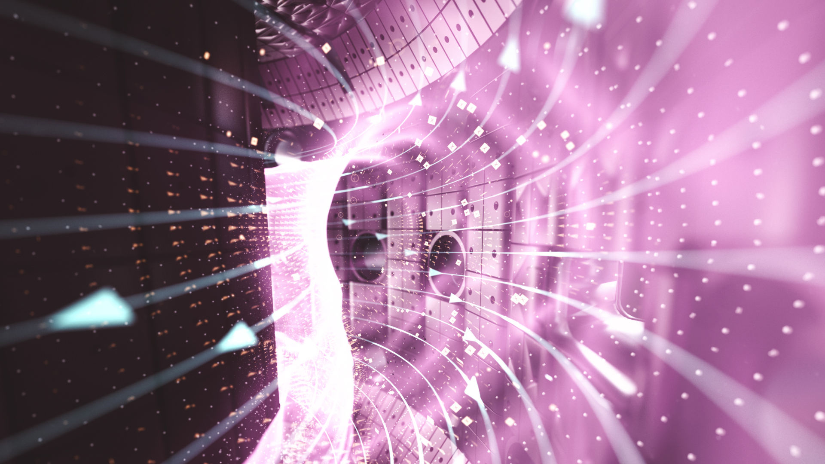
Measures to accelerate the DEMO program
Strengthening R&D in the identified gap areas
Increased effort in simulations for plasma and for engineering
Digitalization effort, including innovative AI approaches

Slide 17
Measures to accelerate the DEMO program
Strengthening R&D in the identified gap areas
Increased effort in simulations for plasma and for engineering
Streamlining licensing for fusion and rapidly identifying site

Slide 18
Measures to accelerate the DEMO program
Strengthening R&D in the identified gap areas
Increased effort in simulations for plasma and for engineering
Streamlining licensing for fusion and rapidly identifying site
Development and maintenance of adequate workforce
Connections with academic and industrial networks, diversity at all levels

Slide 19
Measures to accelerate the DEMO program
Strengthening R&D in the identified gap areas
Increased effort in simulations for plasma and for engineering
Streamlining licensing for fusion and rapidly identifying site
Development and maintenance of adequate workforce
Mutually beneficial new international collaborations
Collaborations with China (CRAFT, EAST, BEST, …), US (SPARC, …) etc., for technology facilities and early burning plasma developments

Slide 20
Measures to accelerate the DEMO program
Strengthening R&D in the identified gap areas
Increased effort in simulations for plasma and for engineering
Streamlining licensing for fusion and rapidly identifying site
Development and maintenance of adequate workforce
Mutually beneficial new international collaborations
Knowledge management
Document lessons learned in the ITER design and developments

Slide 21
Measures to accelerate the DEMO program
Strengthening R&D in the identified gap areas
Increased effort in simulations for plasma and for engineering
Streamlining licensing for fusion and rapidly identifying site
Development and maintenance of adequate workforce
Mutually beneficial new international collaborations
Knowledge management
Parallelization of activities to reduce sequential ITER-DEMO coupling

Slide 22
Measures to accelerate the DEMO program
Strengthening R&D in the identified gap areas
Increased effort in simulations for plasma and for engineering
Streamlining licensing for fusion and rapidly identifying site
Development and maintenance of adequate workforce
Mutually beneficial new international collaborations
Knowledge management
Parallelization of activities to reduce sequential ITER-DEMO coupling
Public Private Partnerships and involvement of industry

Slide 23
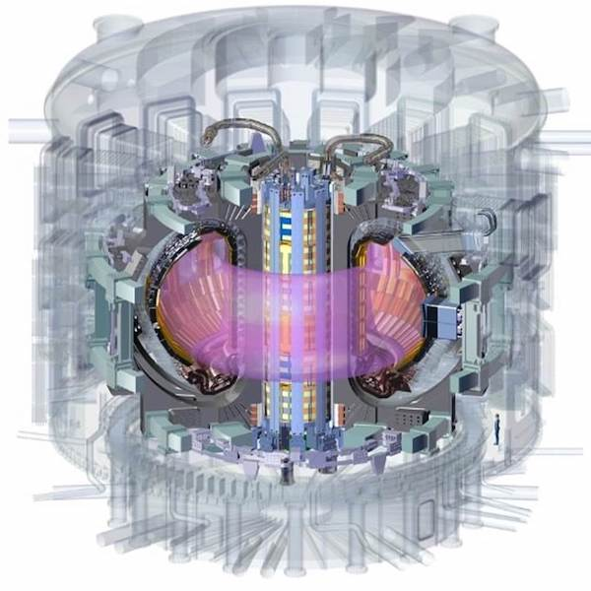
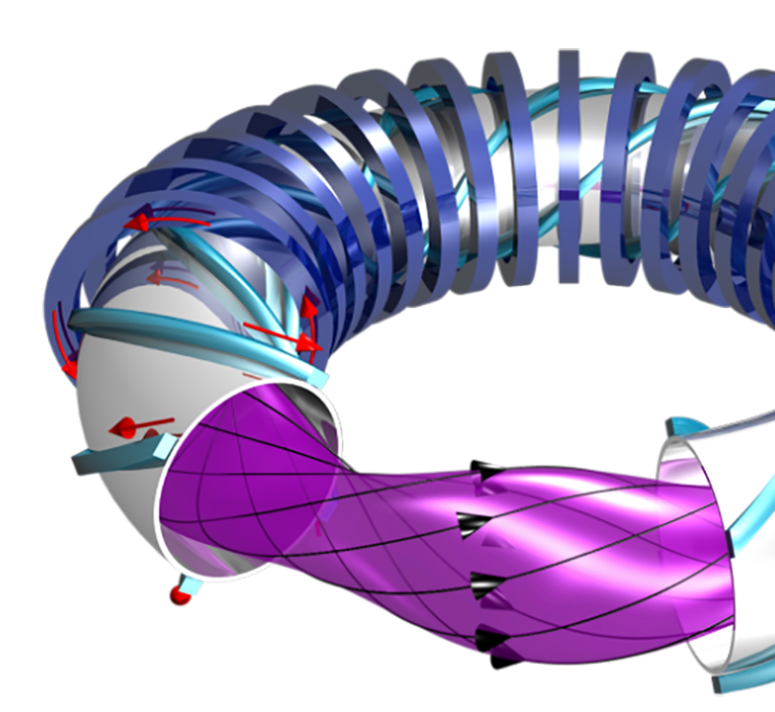
Measures to accelerate the Fusion Power Plant program beyond DEMO
Dedicated test facilities to qualify technologies for FPPs that will be different from DEMO
Increase attractiveness of FPPs
Stellarator FPP design studies
HTS and advanced magnet assembly
Advanced structural materials
Source: ITER
Source: IPP

Slide 24
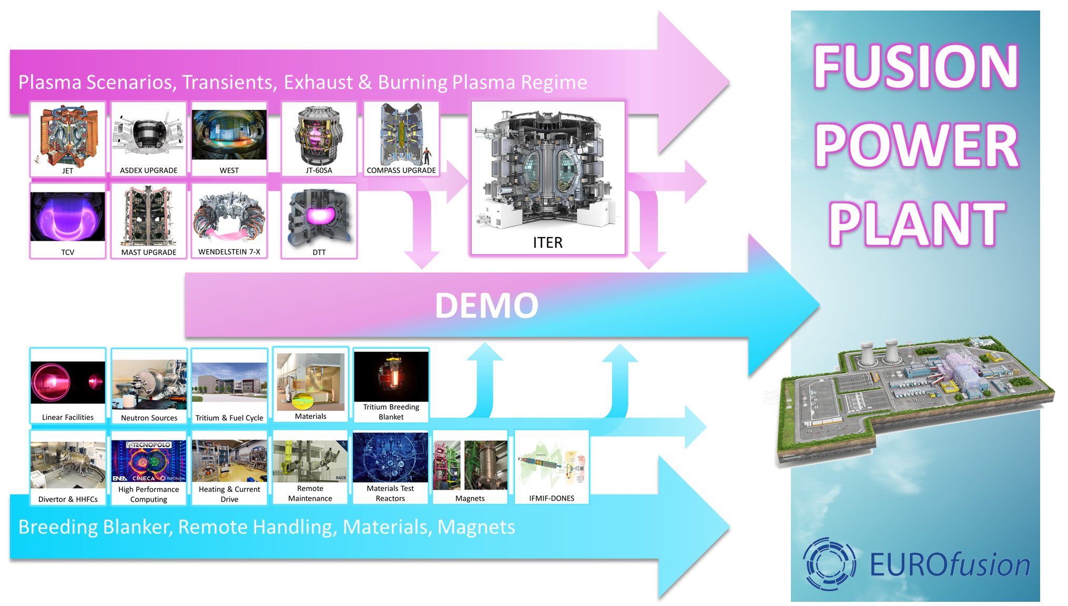
Notes:
Design & construction of ITER will inform design & construction of DEMO
Operation of ITER will inform operation of DEMO (not design)

Slide 25
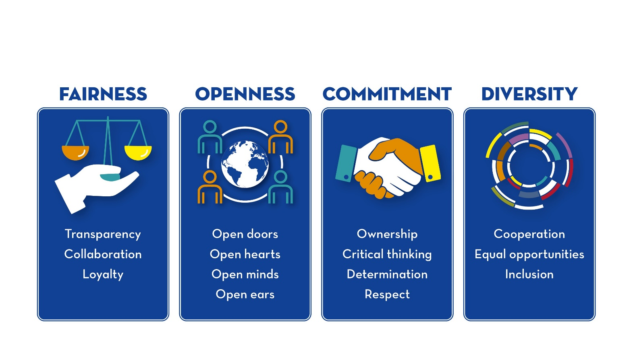
Thank You!

