Slide 1
Recent Progress at Xcimer Susana Reyes Fusion Power Associates Annual Meeting December 3, 2024

Slide 2
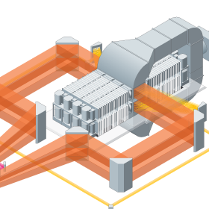
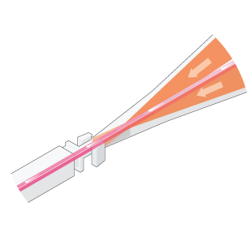
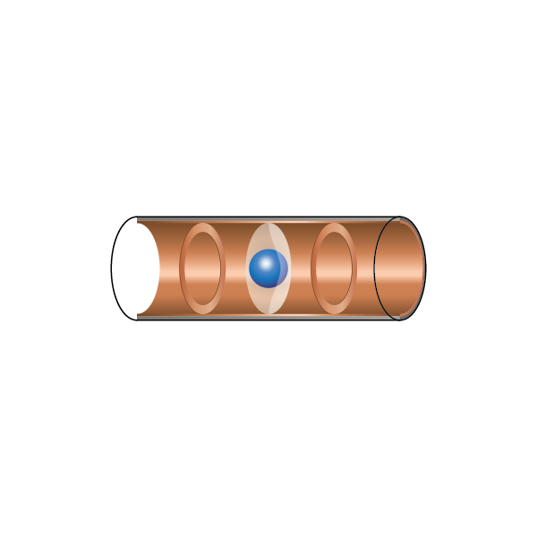
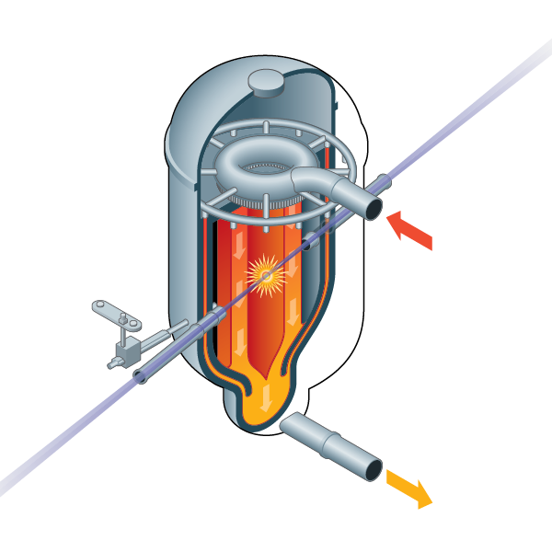
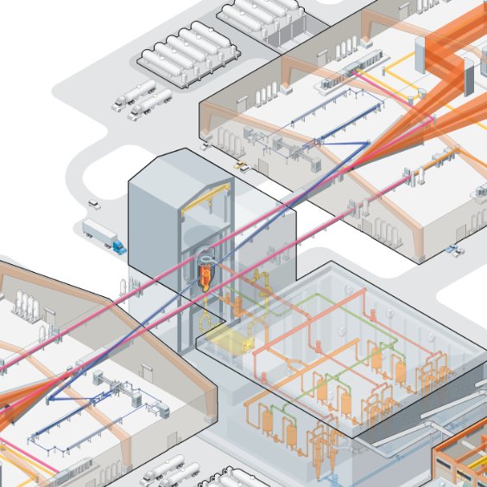
Xcimer’s path to commercializing inertial fusion
60x lower laser cost
10x higher efficiency
10x higher laser energy
3x larger fusion targets
100x larger fusion gain
30x longer first-wall lifetime
Superior economics
Efficient NLO-excimer gas laser reduces costs from
thousands of dollars per Joule to
tens of dollars per Joule
Low costs make a larger, more powerful laser economically viable.
Increased laser energy enables larger, more reliable, high-gain targets.
Directly scale up the NIF-style implosion and ignition, which worked
Improved target and laser enables a simple chamber design that doesn’t require first wall replacement.
These advances enable a low-risk path to energy production with superior economics.
$50 / MWh NOAK costs
Xcimer inertial fusion relies on more proven physics and will be less expensive to develop & commercialize than other fusion approaches

Slide 3
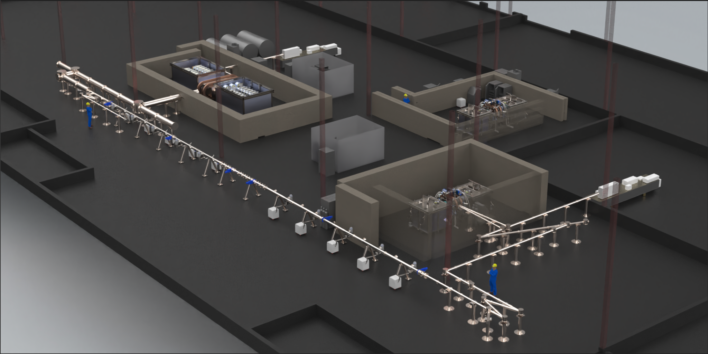
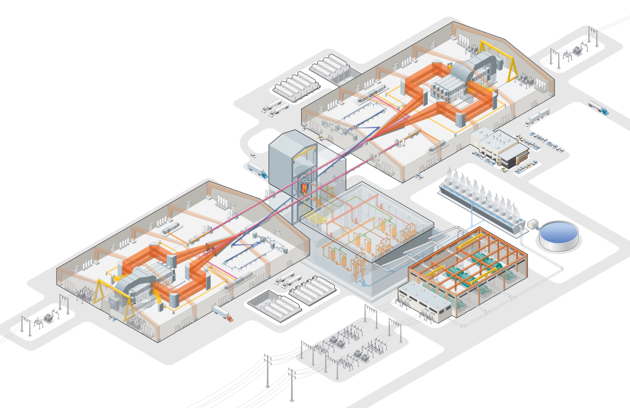
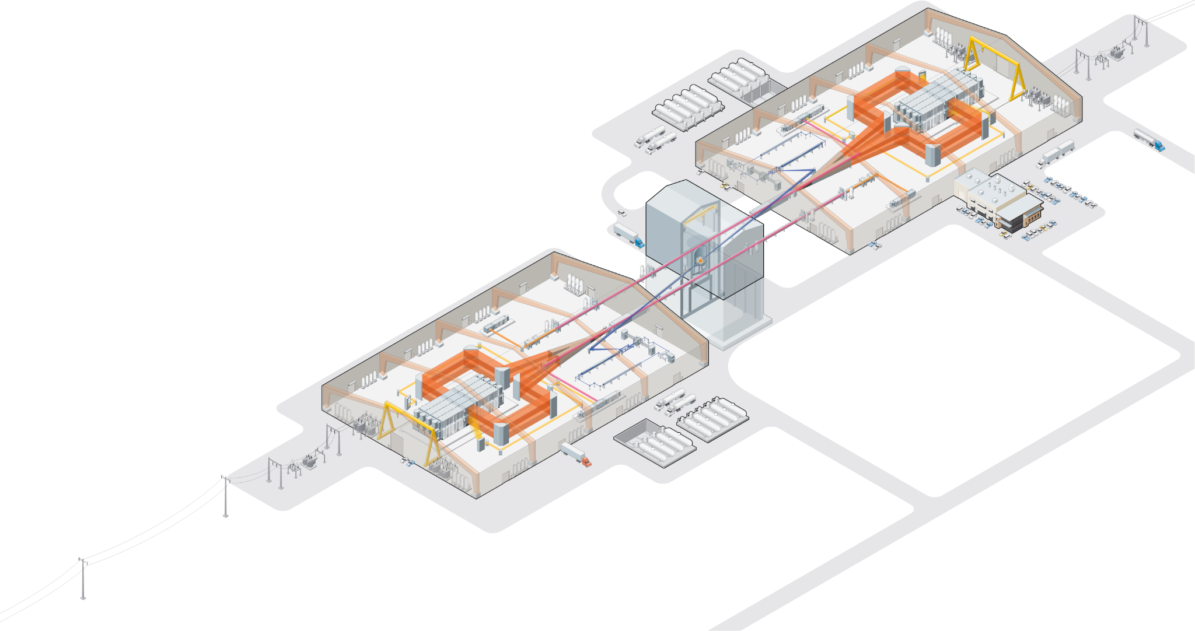
Xcimer’s Roadmap to Fusion on the Grid
Phoenix
Argos
Full-Scale KrF Amplifier
Vulcan
Breakeven Facility
Athena
Fusion Pilot Plant
Demonstrate laser technologies
Q1 2026
Build full-scale KrF module
~2027
Achieve eng. breakeven
~2030
Electricity on the grid
Mid 2030s
Demonstrate SBS pulse compression
Demonstrate pulsed power
Verify KrF long-pulse kinetics
~200 kJ, 𝜇s pulses
World’s largest laser amplifier
Likely sited with Vulcan facility
≥4 MJ on target
Wall-plug fusion breakeven!
National security asset
Integration with blanket
~100 MWe to grid
3 hr continuous operation
Denver, CO
TBD
TBD
TBD

Slide 4
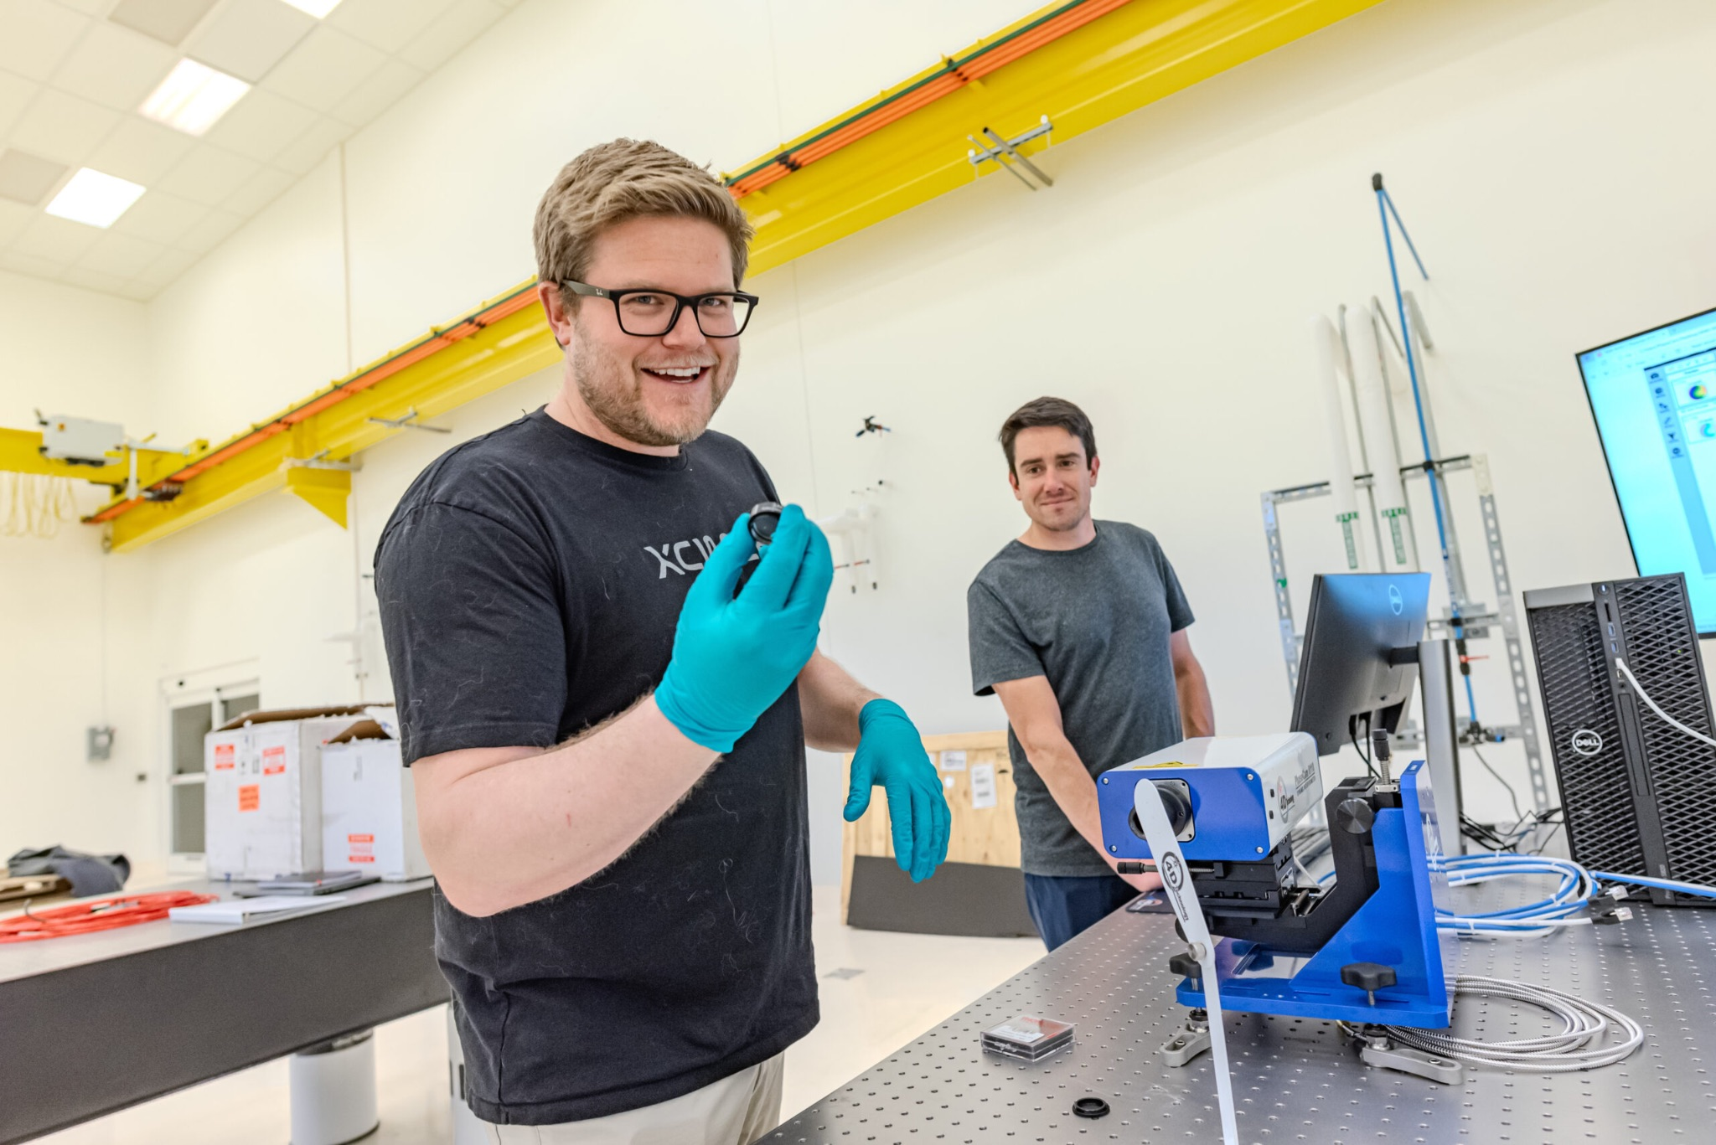
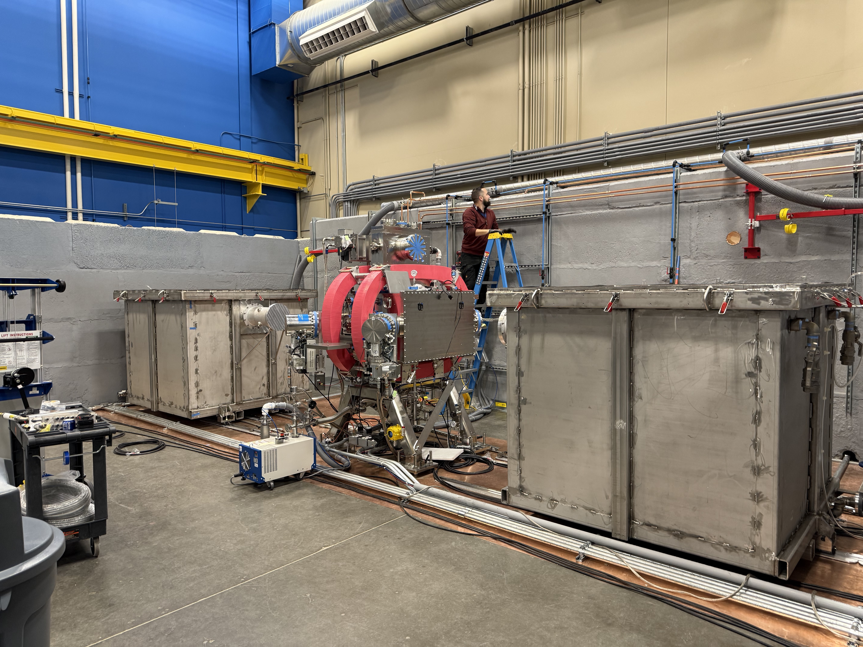
Highlights Since Last FPA Meeting
Took occupancy of Denver facility for Phoenix construction
Closed successful $100M round A
Initial agreement with DOE for milestone program
Signed partner agreements and started work with 6/9 milestone partners
Continued to advance our Fusion Pilot Plant (Athena) preconceptual design
Completed assembly of LPK laser test bed, started commissioning
Ramped up to ~70 employees (24 FTEs in December 2023)
Launched Argos and Vulcan design teams

Slide 5
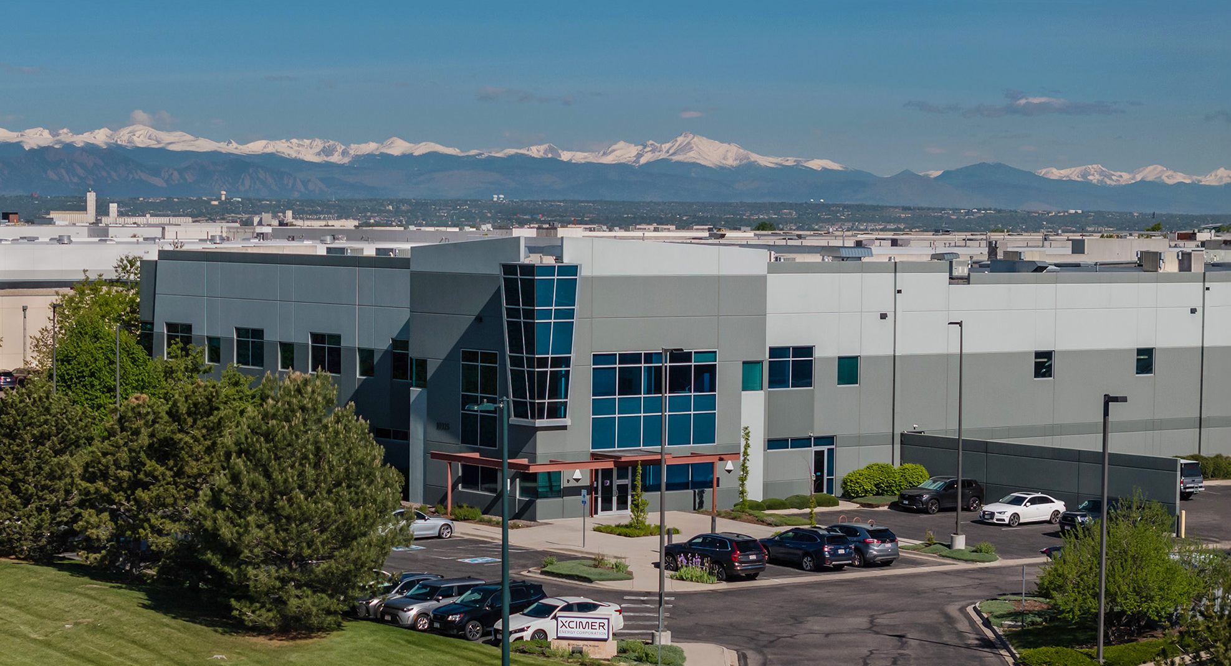
Xcimer’s Denver Facility
Notes:
73,716 SF
12,000 SF Class A office
Took occupancy March 1

Slide 6

Phoenix System Overview
PG2: Long-pulse front-end amplifier
KJC: Kilojoule-class long-pulse excimer amplifier
LPK: Long-pulse kinetics platform (excimer)
PG1: Short-pulse front-end amplifier
SPA: Short-pulse excimer amplifier
OC2: Long-pulse (pump) optical path
Long-pulse (pump) beams
SBS: Brillouin pulse compression cell
OC1: Short-pulse (seed) optical path
Short-pulse (seed) beam

Slide 7
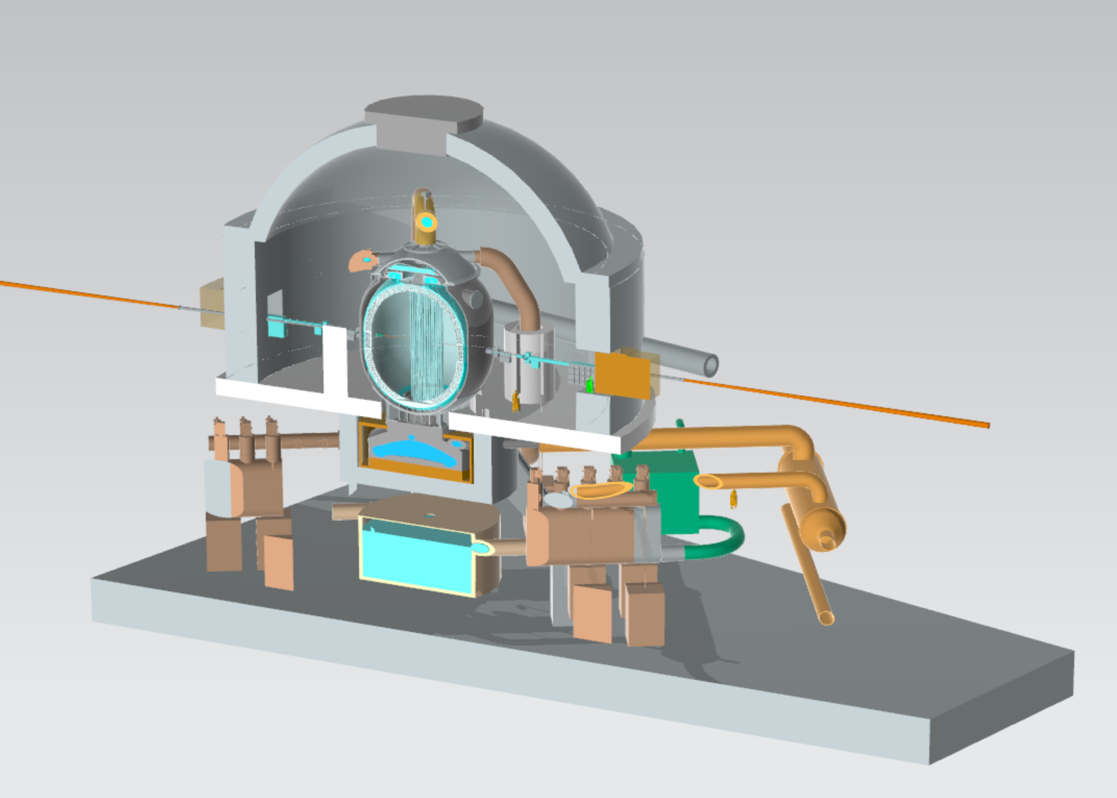
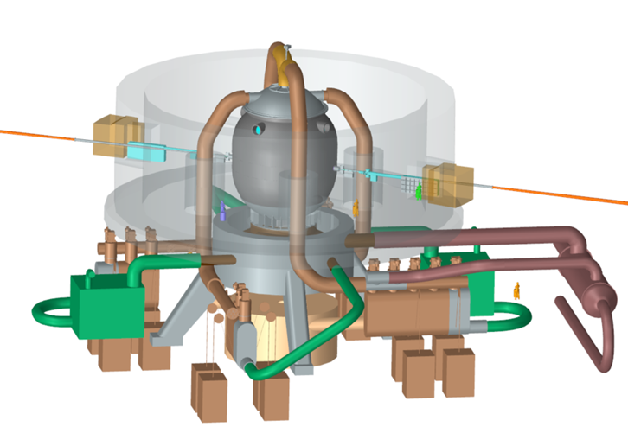
FPP Pre-Conceptual Design is On track
5 m radius, 0.25 Hz
Target yield = 1419 MJ
Fusion power = 355 MW
Net electric = 140 MWe
Plant architecture is informed by detailed Xcimer systems code XPPERT (Wayne Meier, 2024) which allows for design tradeoffs to meet high level goals:
Electricity production (min 3 hrs, >50 MWe)
Justified pathway for Nth of a kind economics (COE ~$50/MWh)
Demonstration of plant availability and plant maintenance cycles
TBR>1.15 enables to close the fuel cycle
Commercially available materials
Safety and environmental objectives
Integration of chamber point design with vacuum systems, molten salt systems, tritium systems, power conversion equipment and building structures underway.

Slide 8

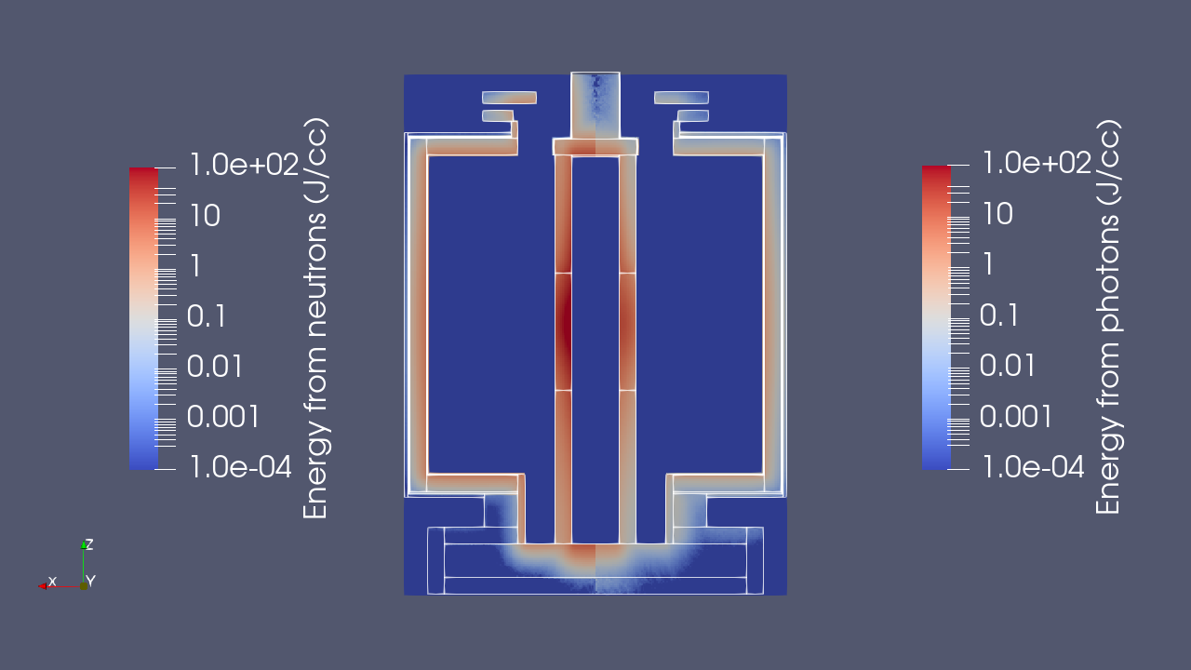
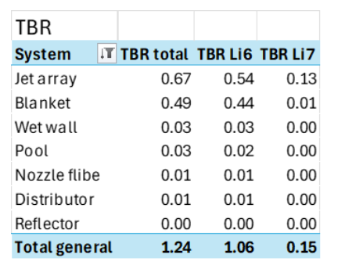
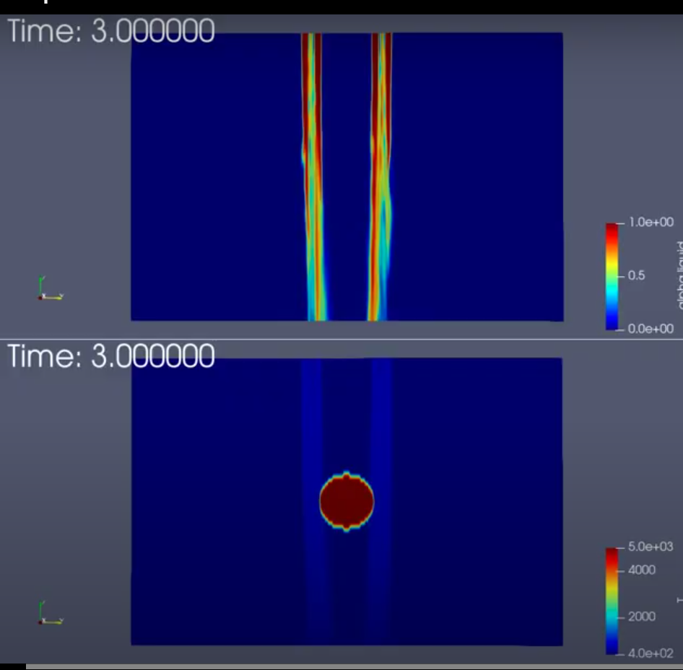
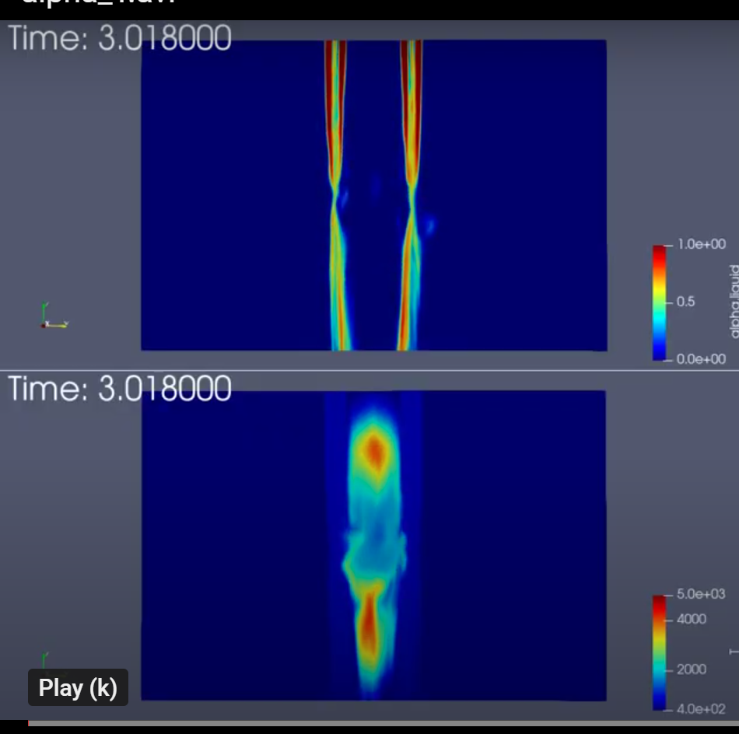
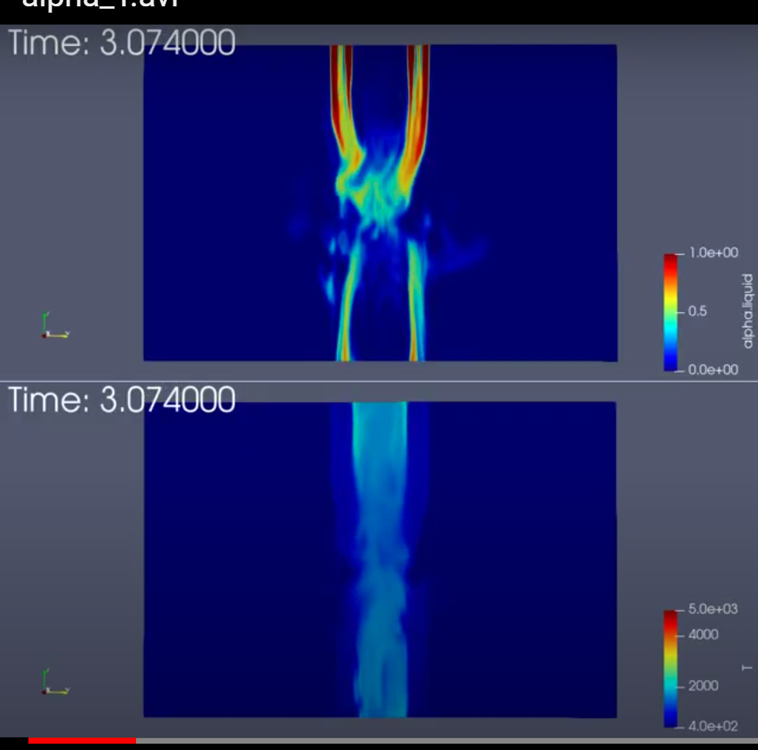
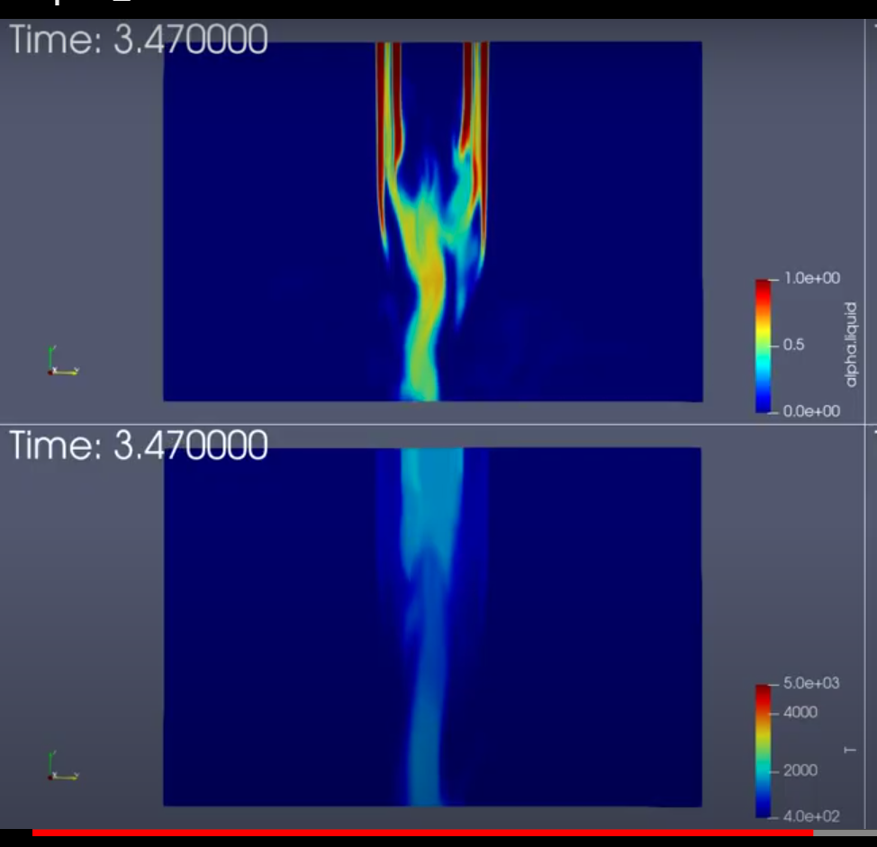
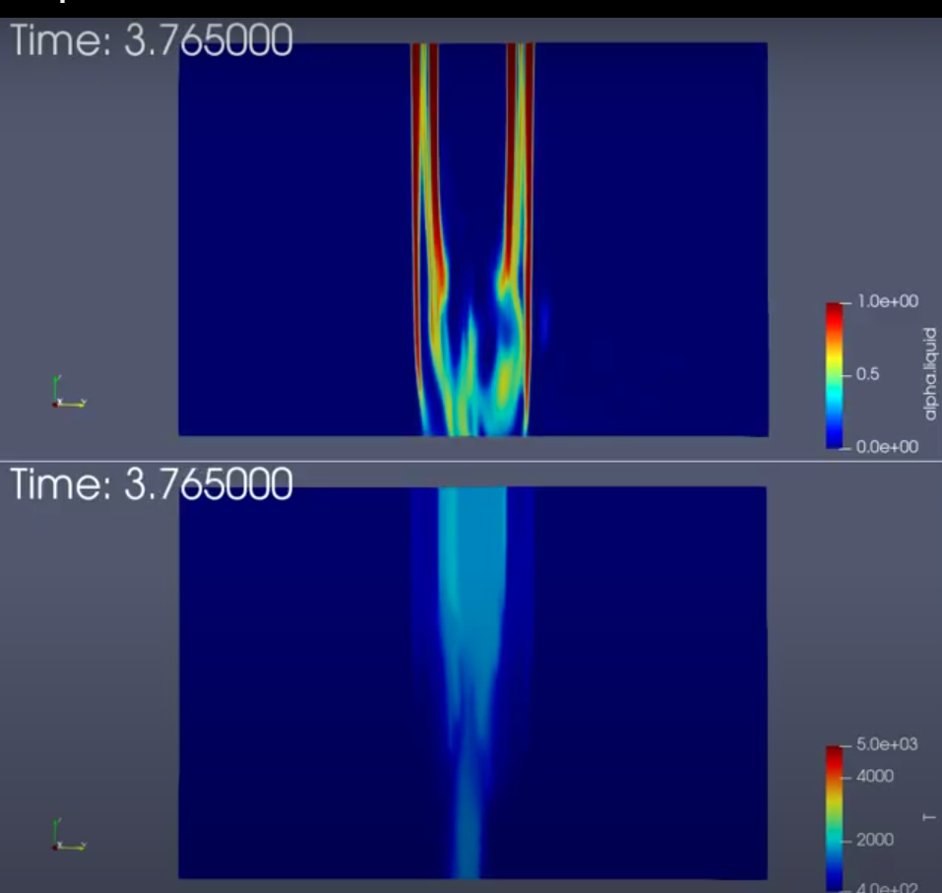

Chamber Design Highlights
Improved neutronics model boosts estimated TBR to >1.2
No Li enrichment needed
Inner jetted liquid wall plus blanket absorb > 95% of energy from neutrons
Damage to chamber first wall < 1 dpa/yr, vacuum vessel wall < 0.02 dpa/yr
Chamber clearing studies underway, indicate loads on structures well below margin and consistent with past studies
Energy deposition per shot
OpenFOAM 3D

Slide 9
Moving forward
Finalize Phoenix laser construction
Use Phoenix as as test bed for laser technology scalability demonstration (long pulse kinetics, high energy KrF amplifier, SBS pulse compression)
Develop conceptual design and initiate site selection activities for Vulcan
Complete Athena FPP preconceptual design report and technology development roadmaps
Advance supply chain and partnerships strategy
Lead the path towards fusion power!
Join us: https://jobs.lever.co/xcimer

