Slide 1
Fusion is Needed Now What is a credible and realistic plan to DELIVER? (and not just promise)
Mohamed Abdou
Distinguished Professor of Engineering and Applied Science
Director, Fusion Science and Technology Center, UCLA
https://www.fusion.ucla.edu/
With much appreciation to the many scientists and engineers I have worked with over decades!
Presentation at the FPA Annual Meeting 12-3-2024

Slide 2
Fusion is Needed Now
Governments & the public want fusion now to solve the climate change crisis
AI needs huge amounts of energy. Because fusion is not available, AI is looking for nuclear power to fulfill its energy needs. (Nuclear stocks gaining on AI optimism)
Enormous interest in fusion energy from industry and private investors
Yet, we cannot deliver!!
We need a credible and attractive plan to actually deliver fusion (not just a promise)
Without serious R&D to address FNST (Fusion Nuclear Science and Technology), it is impossible to have a credible pathway to DT fusion energy
Fusion is like a plane: to fly, it needs an engine with sufficient fuel and reliability. It needs BLANKET.
Yet, no blanket has ever been built or tested!!

Slide 3
Challenging FNST issues identified in comprehensive international studies as most essential to address in defining a credible pathway
Lack of External T Supply to provide the large T Startup Inventory required for any major fusion facility
Technology and physics Uncertainties in achieving Tritium Self-Sufficiency
RAMI (Reliability/Availability/Maintainability/Inspectability)
RAMI is the Achilles’ Heel issue for fusion
Complex and new Multiple/synergistic Effects and Interactions Phenomena
These phenomena cannot be synthesized from “separate effects” experiments or modelling
Nuclear Heating in a large volume with steep gradients
These FNST Issues can be adequately addressed only in the fusion nuclear environment of a DT plasma-based facility (VNS)
The Tritium supply and breeding Issues (1 & 2) mandate that the fusion power of VNS must be small (< 100 MW). So, it cannot be as large as in Pilot or DEMO
Issue 3 requires a very aggressive RAMI program and indicates that it is hard to predict the time in which reliability growth will be sufficient to proceed to Pilot/DEMO plant

Slide 4
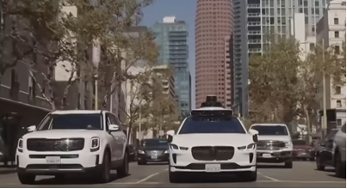

Reliability/Availability/Maintainability/Inspectability (RAMI)
Detailed Analyses show: RAMI is a serious challenge for fusion that has major impact on engineering feasibility and economics: anticipated MTBF is hours/days (required is years), and MTTR is 3-4 months (required is days), and availability is very low < 5%
OTHER Fields of Technology take RAMI very seriously
Aerospace and Fission have had very extensive RAMI Programs with continuous Reliability Growth programs
Self-driving cars are already serving as a taxi in Los Angeles. Even if it is scary to ride the self-driving car, failure modes and rate data are constantly being taken and reliability is being improved
Fusion does not have facilities or programs for RAMI/Reliability Growth.
We urgently need them. VNS will play a central role

Slide 5
A clear conclusion from international studies (most led by US) over the past 30 years: There is no credible plan to build DEMO/Pilot and “deliver” fusion if it does not seriously address FNST- this requires constructing and operating VNS parallel to (or earlier than) ITER
We need a DT plasma-based device (VNS), in which we can learn behavior of Blanket/FW/Divertor in the fusion nuclear environment, discover and understand multiple/synergistic-effects phenomena, quantify the potential to attain T self-sufficiency, and understand failure modes, rates, and effects (RAMI).
It should have a small size (R ~ 2-3 m), low fusion power (< 100 MW), ~ 0.5 MW/m² NWL on ~ 10 m² test area. Only inside the vacuum vessel (Blanket/FW/divertor) needs to be prototypical. Plasma should be highly driven, Q ~ 1 with plasma burn > 200s (VNS should be based on current plasma physics)
EU and China have recently recognized this and are acting on it in major ways:
China decided they could not go directly to constructing CFETR (DEMO/PILOT-type), and is now constructing BEST (a version of VNS but with added physics mission) with operation expected in 2029. Intensive R&D programs are ongoing.
EU concluded after many years of DEMO studies that VNS should precede the DEMO
M. Abdou FPA 12-3-2024

Slide 6
The EU Fusion Program has recently started serious and credible planning to accelerate Fusion. It has VNS as a central element to develop Blanket and RAMI.
The EUROfusion program carried out over the past several years a comprehensive program with intensive physics, engineering, and technological assessments to design a DEMO that follows ITER. The study did not include VNS. Instead, it planned to operate the first stage of DEMO to qualify the blanket.
The conclusions of this comprehensive study are very important: Qualifying the blanket in 1-2 GW DEMO is very expensive and requires a blanket with TBR~1 from day 1. It is also time consuming because of the low reliability and availability.
A study by the EC commission in 2022/2023 showed that VNS can reduce cost and time and accelerate fusion development. This conclusion was strengthened by the long delay in ITER.
So, EUROfusion started in 2023 a year long VNS feasibility study that addressed Programmatic considerations, Concept Definition, and Implementation Strategy.
A recent review was very positive. A Conceptual Design Phase is likely to start very soon.
US-led studies of 30 years developed credible options for VNS. Results from the recent EUROfusion VNS Feasibility Study and Chinese BEST are consistent with US-led studies.
M. Abdou FPA 12-3-2024

Slide 7
An example of US VNS Design Option: 2011 GA Design Standard Aspect Ratio (A=3.5) with demountable TF Cu coils R= 2.5 m, P_{fusion} = 125 MW, NWL = 1MW/m²
High elongation,
high triangularity double null plasma shape for high gain, steady-state plasma operation
Challenges for Material/Magnet Researchers:
Development of practical “demountable” joint in Normal Cu Magnets
Development of inorganic insulators (to reduce inboard shield and size of device)

Slide 8
Another example of US VNS Design Option: 2011 ORNL, Peng et al.
(ST) Smallest power and size, Cu TF magnet, Center Post
R=1.2m, A=1.5, κ=3, P_{fusion}= 75MW, NWL = 1MW/m²
W_{L} [MW/m²] | 0.1 | 1.0
R0 [m] | 1.20
A | 1.50
Kappa | 3.07
Bt [T] | 1.13 | 2.18
Ip [MA] | 3.4 | 8.2
Beta_N | 3.8
Beta_T | 0.14 | 0.18
n_{e} [10²⁰/m³] | 0.43 | 1.05
f_{BS} | 0.58 | 0.49
T_{avgi} [keV] | 5.4 | 10.3
T_{avge} [keV] | 3.1 | 6.8
HH98 | 1.5
Q | 0.50 | 2.5
P_{aux-CD} [MW] | 15 | 31
E_{NB} [keV] | 100 | 239
P_{Fusion} [MW] | 7.5 | 75
T M height [m] | 1.64
T M area [m²] | 14
Blanket A [m²] | 66
F_{n-capture} | 0.76
ST-VNS Goals, Features, Issues, FNST Mtg, UCLA, 8/12-14/08
Notes:
8

Slide 9
Designs and Objectives of recent EU VNS and Chinese BEST are consistent with earlier US studies, but they add improvements
Recent advances in superconducting magnets (including HTS) enabled EU VNS and BEST to use superconducting magnets rather than the CU coils used in earlier US Studies.
The use of superconducting magnets enables VNS designs to be more compact and operate at less fusion power. Reducing fusion power and volume: A- further reduces the tritium consumption (further mitigates the external T supply problem) and B- further reduces the volume of radioactive waste from failed blanket modules
The EU VNS study and BEST project provide further advances in remote maintenance and addressing RAMI issues
The EU VNS study addresses in depth “Blanket Qualification” in VNS to the level required for DEMO.
M. Abdou FPA 12-3-2024

Slide 10
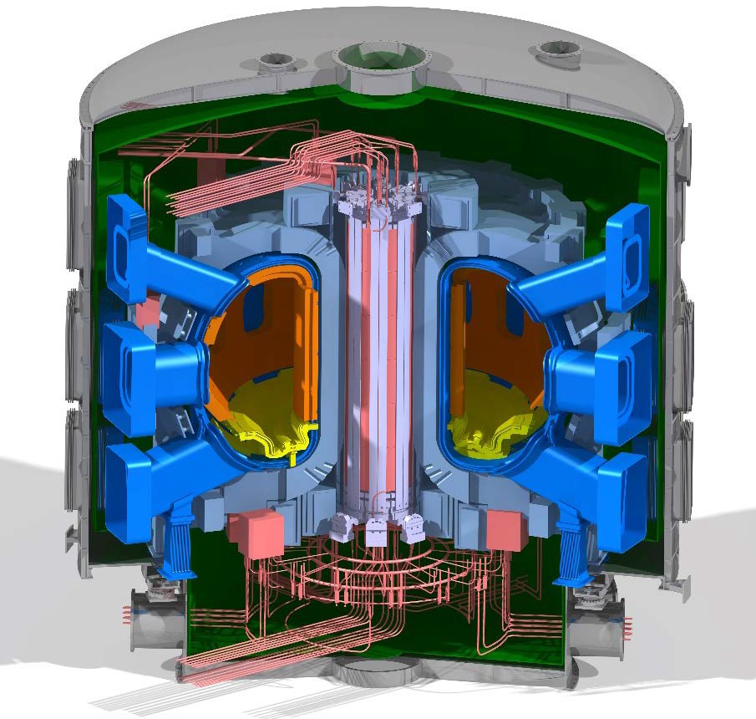
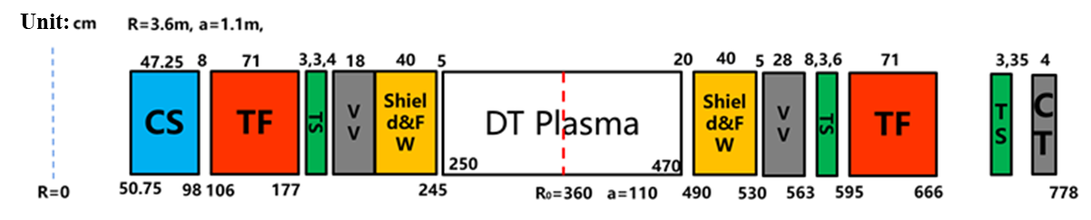
Highlights of Chinese BEST
Mission
Steady state DT plasma with Q ~ 1, together with material, blanket and fuel inventory testing (VNS-type mission): P_{fusion}~ 40 MW
Short pulse DT plasma with Q > 5 (burning plasma physics mission): P_{fusion} = 125 MW
Develop key technologies for CFETR (DEMO/PILOT -type)
 | Q>5(100MW) GASC | Q>1(30MW) GASC
R/a(m) | 3.6/1.1 | 3.6/1.1
Bmax/Bt(T) | 12.48/6.14 | 12.48/6.14
Kappa/delta(q95) | 1.75/0.335 | 1.75/0.335
A | 3.27 | 3.27
^{q}95 | 4.45 | 5.86
Ip(MA) | 6.32 | 4.79
H98 | 1.51 | 1.69
n_{e}/n_{GW} | 0.68 | 0.40
Te/Ti | 16.0 | 20.0
betaN | 2.00 | 1.45
^{f}BS | 0.45 | 0.43
^{f}ohm | 0.44 | 0.00
Pn/Awall | 0.57 | 0.17
P_{CD}(MW)(LH/EC) | 1.4/16.1 | 6.2/9.5
P_{aux}(MW) | 35.0 | 31.5
P_{fus}(MW) | 124.9 | 37.2
^{Q}plasma | 3.56 | 1.18
Zeff | 1.96 | 1.96
P_LH(MW) | 32.7 | 18.1
Features: Superconducting magnets, HTS in CS
TEST ports with blanket TBM/sectors
Notable: fast schedule: design, R&D, construction, etc.
6
Machine size has been fixed on Jan.2022.2

Slide 11
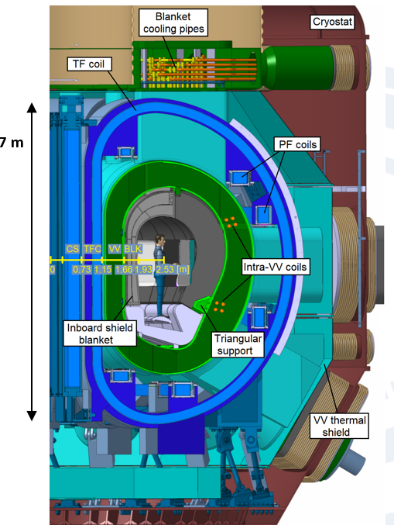
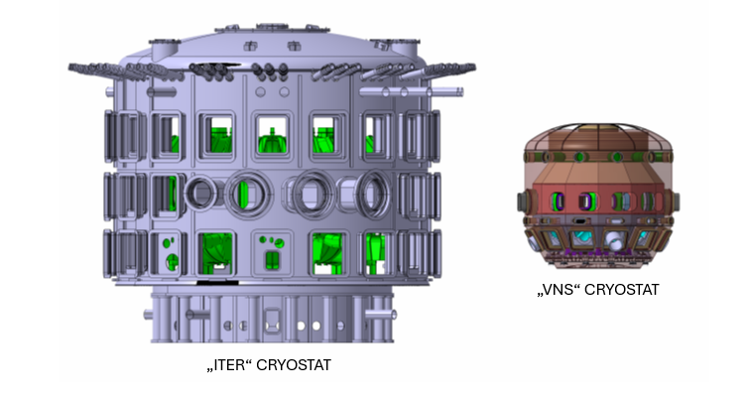
Highlights of EU Study of VNS
Reference: G. Federici - Testing Needs for the Development and Qualification of a Breeding Blanket for DEMO, Nucl. Fusion 63 (2023) 125002.
A Q<1 beam (120 keV) driven plasma. This approach differs considerably from other proposals made for component testing utilising highly performing plasmas that require a full physics qualification mission.
 | VNS | ITER
Linear Size, R_{o}, (m) | 2.5 | 6.2
Fusion power (MW) | <50 | 500
Plasma current (MA) | 1.7 | 15
Magnetic Field (%) | 5.4 | 5.3
Plasma fusion amplif., Q | <1 | 10
Beams energy (keV) | 120 | 1000
Beams power (MW) | 45 | 33
ECH (MW) | 10 | > 40
Plasma volume (m³) | 23 | 1300
Plasma surface (m²) | 80 | 900
Power consumption (MW) | 170
Neutron wall (MW/m²) | 0.5 | 1
Fluence (dpa) | 50 | 0.3
Source: EUROfusion
VNS volume is 50 times smaller than ITER, DEMO, and PILOT
VNS fusion power is < 60 times DEMO fusion Power. T consumption in VNS can be supplied from External sources, but impossible for DEMO
Fluence achievable in VNS is 100 times more than ITER and sufficient to qualify blankets
M. Abdou FPA 12-3-2024
11

Slide 12
What will the US do?
The US has led in FNST studies and has been identifying and defining VNS for > 30 years. It now must consider seriously VNS – start at least a feasibility study. We can not just say we will build PILOT in 10-15 years knowing that it is impossible without constructing a VNS-type facility first.

Slide 13
Thank you!

