Slide 1



delivering fusion power and transformative superconducting magnet technology
Fusion Power Associates 2024

Slide 2
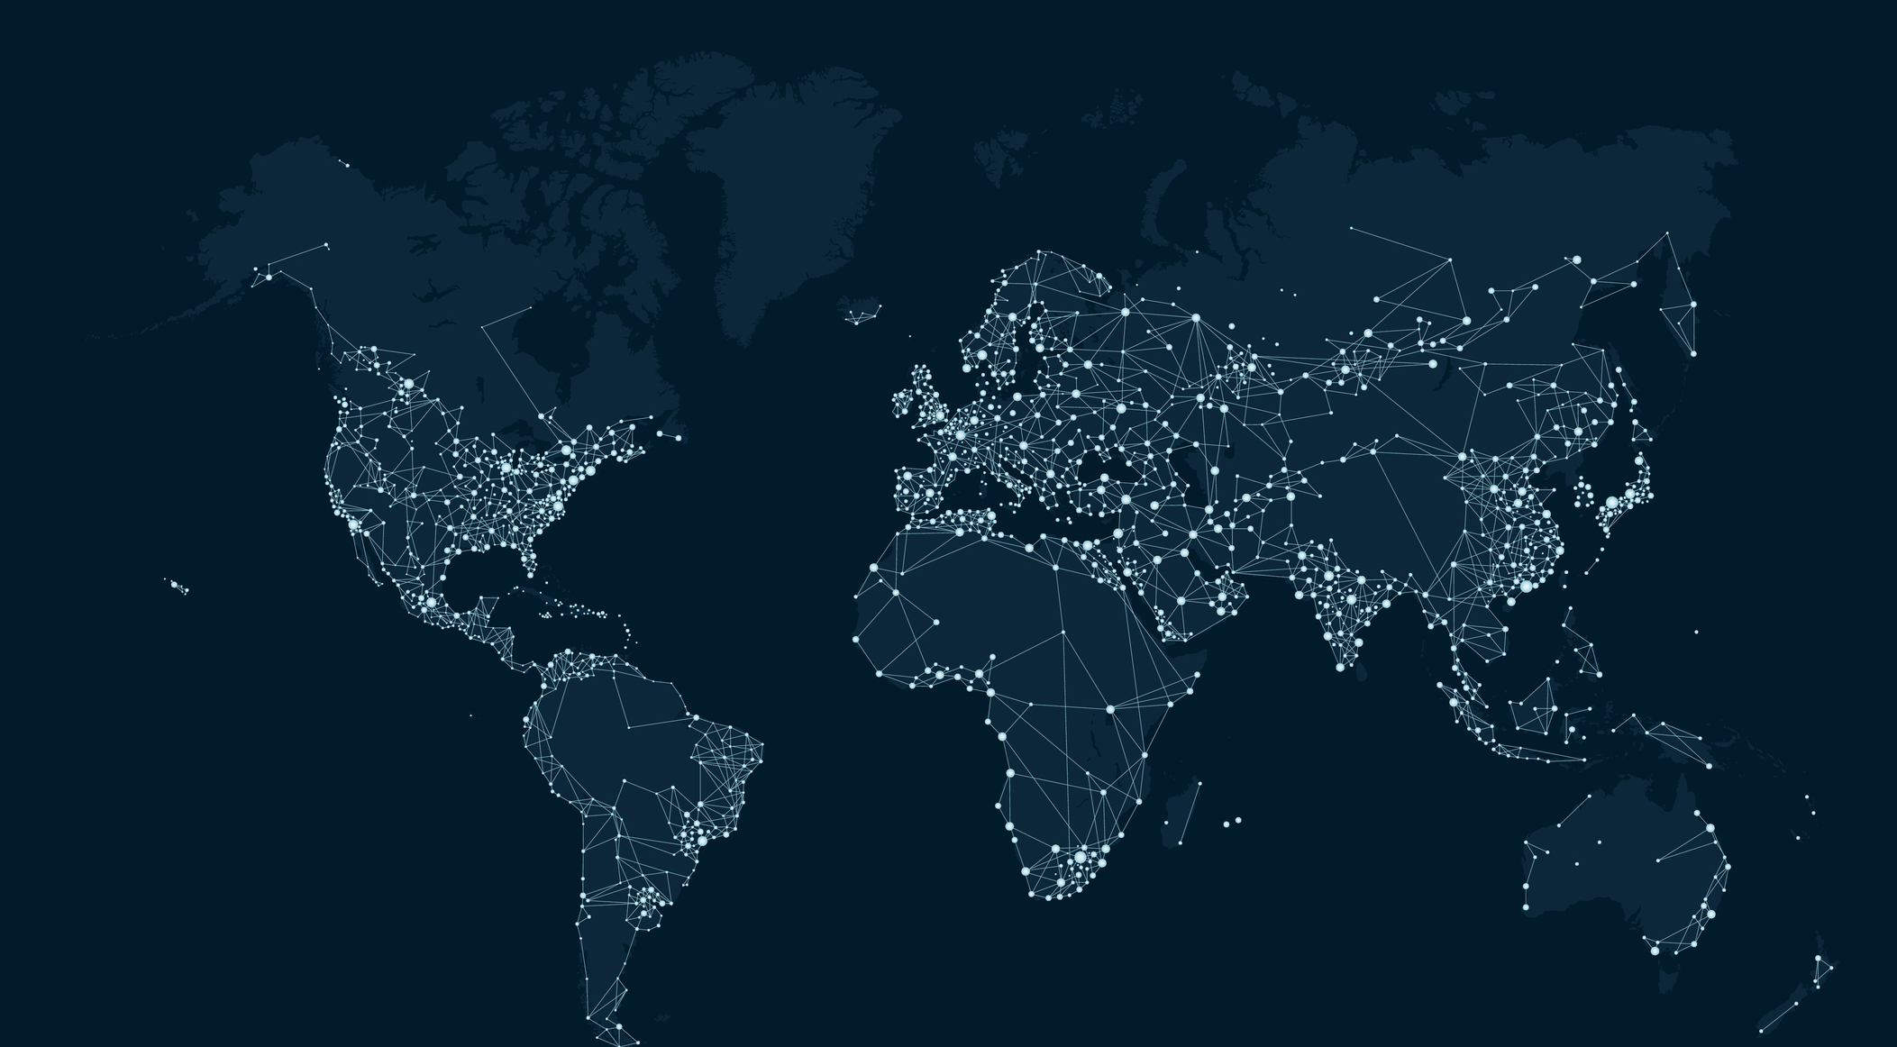













We are Tokamak Energy
The leading global fusion ENERGY company
The leading High temperature superconducting Magnets Company
Princeton, NJ
U.s. subsidiary
Oxford, UK
Global headquarters
Tokyo, JP
Japanese subsidiary
260+
people worldwide
$335M
raised
Partnering with:
Notes:
The leading global fusion company means we are building the partnerships with industry and governments worldwide needed to deliver fusion energy – not just R&D but global demonstration and deployment

Slide 3
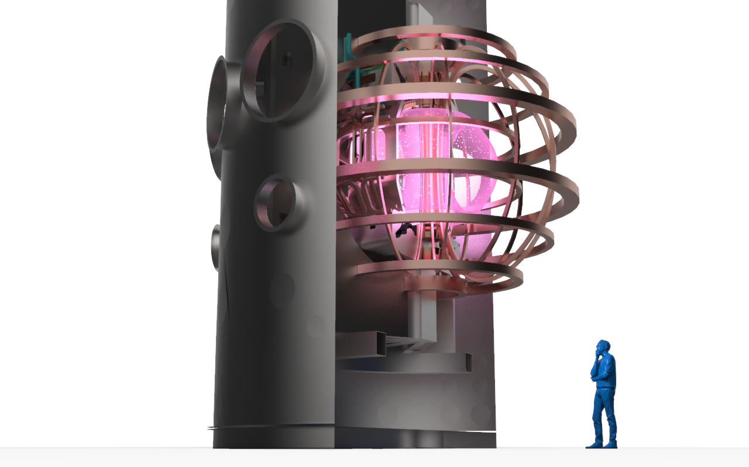



our fusion technology
Spherical tokamak with High Temperature Superconducting (HTS) magnets
Spherical tokamak
High efficiency (high bootstrap current)
Stable plasma
Steady state running
Requires 50% less magnet material*
HTS magnets
Quench-safe, robust magnets
Ultra-high magnetic field (20 Tesla +)
Operate at 20K (no liquid cryogens)
250 people
* Compared to a conventional tokamak (CT)

Slide 4


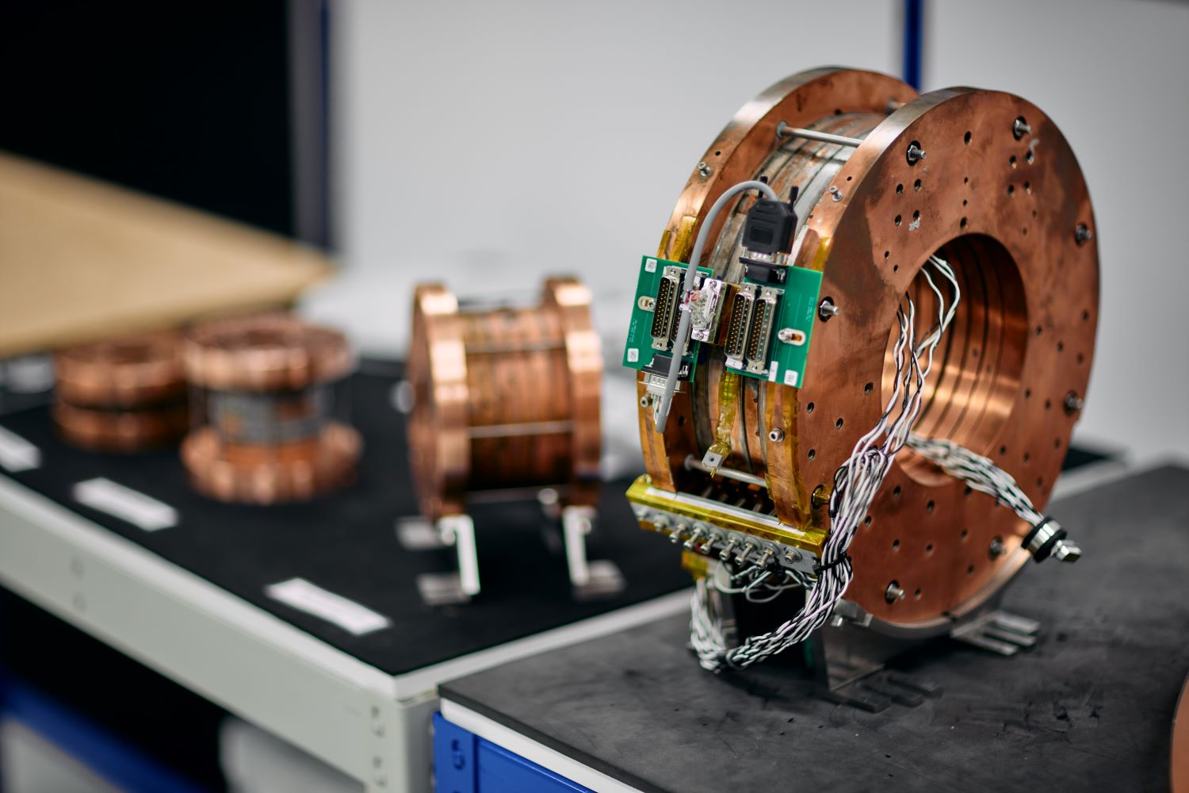
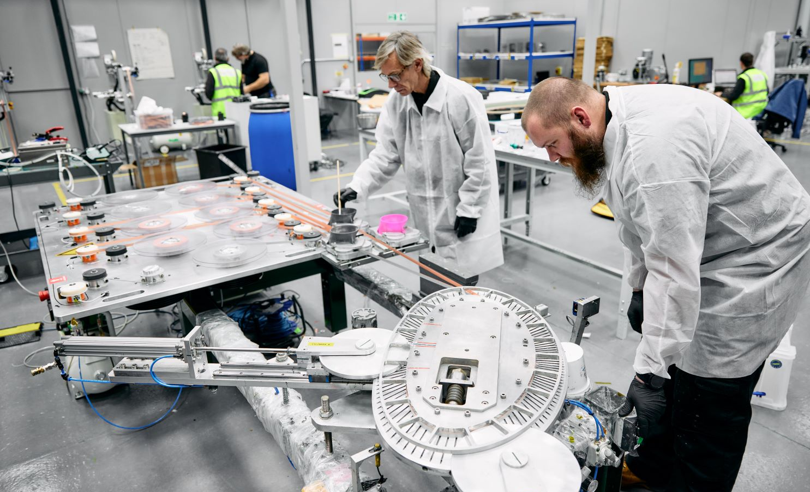
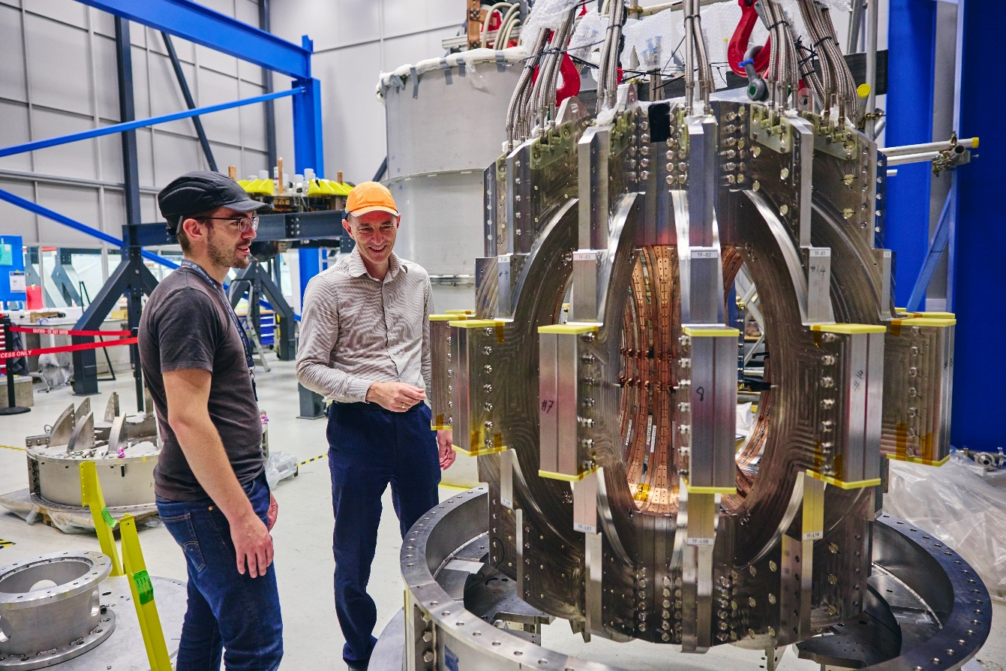
Opening new fields of performance
Born from a world-class fusion energy mission, TE Magnetics is leading the development and deployment of high temperature superconducting magnet technology for fusion and exciting new applications including science, mobility, renewable energy and security
A business division of Tokamak Energy

Slide 5

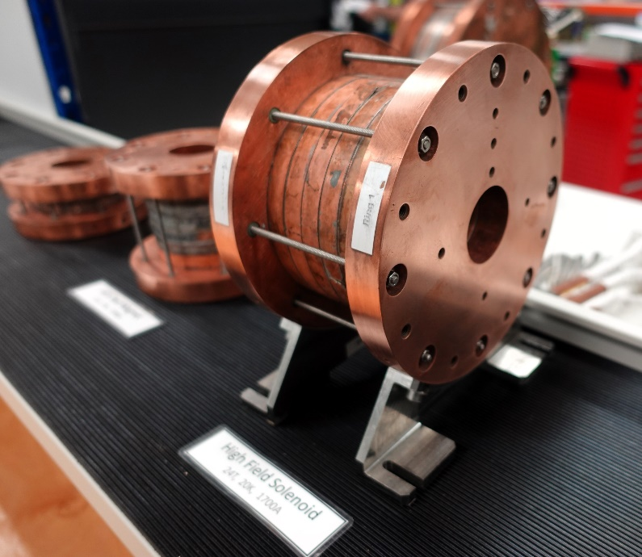
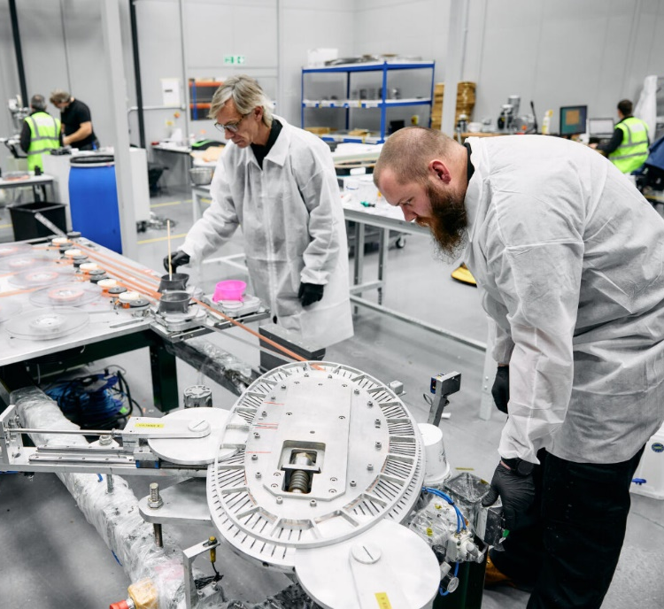

our record – HTS Magnets
World-record ultra-high field magnet with patented HTS technology
24 Tesla field at 20 K
10+ years expertise in design, modelling & manufacture of robust, quench-safe HTS magnets
Designed and built world first all-HTS fusion magnet system in tokamak configuration – ‘Demo4’

Slide 6
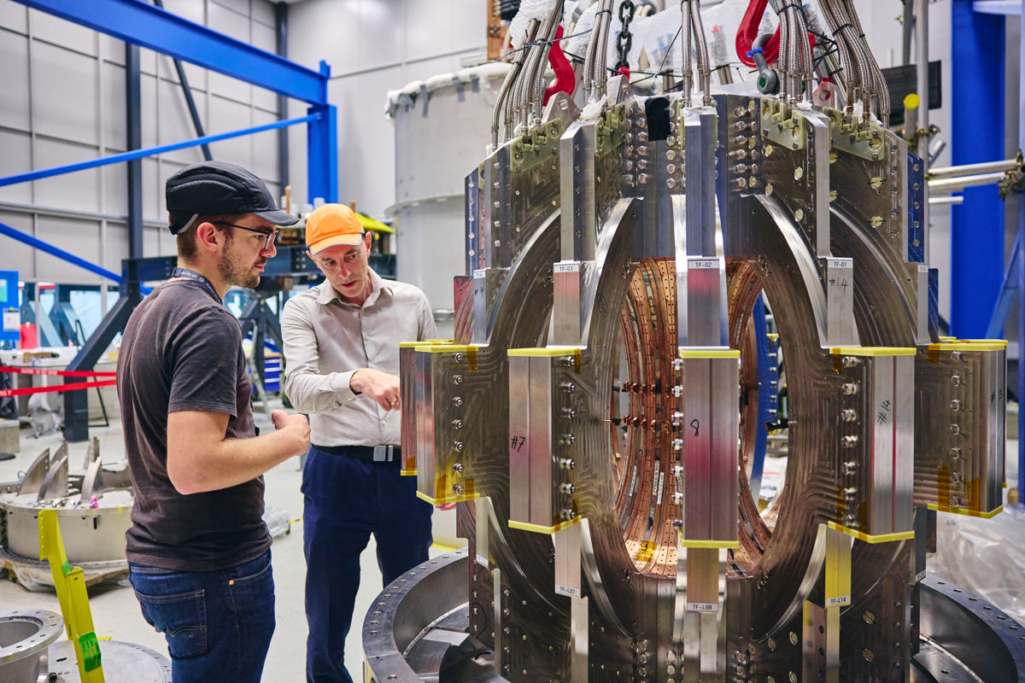
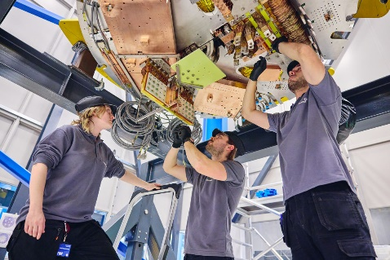
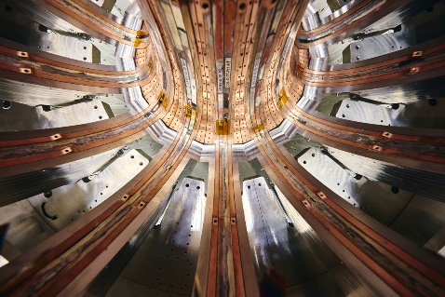
Demo4 fusion magnet system
A vital step on our pathway to fusion energy
World-first complete balanced set of HTS magnets in a tokamak configuration
44 individual HTS coils assembled into 14 toroidal field (TF) limbs and two poloidal field (PF) coils
To operate in a vacuum at 20 Kelvin with stored energy of over 16 MJ
To test the performance and interaction of HTS coils in fusion power plant relevant scenarios for the first time
Validates world-leading expertise in large-scale HTS magnet systems: design, modelling, coil winding, manufacturing and tooling

Slide 7
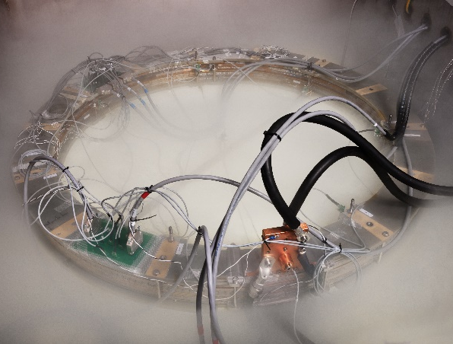
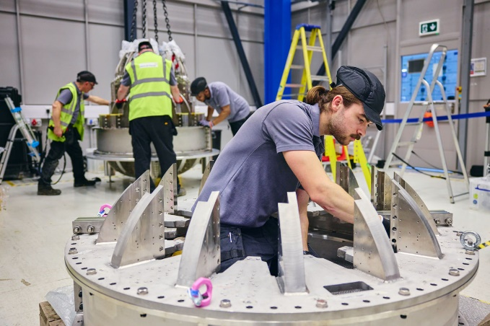
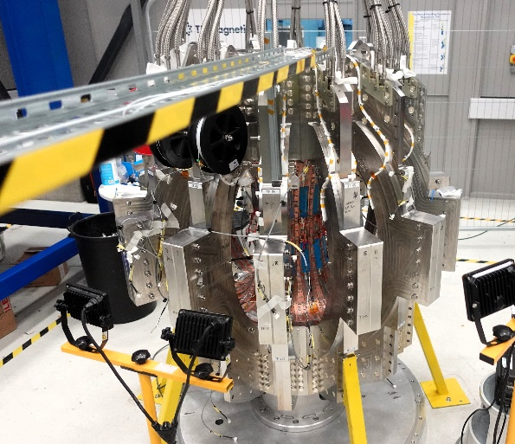
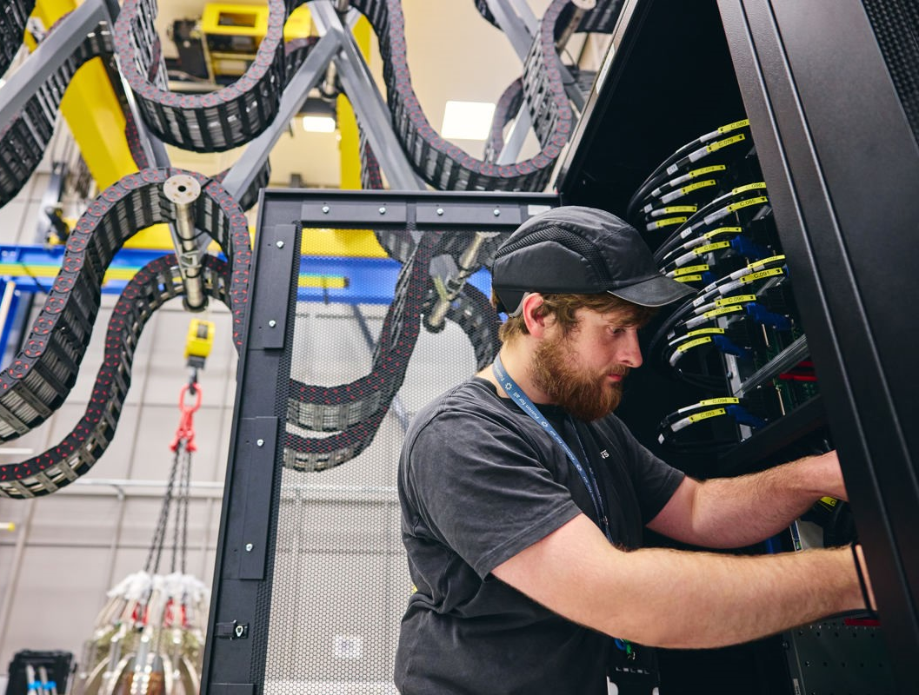

Demo4 fusion magnet system
Gearing up for operations in 2025
All coils successfully tested in liquid nitrogen with 100% yield
Poloidal Field (PF) coils installed in enclosures
PF and TF coils undergoing instrumentation with hall sensors, voltage taps, temperature sensors, and Fibre Bragg Gratings (FBGs) for strain measurement
Three (of four) commissioning phases complete, including cooling and electrical systems, key controls and instrumentation
Full system commissioning early 2025

Slide 8




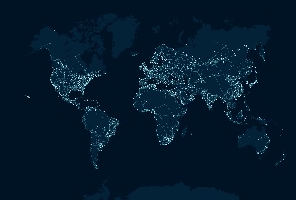
Spherical Tokamak
Chosen as the technology for UK Fusion Pilot Plant (STEP)
Spherical Tokamak
Tokamak Energy Inc. selected for U.S. Milestone Fusion Pilot Plant Program
Advantages of
HTS-ST are recognised throughout the world
Spherical Tokamak
Identified as priority technology for Japan’s fusion R&D program
Spherical Tokamak
Three organisations pursuing low aspect ratio technology
250 people
Spherical Tokamak
Identified as attractive pathway for fusion in countries around the world

Slide 9
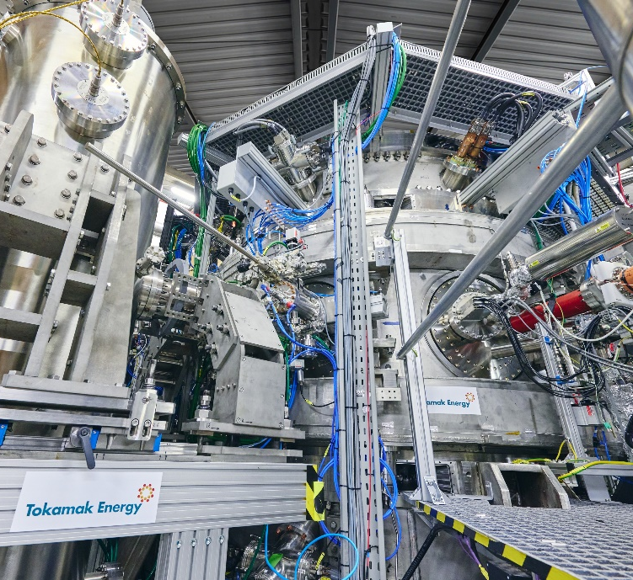
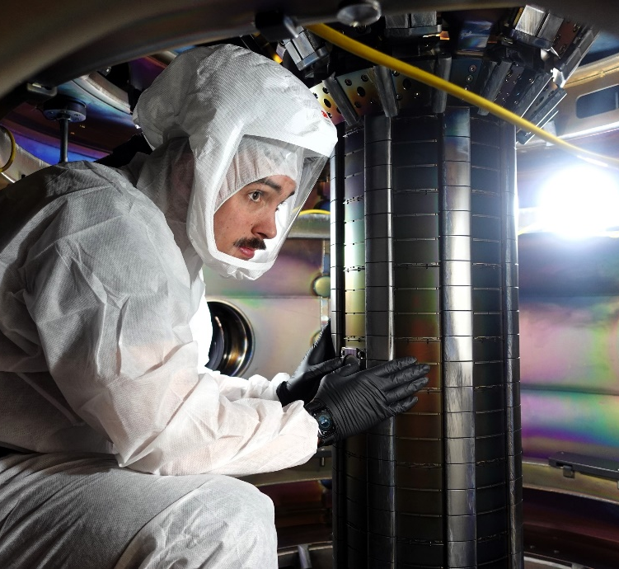
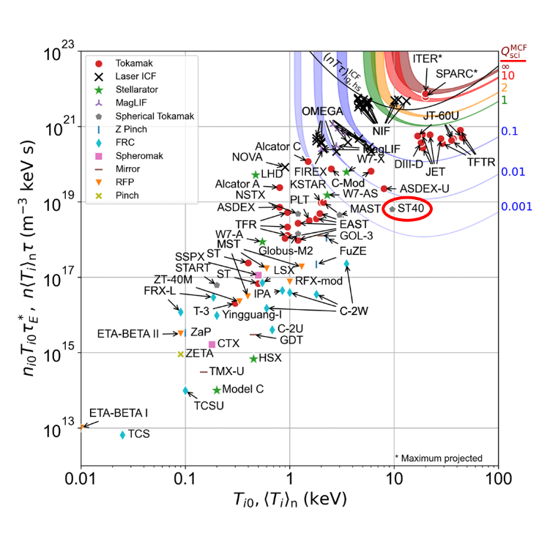


our record – Spherical tokamaks
Only company with 10+ years’ experience designing and building tokamaks and HTS magnets
Unrivaled experience commissioning, operating and upgrading tokamaks
Peer reviewed highest ‘triple product’ in a privately funded tokamak
6 x 10^18 keV.s/m³
$$T_{i}= 9.6 ±0.4 keV$$
Notes:
The key point of the chart on the right is that we have peer reviewed results/achievements, establishing credibility vs other fusion companies. A secondary point is that ST40 is operating in an area where no private company has operated before.

Slide 10

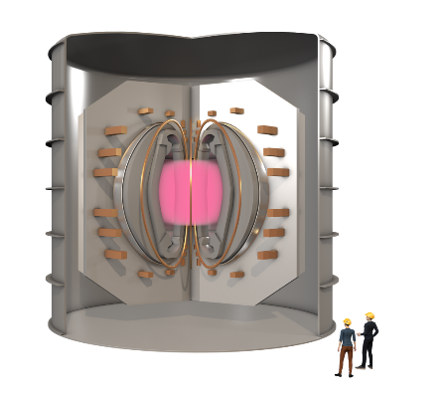




Our roadmap Strategy
Design blueprint
Technology
Develop core enabling technology, IP and expertise
Collaboration with academic and industrial partners
Exceptional commercial potential for fusion, renewable energy, science, mobility and security
Providing early revenues
Demonstration and global deployment in partnership
Leading design for fusion devices incl. pilot plants (e.g. U.S. FPP) and intermediate devices (STX)
Based on most credible and commercially viable route to fusion energy (ST)
Incorporating our core enabling technology and integrating others’ technologies
Integration / ecosystem
Build partnerships with industry and governments, putting our expertise, technology and IP at the heart of fusion energy demonstration and roll-out
Build industrial consortia to accelerate fusion build-out
Licence plant design and enabling IP to industrial partners
Integrate non-proprietary technologies e.g. power and cryogenic systems
Notes:
We are leading the design of next-generation fusion devices. We are designing a pilot plant via the US DOE milestone programme and have developed a design for and intermediate device to prove key technologies. Our designs incorporate our own core technology and IP as well as integrating others’ technology. One core technology – HTS – has huge commercial potential for fusion and beyond and we’re realising this potential via our TE Magnetics business division. At the same time, we’re building the partnerships with governments and industry to deliver fusion energy with our technology central.

Slide 11
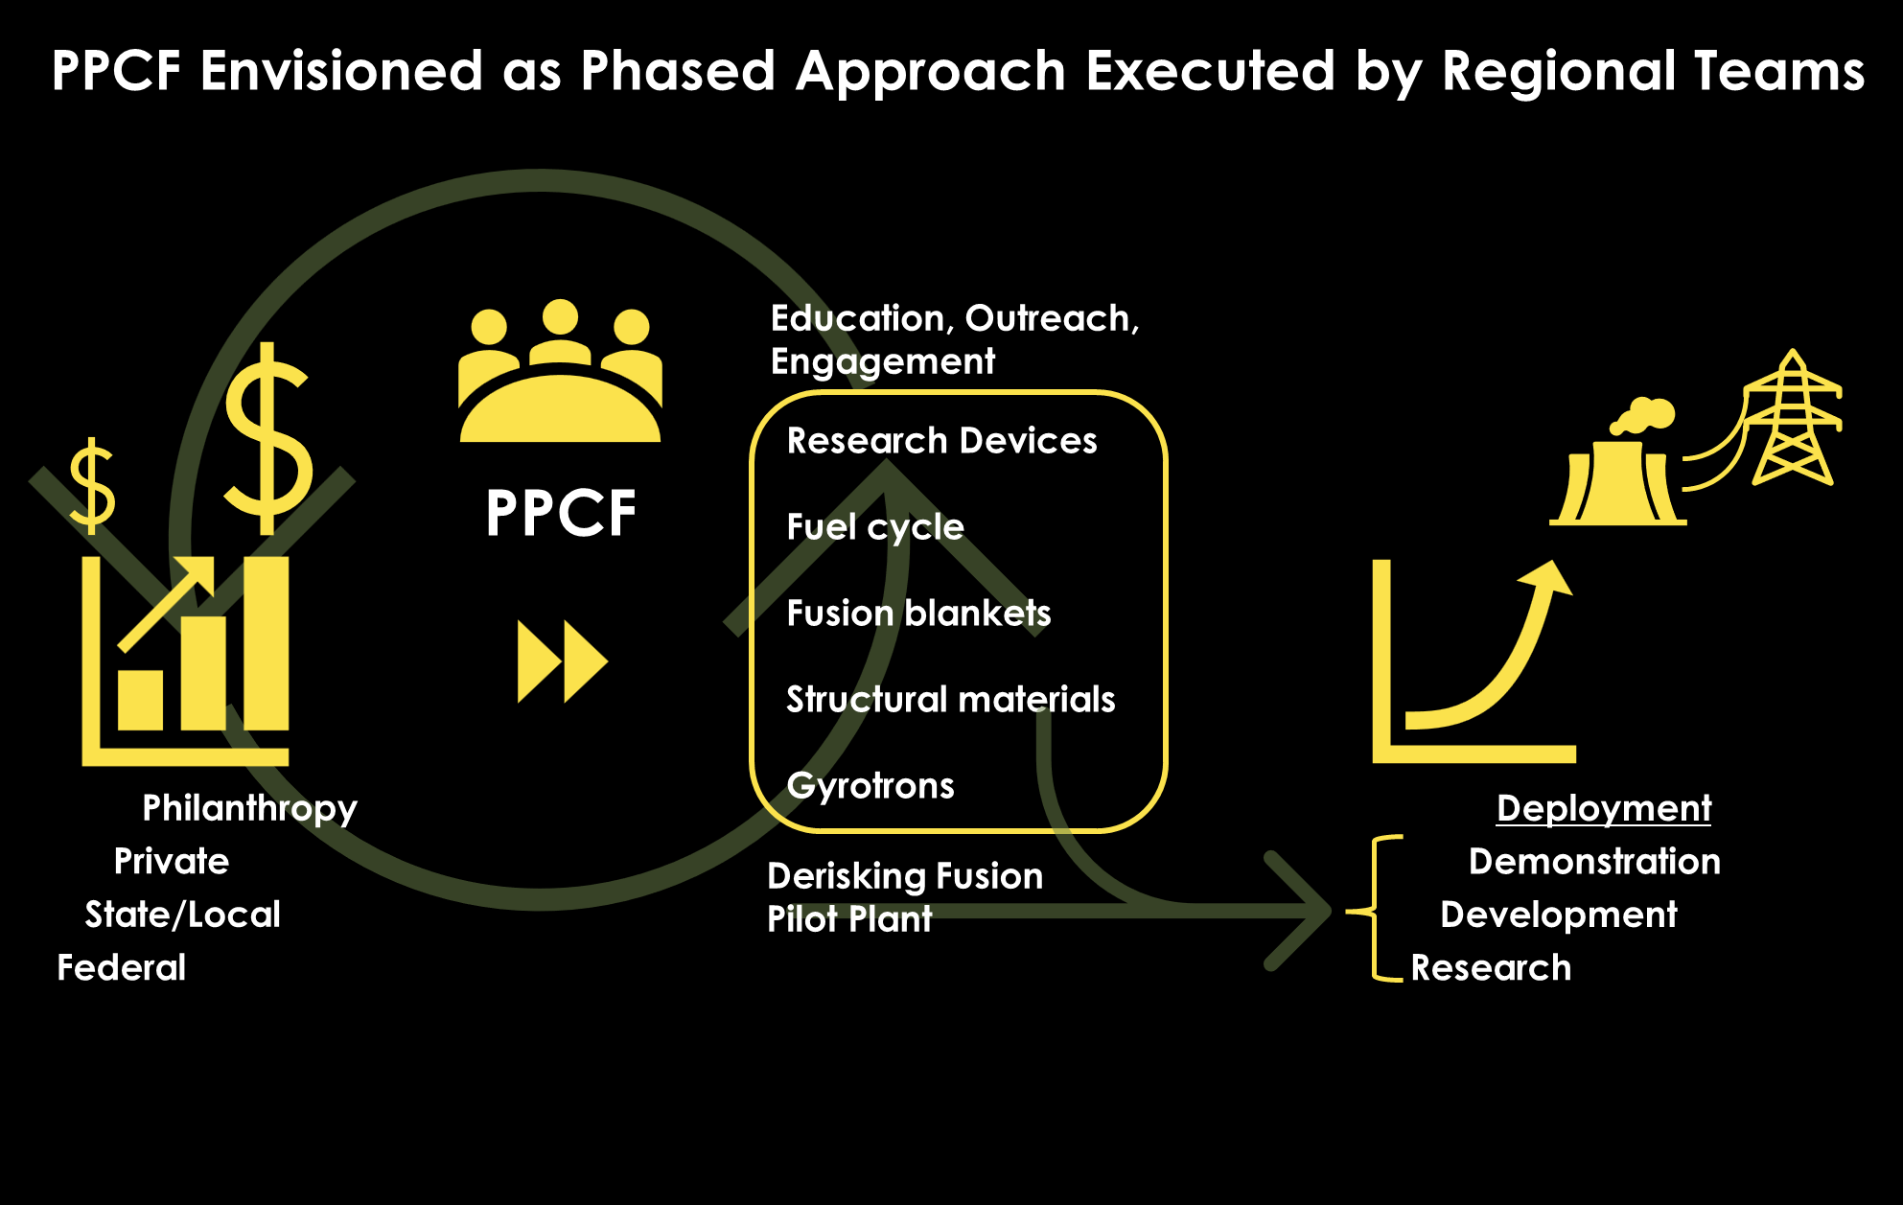
Notes:
The key point of the chart on the right is that we have peer reviewed results/achievements, establishing credibility vs other fusion companies. A secondary point is that ST40 is operating in an area where no private company has operated before.

Slide 12

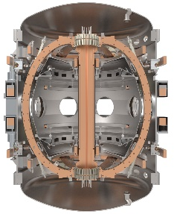
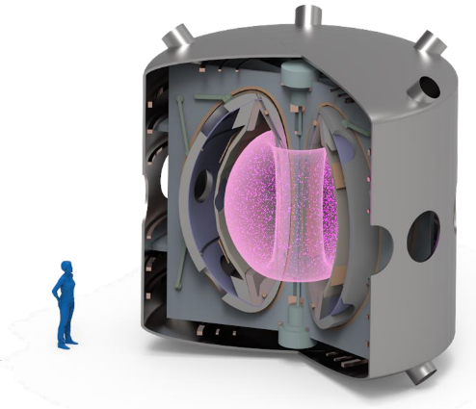
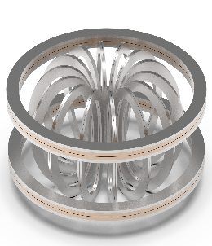



our roadmap to fusion ENERGY
ST40 & Demo4
Intermediate Device (STX)
Pilot Plants
Demonstrate ST physics advantages
Lithium PFC development
RF heating systems optimisation
Expertise in the design and build of large-scale HTS systems
Optimise magnet performance and interaction in full tokamak system
HTS-ST device
Qualify technologies for pilot plant incl. shielding, heating & current drive
Long pulse plasma control
Q>1 with DD equivalent plasma
Net energy generation (50-100 MWe)
US-FPP Program
STEP Programme
FAST Project*
2020s
2030s
2040s
*Not a net energy device
Notes:
The intermediate device we’ve designed will allow us to qualify key technologies and accelerate the pathway to fusion energy. We’re building the partnerships with governments and industry to build STX)

Slide 13
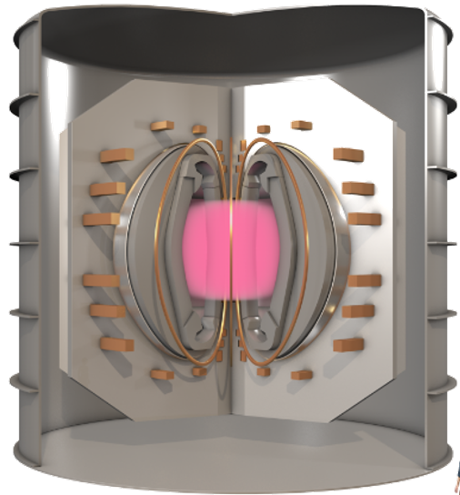
Our Team Has Arrived at a Design Space Decision and Will Continue to Refine FPP Parameters for Our Pre-Conceptual Design
Design Space
Pilot Plant
Parameter | Value | Parameter | Value
R₀ [m] | 4.25 | A [-] | 2.0
B₀ [T] | 4.25 | δ / κ | 0.5 / 2.45
P_{fus-nom} [MW] | 800 | P_{elec-net} [Mw_{e}] | 85
TF lifetime [FPY] | > 5 | Q [-] | 20
TBR [-] | > 1.15 | P_{aux} [MW] | 40
Key Engineering Decisions
Modularity
Liquid lithium blanket
Non-demountable HTS coils
Assuming some inductive current drive at flat-top
Liquid metal PFCs upgrade mission - Milestone program is developing liquid metal technologies for Day n implementation

Slide 14
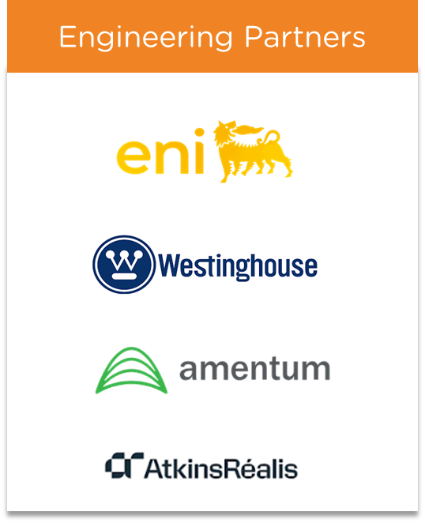
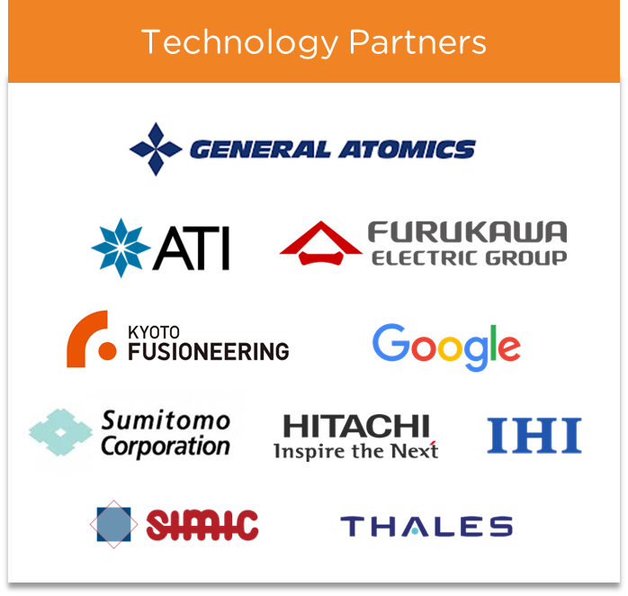
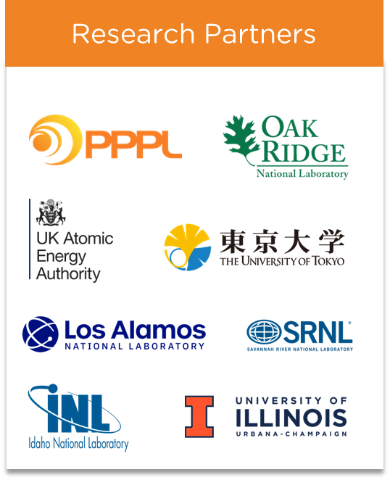

We’re not going it alone
We’re building a global ecosystem of partners
*
*
*Organisations who attended Tokamak Energy’s Partner Day Event in 2024.
Notes:
And we’re nor doing it alone. We are building a world-class ecosystem of industry and research partners to join us on this journey to fusion.

Slide 15
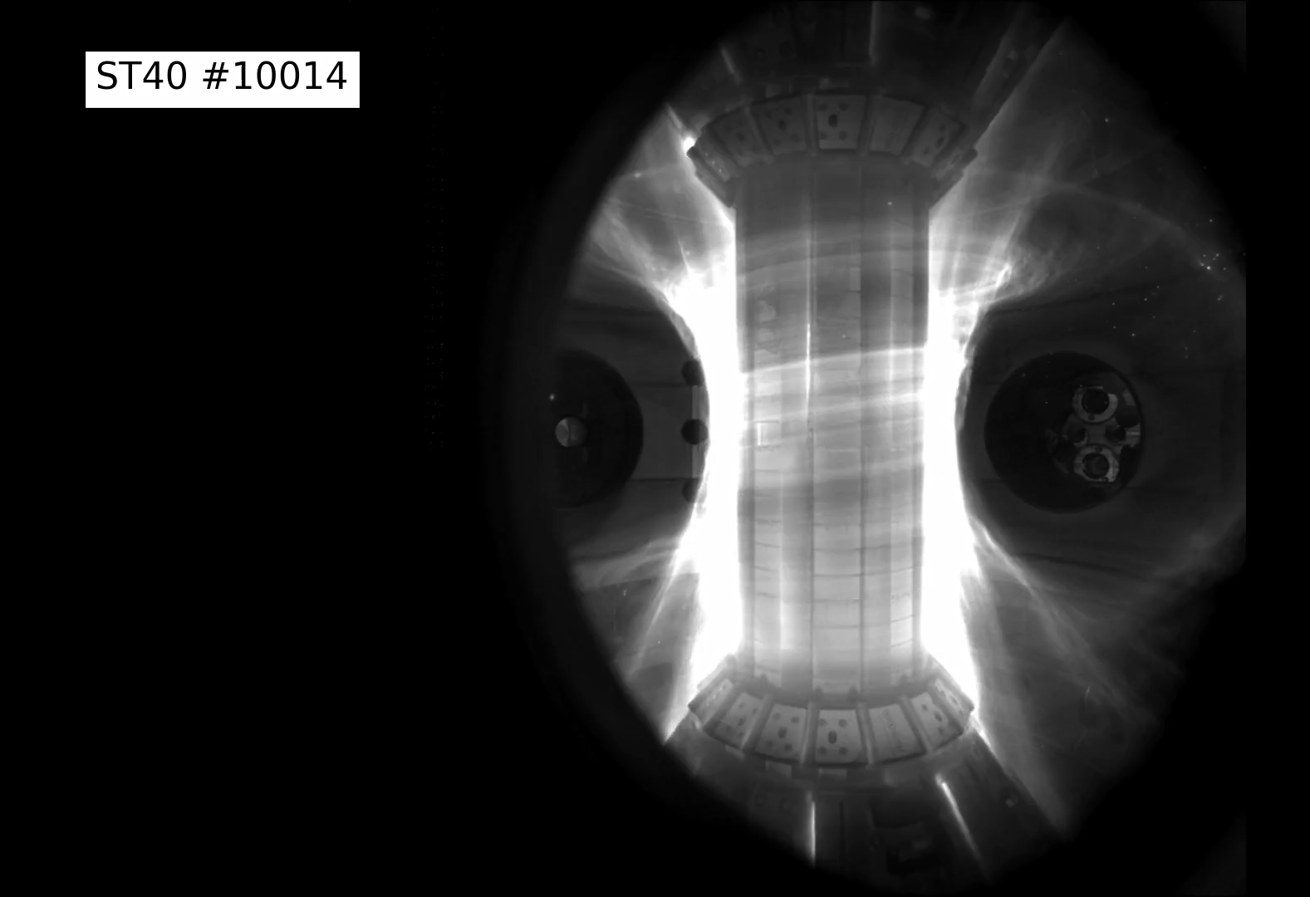

Tokamak Energy’s 2024
Series C raised $125M, total of $335M raised
Officially signed to DOE Milestone Program
CFO (Anita Breslin) and CTO (Itxaso Ariza) Appointed
TE’s US Subsidiary, Tokamak Energy Inc, sets up office in Princeton, NJ
TE Magnetics launches
Awarded 9th INFUSE award
UIUC Collaboration on Liquid Metal PFCs
Peer-Reviewed Publication on Higher ST40 Plasma Performance
Organized US-UK partnership meeting in D.C.
More Announcements Coming Soon…
Notes:
Well, with the technology that Tokamak Energy is developing, we believe that the world won’t have to wait much longer. This is video footage from our operational prototype fusion reactor – ST40. You’re seeing fusion fuel – a plasma of hydrogen (deuterium) nuclei – heated up to more than 100 million degrees Celsius and fusing together to form helium nuclei and in doing so, releasing energy. Scaled up, and with the addition of other fuels (Tritium) this is the process that can turn Hawking’s dream of abundant safe and clean energy into reality.

Slide 16


We are poised to build a bold & resilient fusion company here in the United States
Notes:
US has keys for success: world-leading tech companies + world-leading financial institutions + silicon valley mindset. TE wants to bring these people together and invites them to back our vision for US FPP. We also offer a global perspective: UK STEP, Japan FAST and other opportunities.

Slide 17




Contact us:
Andrew.Shone@tokamakenergy.com
www.tokamakenergy.com
Thank you

