Slide 1
An outlook on laser fusion: Focusing on science and enabling future progress
Work supported by US DoE/NNSA
FUSION POWER ASS0CIATES 44th Annual Meeting
December 20th, 2023, Washington DC
Presented by Max Karasik on behalf of
The Laser Plasma Branch,
Plasma Physics Division
US Naval Research Laboratory
DISTRIBUTION STATEMENT A. Approved for public release: distribution unlimited.

Slide 2
NRL program advances fundamental NNSA science and is developing a promising path for high-yield ICF applicable to IFE
Conducts a vibrant program that includes experiments, theory, simulation, and workforce development
Flexible facility capable of focused experiments, diagnostic development, and code validation
Balanced approach of external collaboration and internal research goals
Unique capabilities – short wavelength, ISI smoothing, bandwidth, zooming, diagnostics
As a federal employees, NRL laser-fusion program provides an independent voice in the field
NRL is the world-leading center for high energy excimer lasers
Offers a path to a future high-yield ICF/IFE facility using a sub-megajoule driver
Enabled by superior target physics with ArF laser and modern implosion designs
Transformational: robust 10’s-100’s MJ yields with sub-MJ laser system capable of shot-on-demand

Slide 3
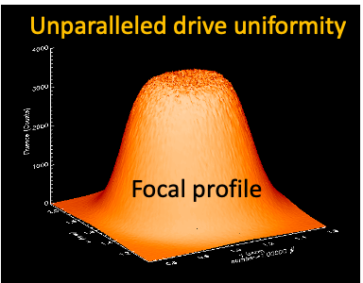
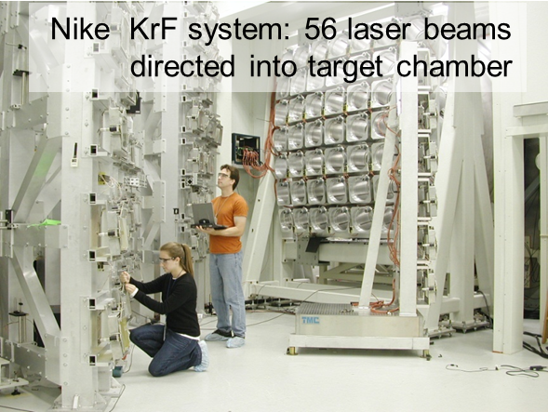
What is unique about NRL’s excimer laser-target facility and what is it good for?
World’s highest uniformity and deepest ultraviolet multi-kilojoule laser-target facility
Premier facility for doing focused hydrodynamic experiments
High pressure drive without contamination from hard x-rays or hot electrons
Drive uniformity without the complexity of a hohlraum
Advanced diagnostics: Monochromatic x-ray imaging, advanced spectroscopy, 1D and 2D VISAR; 5th harmonic probing
Uniquely suited for investigating multi-beam LPI with broad bandwidth
Mid-scale facility with hands-on operation excellent for workforce development

Slide 4
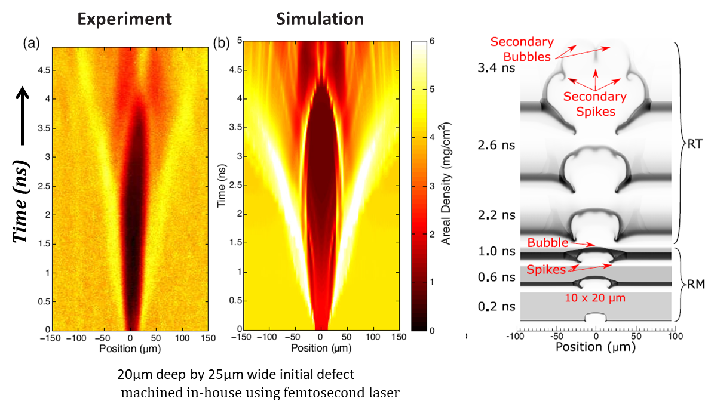
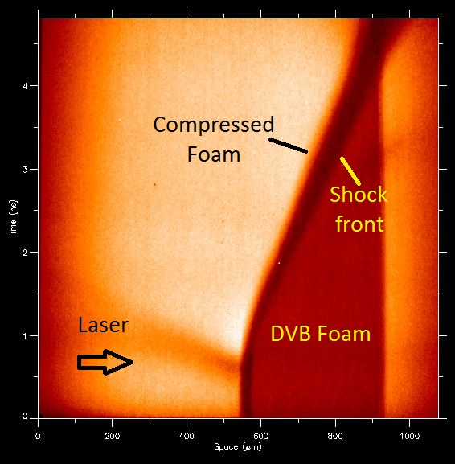
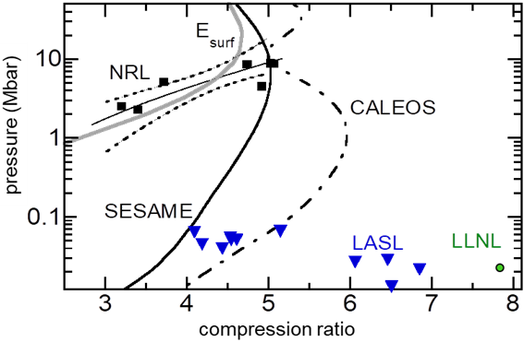
State-of-the art diagnostics and highly uniform drive make the facility extremely well suited for focused experiments with broad ICF/IFE applications
Pioneering study of isolated defects present in all ICF implosions
Foams are useful for HEDP and IFE, but challenging to model accurately
Advanced x-ray imaging and uniform drive allow unique platform for shock propagation and EOS measurement of these materials
Zulick, C et al., PRL, 125, 055001 (2020).
Zulick, C et al., PoP, 27, 72706 (2020).
Velikovich, AL et al., PoP, 27, 102706 (2020).
Y. Aglitskiy et al., PoP 25, 032705
Compressibility measurement on Nike 10% solid density CH foam
Experimental vs. tabulated Hugoniot for 10% solid density CH foam

Slide 5
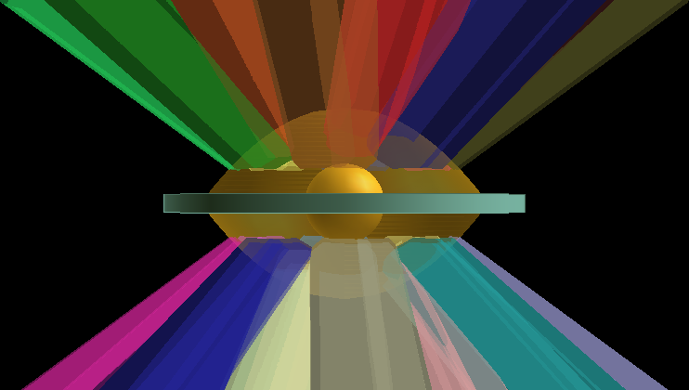
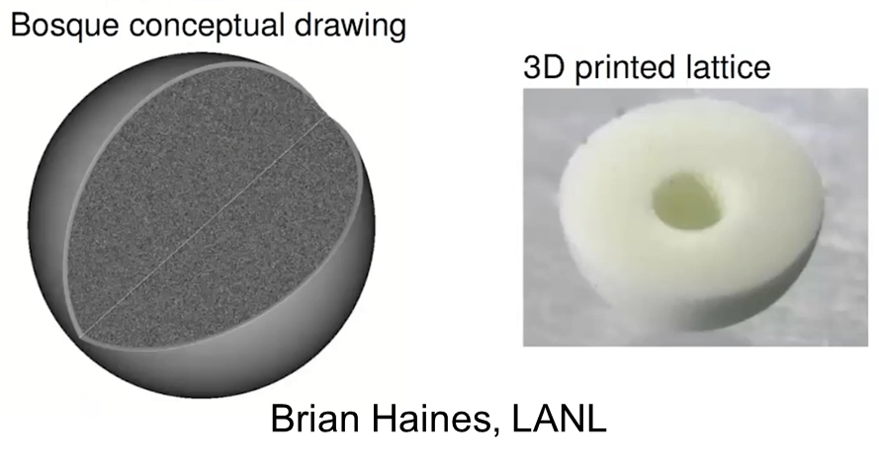
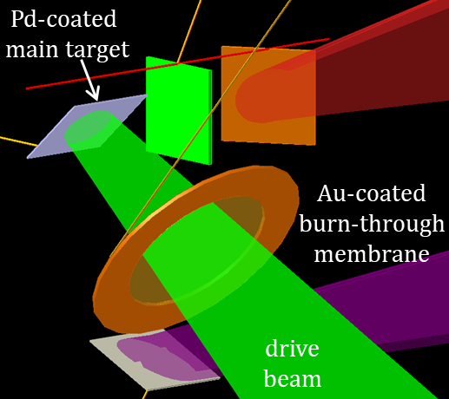
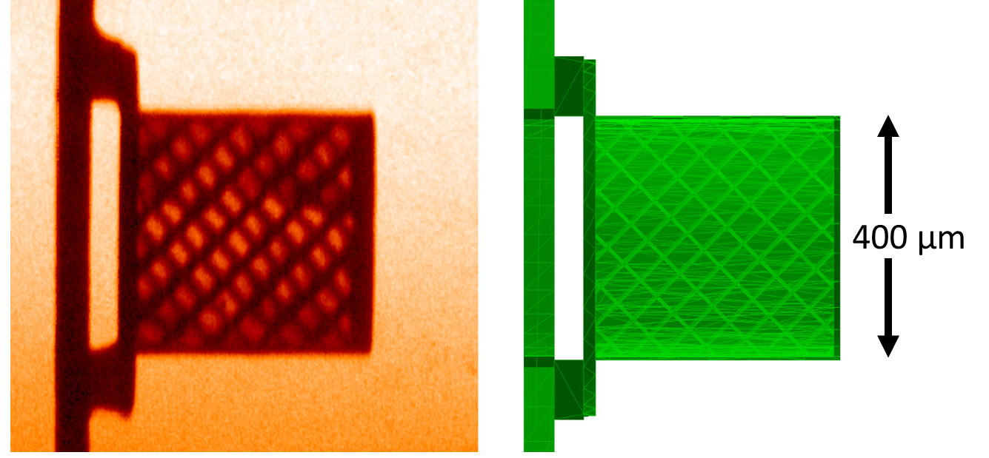
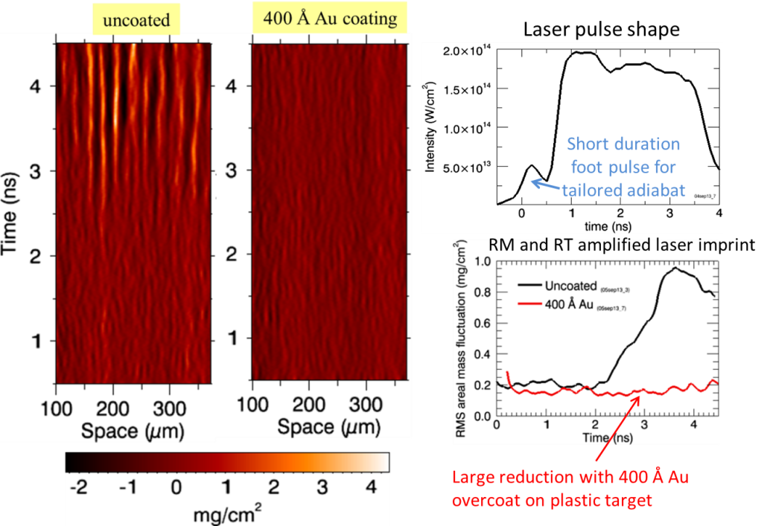

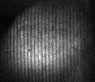
NRL has collaborations on high impact efforts across the complex
with LANL on structured foams
with LLE on Imprint mitigation using burn-through membrane
NIF PDD implosions
Implementation on Omega
X-ray radiograph
at NRL
LANL 3D printed foam lattice
Development on NIKE
400 Å Au coating
uncoated
400 Å Pd
uncoated
26494
37337

Slide 6
NRL is participating in the IFE hubs
DOE release: https://www.energy.gov/articles/doe-announces-42-million-inertial-fusion-energy-hubs
The 3 hubs are:
Inertial Fusion Energy-Consortium on Laser-Plasma Interaction Research hub
Inertial Fusion Science and Technology hub
National Science and Technology Accelerated Research for Fusion Innovation & Reactor Engineering hub
Inertial Fusion Science and Technology hub
Colorado State University (leader)
Cornell University
General Atomics
Los Alamos National Laboratory
Marvel Fusion
SLAC National Accelerator Laboratory
Texas A&M University
U.S. Naval Research Laboratory
University of Illinois Urbana-Champaign
Xcimer Energy Corp.
CSU link https://engr.source.colostate.edu/csu-to-lead-doe-funded-multi-institution-hub-to-advance-laser-driven-fusion-energy/

Slide 7
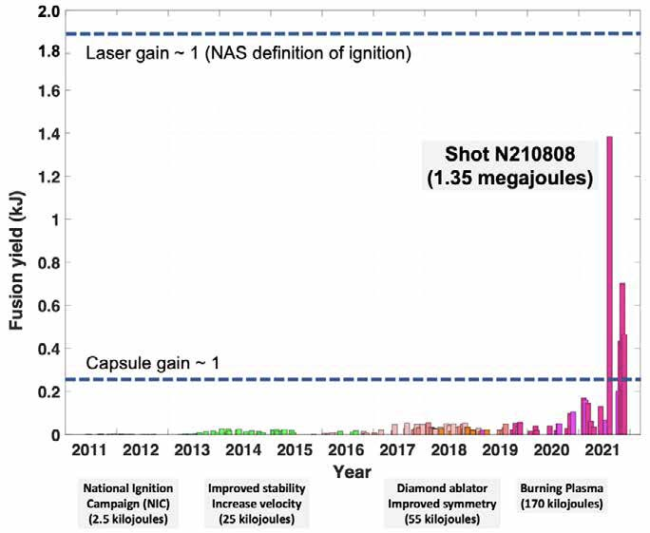
Achievement of ignition at NIF is a milestone for all fusion research
> 3 MJ yield has been achieved with ~ ¼ MJ energy absorbed by the pellet
Shot N221205
(3.15 megajoules)
Laser gain ~ 1.5x
Capsule gain > 10x
Results of decades of work – need to exploit investment for near-term (3-5 yrs.)
What is the best path to high yield capabilities (10’s-100’s MJ)? (>5 yrs.)
At the time of the decision to build NIF, new approaches for direct drive
ICF were nascent and not sufficiently developed for full scale facility
Laser gain ~ 0.7x
Capsule gain ~ 5.7x
(1.35 MJ/230 kJ)
Fusion Yield (MJ)
Sufficient progress in direct drive ICF has been achieved to deserve serious consideration for the next generation high-yield facility
2022

Slide 8
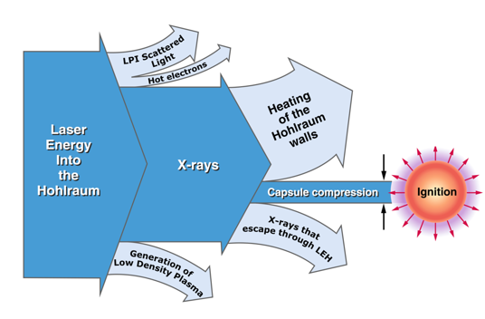
Direct drive couples ~4x more energy into the imploding shell giving higher yields for a given laser energy
Direct drive eliminates major energy losses for indirect drive
But details matter – direct drive still must overcome problems
Coupling of laser to pellet
Uniform illumination
Mitigate laser-plasma instabilities
10-20% of
Laser Energy
Drives Capsule
Excimers are an attractive laser driver for high performance ICF*
Shorter laser wavelength to further suppress LPI and increase hydro-efficiency of implosion
Highly uniform target illumination
Multi-THz bandwidth to suppress LPI
Capable of zooming the focal diameter to follow imploding target
The 193 nm ArF laser best meets all of the above criteria
230 kJ
N210808
Laser
Yield
1.9 MJ
1.35 MJ
N210808
N210808
Shot N210808 capsule gain ~5.7x @ 230 kJ
Substantially less than 1 MJ of energy ignites the NIF pellet
*See JASON report (2021)

Slide 9
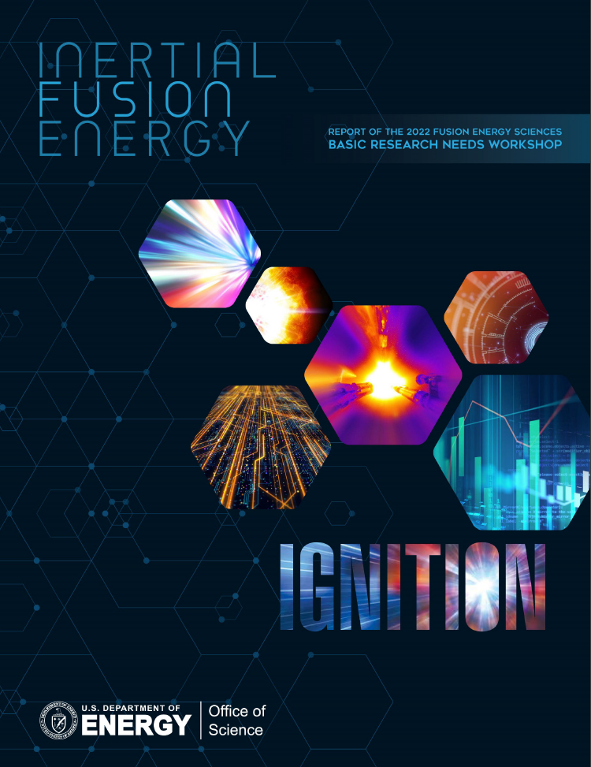
Broad bandwidth and short wavelength will enable robust ICF and IFE
Basic Research Needs Report (BRN 2023) identifies short wavelength, broad bandwidth drivers as enabling technology for IFE
Broad bandwidth 3ω (351 nm) lasers for direct drive proposed by U of Rochester Laboratory for Laser Energetics (LLE) (D. Turnbull, et al., APS/DPP 2023)
Argon Fluoride (ArF) laser driver offers 10 THz bandwidth with the crucial benefit of short wavelength (193nm) and high efficiency
The high drive pressure enabled by short wavelength and wide bandwidth opens up the parameter space
More robust, higher gain implosions => high yield with smaller driver
NNSA Applications
Inertial Fusion Energy

Slide 10
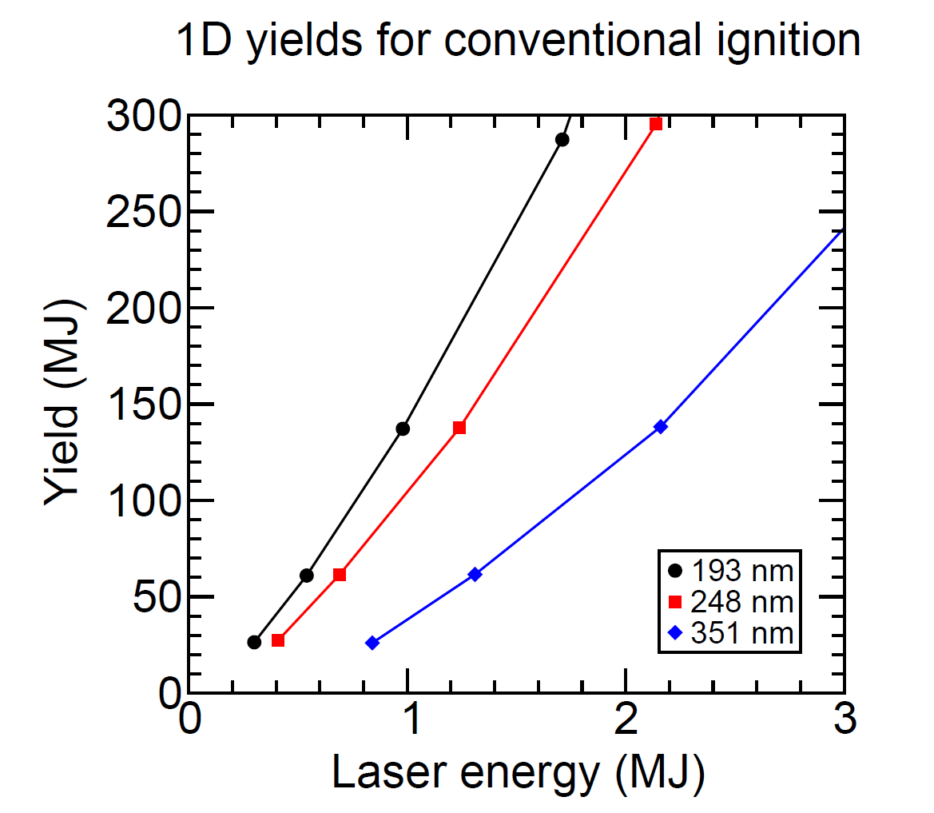
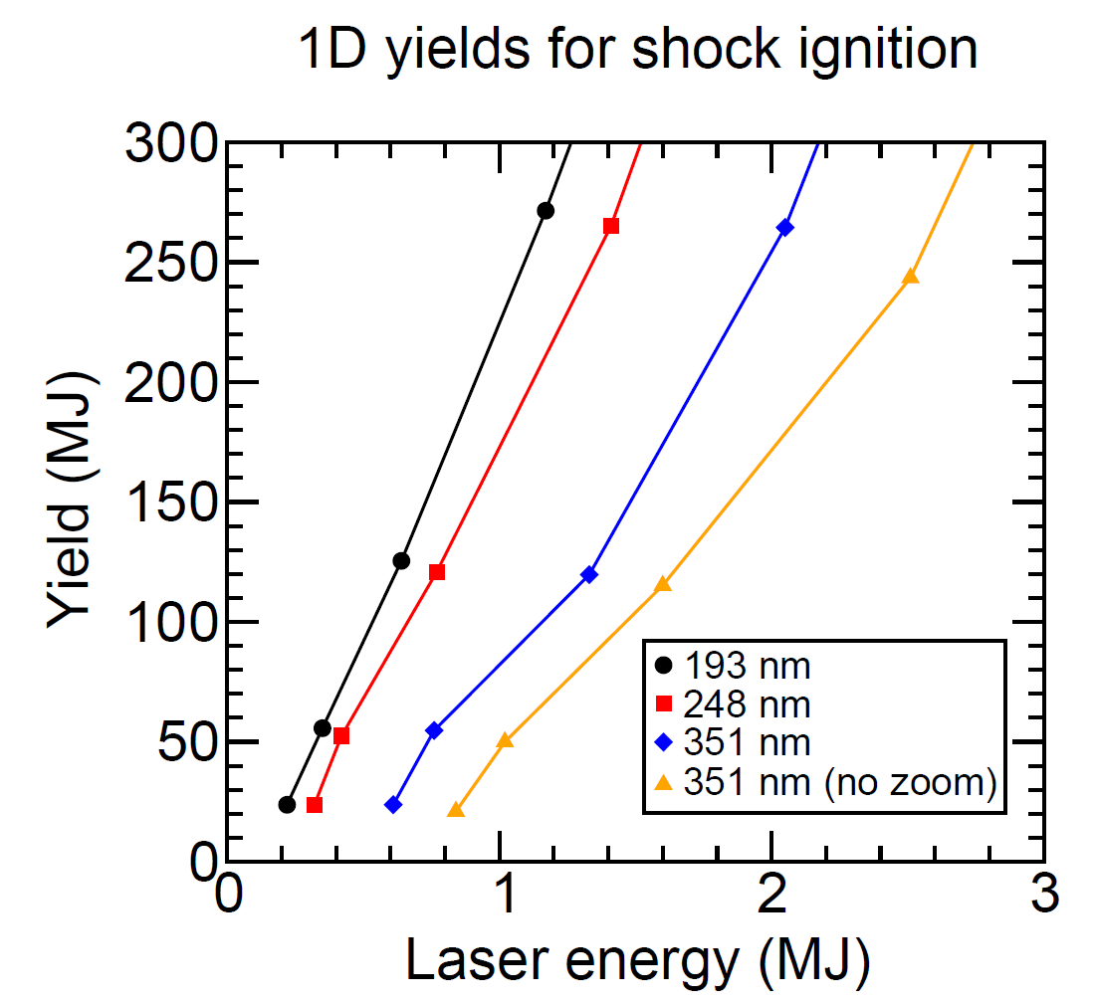
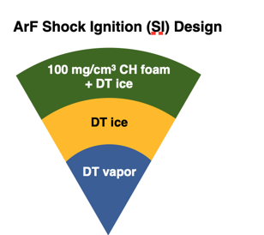
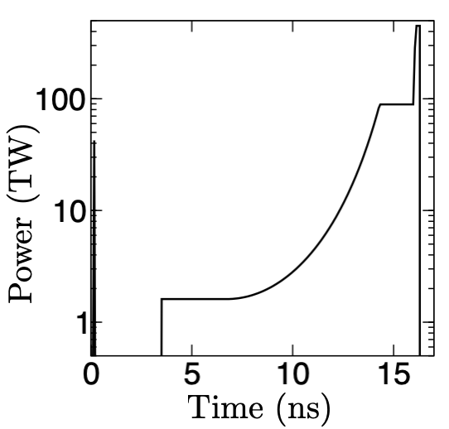
High yields (10’s-100’s MJ) are possible in conventional direct drive designs using sub-MJ of ArF laser light with focal zooming - even higher yields with shock ignition
Low-aspect ratio shell:
Robust against hydro instability
High yields at < 1 MJ laser energy with two different designs indicate robust physics
Increased coupling and higher drive pressure with short wavelength gives higher yield
A. J. Schmitt, PoP 30, 012702 (2023)

Slide 11
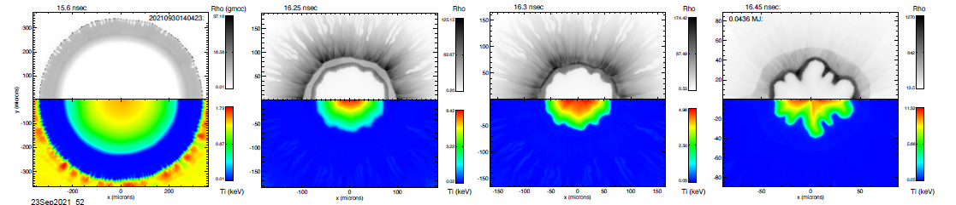
Sub-MJ ArF laser and shock ignition maintain high yield in 2D simulations
Aspect ratio 3.7 pellet, ArF shock ignition: 61 MJ yield with 411 kJ of laser energy
density
0.12 mm
0.6 mm
temperature
Time
A. J.Schmitt, PoP 30, 012702 (2023)
includes effects of laser imprint and target surface roughness
Higher drive pressure allowed by ArF -> lower aspect ratio -> more stable implosions

Slide 12
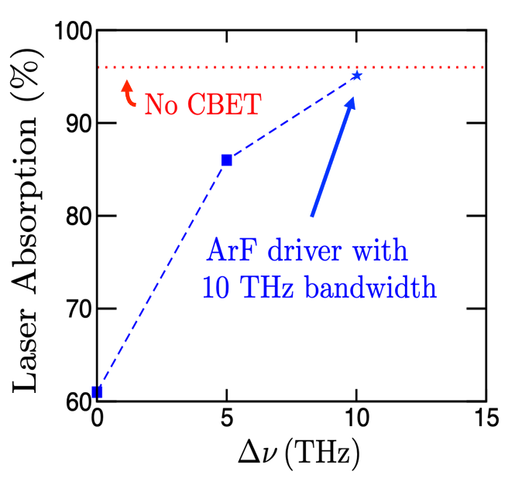
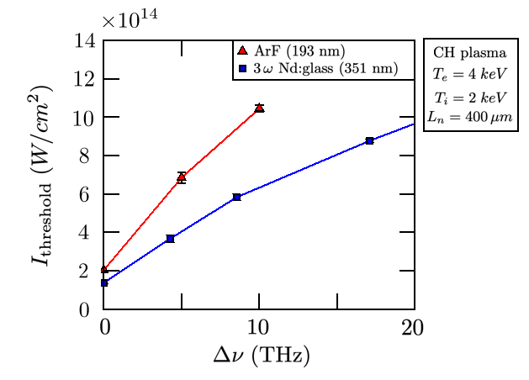
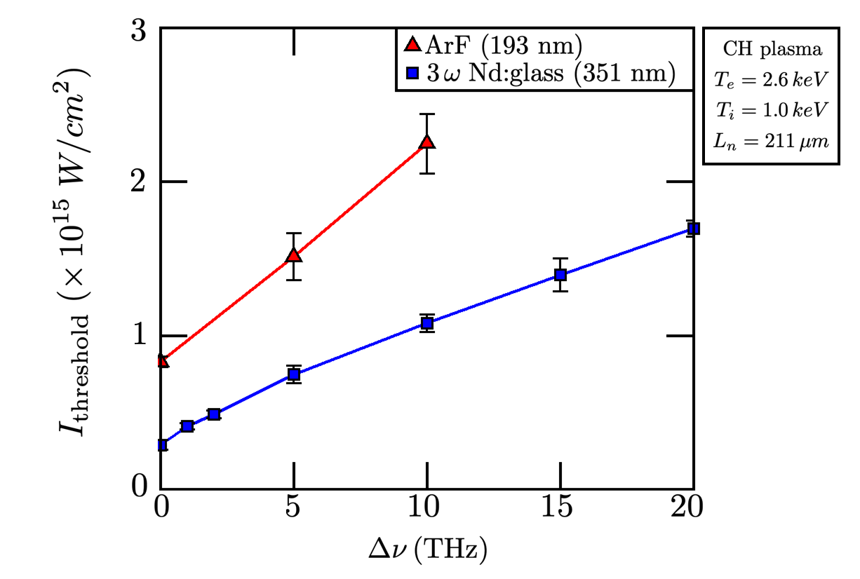
With broadband & deep UV ArF laser, higher LPI thresholds and high absorption allow target to be driven at higher pressure
Cross-Beam Energy Transport
(CBET)
Absolute Two-Plasmon Decay Instability
(TPD)
Absolute Stimulated Raman Back Scattering
(SRS)
Simulations by J. Bates using LPSE code
in collaboration with LLE scientists
Absolute TPD threshold for 6 ArF beams in an Omega-scale plasma is about 5.5x higher than the 3ω Nd:glass laser with currently realizable bandwidths (~1 THz)
Absolute SRS-backscatter instability threshold for ArF beams exceed those of 3ω Nd:glass laser for NIF-like plasma conditions
J. W. Bates, PoP 30, 052703 (2023)

Slide 13
The world’s leading expertise and capability in short wavelength, broad bandwidth drivers is at NRL
NRL is the only lab with the short wavelength, high bandwidth approach for NNSA applications
World-leading capability in excimer lasers developed over decades thanks to NRL’s unique nexus of pulsed power, laser and plasma physics expertise
Leading expertise in direct drive physics and robust implosion designs
Deep UV excimer laser technology at the kJ level demonstrated at NRL
Clear development path has been developed to the ~30 kJ level driver module
With the short wavelength and broad bandwidth, direct drive high gain (~100) implosions require less than a MJ driver energy

Slide 14
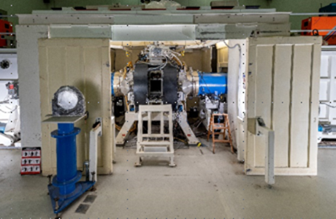
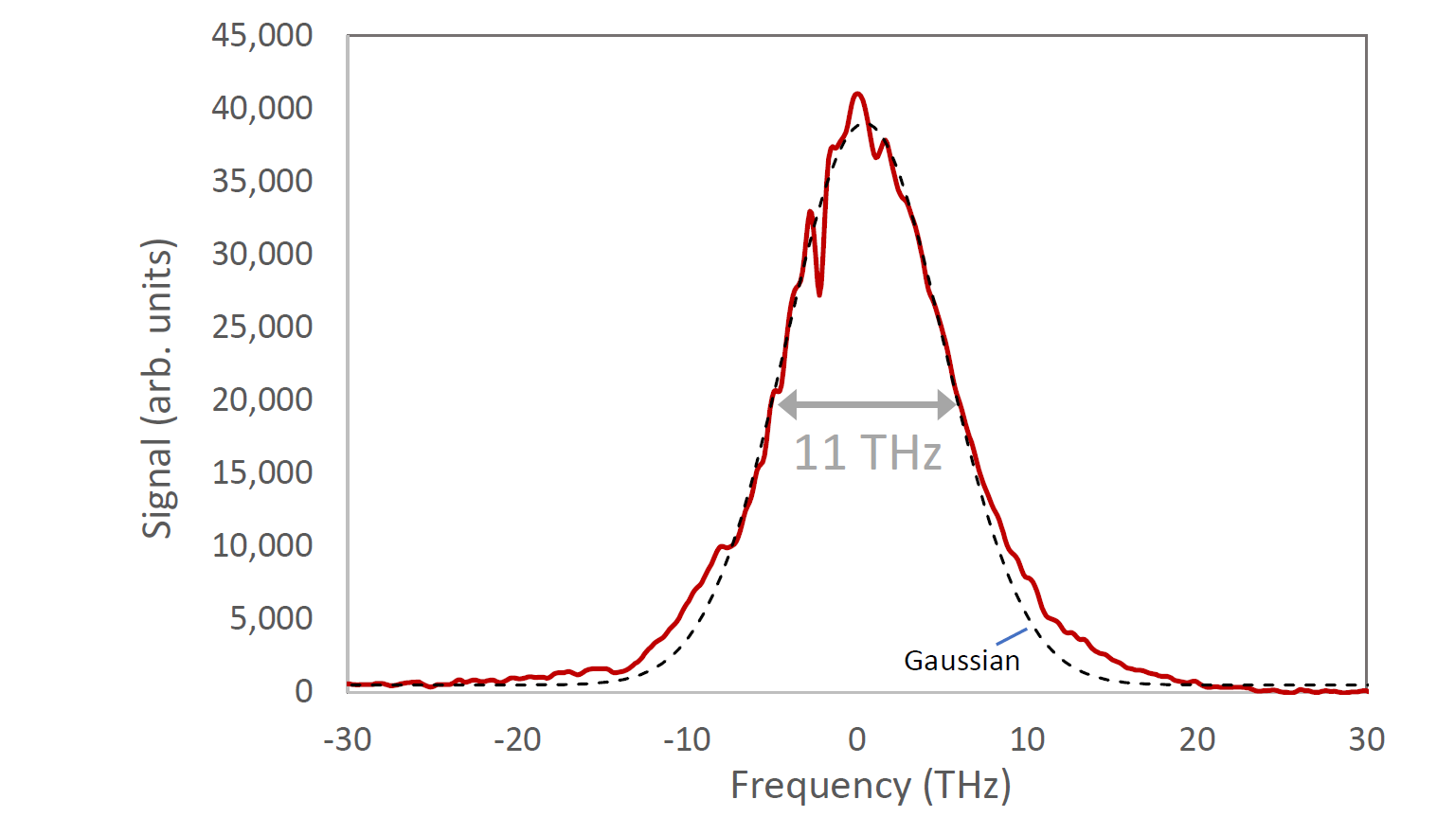
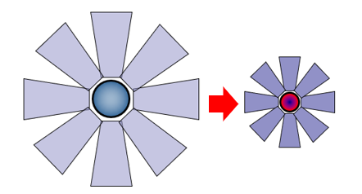
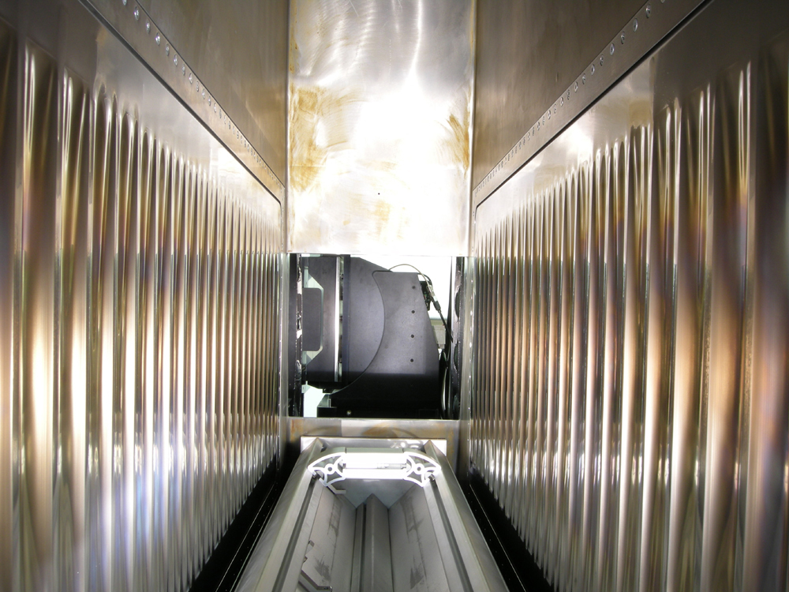
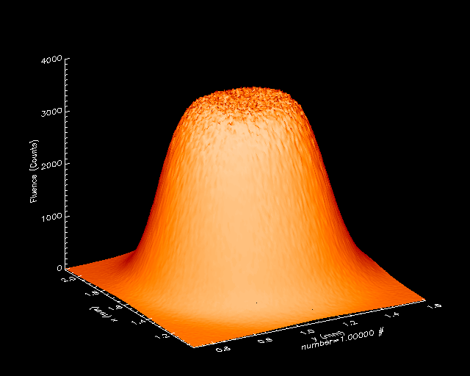
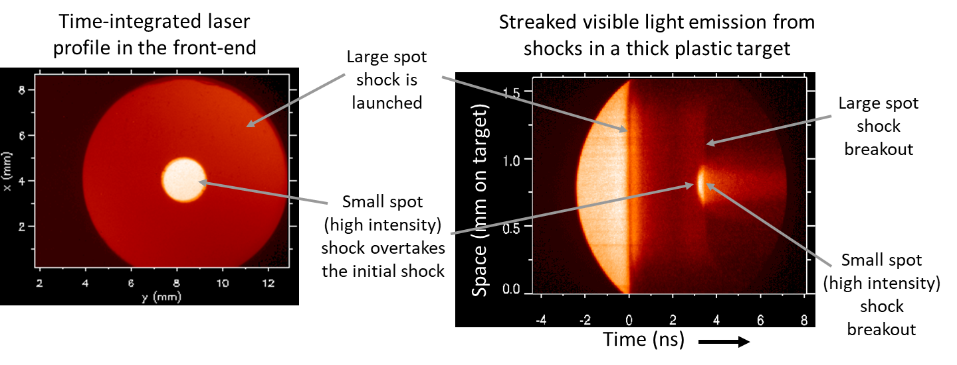
Key excimer technologies demonstrated at NRL (Leverages ONR, FES, and ARPA-E funded programs)
Electra laser facility
11 THz ArF bandwidth
Focal Zooming
Increases laser coupling and mitigates CBET
single pass
ASE output
World record ArF energy (200 J)
Demonstrated ~100k shot capability (KrF)
0.3% beam uniformity on Nike
Zooming demonstrated on Nike
90,000 laser shots (10 hrs) continuous @ 2.5 Hz
300,000 laser shots in 8 days of operation
J. D. Sethian, IEEE Trans. Plas. Sci., 38, 4 (2010)
A. Deniz, Opt. Commun. 147, 402 (1998)
D. Kehne, RSI, 84, 013509 (2013)

Slide 15
Path forward to robust high-yield facility takes advantage of laser drive modularity
NIKE is a prototype of large scale excimer lasers
Facility could be sited elsewhere (DoE labs, industry partners)
Designs and smaller tests would come from NRL - technologies would be transferred to partner laboratories
Modularity of system can be exploited – build from 10’s MJ up to 100’s MJ
.
High Yield Implosion Facility
Excimer beamline
20-30 kJ on target
full shock ignition intensity and large plasma - LPI at scale
Implosion physics
Gain sufficient for ICF
λ=193 nm vs 351 nm
Simulations & theory
3D hydro-implosions
Improved LPI mitigation
22 modules x 30 kJ = 660 kJ

Slide 16
NRL program advances fundamental NNSA science and is developing a promising path for high-yield ICF applicable to IFE
Conducts a vibrant program that includes experiments, theory, simulation, and workforce development
Flexible facility capable of focused experiments, diagnostic development, and code validation
Balanced approach of external collaboration and internal research goals
Unique capabilities – short wavelength, ISI smoothing, bandwidth, zooming, diagnostics
As a federal employees, NRL laser-fusion program provides an independent voice in the field
NRL is the world-leading center for high energy excimer lasers
Offers a path to a future high-yield ICF/IFE facility using a sub-megajoule driver
Enabled by superior target physics with ArF laser and modern implosion designs
Transformational: robust 10’s-100’s MJ yields with sub-MJ laser system capable of shot-on-demand

