Slide 1
The next decade of inertial fusion research at LLNL
Fusion Power Associates
Mark Herrmann
National Ignition Facility Director
and the NIF Team
December 4, 2018

Slide 2
The next decade will be a pivotal time for inertial confinement fusion and inertial fusion energy research
NIF will continue to deliver high energy density (HED) data needed for the Stockpile Stewardship program while advancing our fundamental understanding of HED science
The achievement of inertial confinement fusion ignition in the Laboratory and eventually high yield will continue to be a significant goal of the Stockpile Stewardship Program
  Steady progress is being made on understanding and improving inertial confinement fusion target performance on NIF (as well as Z and Omega)
  New diagnostics and simulations are providing critical insights that will lead to further progress and may motivate facility upgrades
  By the end of the 2020’s we will have achieved ignition or have an ignition facility under construction
Worldwide effort in ICF and HED will grow significantly over this time frame
Continued advances in important related technologies will make leveraging these technologies for IFE research an attractive path

Slide 3
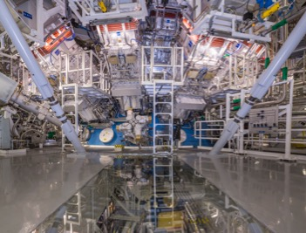
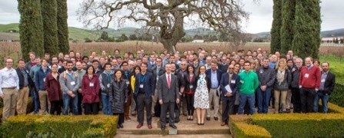
NIF is providing critical data and workforce development for the Stockpile Stewardship Program (SSP)
Life Extension Programs design options
  Energy balance (previous)
  Material substitution
  Removal of a device specific calibration factor
  Nuclear survivability
Improving science understanding
  Material Properties (including Pu)
  Radiation transport
  Complex hydrodynamics
  Achieving ignition for higher-fidelity burn experiments and to create higher-energy-density environments relevant to stockpile science
Workforce
  Attracting, Training, Testing, Retaining
  Practice the ART of design
NIF
NIF Users
We’ve developed an efficient operating point for NIF that will provide the
programmatic data to address SSP needs over the next decade

Slide 4


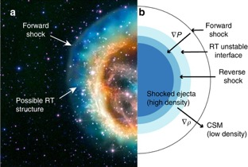
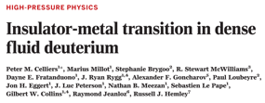

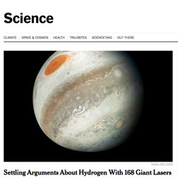
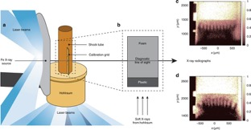
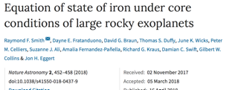
The Discovery Science program is utilizing a small fraction of NIF’s time to generate high impact scientific results
Nature Communications

Slide 5
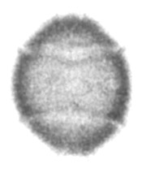
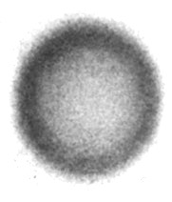
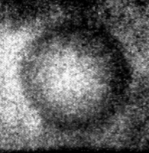
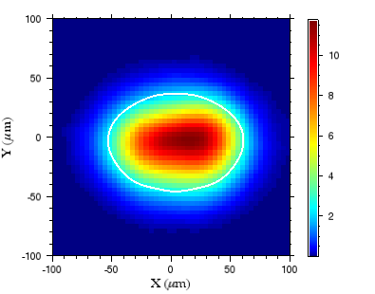
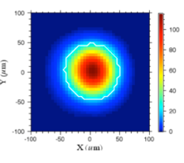
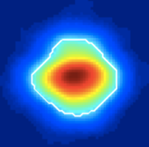
We are making progress in controlling and diagnosing inertial confinement fusion implosions
2012/13
2014/15
2017/2018
Better LPI, symmetry
Reduce fill tube
Better hydro
Yield ~ 2 kJ
Pressure ~ 150 GB
(7e14 DT neutrons)
Yield ~ 27 kJ
Pressure ~ 250 GB
(9 e15 DT neutrons)
Yield ~ 55 kJ
Pressure ~ 350 GB
(~2 e16 DT neutrons)

Slide 6
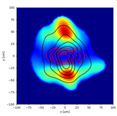
We’ve made steady progress in improving implosions on the NIF, reaching closer to the predicted ignition boundary
Ignition boundary
1.3
1.5
100
2.5
T_{Brysk}(keV)
Y ~ 2.5 kJ
E_{hs} ~ 1-2 kJ
Y_{a}/Y_{noa} ~ 1.3x
P ~ 100 Gbar
Y
kJ
E_{HS}
kJ
Y_{amp}
P
Gbar
N130331
Sensitive implosion design (for high gain)
A-RT Instability
Mix
Asymmetry
Engineering feature perturbations
NIF Data: 2010-2012
⍴R_{hs} (g/cm²)
O. Hurricane

Slide 7
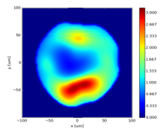
We’ve made steady progress in improving implosions on the NIF, reaching closer to the predicted ignition boundary
Ignition boundary
4.5
2.2
220
25
T_{Brysk}(keV)
Y ~ 25 kJ
E_{hs} ~ 4-5 kJ
Y_{a}/Y_{noa} ~ 2.2x
P ~ 220 Gbar
Y
kJ
E_{HS}
kJ
Y_{amp}
P
Gbar
N131119
NIF Data: 2010-2015
Less sensitive implosion design(s)
Asymmetry/swings still an issue
Engineering features (tent/fill-tube) still an issue
⍴R_{hs} (g/cm²)
O. Hurricane

Slide 8
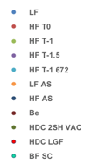
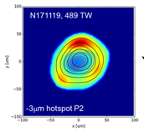
We’ve made steady progress in improving implosions on the NIF, reaching closer to the predicted ignition boundary
Ignition boundary w/ uncertainty
56
6
2.9
360
T_{Brysk}(keV)
Y ~ 56 kJ
E_{hs} ~ 5-7 kJ
Y_{a}/Y_{noa} ~ 2.9x
P ~ 360 Gbar
Y
kJ
E_{HS}
kJ
Y_{amp}
P
Gbar
N171119
NIF Data: 2010-2018
Less sensitive design(s)
Fixing Asymmetry/swings
Fixing Engineering Features
⍴R_{hs} (g/cm²)
O. Hurricane

Slide 9
X-ray drive on NIF is approaching “burning plasma”
Ignition (with G>1 at NIF, ~ 2MJ)
*“Burning plasma”: energy deposited in DT hot spot by alpha particles exceeds compressional work
1000
300
Capsule gain > 1 (~150-200 kJ)
100
Q_{a}~1 burning plasma (~70kJ)
30
Smaller fill tube, Diamond Capsule, Improved hydro stability, LPI and hohlraum drive symmetry
Yield (kJ)
Alpha-heating (~28 kJ)
(Diamond,2017/18)
10
(High Foot, 2014/15)
Improved hydro stability
3
(NIC, 2012)
1
Degraded by hydro instability, LPI and asymmetry
0.3
(March 2011)
0.1
0.2
0.3
0.4
0.5
0.6
0.7
0.8
0.9
1
Pressure * Confinement

Slide 10
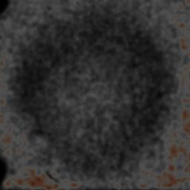
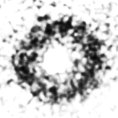


Recent advances in x-ray measurements allow us to track final stages of the imploding fusion fuel and shell
Previous
New
Broadband Area
Radiography
(8-9 keV) BT - 0.35 ns
Crystal Imager
Monochromatic
Radiography
(11.66 keV)
Point Projection Compton
Radiography
(ARC)
(50-150 keV)
BT - 0.35 ns
BT - 0.2 ns
BT -. 01ns
BT + 0.16 ns
600 µm
Tommasini
Hall
Rygg PRL 2014
400 µm
These new measurements are giving us new physics insights, which will help us further optimize implosion performance.

Slide 11
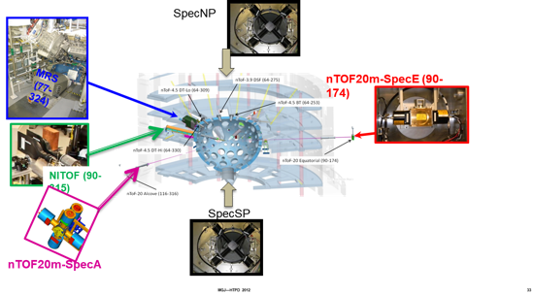
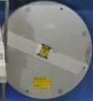
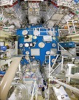
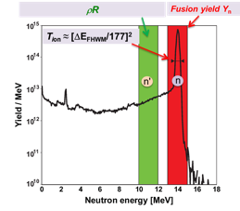

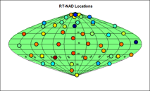
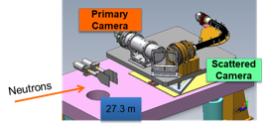
New nuclear measurements are giving us a consistent picture of the cold fuel distribution
Zirconium samples
mounted to ports
⁹⁰Zr(n,2n)⁸⁹Zr
Escaping yield
related to ΔρR
n
ρ
Neutron imager
n
A consistent picture is emerging of a cold fuel distribution that is asymmetric

Slide 12
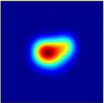
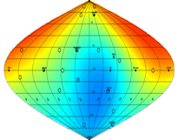
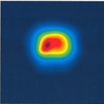
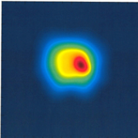
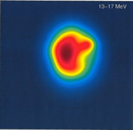
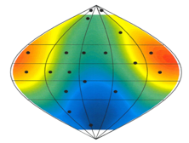
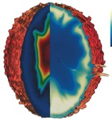
We are making exciting progress in matching experimental results with sophisticated 3D simulations
Experiment
nuclear activation detectors
time integrated
equator
P₀ = 28 µm
time integrated
pole
M₀ = 27 µm
13-17 MeV
neutrons
P₀ = 30 µm
50
50
50
fill tube
fill tube
fill tube
y (μm)
0
0
0
-50
A. Pak
-50
-50
P. Volegov
A. Pak
P. Volegov
-50
0
50
-50
0
50
-50
0
50
x (μm)
x (μm)
x (μm)
0.90
0.95
1.00
1.05
1.10
Y/Y_{avg}
time integrated
equator
P₀ = 30 µm
time integrated
pole
M₀ = 32 µm
13-17 MeV
neutrons
P₀ = 32 µm
50
50
50
y (μm)
0
0
0
fill tube
-50
-50
-50
-50
0
50
-50
0
50
-50
0
50
x (μm)
x (μm)
x (μm)
3-D simulation
Coupled hohlraum capsule simulations together with analysis of correlations between laser power imbalance and cold fuel distribution and hot spot flows suggest that improvements to laser power balance

Slide 13
Path forward is to work on improving implosions while also exploring scaling to higher energy
Scientific understanding leading to quality improvements:
  Improved symmetry including laser power balance
  Higher coupling efficiency capsules (~10% -> ~15+%)
  Reduced engineering features (fill tubes, tent)
  Improved capsule fabrication
Scaling
  Higher laser power and energy
  Alternate designs
Data from HDC implosions
“Quality”
(faster, rounder, denser, cleaner)
Energy
(Bigger)
Increasing size
Increasing velocity
NNSA is planning an ignition assessment in 2020

Slide 14
NIF is capable of operating at higher powers and energies with modest modifications to the laser
Current upper estimate for NIF “Medium” Blue Capability
Improved Power Configuration
HDC
Performance Quad Configuration
CH High Foot
2018
Demonstration
Hydro-scaled
Inner cone (FNE)
Outer cone
NIF shots

Slide 15
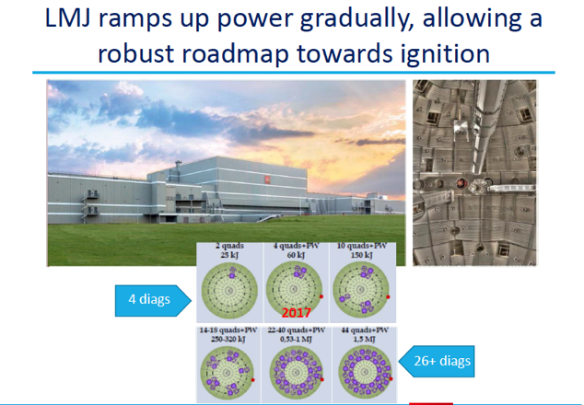
France’s Laser Megajoule has performed its first experiments and will be ramping up the number of beams over the next few years
First user experiments have been performed
Plan has 40 beams coming on line in 2019 eventually 176
CEA-NNSA agreement has been renewed and there is increasing outreach and coordination
  Optics
  Laser modeling
  Diagnostics
  Infrastructure
  Operations
  Targets

Slide 16
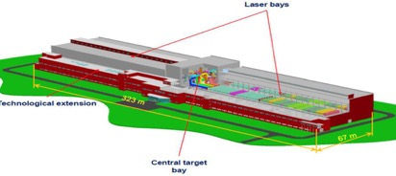
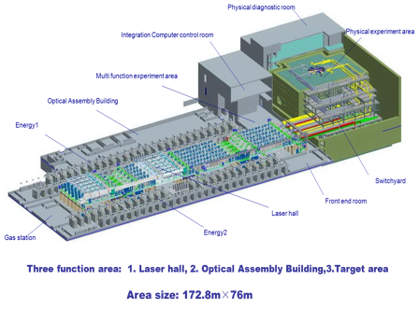
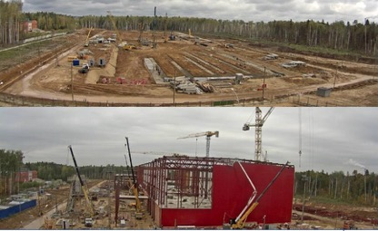
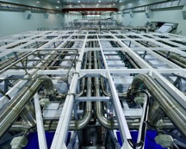
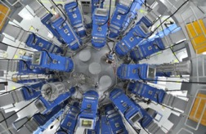
Both Russia and China are investing significantly in the area of lasers for high energy density physics
UFL-2M
• 192 beams, 2.8 MJ (1.5x NIF energy)
Construction underway
Shenguang III (180 kJ) is now operating
48 beams arranged in polar configuration
80 diagnostics
World’s second most energetic laser

Slide 17
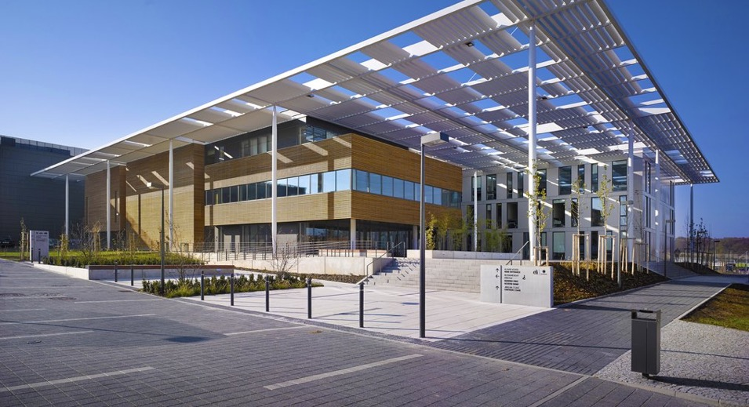
LLNL delivered to the Extreme Light Infrastructure the world’s highest average power, diode pumped Petawatt laser:
HAPLS is capable of firing at 10Hz repetition rate = 1MJ/hour
Designed, built and commissioned at LLNL (2013-2016): 3 years from concept to product
Shipped and installed at ELI Beamlines (2017/18)
Integrated team approach to ensure successful technology transfer
Fixed price contract: all milestones met on schedule
Delivery of a robust, highly automated laser system for integration into user facility

Slide 18
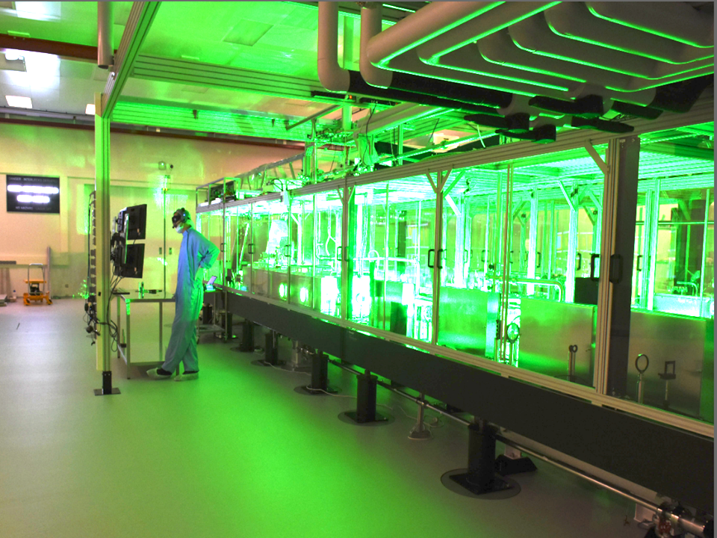
HAPLS is an operational, diode pumped high average power laser system capable of delivering 1PW pulses ten times a second.
 | Specification
Energy at 820nm | ≥30 J (Phase 2)
Pulse Length | ≤30 fs
Peak Power | ≥1 PW
Pre-pulse Power Contrast | ≤10⁻⁹ ≤ c ≤10⁻¹¹
Energy Stability | 0.6% rms
Technology | DPSSL pumped Ti:sapphire CPA
Repetition Rate | 10 Hz (Phase 2)
Power Consumption | <150 kW
Commissioned for early experiments, HAPLS currently runs at 3.3Hz, ~0.5 PW
LLNL-PRES-943927

Slide 19
The recently passed Department of Energy Research and Innovation act calls for research into IFE
NAS 2013 Study “An Assessment of the Prospects for Inertial Fusion Energy”* had a number of conclusions and recommendations including:
“The appropriate time for the establishment of a national, coordinated, broad-based inertial fusion energy program within DOE would be when ignition is achieved”.
Nevertheless the committee also concluded: “The potential benefits of energy from inertial confinement fusion … also provide a compelling rationale for including inertial fusion energy R&D as part of the long-term R&D portfolio for U.S. energy.”
A modest IFE program in the US would leverage significant investments:
World leading capabilities in ICF research (including NIF, Omega, and Z) funded by NNSA
Advances in rep-rated lasers and pulsed power drivers, advanced manufacturing, new materials, machine learning, …
The Department of Energy Research and Innovation Act (H.R. 589):
INERTIAL FUSION ENERGY RESEARCH AND DEVELOPMENT.—The Director shall support research and development activities for inertial fusion for energy applications.
*An Assessment of the Prospects for Inertial Fusion Energy, Committee on the Prospects for Inertial
Confinement Fusion Energy Systems, NRC (National Academies Press, Washington, D.C., 2013).

Slide 20
The next decade will be a pivotal time for inertial confinement fusion and inertial fusion energy research
NIF will continue to deliver high energy density (HED) data needed for the Stockpile Stewardship program while advancing our fundamental understanding of HED science
The achievement of inertial confinement fusion ignition in the Laboratory and eventually high yield will continue to be a significant goal of the Stockpile Stewardship Program
  Steady progress is being made on understanding and improving inertial confinement fusion target performance on NIF (as well as Z and Omega)
  New diagnostics and simulations are providing critical insights that will lead to further progress and may motivate facility upgrades
  By the end of the 2020’s we will have achieved ignition or have an ignition facility under construction
Worldwide effort in ICF and HED will grow significantly over this time frame
Continued advances in important related technologies will make leveraging these technologies for IFE research an attractive path

