Slide 1
Safety Requirements for the Compact Pilot Plant
¹Brad J. Merrill
Input from: ²Neill Taylor, ³Lee Cadwallader, and ⁴Laila El-Guebaly
¹INL Fusion Safety Program
²Culham Centre for Fusion Energy
³Retired INL Employee
⁴University of Wisconsin-Madison
Future of Fusion: Transitioning to Fusion Power
SOFE Town Hall, June 4, 2019

Slide 2
Overview
High level safety requirements
Integrating safety into reactor design
ITER’s experience with fission specific design codes and standards (C&S)
Improved confinement through design simplification
What C&S will the Compact Pilot Plant (CPP) use?
Fusion safety needs for CPP licensing

Slide 3
¹DOE Fusion Safety Standard’s Requirements
Fusion facilities shall be designed, constructed, operated, and removed from service in a way that will ensure the protection of workers, the public, and the environment. Accordingly, the following points of safety policy shall be implemented at fusion facilities:
  The public shall be protected such that no individual bears significant additional risk to health and safety from the operation of those facilities above the risks to which members of the general population are normally exposed.
  Fusion facility workers shall be protected such that the risks to which they are exposed at a fusion facility are no greater than those to which they would be exposed at a comparable industrial facility.
  Risks both to the public and to workers shall be maintained as low as reasonably achievable (ALARA).
  The need for an off-site evacuation plan shall be avoided.
  Wastes, especially high-level radioactive wastes, shall be minimized.
¹DOE STANDARD, Safety of Magnetic Fusion Facilities: Requirements, DOE-STD-6002-96. (recently revised after 20 y), DOE-STD-6003-96, Guidance for implementing the requirements in large facilities (under revision)

Slide 4
How is Safety Achieved?
The principal safety functions for a fusion system are
  Confine radioactive material: prevent mobilization and dispersal within the plant, and the avoid leakage to the environment.
  Limit exposure: minimize occupational exposure to ionizing radiation sources including secondary activation and mobile source terms.
Radioactive confinement is generally provided through nested strong passive physical barriers (failure rate < 10⁻⁴ y⁻¹), together with passive and active supporting systems that mitigate potential challenges to these barriers, examples: isolation valves and depressurization, ventilation, filtration, detritiation, and decay heat removal systems (defense in depth)
Limiting exposure is generally provided by a combination of source control/minimization, radiation shielding, protective equipment, access control and optimized human work effort, example: use of advanced semi-autonomous remote handling equipment

Slide 5
Integrating Safety Into Fusion Reactor Design Process
As reactor plant design evolves, a Plant Breakdown Structure (PBS) is developed. A PBS is a hierarchical breakdown listing of the top-level systems, down to individual components at the lowest level of these system.
The PBS is used to assign the safety importance class (SIC) of structures, systems, or components (SSCs). “The safety classification of SSCs must consider their ‘role’ within the overall safety architecture of the plant and the consequence of their failure during normal and off-normal operation.”
The safety classification of some SSCs is obvious, for example the primary (VV) and secondary (building) confinement boundaries. But to fully understand hazards associated with SSC failures on a plant wide basis, probabilistic risk methods must be used.
Note: IAEA-TECDOC-1851 (2018):”Integrated Approach to Safety Classification of Mechanical Components for Fusion Applications” for an excellent discussion on classification methods
DOE STD 3009-14:PREPARATION OF NONREACTOR NUCLEAR FACILITY DOCUMENTED
SAFETY ANALYSIS, discusses SSCs & cites 10CFR830.3:Nuclear Safety Management: as providing an acceptable methodology for documented safety analyses.

Slide 6
Integrating Safety Into Fusion Reactor Design Process (cont.)
Once a component’s safety classification is complete, licensing Codes and Standards (C&S) are selected to develop Structural Design Criteria (SDC).
The overall objective of a SDC is to “ensure that a component can safely withstand all loading conditions and remain fit for operation” with sufficient design safety margins “throughout the components design life”.
However, given the complexity a fusion facility and unique environmental conditions specific to fusionª no approved fusion specific Codes and Standards exists.
ª high temperatures, electromagnetic fields and nuclear radiation, complexity of loads (nuclear heating and electromagnetic forces), special materials (i.e. non-metallic or plasma facing materials) and the lack of in-service inspection”, etc.

Slide 7
ITER licensing experience
The French regulator (ASN, Autorité de Sûreté Nucléaire) does not demand the use of any particular Codes & Standards (C&S). It is up to the operator to select C&S and then justify that it is a good choice.
IO selected various C&S for different systems, and also had to develop Structural Design Criteria for components where there are no applicable existing C&S:
  In-vessel components
  Magnet structure
  Non-metallic windows
Apparently this was accepted by ASN and IRSN
RCC-MRx 2015a (developed for liquid metal fission reactors) modified to include Eurofer and a irradiated material data (2018). This includes a specific part for ITER Vacuum Vessel and rules for irradiated components (research reactors)

Slide 8
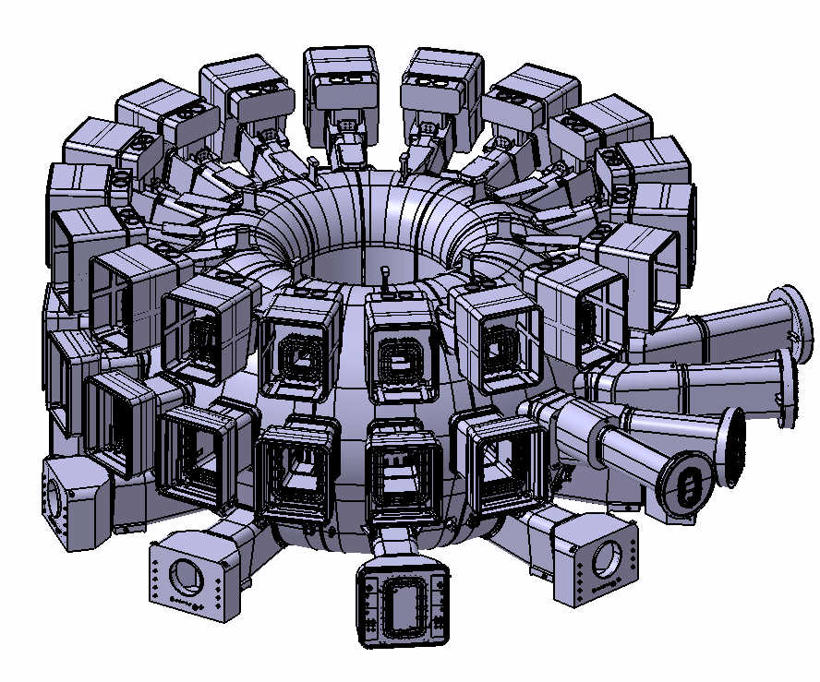
ITER experience: vacuum vessel and extensions as first confinement
ITER Vacuum Vessel:
Robust, double-walled.
Design loads include electromagnetic loads in plasma events such as Vertical Displacement Events
  must show that these loads are enveloping
Design pressure limit must be observed
  pressure limited by relief system with rupture discs
Subject to nuclear pressure equipment regulation (ESPN)
Penetrations
neutral beams
cooling pipes
RF heating systems waveguides
diagnostics systems
vacuum pumping lines
fuelling systems
feeders for in-vessel coils
Confinement barrier includes
seals
bellows
windows (including non-metallic)
isolation valves
pipes, ducts, waveguides
All must remain leak-tight in all normal and accident situations, and
all are Safety Importance Class
ASME SEC III Like
N-STAMP
Not-ESPN
https://www.usiter.org/sites/default/files/2018-06/TCWS.pdf

Slide 9
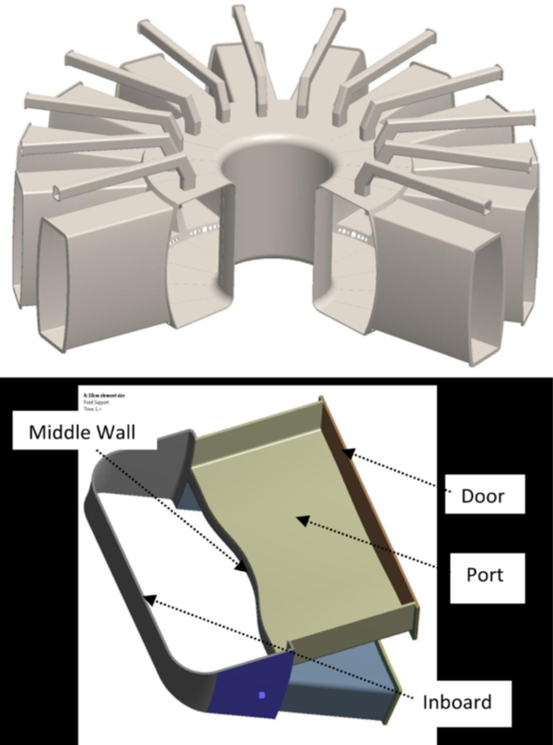
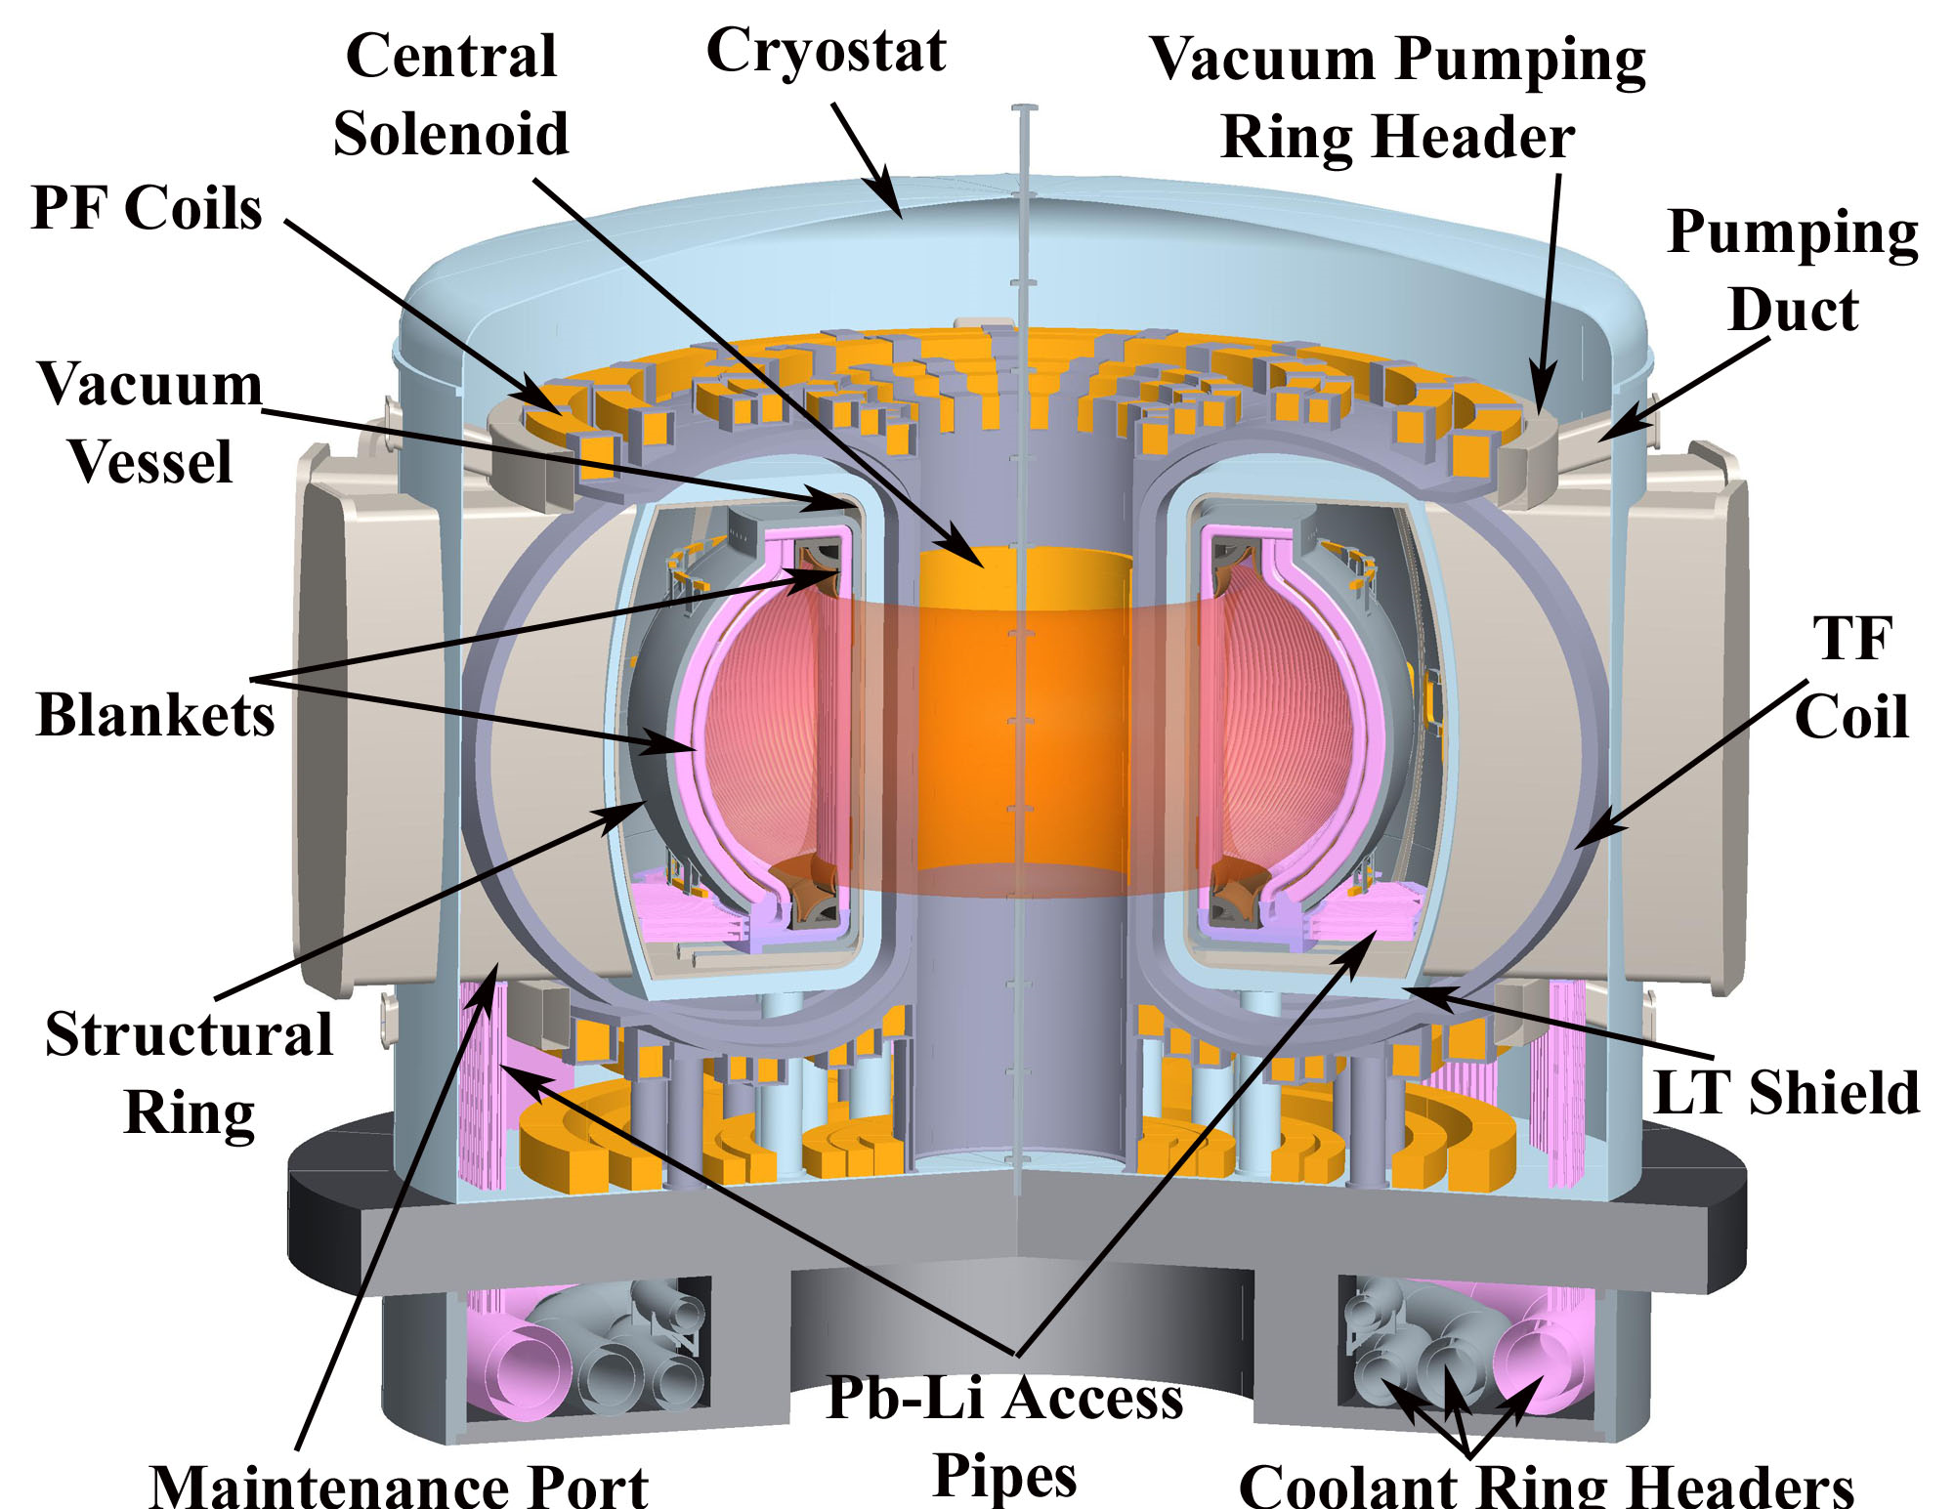
A Recent Fusion Reactor Design Concept With Remote Maintenance Considered
ARIES-ACT and FNSF VVs were designed to allow ease of horizontal remote maintenance
VV radiation shielding function dropped in favor of a low temperature shield
VV is the primary confinement boundary for activated dust and tritium. VV isolation not considered
Tritium permeation from FNSF was estimated to be ~1.3 g/y PbLi pipes and ~3.0 g/y helium pipes
SIC-1
N-STAMP?
UHV
1 atm
Coolant
Ring Header
Humrickhouse, Fusion Engineering and Design135 (2018) 302–313

Slide 10
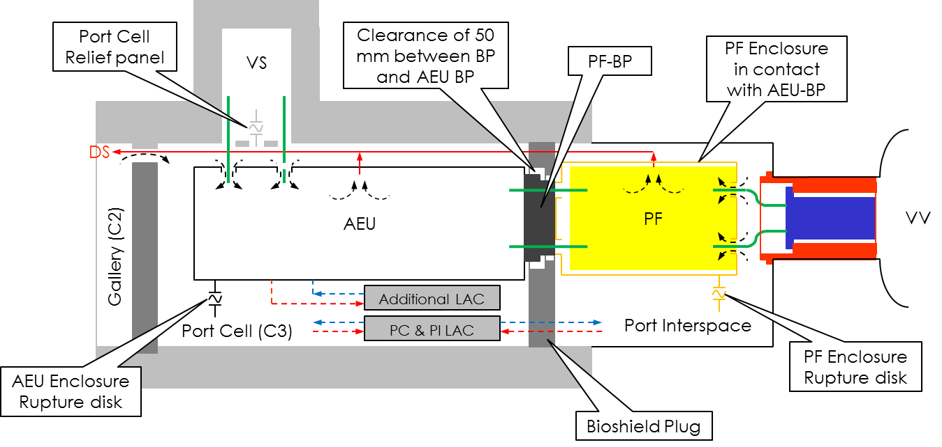
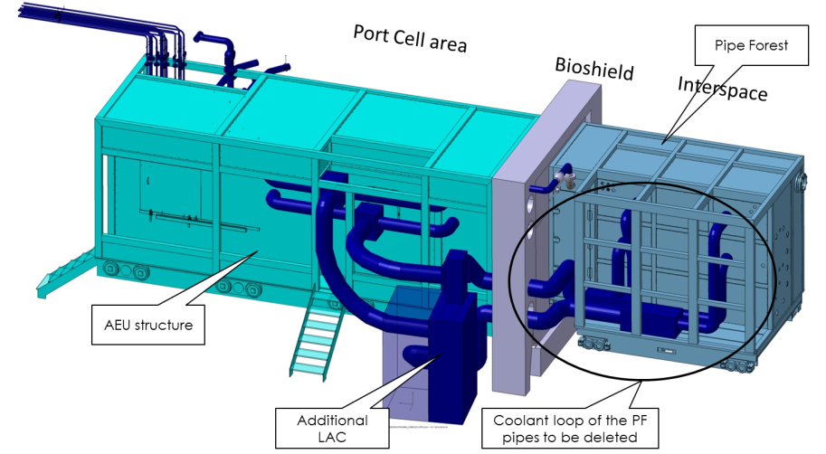
Even Small Tritium Releases Can Create Significant Maintenance Concerns
Even though ITER Test Blanket Modules (TBMs) collectively produce low levels T compared to a CPP, the mobility of T in hot metals results in permeation releases into ITER’s Port Cells (PCs) at a rate that outgassing of this tritium absorbed by an epoxy-based paint on the PC walls may not allow access for maintenance operations, without Radiation Protective Equipment or bubble-suit for about 1 week after reactor shutdown
To solve this problem, ITER IO is now designing ventilated enclosures for the Test Blanket System’s (TBS’s) Pipe Forest and for the Ancillary Equipment Units
Because these components require ~12 kW of local air cooling and contain high pressure coolants, cooling units must be connected to/in these enclosures and pressure relief measures are needed for possible LOCAs (inside and outside)
ITER_D_V72ALU
*Entry without Radiation Protective Equipment requires a DAC of ~ 10 µCi/m³

Slide 11
What C&S will the Compact Pilot Plant Use (?)
Depends on whether the NRC or DOE takes jurisdiction over licensing (NRC)/permitting(DOE). If the CPP produces electricity, the NRC is likely to assert licensing jurisdiction even if CPP is funded by DOE and sited at a DOE Lab
Whether NRC or DOE has jurisdiction, a Design Code for Fusion reactors will be required
  If NRC has jurisdiction, then ASME C&S will be required license CPP (10CFR50: Domestic Licensing of Production and Utilization Facilities). Probably ASME Section III, Division 4 (fusion). Division 4 was formed in 2008. A draft rules was recently issued (March 2018). Covers magnets, vacuum vessel and invessel components (appears to be at an early development stage, ITER VV)
  More flexibility may exist under the DOE permitting process to establish a design code under the DOE Fusion Safety Standards (as with ITER and ASN)
DOE STD 0100T: LICENSED REACTOR NUCLEAR SAFETY
CRITERIA APPLICABLE TO DOE REACTORS

Slide 12
What C&S will the Compact Pilot Plant Use (cont.)
There has been an ongoing discussion in the US Fusion Community regarding a physics based design rule for invessel components and magnetic field coils. Example (ReNew p 154-155) high temperature thermal creep:
  “Current ASME [American Society of Mechanical Engineers] creep-fatigue design rules are based entirely on empirical fits to experimental data. Hence, there is a compelling need to apply advanced experimental techniques and sophisticated computational methods for a better physical description of high-temperature deformation processes.”
It is unclear from the discussion thus far how this new Fusion Design C&S will evolve. However, this discussion needs to start with subject mater experts in this area (ASME?).
Perhaps a good starting point is ITER’s design criteria for these components
Still, once the path forward is known, to write and get approval this C&S will time (10 y)

Slide 13
Future CPP Licensing Needs
Because C&S can take 10 y to develop and approve and because this C&S must be in place before the CPP becomes a line item project, the time is now for an initiative to develop this New Fusion C&S. Designers should lead the way here.
An in-vessel component development, fabrication and testing facility needs to be develop that at a minimum can demonstrate acceptance testing of divertor and blanket modules
Failure rate data for prototypical CPP blanket modules are needed for licensing. Optimally, this data should be from testing modules in a prototypical fusion reactor environment (surface heat flux, 14 MeV neutrons, magnetic fields, at temperature, etc).
The time required to develop the ITER safety case was 20 y. It’s not too early to start a conceptual plant design study for the CPP. Safety needs to start developing the (statistical) safety analysis tools for CPP.

Slide 14
Thank you for your attention

Slide 15
Reliability/Availability/Maintainability/Inspectability (RAMI) is a serious challenge that has major impact on priorities and strategy for fusion R&D
Availability required for each component needs to be high
Component # failure MTBF MTTR/type Fraction Outage Component
rate Major Minor Failures Risk Availability
(1/hr) (yrs) (hrs) (hrs) Major
MTBF – Mean time between failures
MTTR – Mean time to repair
Two key parameters:
DEMO availability of 50% requires:
Blanket/Divertor Availability ~ 87%
Blanket MTBF >11 years
MTTR < 2 weeks
(Due to unscheduled maintenances)
Extrapolation from other technologies shows expected MTBF for fusion blankets/divertor is as short as ̴hours/days, and MTTR ~months
GRAND Challenge: Huge difference between Required and Expected!!
15
Notes:
15
15
15

Slide 16
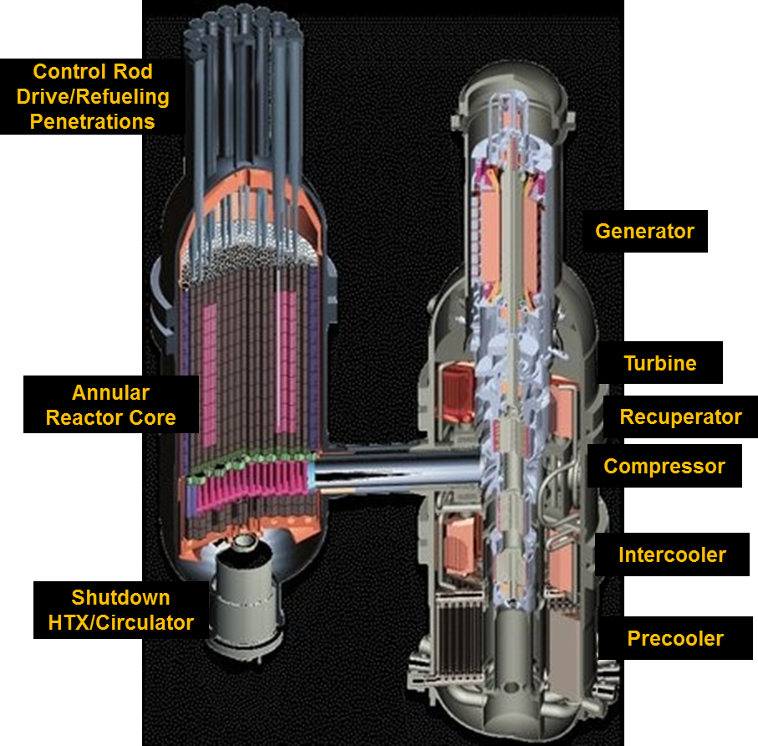
A Recent Fission Reactor Concept Confinement Strategy
Very High Temperature Reactor (VHTR)
Common primary confinement boundary for reactor, piping and Brayton cycle electrical power system
Minimize number of isolation valves required
Keep Confinement Simple

Slide 17
Structural Design Codes Need Change for Fusion.. Are they changing enough for CPP?
“Currently, there are two existing industrial codes for nuclear safety related components: ªRCC-MR Edition 2007 and ^{b}ASME Section III
RCC-MRx 2015ª (developed for liquid metal fission reactors) modified to include Eurofer and a future edition 2018 will include irradiated material data. This includes a specific part for ITER Vacuum Vessel and rules for irradiated components (research reactors)
In the US, codes being developed are ASME III Division 4 (fusion) and 5 (SMRs). ASME III development has a long history of safe use for design, construction and operating of nuclear power plants. This code reflects a continuous attempt to understand all failure modes, and provide rational margins of safety against each type of failure. Section III is design by analysis. Section III vessels require more design documentation.
Existing ASME III construction code rules do not adequately cover the design, fabrication or construction of fusion devices. Recently, efforts within ASME (Division 4) aim to develop fusion standard and Rules for Construction of Fusion Energy Devices
ª Association Française pour les règles de Conception et de Construction des Matériels des Chaudières Electro-nucléaires’s (AFCEN) Règles de Conception et de Construction (RCC)-MRx : Design and Construction Rules for Mechanical Components in high-temperature structures, experimental reactors and fusion reactors
^{b} American Society of Mechanical Engineers Boiler and Pressure Vessel code for Construction of Nuclear Facility Components, Section III (ASME III)

