Slide 1
Closing the Fusion Fuel Cycle: Tritium Breeding Blanket R&D
Paul Humrickhouse
Town Hall Meeting: The Future of Fusion- Transitioning to Energy Production
28th Symposium on Fusion on Fusion Engineering
June 4, 2019

Slide 2
Tritium needs for fusion
In future fusion reactors it will be necessary to breed tritium at the same rate it is consumed (55.6 kg/GW_{f}-year)
The tritium production rate in DEMO will need to be ~10³-10⁵ times that of ITER or fission reactors:
Tritium is a concern in advanced fission reactor concepts
Most LWRs have experienced leaks of water tritiated beyond EPA drinking water limits²
More efficient power generation requires higher temperatures, but these facilitate tritium permeation, which must be mitigated
Scale up in temperatures and tritium use are a real technological challenge
 | PWR¹ | CANDU¹ | Gas-cooled reactor¹ | Molten salt reactor¹ | ITER | FNSF/CPP (~0.5 GW_{fus})
T generated (kg/y) | 0.000075 | 0.1 | 0.002 | 0.09 | ~0.004 | ~28
¹H. Schmutz, INL/EXT-12-26758, 2012
²S. Zinkle 1/19; https://www.nrc.gov/docs/ML1723/ML17236A511.pdf

Slide 3
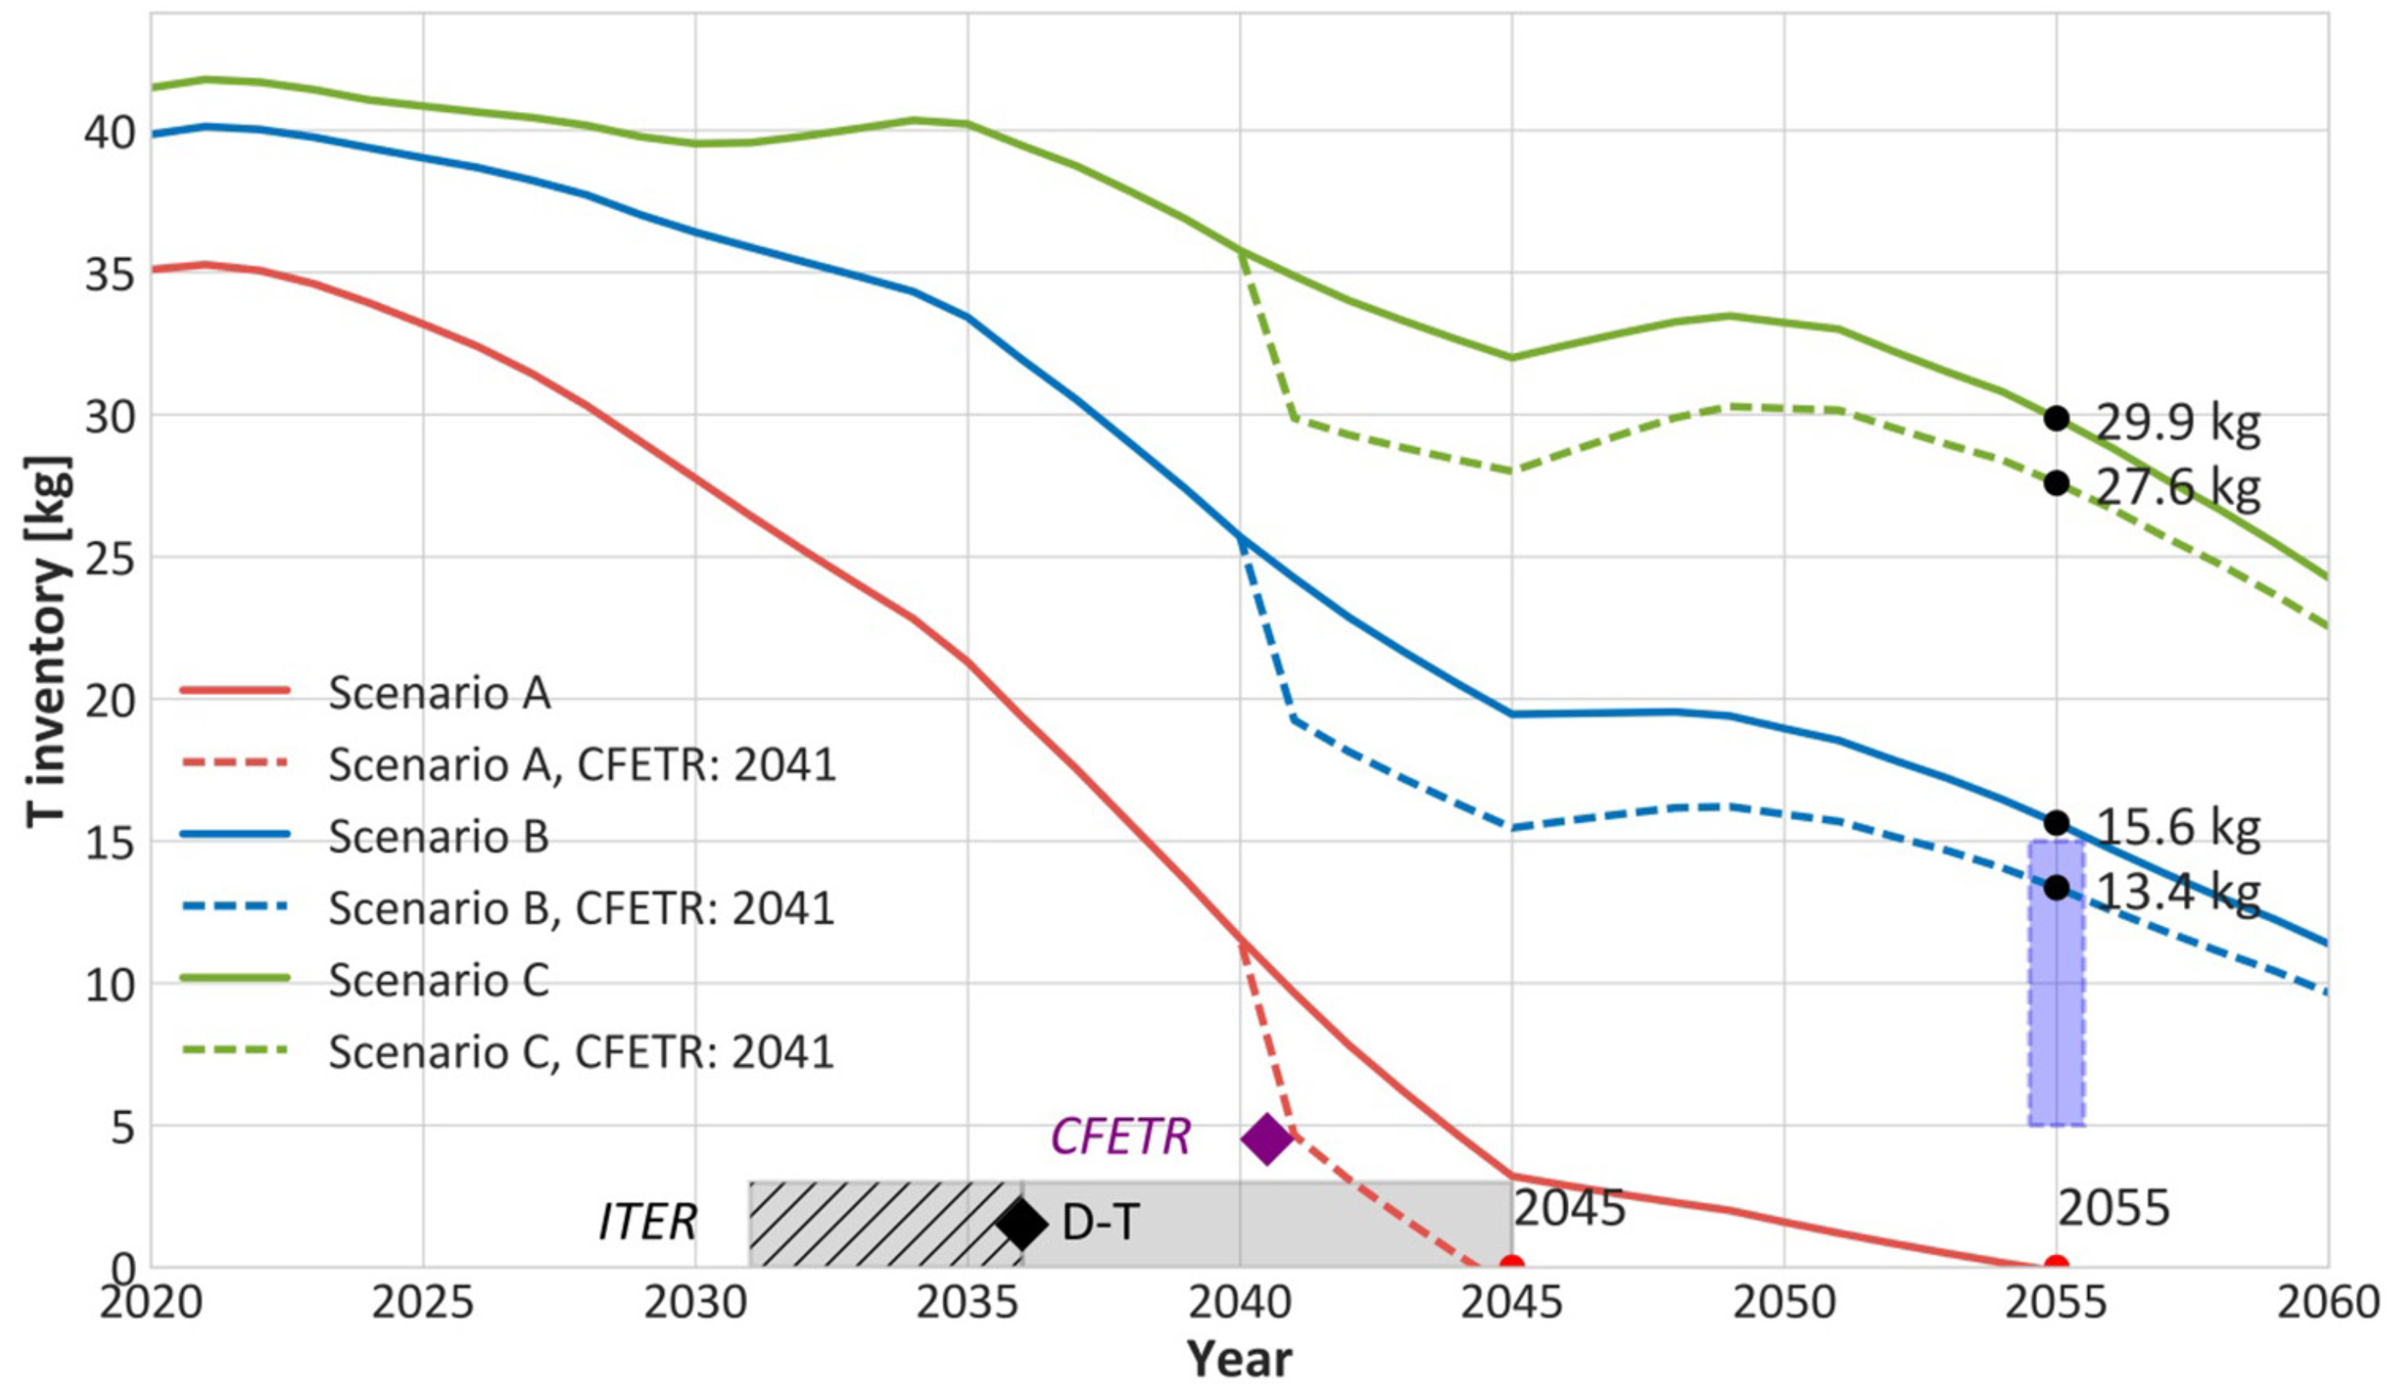
Tritium Supply
Tritium for ITER will be obtained from Ontario Power Generation, using tritium produced within CANDU nuclear power stations
Available tritium for subsequent reactors will likely to come from Canadian, Korean, and Romanian CANDUs and availability depends on their future operation
Other sources theoretically possible: Lithium absorbers in LWRs, D-D tokamak operation ($2B/kg¹)
Breeding blankets can’t be put off indefinitely!
Necessary startup T inventory depends on:
  Burnup fraction in plasma (low, ~1%)
  Processing time in exhaust system
¹M. Kovari, Nuclear Fusion 58 (2018) 026010

Slide 4
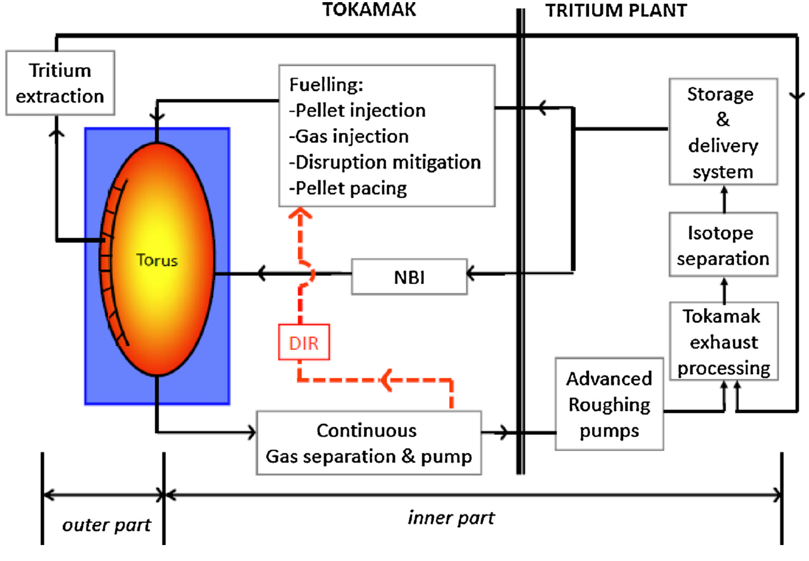
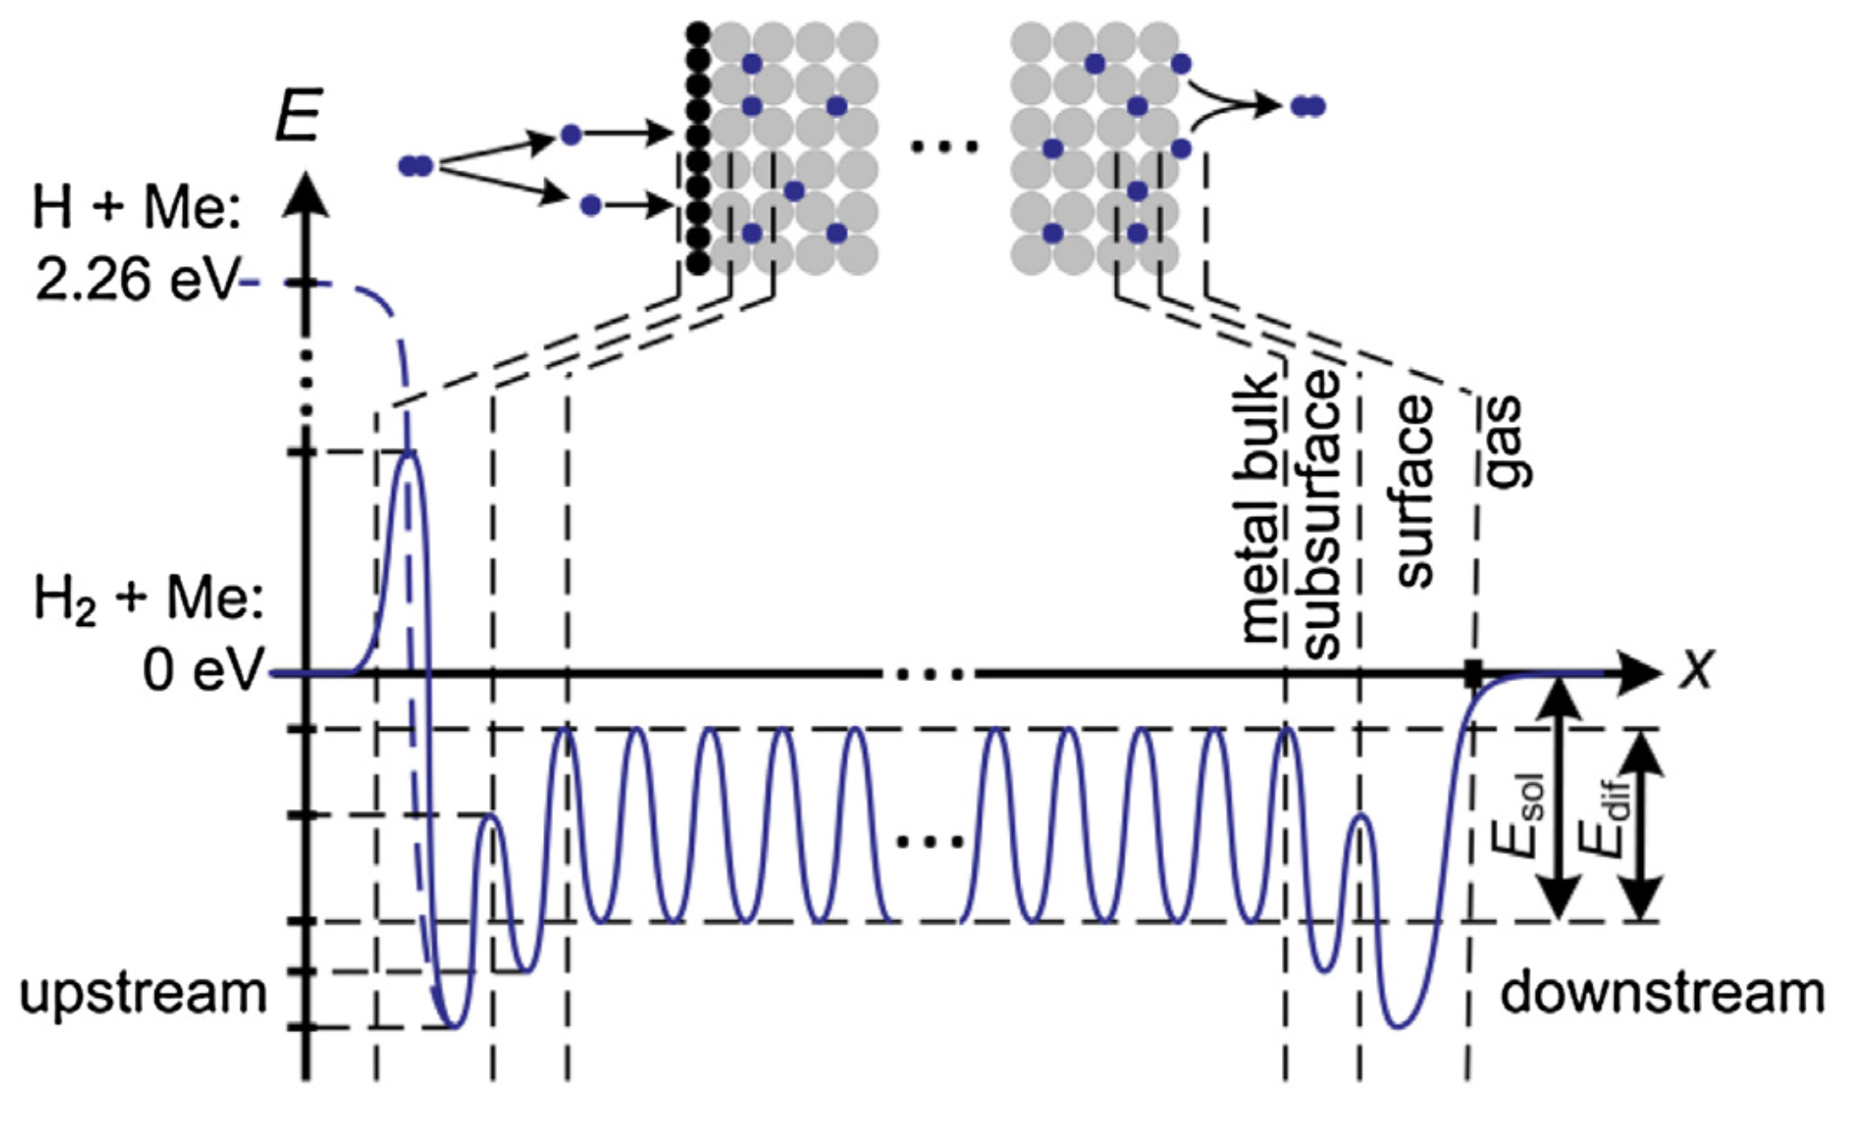
Exhaust Processing
Increasing fusion power and plant availability lead to larger inventories in the tritium plant
Batch processes such as cryopumping and isotope separation less conducive to continuous operation
Direct Internal Recycling concept seeks to merge pumping and separation functions, and bypass the tritium plant in the process
Super-permeable metal foil pump potentially accomplishes this- identified by FESAC as Transformative Enabling Technology
C. Day, T. Giegerich / Fusion Engineering and Design 88 (2013) 616–620
See T. Giegerich, Innovative fuel cycle concepts for the EU-DEMO 16:40 tomorrow!
B.J. Peters, C. Day / Fusion Engineering and Design 124 (2017) 696–699

Slide 5
Functions of the blanket
Assure tritium self-sufficiency: a tritium breeding ratio (TBR) > 1
  Li breeder:
    ⁶Li + n -> ⁴He + T + 4.78 MeV
    ⁷Li + n -> ⁴He + T + n -2.47 MeV
  Pb or Be multiplier
    Highest (n,2n) cross sections with low parasitic absorption
Maximize the net efficiency of the power plant
  Push toward high coolant temperatures- limited by material operating windows and compatibility with coolants
Act as a radiation barrier
Act as structural barrier to limit dispersion of the tritium and potential activation products suspended in the coolant
  A pressure vessel with high incident 14 MeV neutron flux
  A tritium partial pressure vessel, through which permeation can occur (especially at high temperature)

Slide 6
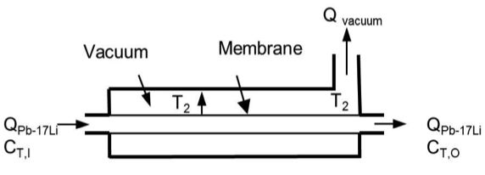
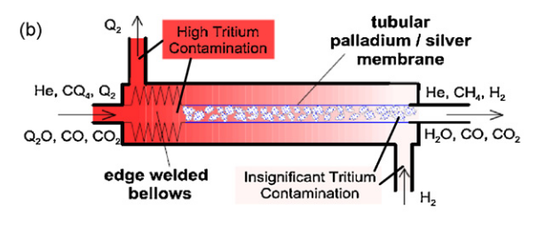
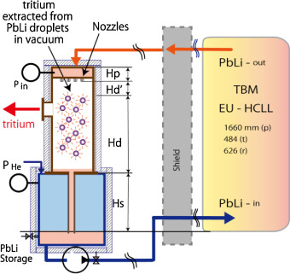
Tritium Extraction
Tritium bred in the blanket must be extracted for subsequent use as fuel
Highly efficient extraction, as near to the blanket as possible, minimizes unwanted tritium permeation elsewhere
  Reduces burden on or obviates the need for permeation barriers
Solid breeders: tritium removed from He purge gas via hydrogen swamping and catalyzed isotope exchange from HTO and hydrocarbon impurities, followed by permeation through Pd-Ag membrane (PERMCAT)
Liquid breeders: rely on liquid/gas (or vacuum) contact or highly permeable membranes
F. Okino, FED 109-111 (2016) 1748-1753
Transformative Enabling Technology
D. Demange et al., Catalysis Today 156 (2010) 140-145.

Slide 7
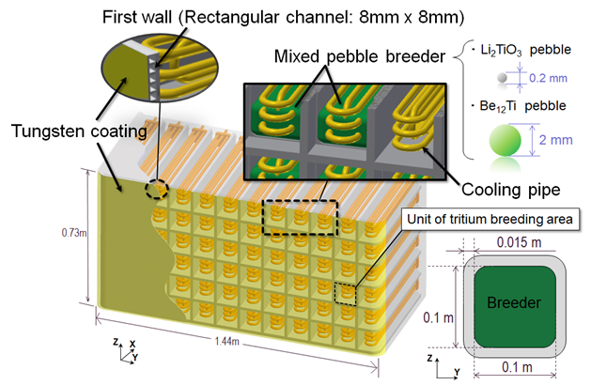
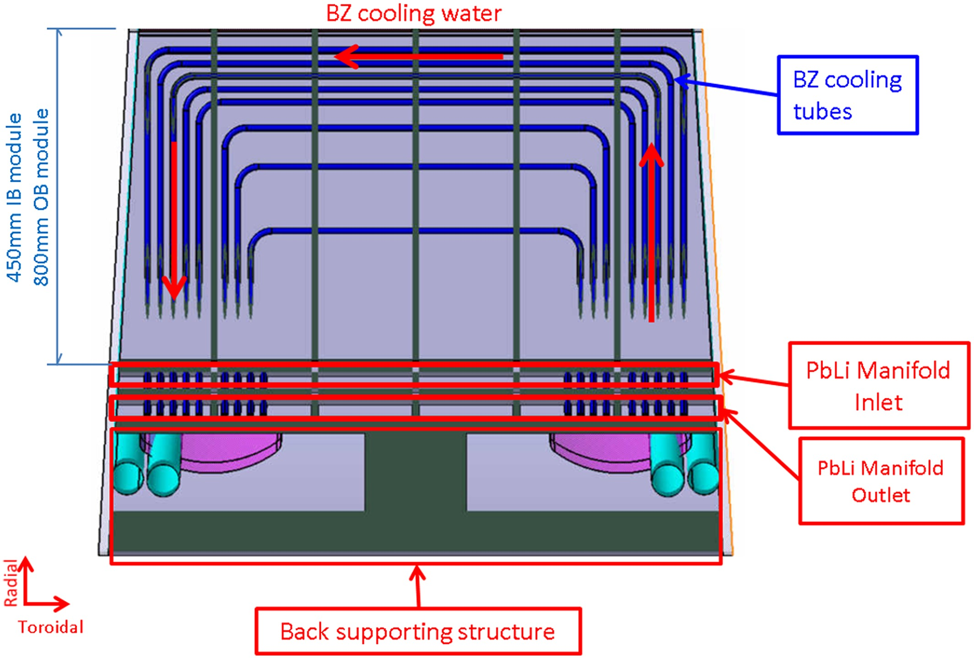
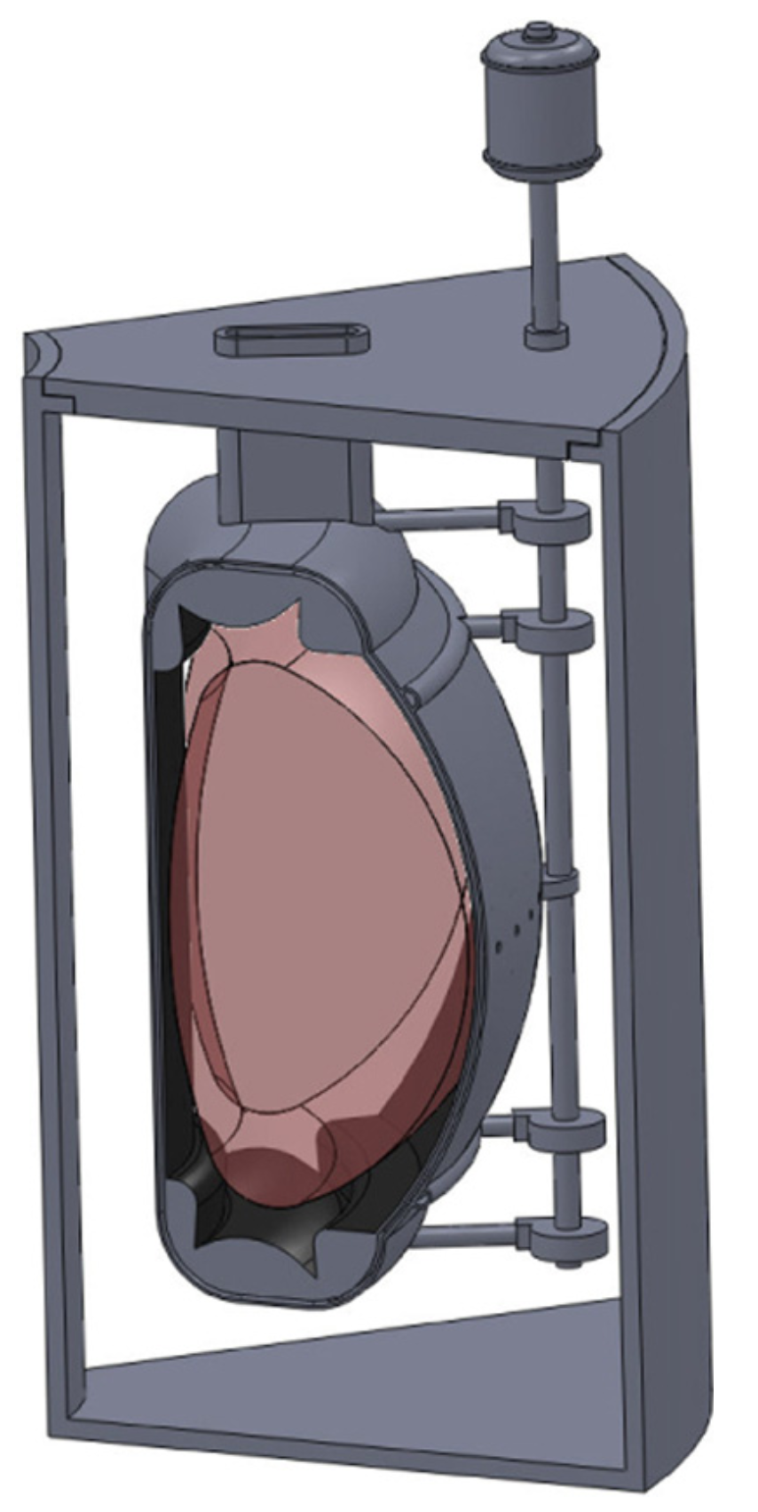
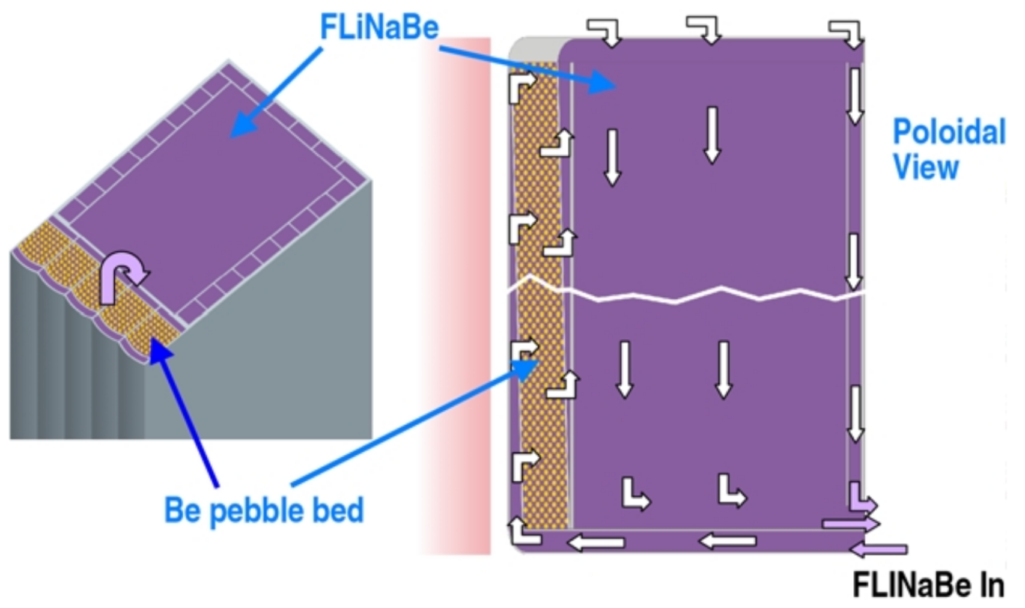
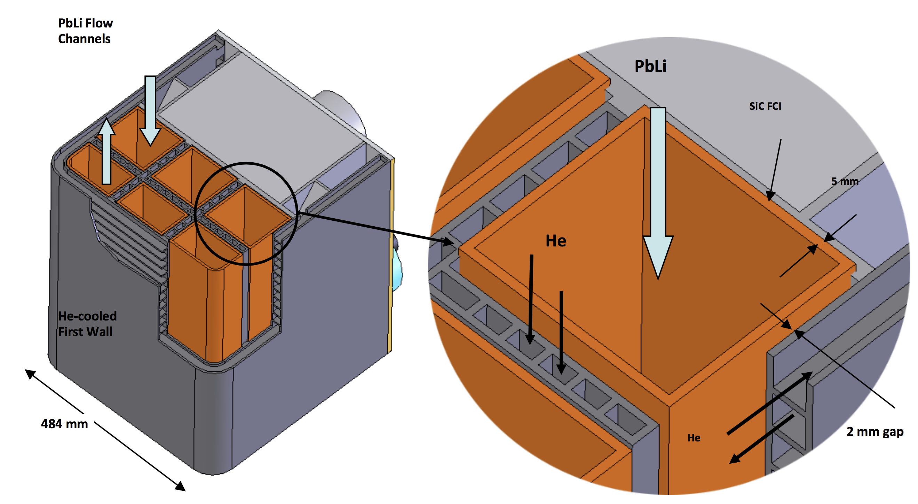
Blanket concepts
(H/W)CCB
Li₂TiO₃ or Li₄SiO₄ breeder, Be₁₂Ti multiplier pebbles
Water or He coolant
(H/W)CLL
  Slow flowing PbLi breeder
  Water or helium coolant
E. Martelli
Int. J. Energy Res.
42 (2018) 27-52
Y. Someya, 2018 US-JA Workshop
FLiBe
  Molten Salt (LiF/BeF₂) breeder, possibly with additional Be multiplier
DCLL
  Fast flowing PbLi breeder
  Cooled by both He and PbLi
  Insulating SiC inserts
Transformative Enabling Technology
B. Sorbom, FED 100 (2015) 378-405
C. Wong, FST 47 (2005) 502–509
FESAC TEC report, 2018

Slide 8
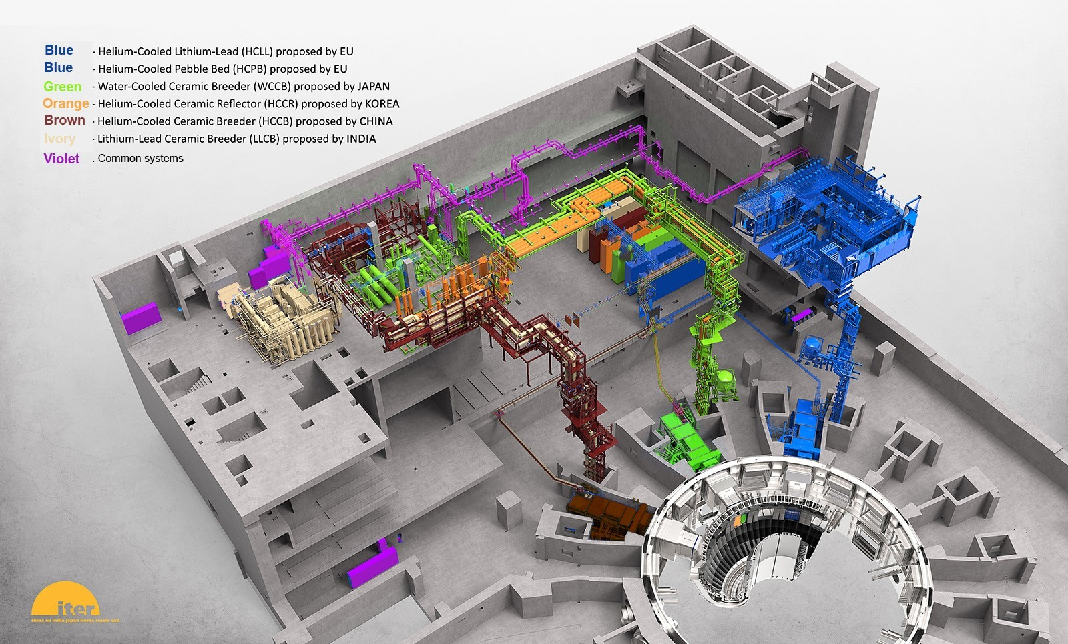
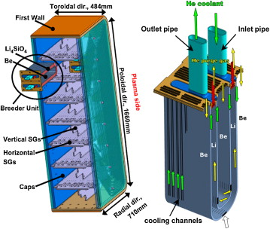
ITER TBMs
ITER TBMs allow for large-scale testing of integral blanket modules in a prototypic nuclear environment, if not neutron fluence
  Valuable test of neutronic, thermal-hydraulic, mechanical, and tritium transport performance (model validation)
U.S. not presently a member of TBM program, but previously designed a DCLL TBM
iter.org
Prelim. Design: 2023
Final Design: 2025
Installation: after 2030
HCPB TBM
F. Hernández, FED 86 (2011) 2278-2281

Slide 9
The NAS report and Compact Pilot Plant
The NAS report endorses an electricity mission and outlines a strategic plan leading to a Compact Pilot Plant to realize it
In the NAS report, the Compact Pilot Plant:
  Produces fusion power comparable to ITER in a smaller machine
    Employs high-temperature superconducting magnets
    Minimizes capital cost
  Produces net electricity from fusion
  Is the only US nuclear fusion reactor prior to commercialization
  Operates in two phases:
    Phase 1: Demonstrate electricity production for ~minutes, assess performance, PMI, tritium pumping, limited breeding and extraction
    Phase 2:
      Operate at high fusion power for long periods of time (weeks)
      Full fuel cycle, integrated blanket testing

Slide 10
What the NAS report says about blankets
“… are at a very low technical readiness level, and significant fusion nuclear science and technology research is needed to provide the technological foundation required for the design and construction of a compact fusion pilot plant
“U.S. DOE needs to significantly expand the U.S. research program in fusion nuclear technology, advanced materials, safety, and tritium and blanket technologies to fully enable fusion energy”
Recommends creating a new division within DOE-SC OFES to execute technology mission
Recognizes that there are risks to the compact approach, and that a sustained technology R&D program (and some new facilities) are needed to retire these…

Slide 11
Necessary Facilities
Non-nuclear testing of blanket thermo-fluid and solid mechanics with surface and volumetric heating; hydrogen/deuterium migration and extraction
  Fission reactor can provide volumetric tritium source for extraction system testing
Fusion prototypic neutron source for understanding behavior of structural materials under irradiation
  Accelerator-based, small volume?
There is a significant gap from small-volume irradiation specimens to CPP phase 2 (pre-commercial demonstration)… NAS report mentions some possibilities for larger volume irradiations:
  Beam-driven plasma source
  Gas dynamic trap
  Beam-driven tokamak
  Re-join ITER TBM program
What is “limited breeding” in CPP phase 1? Can TBM-like testing occur?
This aspect of strategic plan requires some input

Slide 12
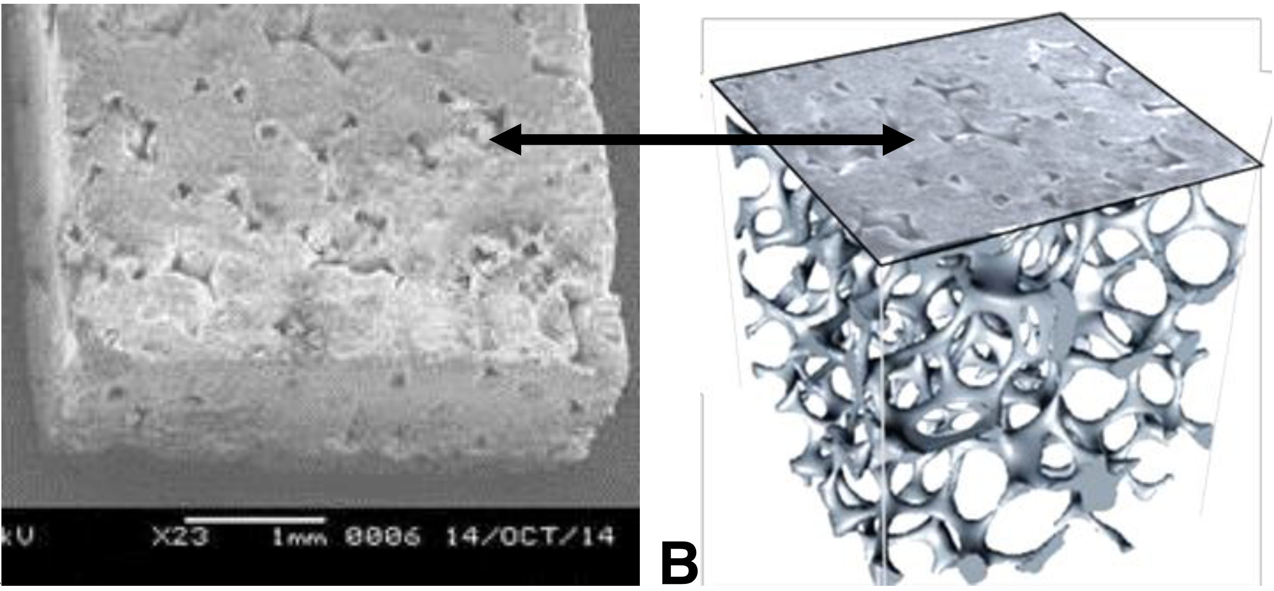
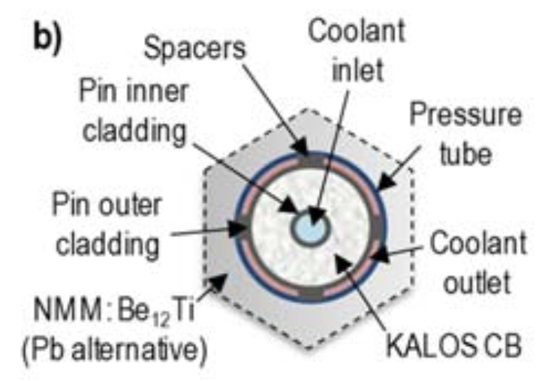
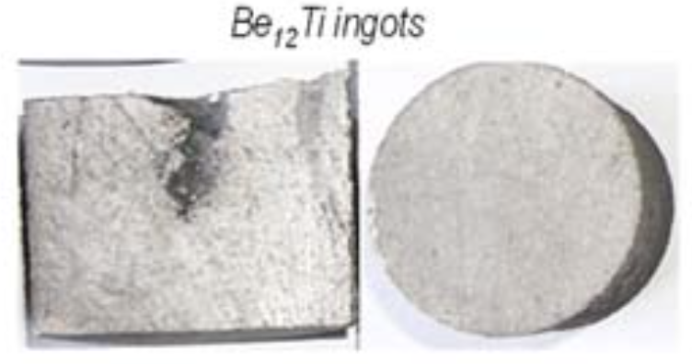
Implications of technological advances
The NAS report repeatedly cites high temperature superconductors and advanced materials/manufacturing as enablers for a compact pilot plant- these will impact blanket designs as well
Adequate TBR might be more difficult to achieve in compact device
Higher magnetic field affects MHD in flowing PbLi concepts- impact?
None of the current leading candidate solid breeder materials (Li₂TiO₃, Li₄SiO₄, beryllides) were considered in the 1984 Blanket Concept Selection Study (Li₂O, LiAlO₂, Be)
Li₂ZrO₃
Cellular Ceramic Breeder:
Transformative Enabling Technology
Significant advances in materials synthesis, manufacturing and materials design cited in NAS report are potentially transformative for solid breeders
If a compact, high field device is to be pursued, a re-evaluation of these concepts may be warranted
Solid Beryllide Multiplier
F. Hernández, 2018 TOFE

