Slide 1

DOE’s Role in Fusion Innovation and Commercialization
Adam Cohen
Deputy Under Secretary for Science and Energy
Technology of Fusion Energy (TOFE) 2016
August 22, 2016

Slide 2
Bottom Line Up Front
The Department of Energy has a role in researching and developing ideas and technologies that can provide for future energy solutions
Innovation will be vital to meeting the nation’s clean energy and climate goals
  The Department supports research and development activities across a wide range of the energy spectrum, from generation through end use, and in the underlying science to support such developments
Fusion energy development fits within the overall strategy
  This includes research in plasma physics with eventual application toward fusion energy and other energy technologies
The Department promotes innovation and commercialization of energy-relevant technologies

Slide 3
A view of the future……

Slide 4
Project Growth in Total Energy

Slide 6
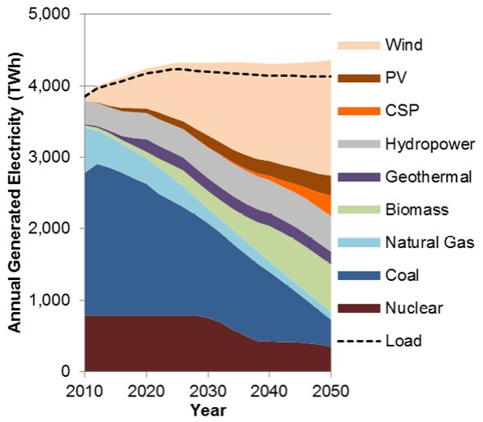
80% Renewable Energy Case - Conservative
Reference: NREL Renewable Electricity Futures Study 2010, http://www.nrel.gov/analysis/re_futures/

Slide 7
CO2 Emissions for 80% Renewable Energy Cases - Conservative
Reference: T. Mai, et al, “Envisioning a renewable electricity future for the United States” Energy, 2014

Slide 8
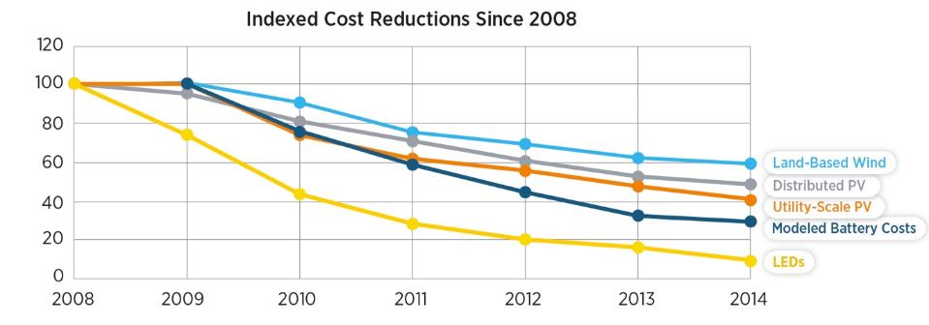
Falling Costs for Clean Energy Technologies
Wind: Representative LCOE excluding PTC, inflation adjusted
Utility and Distributed PV: Installed $/Watt_{DC}, inflation adjusted
Batteries: DOE/VTO modeled high volume production costs
LEDs: cost/kilolumen
Reference: DOE’s Revolution Now 2015 Report

Slide 9
Department of Energy
A technological powerhouse
  U.S. must be a builder and a leader in this new economy
  DOE has three basic thrusts: weapons, waste and watts
Science and energy portfolios under a single Under Secretary
  Enhance enterprise-wide planning and improve collaboration across organization boundaries (i.e., breaking down stovepipes)
Crosscutting initiatives
  Advanced Materials
  Energy-Water Nexus
  Grid Modernization
  Subsurface Technology and Engineering
  Exascale Computing
  Cyber Security
  Supercritical CO2
Technology Transitions
  Technology Commercialization Fund (TCF)

Slide 10
DOE Planning
Strategic Plan
Quadrennial Technology Review (QTR)
  Survey of the technology state and gaps
  Electric Power System (the Grid)
  Advanced Clean Electric Power
  Building Efficiency
  Advanced Manufacturing
  Cleaner Fuels
  Clean Transportation
  Underlying Science
Quadrennial Energy Review (QER)
  Consider policy options, markets, technology, etc. as an overall system
  Second Installment (1.2) – focus on electricity sector
Portfolio planning
  Brainstorming – Big Ideas Summits
  Budget formulation

Slide 11
DOE Big Idea Summit 2016
Enhancing the Global Carbon Sink
Greenhouse Gas Emissions Reporting & Analysis System (GHG-ERAS)
Hydrogen @ Scale: Deeply Decarbonizing our Energy System
Solving Big Problems with Small Accelerators
Transportation as a System
Solving the Information Technology Energy Challenge Beyond Moore’s Law
Advancing Biomanufacturing: The SynBio Foundry
Energy Everywhere: Clean Energy through Modular Chemical Conversions
Metropolitan Energy Initiative

Slide 12
Mission Innovation
Paris Agreement (Climate Conf - COP21, November 2015)
  Mission Innovation – 20 Countries committing to doubling of energy R&D over next 5 years
  Breakthrough Energy Coalition – parallel effort to have “patient” capital investments for early to mid-stage innovation
Great start but the world has to continue to create and innovate and invest in technologies if we’re to avert the worst outcomes of climate change
DOE’s Mission Innovation portfolio is ~ 75% of the U.S. portion
  Fusion is part of the portfolio
Need innovation to address reduction in GHG across all sectors (e.g., power, industrial applications, transportation)

Slide 13
Areas for Consideration
Fusion as an energy source
  Models are only as good as models are…..
  Worst case future is fusion energy is needed but not available!
Don’t ignore other energy needs and sectors
  Knowledge as applied to other generation (e.g., improved thin film processing of photovoltaics, processing of wind turbine blades)
  Big ideas applied to transportation needs or industrial process heat
    Purification of power plant waste streams?
    Purification of water?
Advanced Manufacturing
  Plasma processing knowledge
  Areas of particular interest or importance to the fusion field (e.g., superconducting cables for magnets, materials for really extreme environments)

Slide 14
Can fusion technology or plasma physics help identify better options?
IAEA, “Technology Roadmap – Energy and GHG Reductions in the Chemical Industry via Catalytic Processes,” 2013

Slide 15
DOE Path Forward in FES
DOE planning for “burning plasma science” era and opportunities in fusion science to maintain U.S. leadership in the pursuit of fusion power
ITER
  Exciting experiment – commencement of the burning plasma science era and enable questions critical to advancing fusion energy to be researched
  May 2016 U.S Participation in the ITER Project Report - U.S. remain a partner in the ITER project through FY 2018 and focus on efforts related to First Plasma
  DOE to revisit this recommendation as part of the FY 2019 budget process
DOE Fusion Energy Sciences (FES) Strategic Planning
  Community studies – identify the key scientific and technical challenges tackled during the past decade and a half. Built upon the Research Needs Workshop (ReNeW) for Magnetic Fusion Energy Sciences in 2009
  Fusion Energy Sciences: A Ten-Year Perspective (2015-2025) - study of burning plasma science using 1) Flexible U.S. experimental facilities, 2) International partnerships, 3) Numerical simulations based on validated models, 4) Advanced fusion-relevant materials, and 5) New measurement techniques
Non-fusion applications - FES published the “Applications of Fusion Energy Sciences Research: Scientific Discoveries and New Technologies Beyond Fusion” in 2015 – outlines contributions across many fields

Slide 16
Questions?

